Slide 1
Basics of R
Joseph White

Slide 2
Background

Slide 3
In this workshop, we will cover four primary topics to get you started with R/RStudio.
On day 1, we will cover:
Installing R/RStudio and setting up your workspace
Basics of data cleaning, manipulation & plotting
On day 2, we will cover:
Version control & collaborating
Reporting R outputs

Slide 4
1. Installing R/RStudio and setting up your workspace

Slide 5


Slide 6
Installing R/Studio

Slide 7
Setting up your workspace

Slide 8
2. Basics of data cleaning, manipulation & plotting

Slide 9


Slide 10
What is the tidyverse?

Slide 11
dplyr

Slide 12
ggplot2

Slide 13
3. Version Control & Collaborating

Slide 14


Slide 15
What is Github?

Slide 16
Why should you use Github?

Slide 17
4. Reporting R outputs

Slide 18
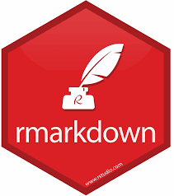

Slide 19
What is RMarkdown?

Slide 20
Why should you use RMarkdown?

