Slide 1
Basics of R
Joseph White

Slide 2
Table of Contents
Background
1. Installing R/RStudio and setting up your workspace
2. Basics of data cleaning, manipulation & plotting
3. Version Control & Collaborating
4. Reporting R outputs

Slide 3
Background

Slide 4
In this workshop, we will cover four primary topics to get you started with R/RStudio.
On day 1, we will cover:
Installing R/RStudio and setting up your workspace
Basics of data cleaning, manipulation & plotting
On day 2, we will cover:
Version control & collaborating
Reporting R outputs

Slide 5
1. Installing R/RStudio and setting up your workspace

Slide 6


Slide 7
Installing R/Studio

Slide 8
Setting up your workspace

Slide 9
2. Basics of data cleaning, manipulation & plotting

Slide 10


Slide 11
What is the tidyverse?

Slide 12
dplyr

Slide 13
ggplot2

Slide 14
3. Version Control & Collaborating

Slide 15


Slide 16
What is Github?

Slide 17
Why should you use Github?

Slide 18
4. Reporting R outputs

Slide 19
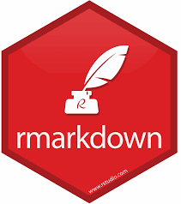

Slide 20
What is RMarkdown?

Slide 21
Why should you use RMarkdown?

