Slide 1
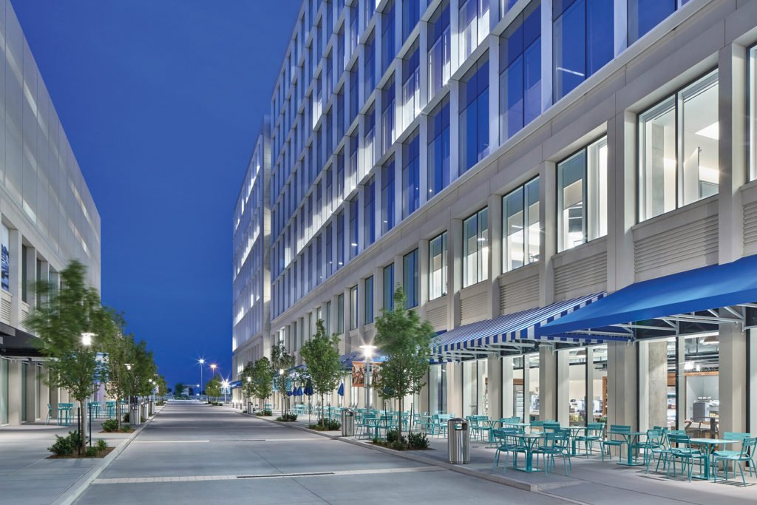
Agenda – Python Basics
Day 1
Your first python program
Working with variables
Getting user input
Data types and type conversions
01
Day 2
Strings
Operators
If statements
Lists
Tuples
Dictionaries
02
Day 3
While loops
For loops
Range
Math functions
03
04
Day 4
File I/O
Functions
Exception handling
Command line arguments

