Slide 1
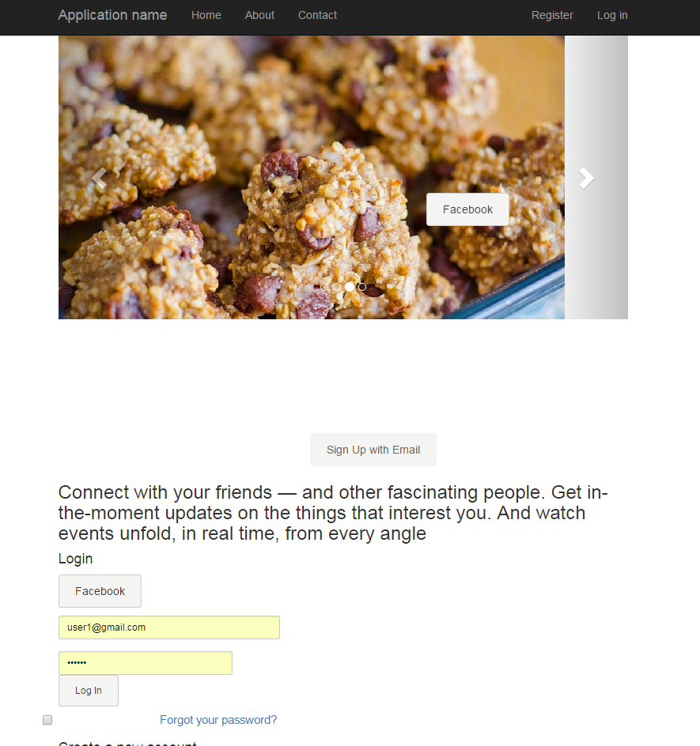
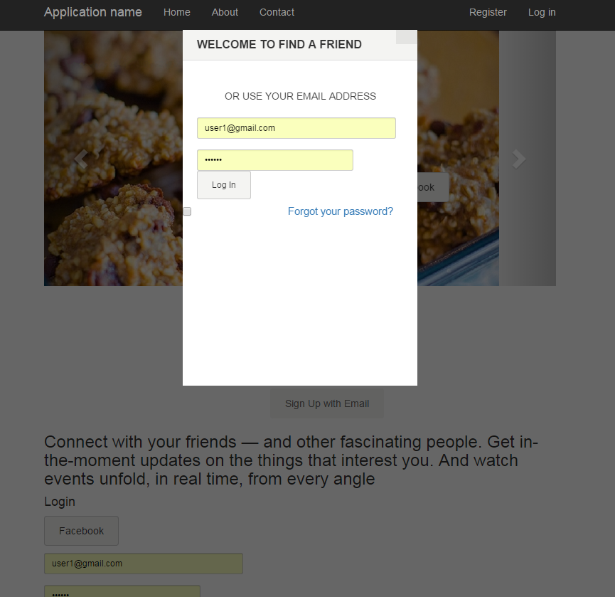
Notes:
Front page. This will include login, and sign up mainly nothing else is really needed. When we log in with facebook it will pop out a window and allow you to log in. If you want to sign up a pop out box will come out to log in with log in info. I don’t know if we need an about section or something. This site will require the user to log in before doing anything. Needs to have Help, Privacy, Cookies and Terms section.

Slide 2
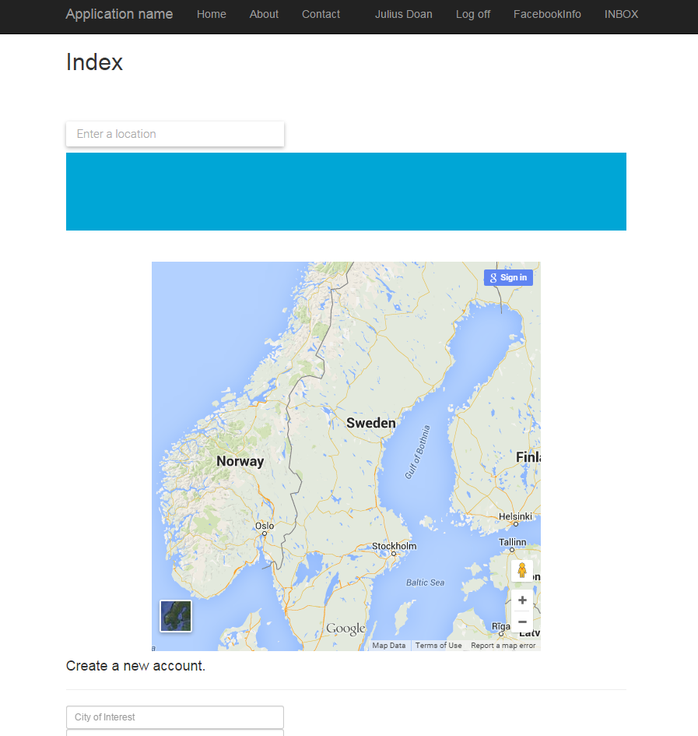
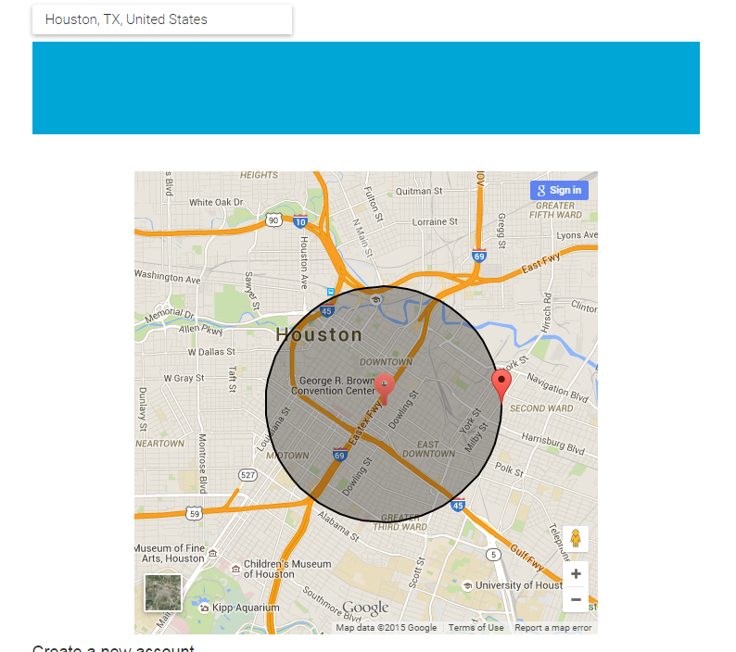
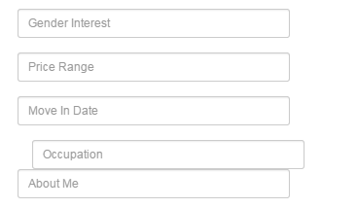
Notes:
If the user is a first time user some basic questions would need to be asked. Where they are interested in. A google maps will show and you are able to pick a city/location you’d like to move to. Should this be full page? And after you click Save. There should be 4-5 more questions that will be asked (Basic Questions: shown in the bottom right) I’m not sure how these pages will look like if you want to ask these basic ones.

Slide 3
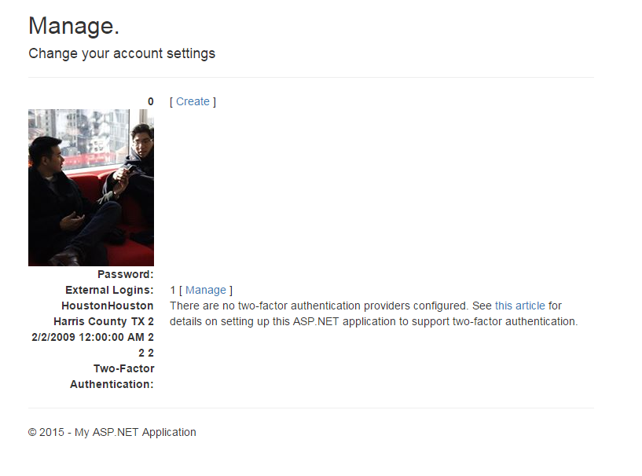
Notes:
After you log in, you go to your manage page. This will allow you to manage your account as in change some info, and show your answers to your question. Not sure what else should be on there? These questions will be from FB and the questions you answered earlier. Allow user to change their picture.

Slide 4
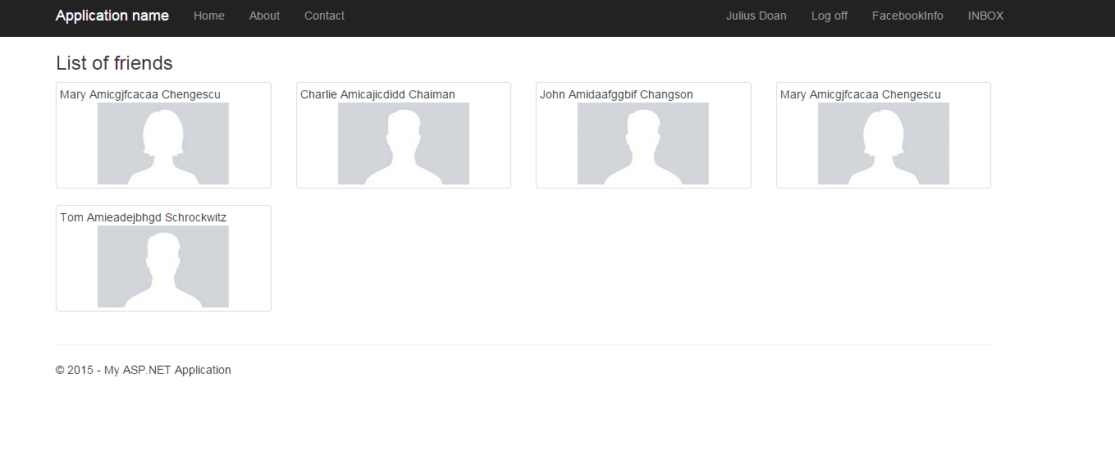
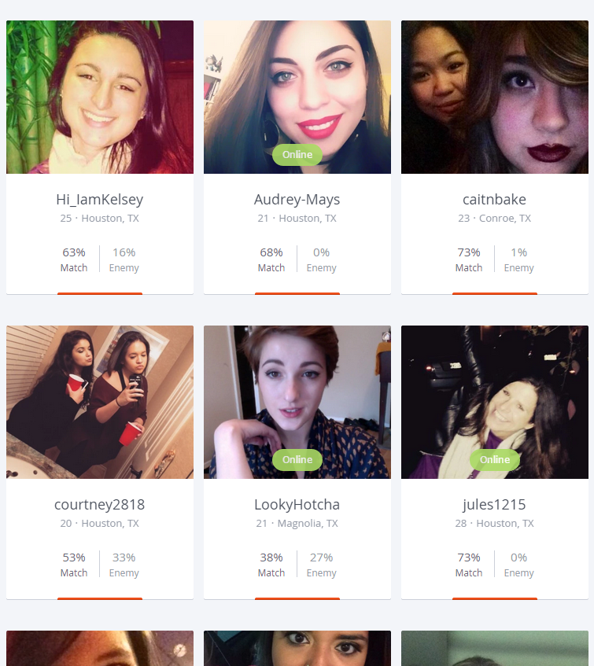
Notes:
So this page shows all users that show similar interest in moving to a certain city. It will show if you have mutual friends and rank them accordingly. Looks really plain, but maybe you could allow user to filter here. Maybe a map of where the users are at not sure though. Right now if you hover over them, you can see some properties. These properties are based on FB and questions they answered. This example is from OK cupid, looks somewhat plain too, but I think it should be similar?

Slide 5
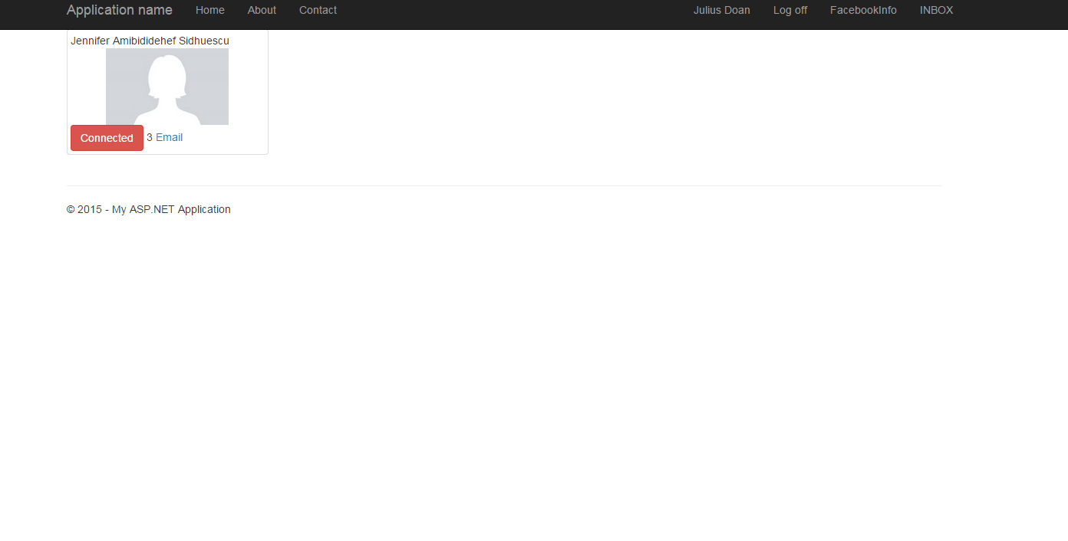
Notes:
This page would be your matches page. This shows who you matched with and who you can access. If you click on the user you should be able to go to their manage page and see some information about them. This will also allow you to email them when you want to contact them and etc.

Slide 6
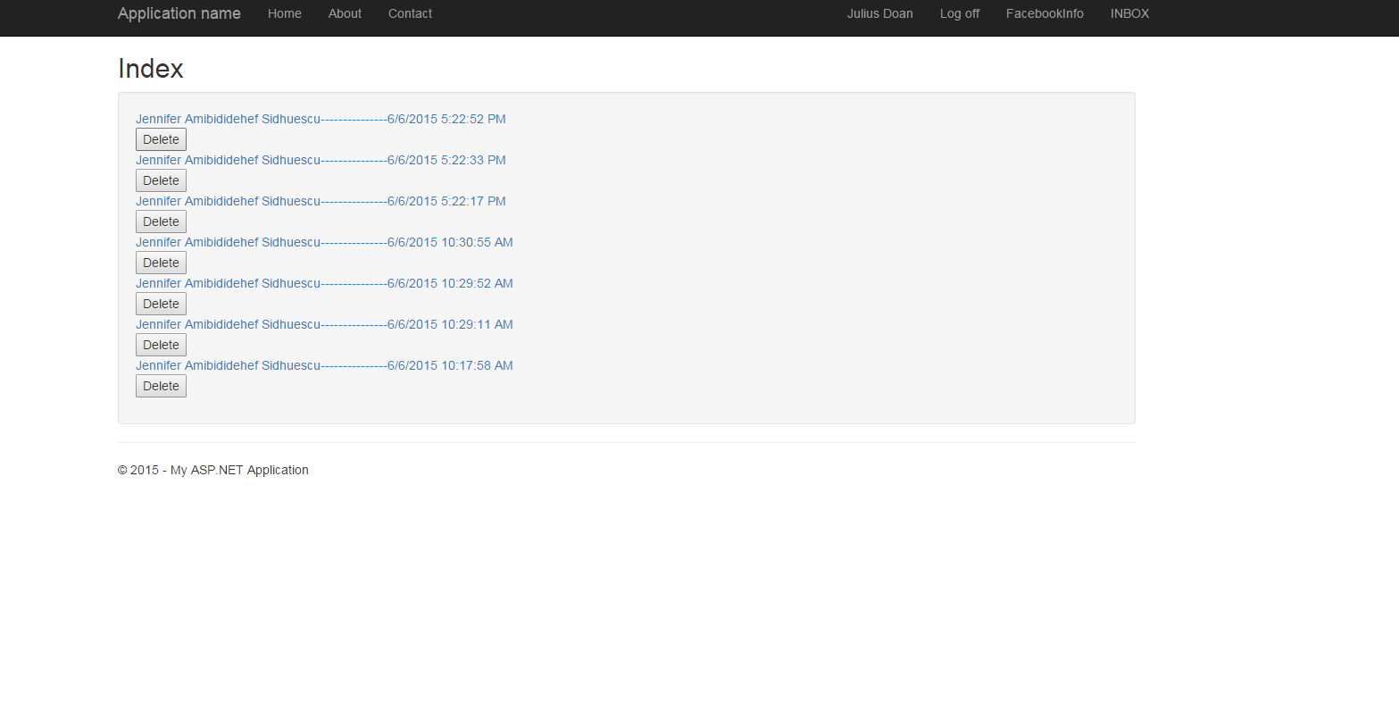
Mailbox system
Notes:
This is the mailbox. Allows people to chat with each other on the local server. You can respond/delete/create emails here only when you have access to that user from matching.

Slide 7
Notes
Trying to make the site more dynamic rather than static. Allow the user to do stuff other than just show $$ and apartment.
I also wanted to incorporate a news feed thread that shows whos interesting in moving to the area. Not sure where it would go though.
Later on when they match, apartment suggestions would be listed to show where they can stay.

