Slide 1
Getting Started with OpenStack Heat
Jay Dobies
IRC: jdob
Red Hat

Slide 2
What is Heat?
Orchestration on OpenStack (IaaS)
  Provision and configure instances
    Wide scope encompassing infrastructure and software
  Define infrastructure resources using a simple text format
    Defined in terms of the desired end state
  Manage the entire lifecycle
    Scale out an existing installation
    Release unused resources
Leverages other OpenStack services

Slide 3
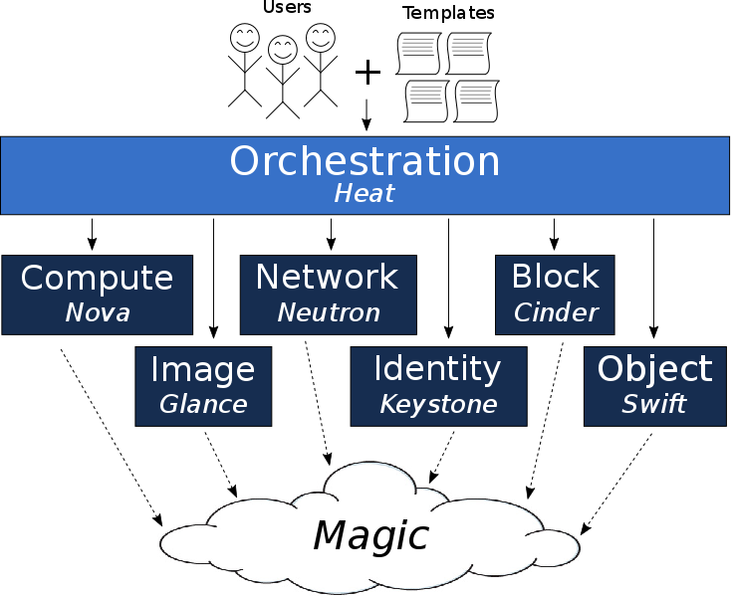
Heat Overview

Slide 4
Terminology

Slide 5
Terminology
Template
  Describes the infrastructure for Heat to create
  Reuse through composition
  YAML text file(s)
  Formats:
    “Heat Orchestration Template” (HOT)
    CloudFormation compatible (CFN)

Slide 6
Terminology
Environment (File)
  Two functions:
    Specify values for a template's configurable parameters
    Define namespace mappings for resource types used by the template
  May specify multiple environments
  YAML text file(s)

Slide 7
Terminology
Stack
  The instantiation of a template within the Heat server
  Carries state, input/output values
  Template + Environment(s) = Stack
Nested Stack
  Stacks can be built from other stacks for composability

Slide 8
Terminology
Resource
  An entity created by a stack
  Examples:
    Nova Server
    Cinder Volume
    Neutron Port
    Software Configuration
    Group of other resources
    Another stack
  New types added via Heat plugins

Slide 9
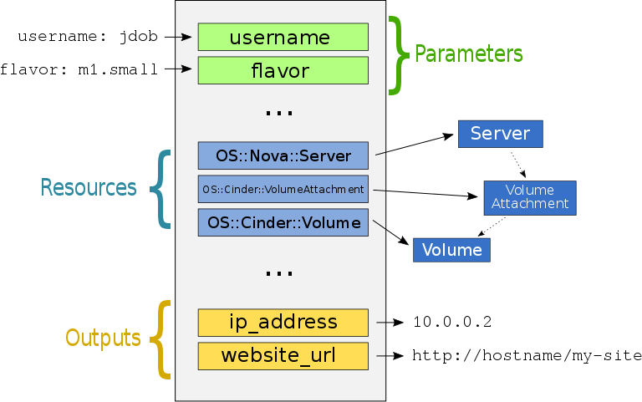
Stack Visualized

Slide 10
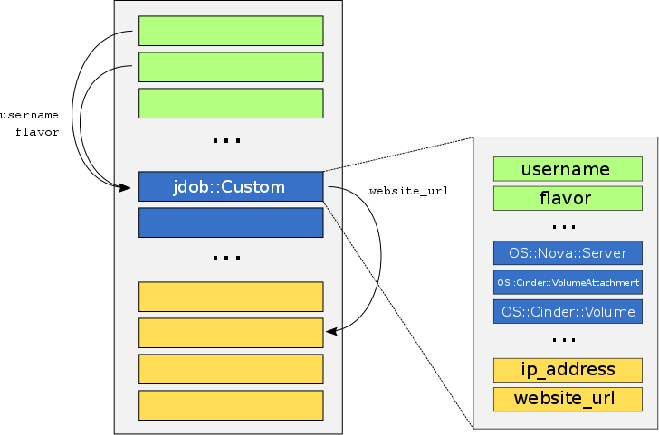
Nested Stack Visualized

Slide 11
Anatomy of a Heat Template

Slide 12
HOT Template Structure
Version
  Defines capabilities of a given template
  Correspond to OpenStack releases:
    Mitaka = 2016-04-08
    Liberty = 2015-10-15
Description
  Optional description of the template's contents

Slide 13
HOT Template Structure
Parameters
  Inputs specified when creating a stack from a template
  Defined by name and type
  Optional constraints
    length, range, regex, enumeration
  May be defaulted in the template
  Definitions may be grouped

Slide 14
HOT Template Structure
Resources
  List of entities to be created by the stack
  Defined by a type and (optional) properties for each resource
Outputs
  Values to make available for an instantiated stack
  May be derived from parameters or resources

Slide 15
HOT Template Structure
Intrinsic Functions
  Dynamic value manipulation within a template
  Examples:
    Access the value of a parameter
    Retrieve an attribute from another resource
    Read the contents of a file
    Manipulate strings (list join, string splitting, replacement, etc.)

Slide 16
Example (page 1 of 3)
heat_template_version: 2015-04-30
parameters:
username:
type: string
description: name of the user to create
default: admin
constraints:
- allowed_pattern: "[A-Z]+[a-zA-Z0-9]*"
password:
type: string
description: password for newly created user
hidden: true
flavor:
type: string
description: Nova flavor of the instance to create
constraints:
- custom_constraint: nova.flavor
...

Slide 17
Example (page 2 of 3)
...
resources:
generated-password:
type: OS::Heat::RandomString
properties:
Length: 4
server1:
type: OS::Nova::Server
depends_on: server2
server2:
type: OS::Nova::Server
properties:
image: { get_param: image_id }
flavor: { get_param: flavor }
awesome-thing:
type: jdob::CustomResourceThing
...

Slide 18
Example (page 3 of 3)
...
outputs:
my-generated-password:
description: super secure password created by Heat
value: { get_resource: generated_password }
instance-ip:
description: IP address of the deployed compute instance
value: { get_attr: [my_instance, first_address] }

Slide 19
Live Demo
I hope.
… I mean, I might play the recorded version
if something goes horribly wrong…
… but let's be optimistic and assume it will be live.

Slide 20
Advanced Topics
Convergence
Auto Scaling Groups
  Ceilometer integration
Software Configuration
  Puppet Manifest, Script, Ansible Playbook

Slide 21
Shameless Plugs
Deploying OpenStack on OpenStack with TripleO, Heat and Ironic
  Feb 5th, 14:00-14:40
  Steven Hardy
Updating a live OpenStack cloud
  Feb 5th, 15:40-16:20
  Marios Andreou, Giulio Fidente, Jiří Stránský

Slide 22
Links & Stuff
Heat Wiki
  https://wiki.openstack.org/wiki/Heat
HOT Spec
  http://docs.openstack.org/developer/heat/template_guide/hot_spec.html
HOT Template Guide
  http://docs.openstack.org/developer/heat/template_guide/index.html
Demo Materials
  https://github.com/jdob/kukri/tree/master/heat-templates/devconf-demo
IRC: #heat on Freenode
  Tell me how awesome I was: jdob

