Slide 1
Induction, confirmation and choice
Rushworth lab meeting, 28/5/2012

Slide 2
Questions
1/ humans and other primates can exert task-level control over behaviour, i.e. use rules
But how do we create new task sets?
2/ when learning propositional information, humans are subject to inductive biases
among the best-known of these is the confirmation bias, whereby agents tend to overweight prior hypotheses in decision-making

Slide 3
Questions
The confirmation bias is often thought of as a bias to seek confirmatory evidence, e.g. Wason card selection task
However, humans may also
fail to learn from disconfirmatory evidence
fail to use this information to rule out incorrect hypotheses

Slide 4
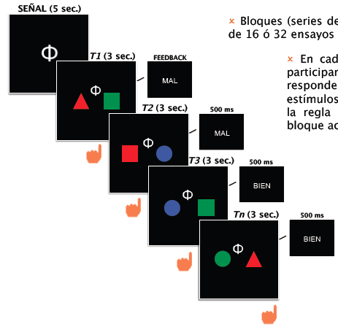
Participants viewed coloured shapes left and right of the screen in blocks of 16 trials
Task
On each trial they had to decide whether the stimulus was a target or not
They received deterministic feedback according to a disjunctive rule
e.g.
red left | blue right = target
or
square left | green right = target
Symbols instructed the relevant dimension (e.g. shape left/colour right) but not the precise exemplar

Slide 5
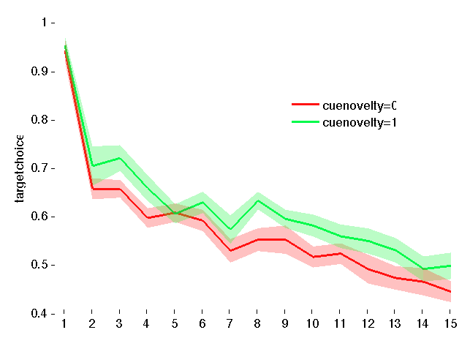
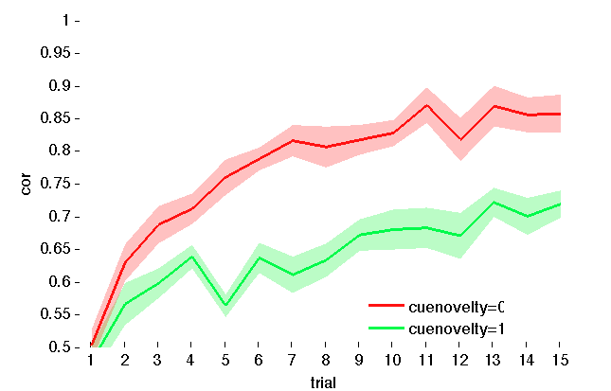
Behaviour
accuracy
target bias
Participants learned across the block
They learned better when the cue was informative
Participants’ tendency to respond ‘target’ began high and declined with time

Slide 6

Models and mechanisms…
Lets consider the simple case where you know the dimensions, eg colour-colour
We define prior belief in any sub-rule as α
 | RED | GREEN | BLUE
LEFT | α | α | α
RIGHT | α | α | α
ϕ
‘target’
incorrect
 | RED | GREEN | BLUE
LEFT | -Inf | α | α
RIGHT | α | -Inf | α

Slide 7
Models and mechanisms…
Lets consider the simple case where you know the dimensions, eg colour-colour
We define prior belief in any sub-rule as α
 | RED | GREEN | BLUE
LEFT | α | α | α
RIGHT | α | α | α
ϕ
‘target’
correct
 | RED | GREEN | BLUE
LEFT | α | α | α
RIGHT | α | α | α

Slide 8
Models and mechanisms…
Lets consider the simple case where you know the dimensions, eg colour-colour
We define prior belief in any sub-rule as α
and the increased belief from confirmation as δ
 | RED | GREEN | BLUE
LEFT | α | α | α
RIGHT | α | α | α
ϕ
‘target’
correct
 | RED | GREEN | BLUE
LEFT | α+δ | α | α
RIGHT | α | α+δ | α

Slide 9
3 models
confirmation model
 | RED | GREEN | BLUE
LEFT | +1 | 0 | 0
RIGHT | 0 | +1 | 0
ϕ
target
disonfirmation model
 | RED | GREEN | BLUE
LEFT | -1 | 0 | 0
RIGHT | 0 | -1 | 0
ϕ
nontarget
hybrid model
 | RED | GREEN | BLUE
LEFT | +1/-1 | 0 | 0
RIGHT | 0 | +1/-1 | 0
ϕ
Target/nontarget

Slide 10
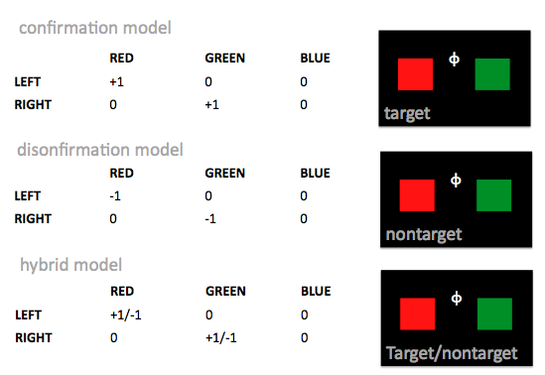
Further assumptions
1/ if you have no evidence either way, then assume target
2/ no free parameters – adding leak/bias does not improve fits
3/ hardmax choice rule on expected value:
confirmation/disconfirmation: defined as abs MAX of two values
hybrid: defined as v[max(confirm)] – v[max(disconfirm)]

Slide 11
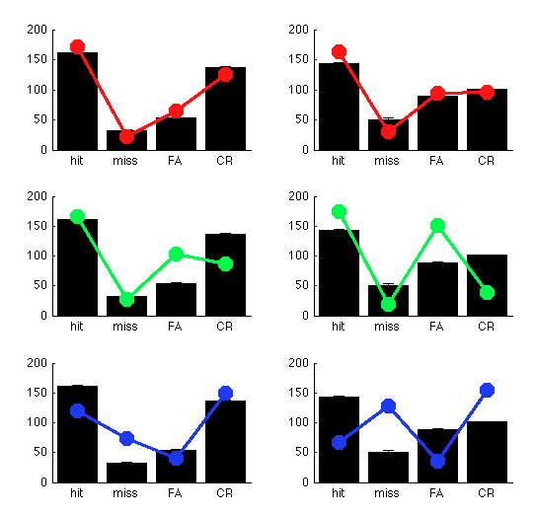
Model fits
cued
uncued
hybrid
confirmation
disconfirmation

Slide 12
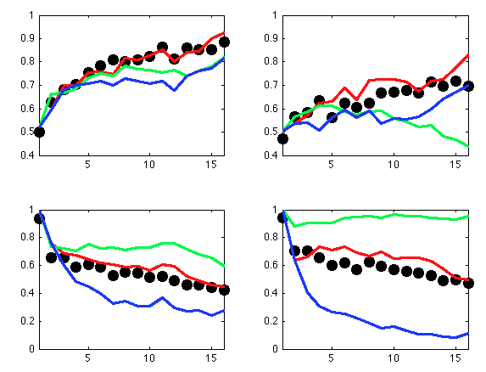
Model fits
cued
uncued
accuracy
target bias
hybrid
confirmation
disconfirmation

Slide 13
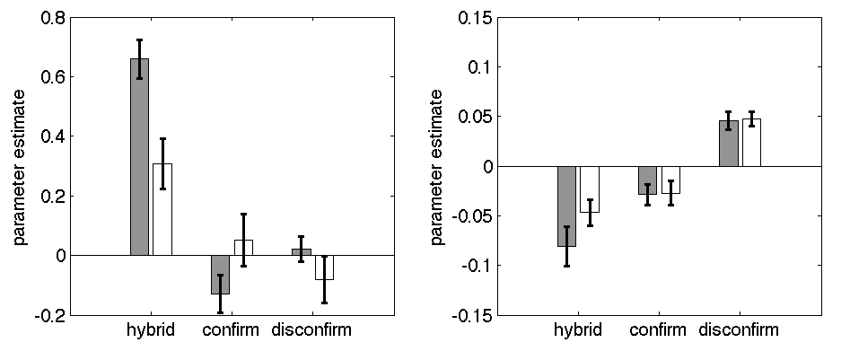
3 models
predicting choice
predicting RT

Slide 14
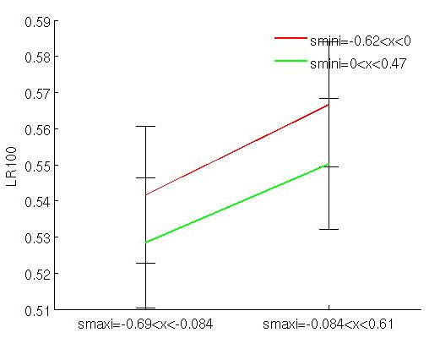
Sampling bias? Eyetracking data..
disconfirm L>R
disconfirm R>L
P (gaze left in first 1000 ms)
confirm R>L
confirm L>R
Eye tracking….is participants’ gaze predicted by the strength of confirmatory or disconfirmatory evidence?
Seems to be both (both main effects significant)

Slide 15
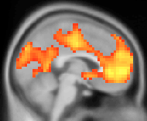
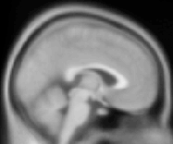
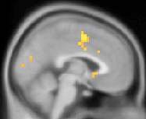
3 models: neural data
hybrid
confirmation
disconfirmation
correlates of expected value under the three models
Confirms behavioural data in strongly supporting hybrid model
OK so let’s do something more interesting…

Slide 16
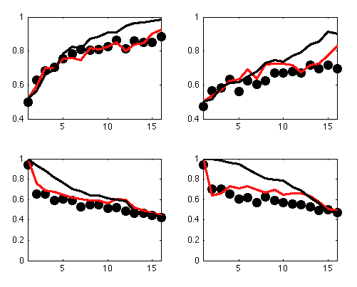
Hybrid model is suboptimal
cued
uncued
accuracy
target bias
The optimal model is like the disconfirmation model, except that options are ruled out definitively
hybrid
optimal

Slide 17
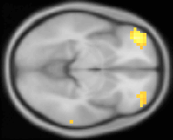
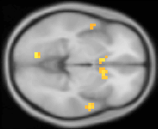
Confirmation and disconfirmation: choice
Both evidence for confirmation and disconfirmation make a contribution to expected value, so we can look for independent correlates of v[max(confirm)] and v[max(disconfirm)] at the time of choice
value of confirmation:
lateral OFC
value of disconfirmation
striatum
p < 0.001, entered alongside overall expected value signal, feedback, target, etc

Slide 18
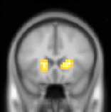
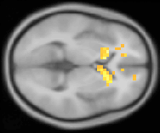
Confirmation and disconfirmation: learning
We can also measure prediction error signals for confirmatory and disconfirmatory learning
For example, confirmation bias might be due to larger prediction error signals for confirmatory than disconfirmatory learning
Interaction between prediction error and
target/nontarget, p < 0.0001

Slide 19
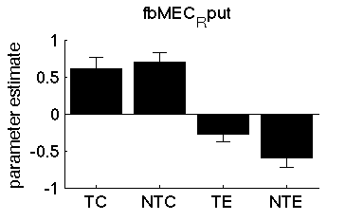
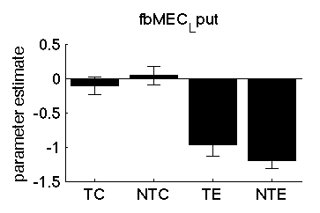
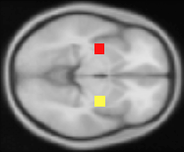
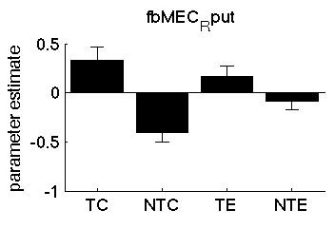
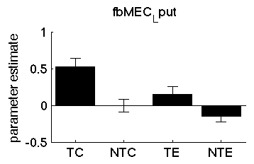
Hybrid model
ROIs in the basal ganglia - putamen
Response to feedback (main effect)
R putamen
L putamen
Response to prediction error
R putamen
L putamen

Slide 20
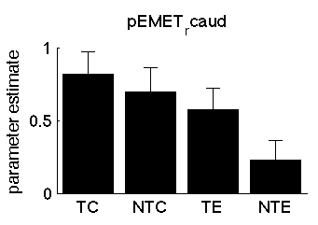
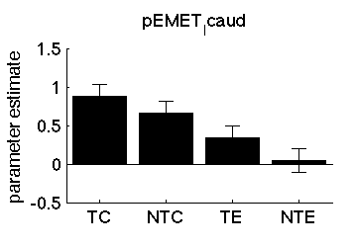
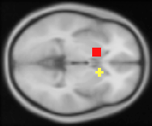
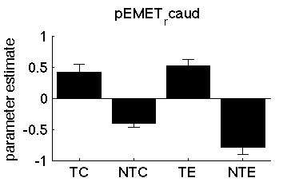
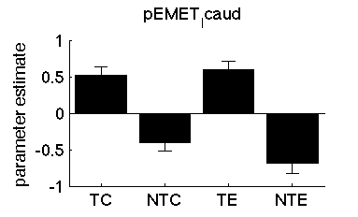
Hybrid model
ROIs in the basal ganglia - caudate
Response to feedback (main effect)
R caudate
L caudate
Response to prediction error
R caudate
L caudate

Slide 21
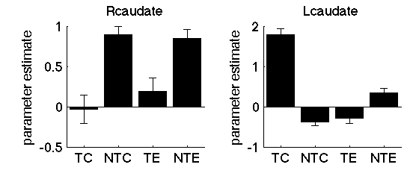
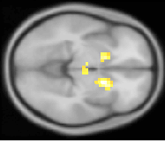
Hybrid model
Whole brain analysis
Interaction between prediction error, feedback (correct/error) and
target/nontarget, p < 0.0001

