Slide 1

Why we are all bad scientists?
RL, confirmation bias, and lots more...
Student
Juan del Ojo Balaguer
Supervisor
Dr Christopher Summerfield

Slide 2
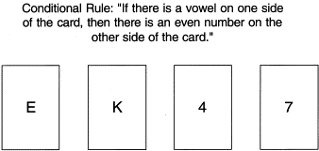
Wason Rule Discovery Test
1 (7)

Slide 3
Wason Rule Discovery Test
1 (7)
We should learn as much from confirmatory than from disconfirmatory evidence!
“Vowel → Even”, then “~Even → ~Vowel” !

Slide 4
Confirmation Bias
So, three types of confirmation bias:
- Biased search for information e.g. making experiments that confirm our hypothesis
- Biased interpretation e.g. understanding ambiguous results as if they were completely supporting our hypothesis
- Biased memory e.g. not paying attention to results that deny or reject our hypothesis
Intuitively, we may even believe that we (usually) learn from surprising information. So we should mainly learn from disconfirmatory information!
2 (7)

Slide 5
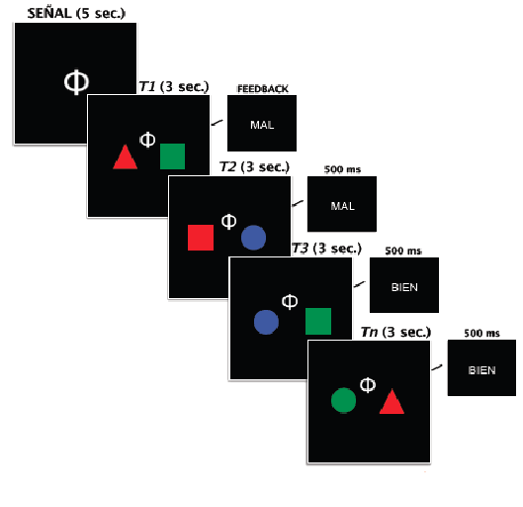
The task
(Almost) not a single squircle!
Inductive rule task
Two dimensions:
Color / Shape
Three features:
Triangle / Square / Circle
Red / Green / Blue
3 (7)

Slide 6
The task
Two disjunctive simple rules
Example:
- Left side: BLUE
- Right side: TRIANGLE
Target:
BLUE (left) or
TRIANGLE (right)
Non-Target: otherwise
3 (7)

Slide 7
The task
Cues give information about the relevant dimensions on each side.
Two conditions:
- Familiar cues (easy)
- Novel cues (crazy)
3 (7)

Slide 8
The task
Research question:
Biased learning between
Target trials and
Non-Target trials
→ is not really a confirmation bias.
3 (7)

Slide 9
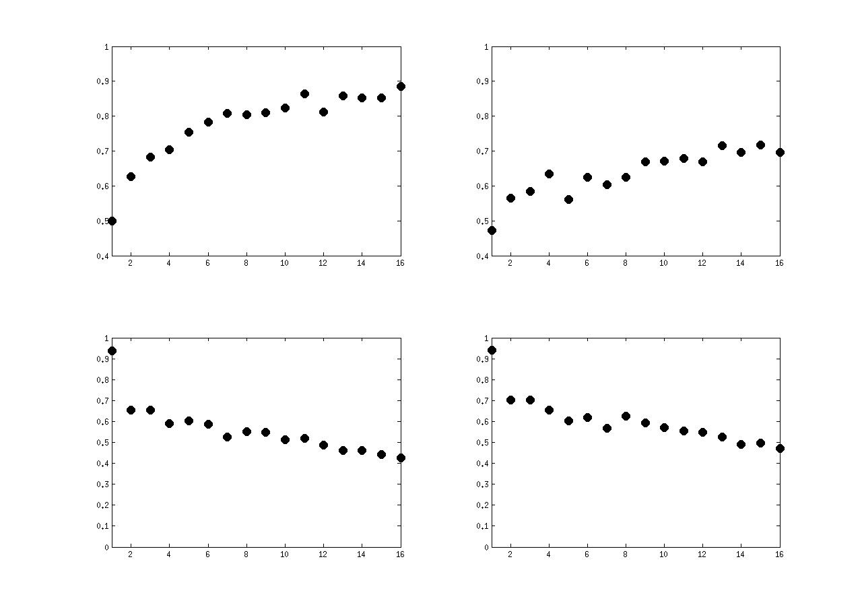
Human Results
% COR
% TARGET
FAMILIAR
CUES
NOVEL
CUES
4 (7)

Slide 10
Models
“Confirmer” model
→ buffer with one number for each (side/dim/feat)
→ we say T if the value is greater than 0 for any side
[hack] = in the first trial we increment the features of the the stimulus … so we always start choosing T.
→ we increment values of each feature when is T
→ we reset values of each feature when is N
5 (7)
Red | Green | Blue
Red | Green | Blue

Slide 11
Models
“Disconfirmer” model
→ buffer with one number for each (side/dim/feat)
→ we say T if the value is 0 for any side
→ we decrement values of each feature when is N
→ we reset values of each feature when is T
5 (7)
Red | Green | Blue
Red | Green | Blue

Slide 12
Models
“Hybrid” (RL) model
→ buffer with one number for each (side/dim/feat)
→ we say T if the value is the max for any side
→ we increment values of each feature when is T decrement when is N
5 (7)
Red | Green | Blue
Red | Green | Blue

Slide 13
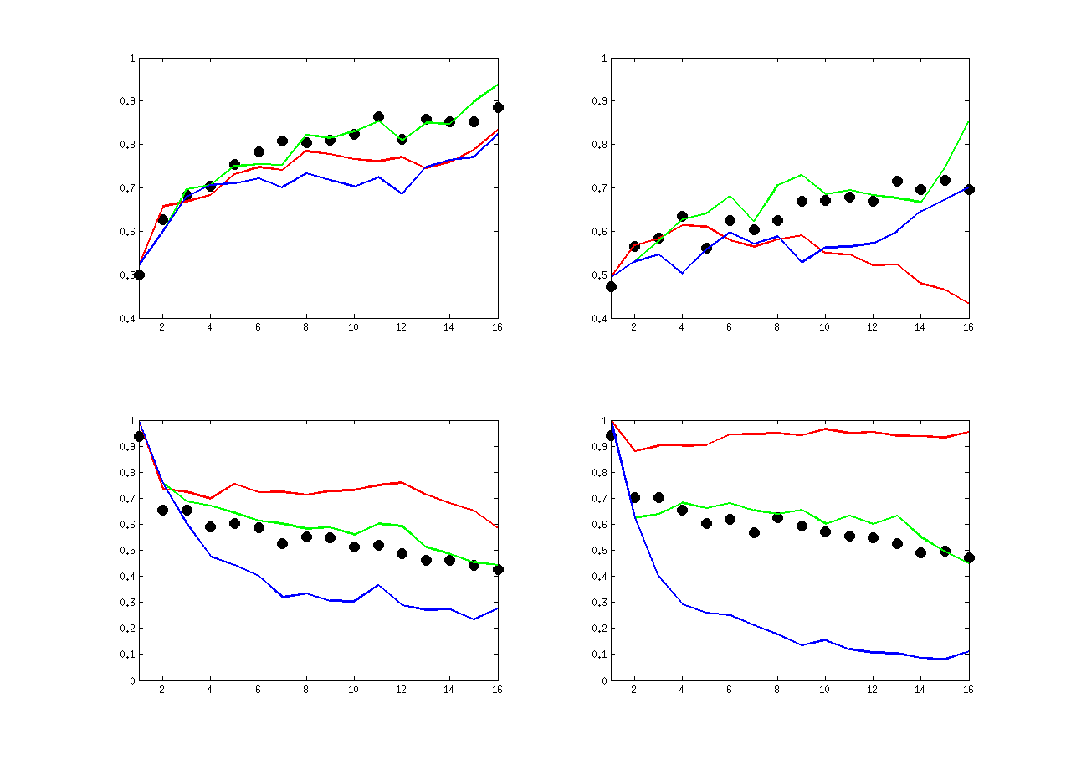
Models
Confirmer
Hybrid
Disconfirmer
% COR
% TARGET
FAMILIAR
CUES
NOVEL
CUES
5 (7)

Slide 14
Models
“Hypothesis” model
Thoughts:
Target
is Target!
Non-Target
5 (7)

Slide 15
Models
“Hypothesis” model
Thoughts:
Target
is Target!
Target
5 (7)

Slide 16
Models
“Hypothesis” model
Thoughts:
Non-Target
is Target!
Non-Target
5 (7)

Slide 17
Models
“Hypothesis” model
Conclusions:
- we can learn deterministically by combining trials
- we may learn the same from T and NT trials
- if we understand how the task works, we may use logic to over-perform probabilistic (RL) strategies. but!
- we need to combine trials in an efficient way
- the third combination is the most expensive in memory.
→ we can ignore the third combination
5 (7)

Slide 18
Models
“Hypothesis” model
1\ We use a variable to remember a Target trial.
→ is the 'hypothesis'
2\ We wait until we have another trial that partially matches our hypothesis
→ we deduce the rule
→ we store this into a second variable ('knowledge')
3\ Using the same logic, plus our new knowledge, we can work out what is the rule for the other side!
5 (7)

Slide 19
Models
“Hypothesis” model
Interesting explanation for human results:
- They say Target on first trials
- When they have no information
→ Because they are waiting for a T trial!
Interesting bias in the model
Order of trials should not be important.
Model show a bias:
- learns from “T then NT”
- doesn't learn from “NT then T”
Generalization for novel cues (too long to explain)
5 (7)

Slide 20
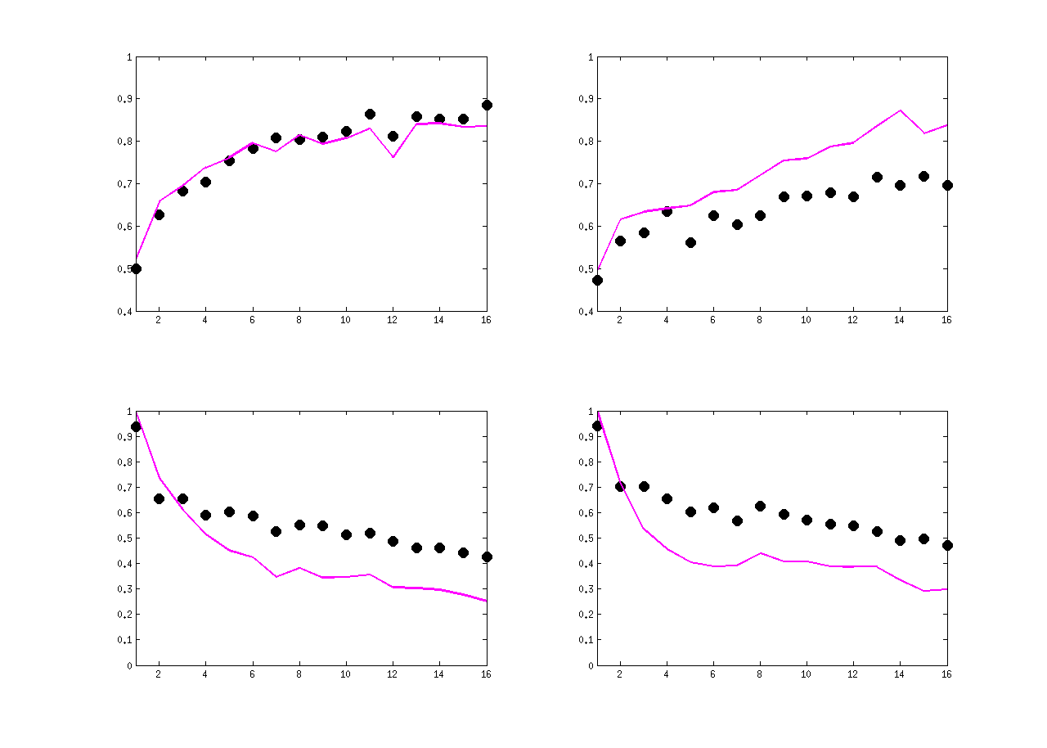
Models
% COR
% TARGET
FAMILIAR
CUES
NOVEL
CUES
5 (7)

Slide 21
Comparison between models
Humans
Hybrid (RL)
Hypothesis
6 (7)

Slide 22
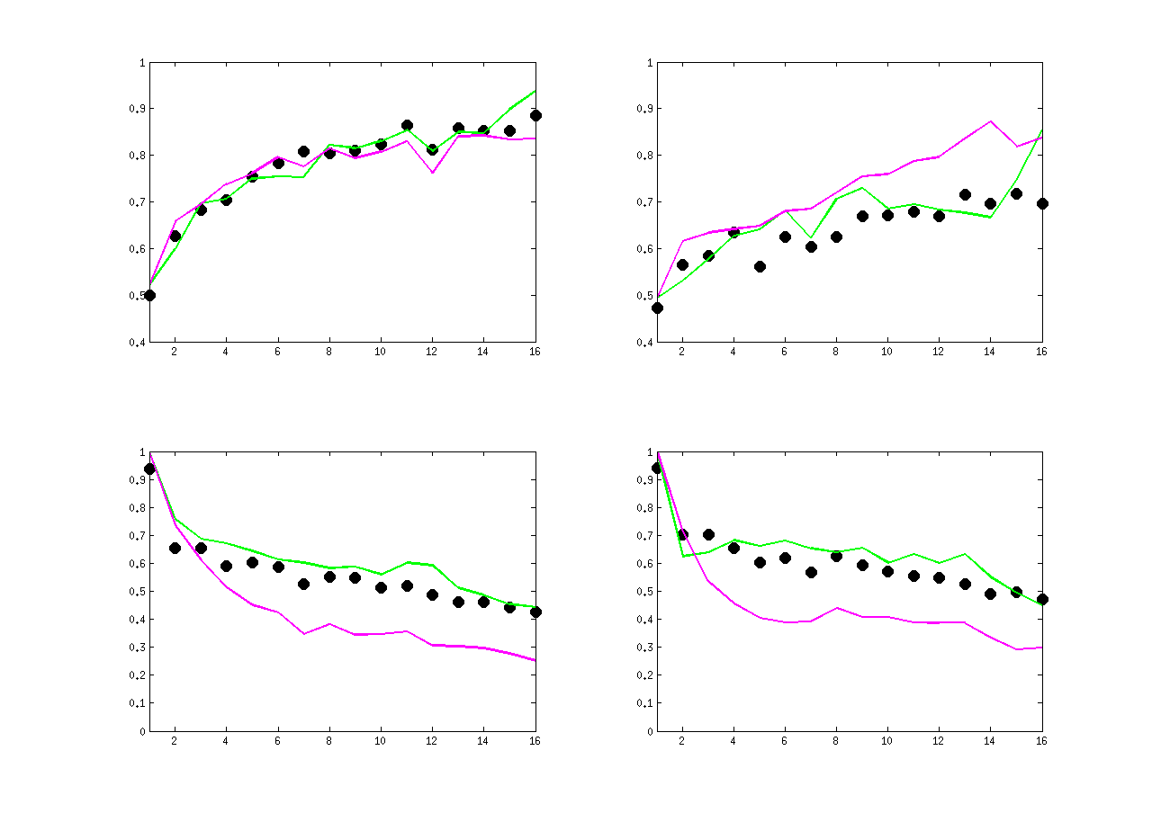
Comparison between models
% COR
% TARGET
FAMILIAR
CUES
NOVEL
CUES
6 (7)

Slide 23
Comparison between models
ERRORS
Flag fitting!
Hypothesis model
- Familiar Cue Confident Error = .1132
- Familiar Cue Not-confident Error = .2924
- Novel Cue Confident Error = .2296
- Novel Cue Not-confident Error = .3601
6 (7)

Slide 24
Comparison between models
ERRORS
Hybrid: Mean(abs(error)) = 0.2990
Hypothesis: Mean(abs(error)) = 0.2966
6 (7)

Slide 25
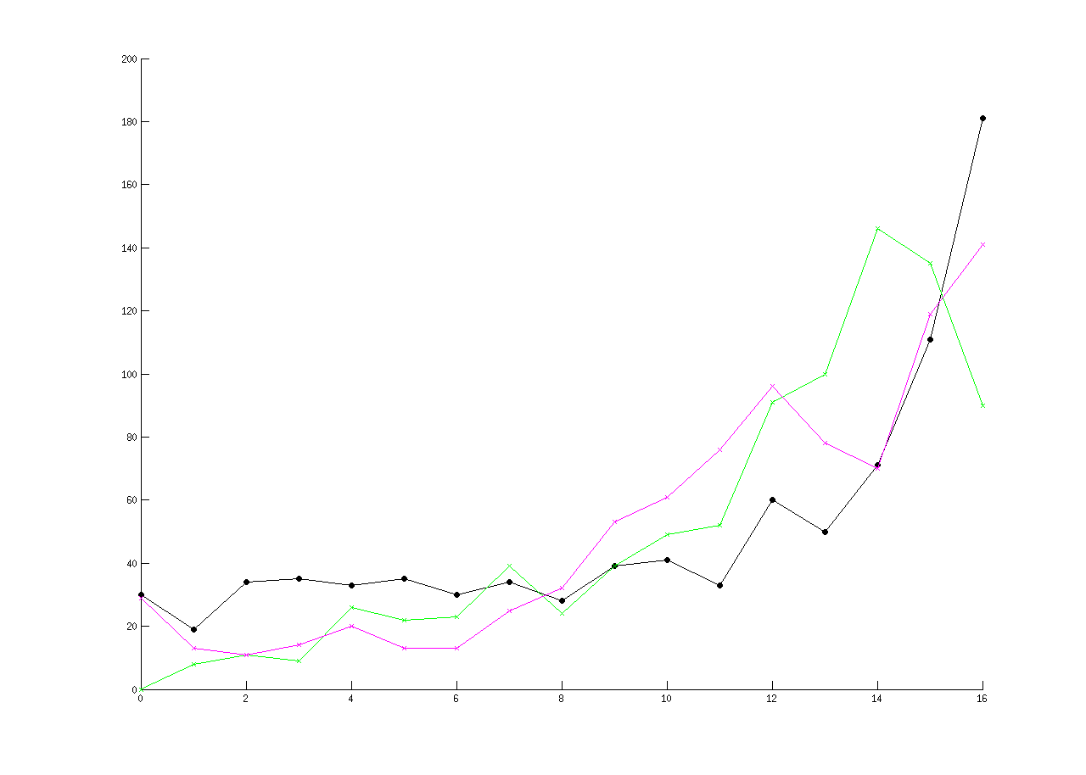
Comparison between models
INSIGHTS
6 (7)

Slide 26
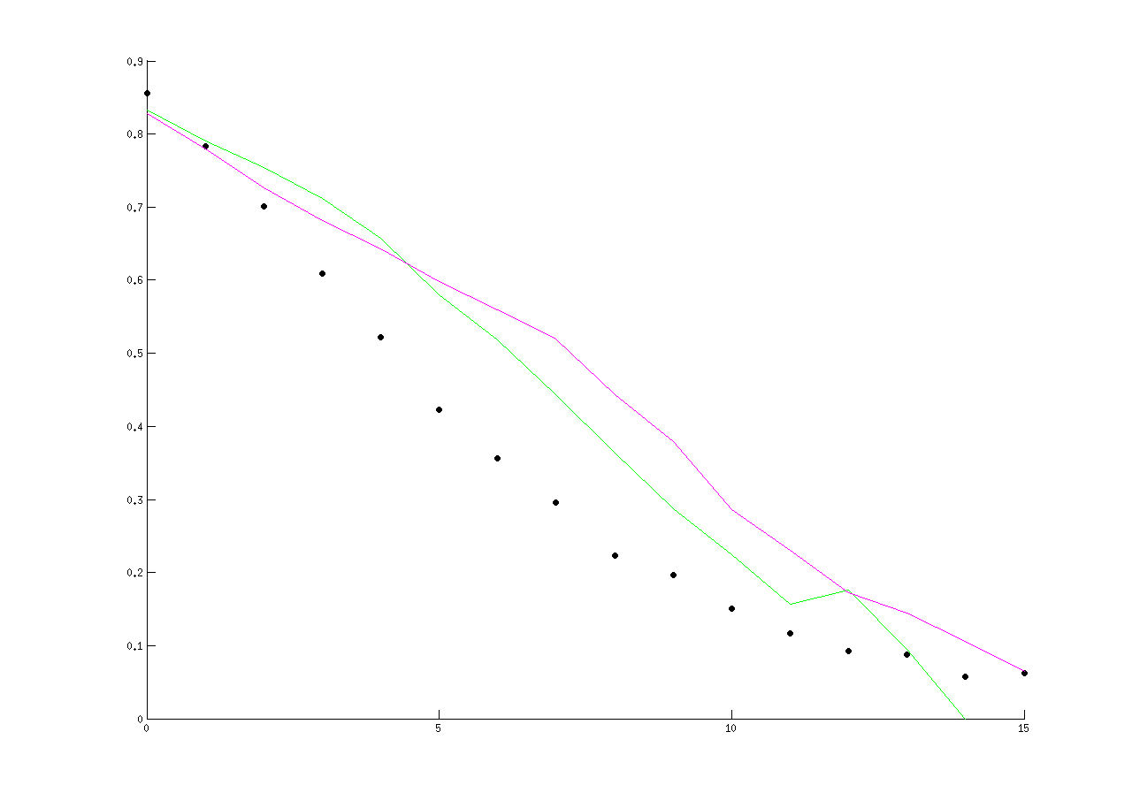
Comparison between models
INCORRECT TRIAL AFTER SOME CORRECT ONES
6 (7)

Slide 27
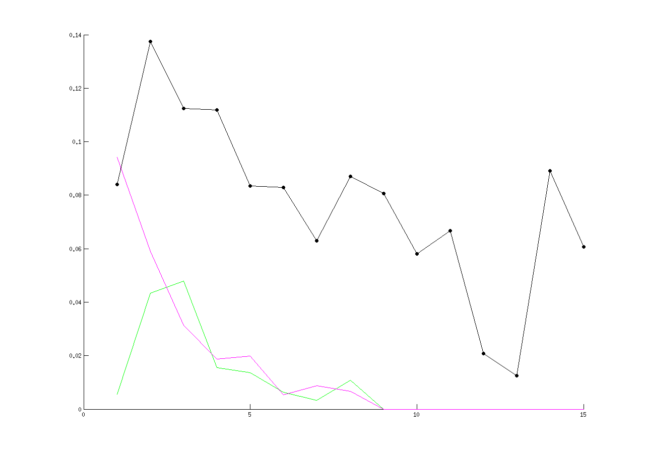
Comparison between models
LEAKAGE
trials
6 (7)

Slide 28
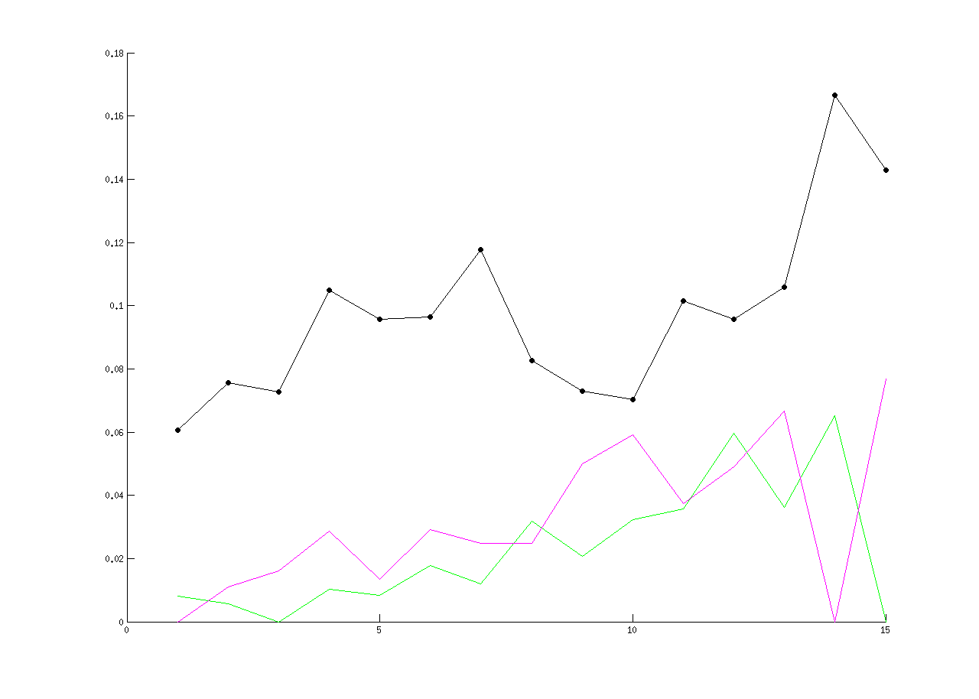
Comparison between models
LEAKAGE
trial distances
6 (7)

Slide 29
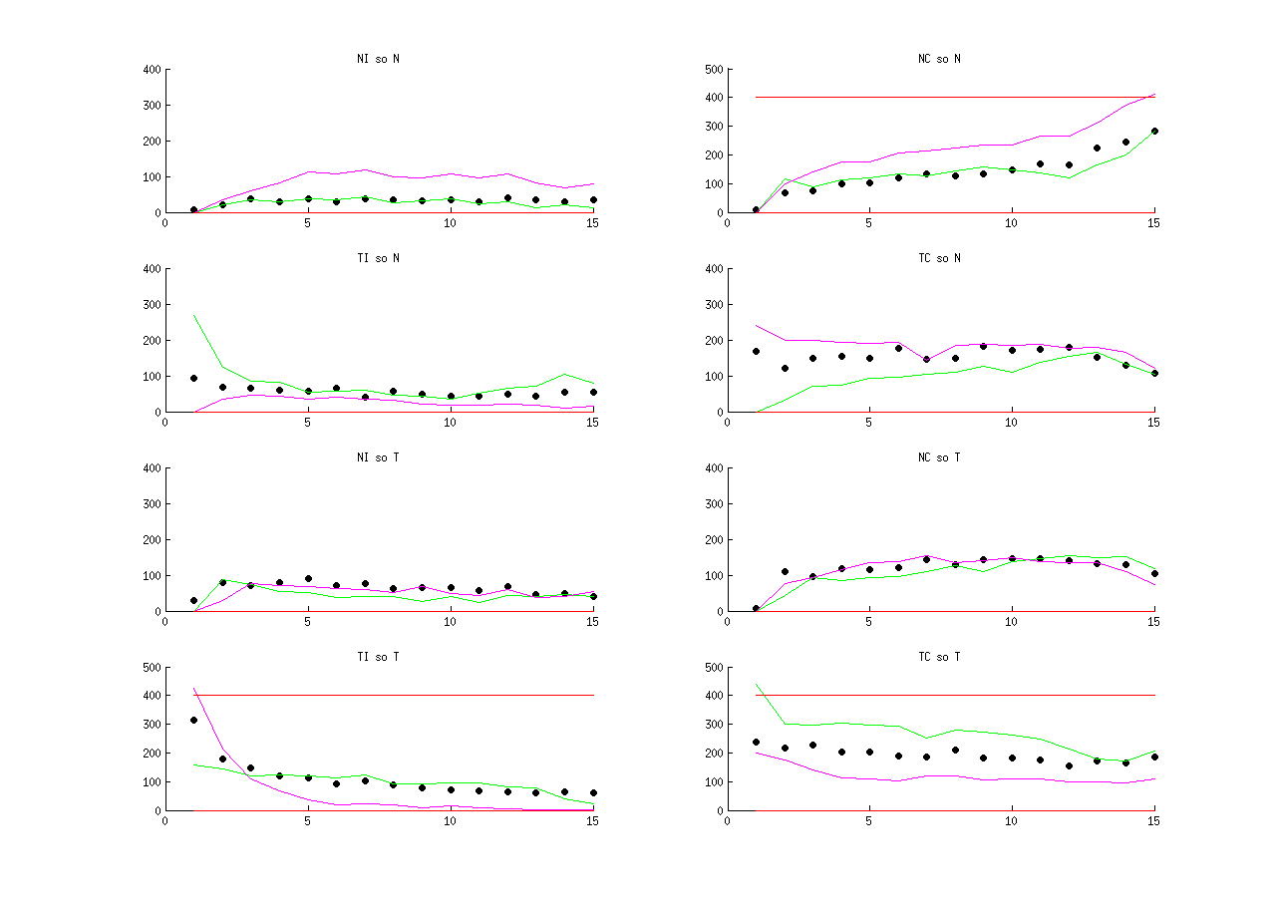
CONDITIONAL PROBABILITIES (length)
Humans
Hybrid
Hypothesis
6 (7)

Slide 30
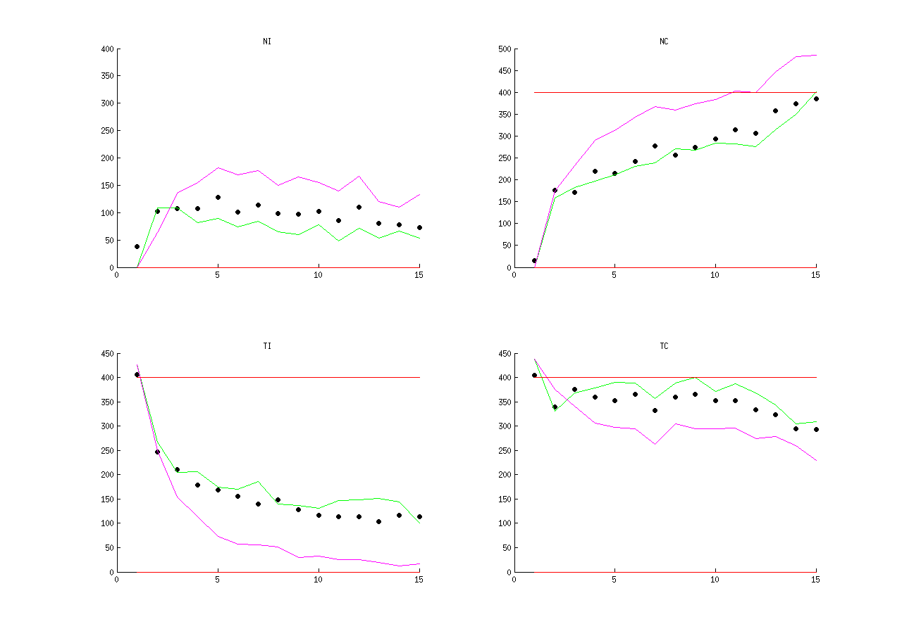
CONDITIONAL PROBABILITIES (sum)
Humans
Hybrid
Hypothesis
6 (7)

Slide 31
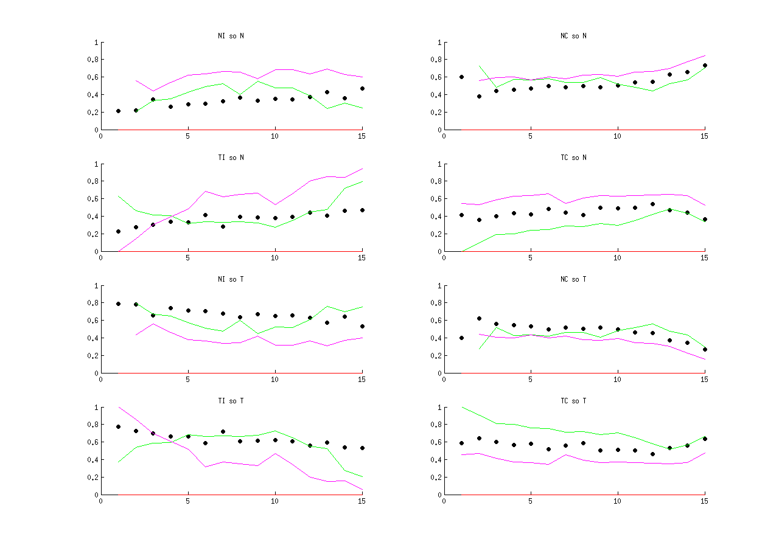
CONDITIONAL PROBABILITIES (prob)
Humans
Hybrid
Hypothesis
6 (7)

Slide 32
What's next
Still need to find where they make divergent predictions! fMRI:
- incremental value of features
- one trial learn
Behavioral:
- order of trials is not relevant
- order of trials is relevant
7 (7)

Slide 33
Thank you!

