Slide 1

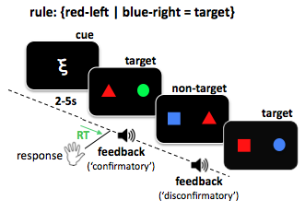
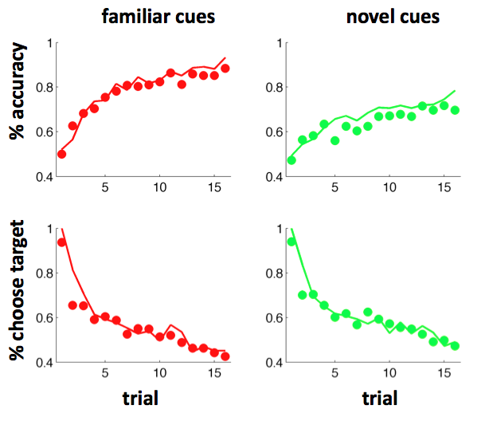
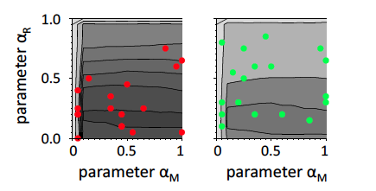
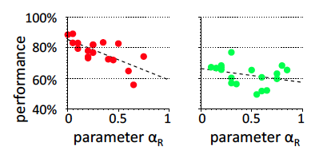
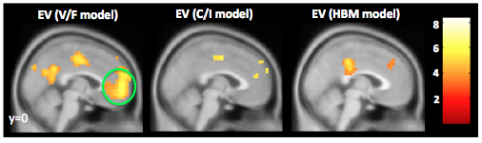
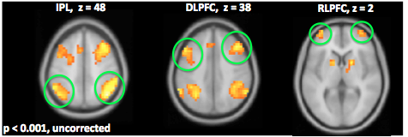
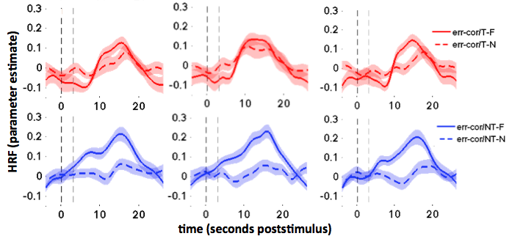
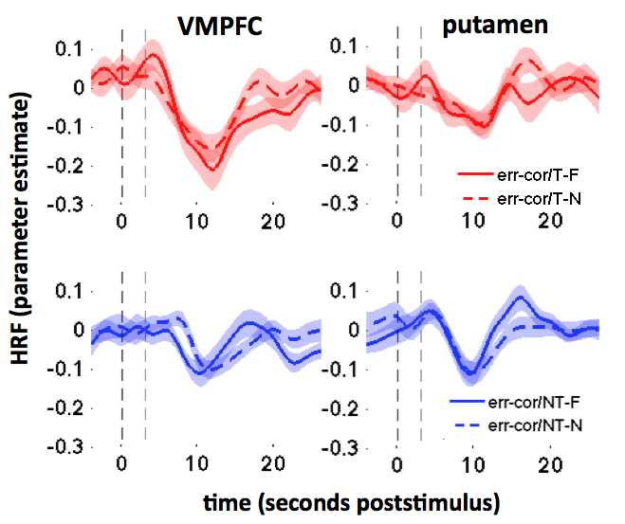

Neural mechanisms underlying verification and falsification in human reasoning
MARIA RUZ¹, JAN BALAGUER², CHRISTOPHER SUMMERFIELD²
1 CIMCYC, University of Granada, Granada, Spain 2 University of Oxford, Oxford, UK.
1
Introduction
2
Task and methods
Behaviour
Humans can learn rules (or theories) that allow old knowledge to be generalised to new stimuli or contexts.
Theories can be formed by trial-and-error learning, as in scientific discovery
However, evidence that verifies a theory provides incremental evidence in its favour, where evidence that falsifies a theory allows it to be definitively ruled out.
Do humans learn faster from verification or falsification?
3
Participants performed a rule learning task in which pairs of coloured shapes were designated “targets” or “nontargets” on the basis of a disjunctive combination of their features. For example, a rule might be: “if the left hand shape is red, or the right hand shape is blue, the stimulus is a target”.
Participants learned the rules across blocks of 16 trials, and faster when cues were familiar. A bias towards “target” diminished over the block. This occurred irrespective of the presence of advance cues that provided information about the relevant dimension for the rule. Dots show average human performance; model fits are shown with lines (see below)
In this disjunctive design, feedback to nontargets allows rules (theories) to be ruled out, whereas feedback to targets allows incremental verification.
4
Normative simulations
Familiar
Novel
Familiar
Novel
We modelled learning with a reinforcement learning model with 2 parameters, the absolute (α_{M}) and relative (α_{R}) learning rates for verification (learning from targets) and falsification (learning from nontargets). The disjunctive rule ensured the that best performance was achieved with steeper learning from falsification (dark shading). Modelling suggested that relative to optimal, humans tended to learn faster from verification.
5
Imaging data
Model-based analyses provided support for the verification falsification model over competing models with differential learning from correct/incorrect trials.
err-corr T-FAM
err-corr NT-FAM
err-corr T-NOV
err-corr T-FAM
err-corr NT-NOV
err-corr T-NOV
err-corr NT-FAM
VMPFC BOLD
err-corr NT-NOV
time (s)
time (s)
VMPFC reponse to error-correct was stronger for learning from verification than from falsification.
IPL, DLPFC and RLPFC responded to error-correct for both (familiar and novel) targets (verification), but to nontargets only in the familiar condition.
We learn from faster from evidence that verifies, rather than falsifies, a rule, even where this strategy leads to poorer performance.
This is reflected in brain activity in the reward system, and is more pronounced when the number of possible rules is large

