Slide 1
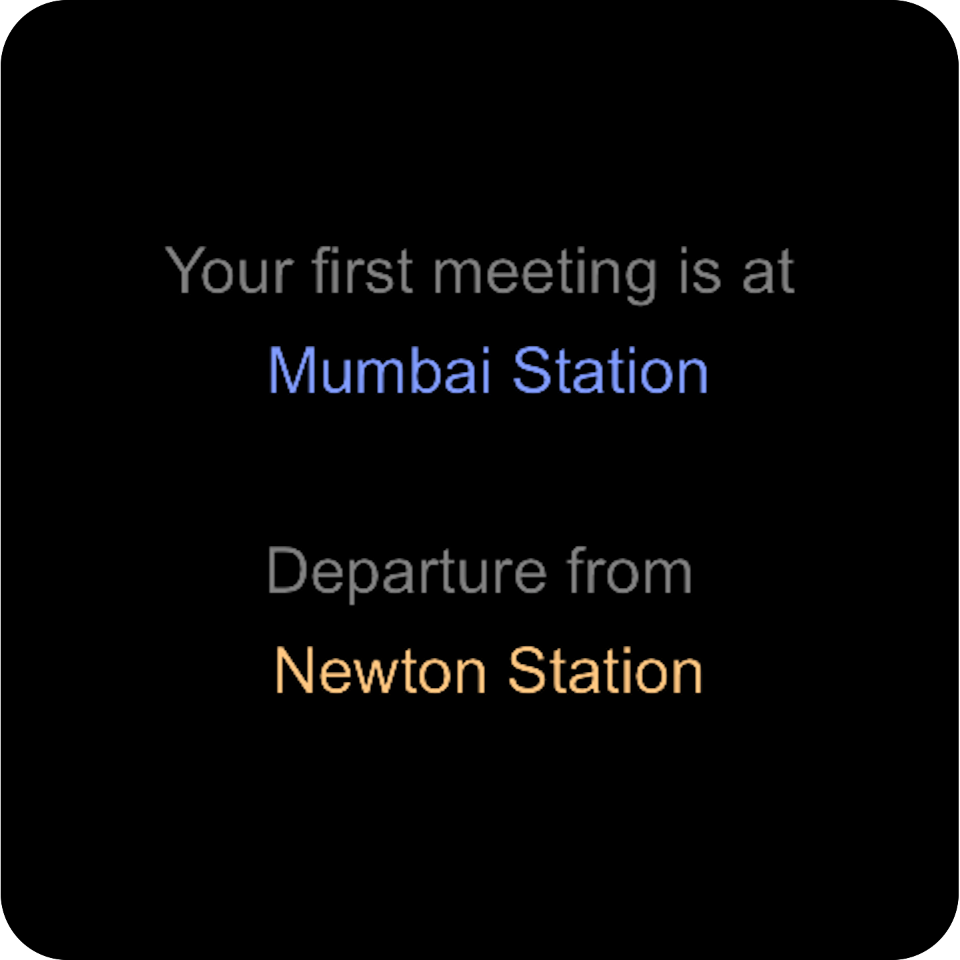
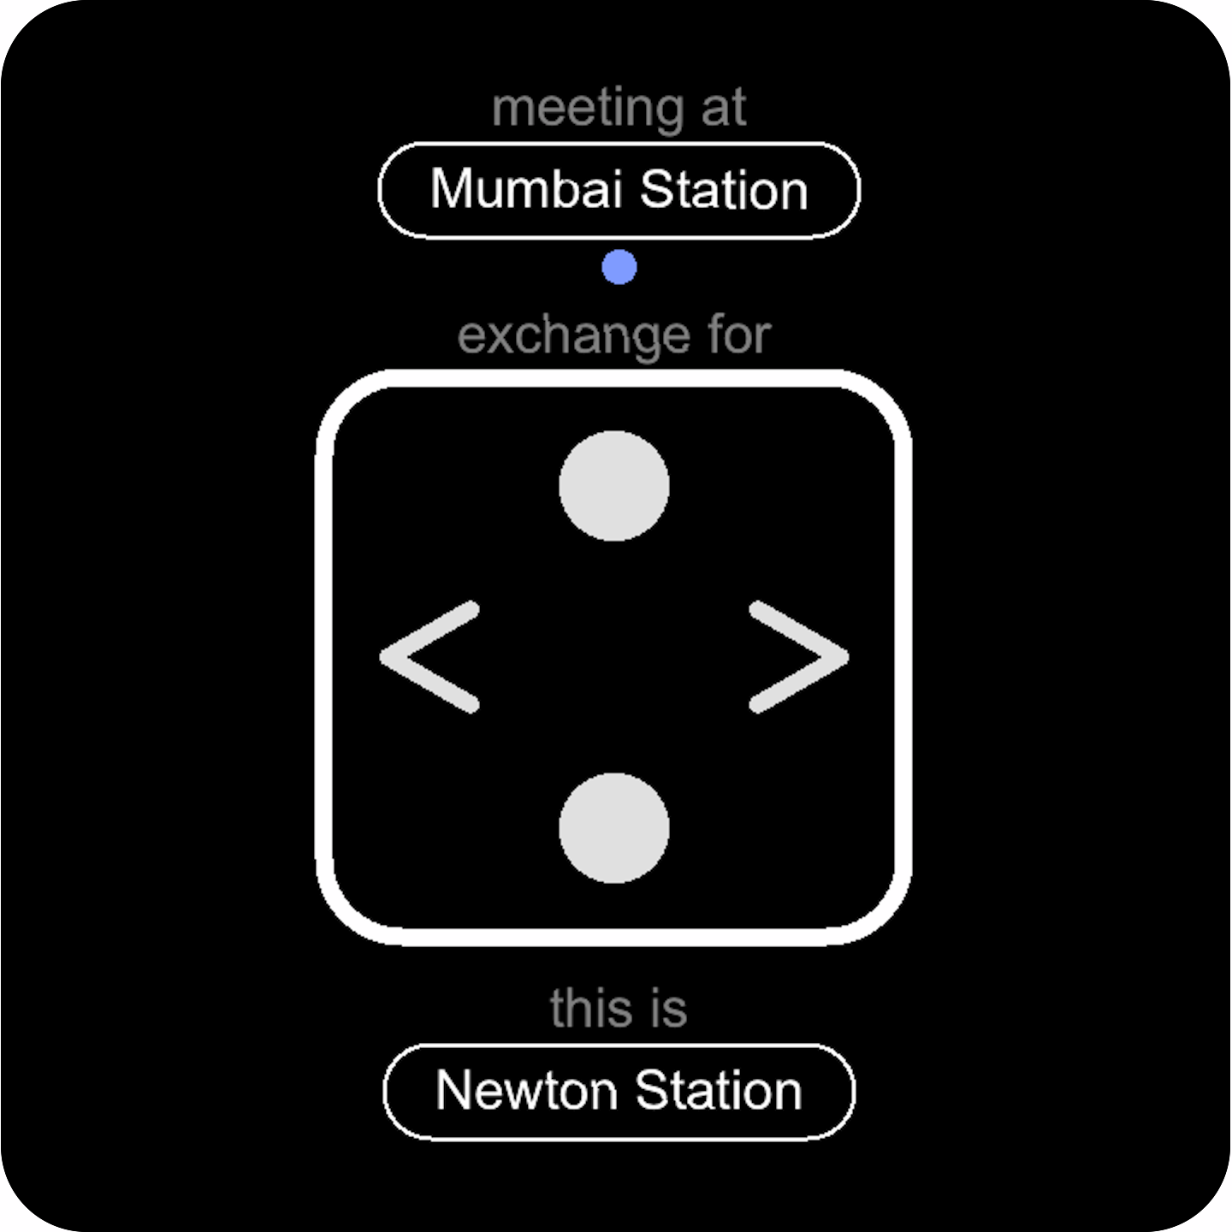
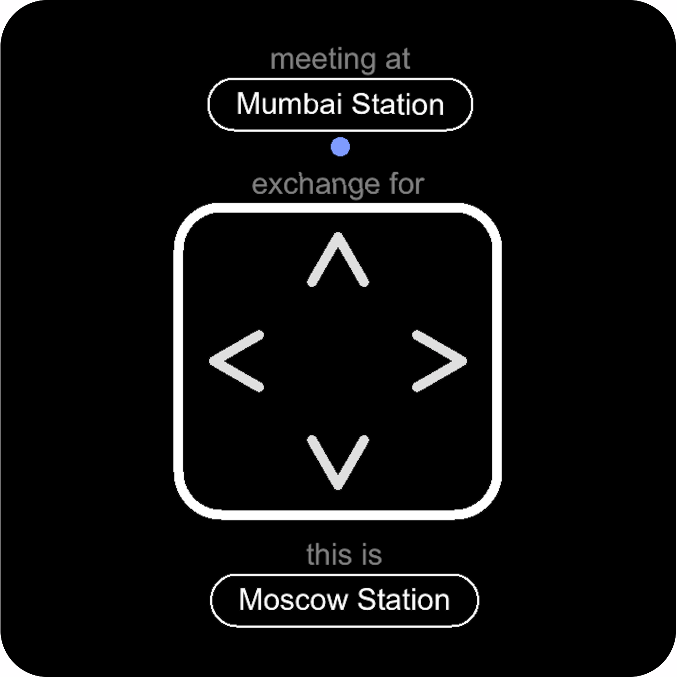
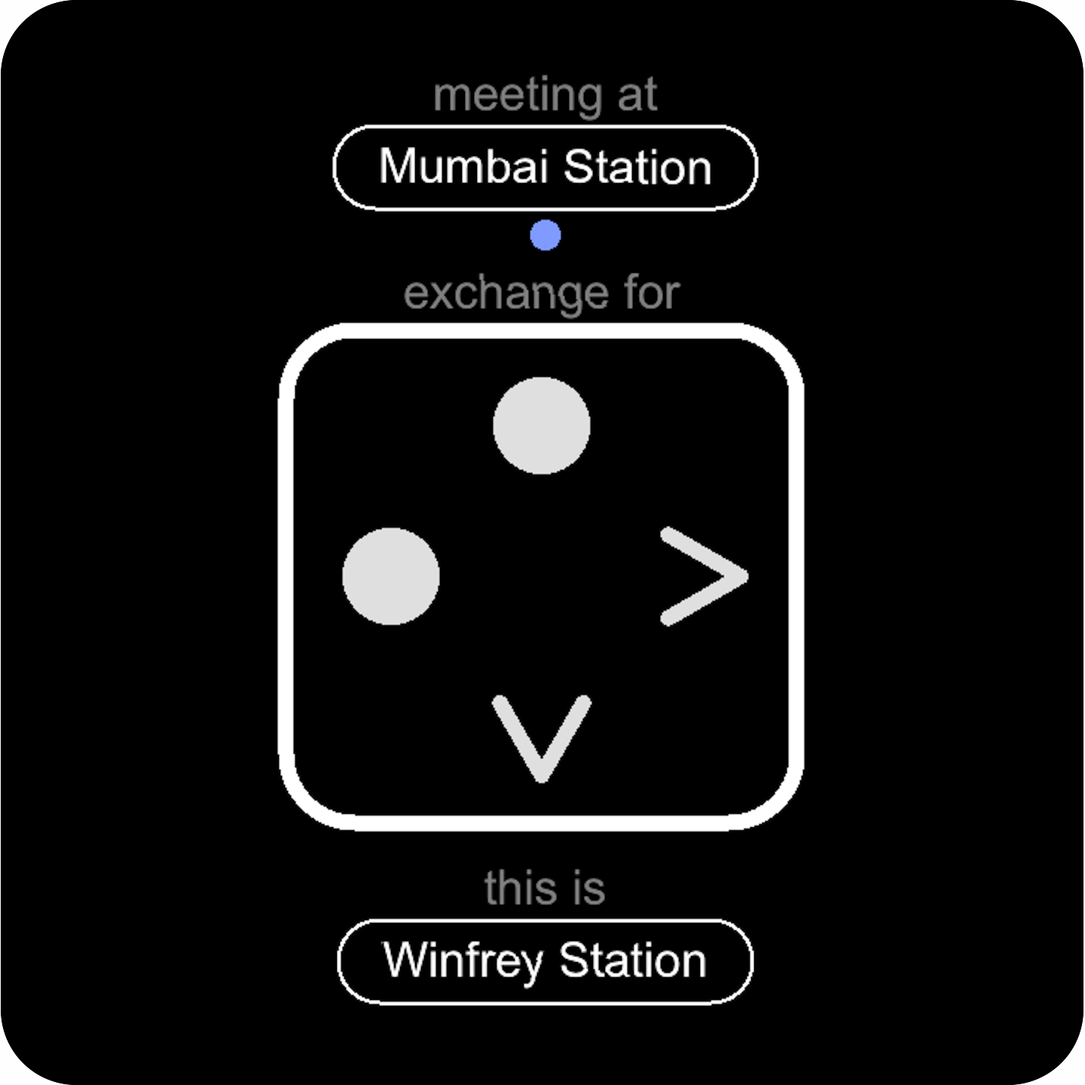


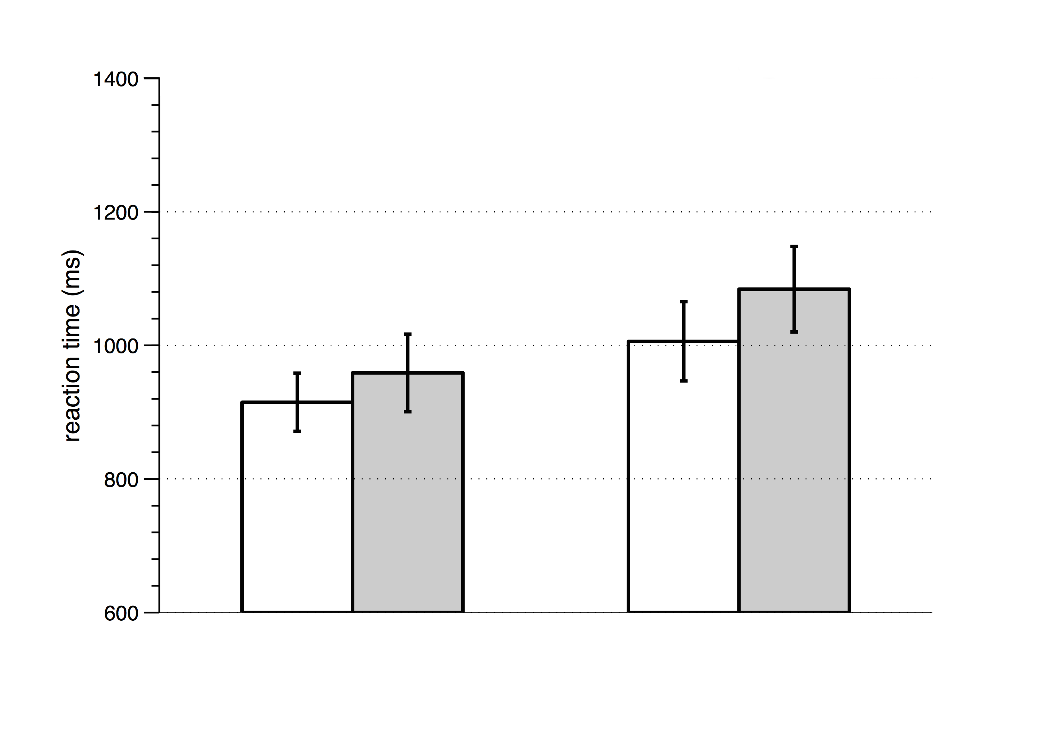
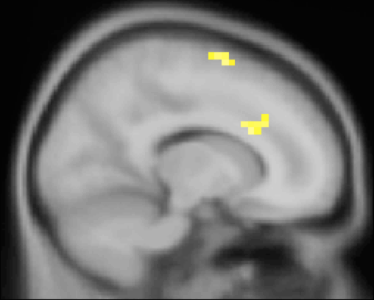
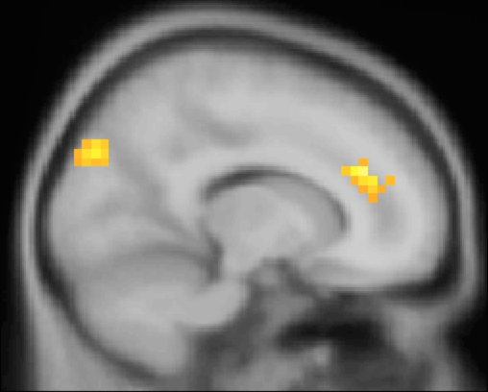

Neural Mechanisms of Hierarchical Planning during Navigation
Balaguer J¹, Hassabis D², Spiers H², Summerfield C¹
1 Dept. Experimental Psychology, University of Oxford, Oxford, UK.
2 Dept. Psychology, University College London, London, UK.
Correspondence : jdobalaguer@gmail.com
Introduction
Reinforcement Learning (RL) is a general framework of Machine Learning that also describes mammalian behaviour ¹.
Hierarchical Reinforcement Learning (HRL) ² is an extension of RL for temporal abstraction ^{3,4}.
To achieve this, HRL exploits the concept of options (or contexts), each defined by its subgoal state.
Prediction error signals for interim goals have been observed in the striatum ⁵, but it remains unknown whether representations of context switching exist in the human brain.
We predicted that subgoal states would be associated with activation in the dorsal Anterior Cingulate Cortex (dACC), a region previously associated with task-switching ⁶ and tracking the reward value of alternative contexts ⁷.
Methods
N = 19 participants (age 00±00, 00 males) performed a navigation task while undergoing fMRI. There was a preliminary training session.
Design
Participants navigated in a virtual subway network (stations and lines) with which they were familiar. The instruction was to minimise the length of their journey. The map was not shown during navigation.
Possible directions (actions) were North/South/East/West.
Regular, exchange and elbow stations allowed us to disentangle between effects due to number of directions, direction switch and line switch.
1
2
3 ± 3.5
3 ± 2
3 ± 2
3 ± 2
2 ± 3.5
time (secs)
yellow line
blue line
50% journeys
are cancelled
Results
3
Behavioural
Neural
General Linear Model of BOLD signal
p < 0.001
***
interaction
p < 0.05
*
main effect of action switch
main effect
dACC was significantly more activated in exchange stations than in regular stations.
F_{MAX} = 4.64
left
F_{MAX} = 5.68
interaction
Critically, this activation was strongest when switching line.
bilateral
x = 14, p < 10⁻³
Conclusions
This results provide evidence that a unique network is activated when participants reach an interim goal during navigation. This network bears a striking resemblance to that previously implicated in response inhibition during speeded decisions⁸. The dACC, which forms a prominent part of this network, may be key for switching to a new context in pursuit of reward⁷.
Our findings suggest that human dACC and/or interconnected structures signal when a subgoal has been reached.
4
References
1. Sutton, Barto (1998), Reinforcement Learning: An Introduction, The MIT Press
2. Sutton, Precup, Singh (1999), Between MDPs and semi-MDPs: A framework for temporal abstraction in reinforcement learning, Artificial Intelligence
3. Schapiro et al. (2013) Neural representations of events arise from temporal community structure, Nature Neuroscience
4. Botvinick, Niv, Barto (2009), Hierarchically organized behavior and its neural foundations: A reinforcement learning perspective, Cognition
5. Ribas-Fernandes et al. (2011) A Neural Signature of Hierarchical Reinforcement Learning, Neuron
6. Hyafil, Summerfield, Koechlin (2009), Two mechanisms for task switching in the prefrontal cortex, Journal of Neuroscience
7. Kolling et al. (2012) Neural mechanisms of foraging, Science
8. Aron et al. (2007) Triangulating a Cognitive Control Network Using Diffusion-Weighted Magnetic Resonance Imaging (MRI) and Functional MRI

