Slide 1

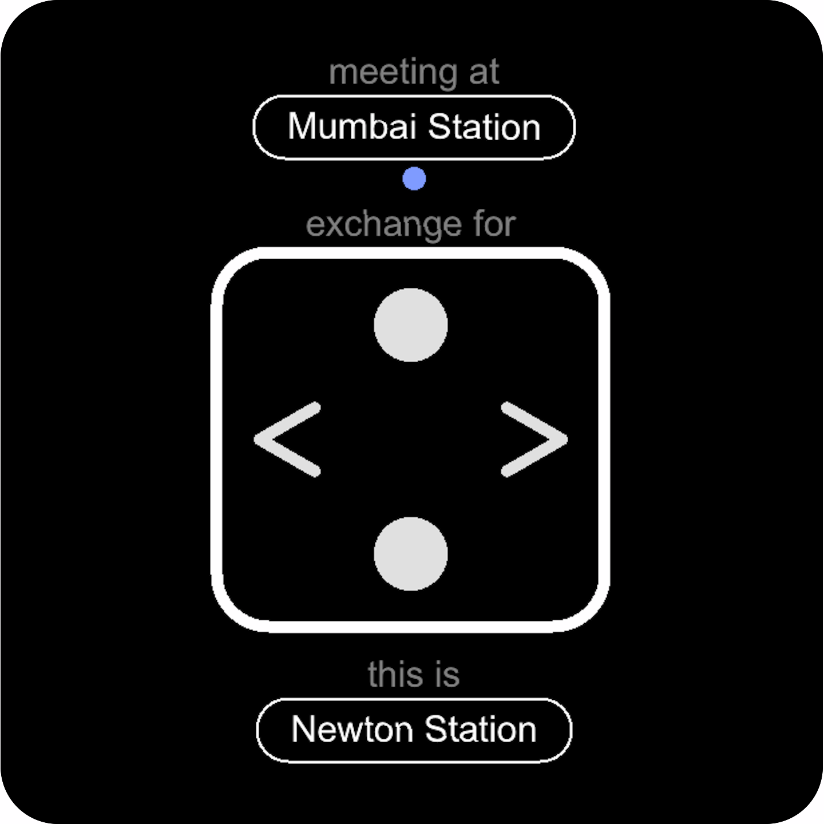
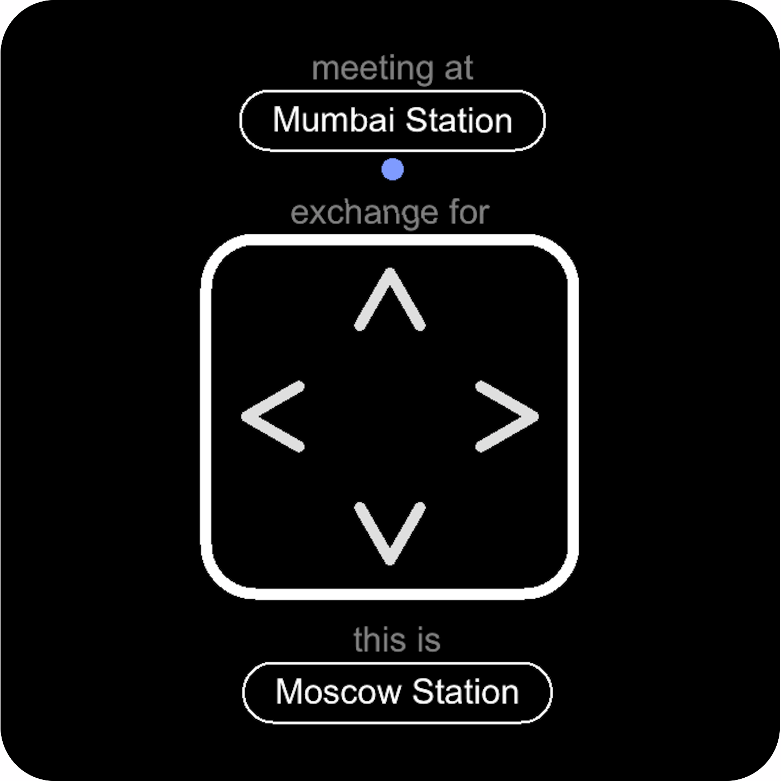
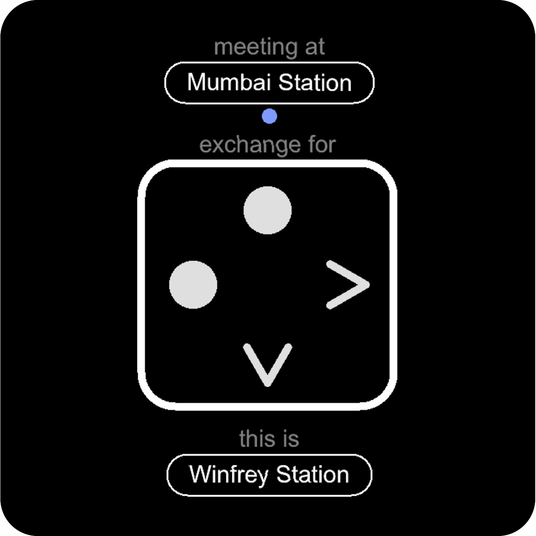


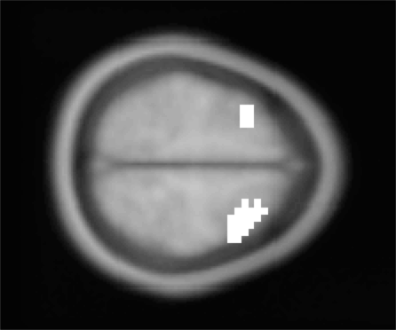
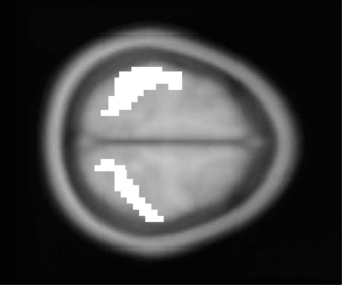
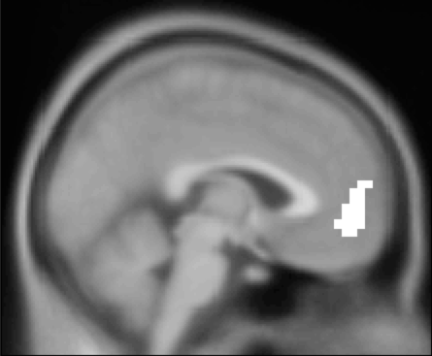
hierarchical planning during navigation
¹ Jan Balaguer, ² Demis Hassabis, ² Hugo Spiers, ¹ Chris Summerfield
¹ University of Oxford
² University College London
juan.delojobalaguer@psy.ox.ac.uk
Introduction
Task design
Hierarchical representations alleviate the complexity of planning. Using fMRI, we looked for the neural correlates of line changes within a navigation task virtual environment
Hierarchical representations alleviate the complexity of planning. Using fMRI, we looked for the neural correlates of line changes within a navigation task virtual environment
Hierarchical representations alleviate the complexity of planning. Using fMRI, we looked for the neural correlates of line changes within a navigation task virtual environment
3 ± 3.5
3 ± 2
3 ± 2
3 ± 2
2 ± 3.5
time (secs)
Regions of interest
50% probability
of journey being cancelled
Reaction time
dlPFC
IPL
vmPFC
dlPFC
dlPFC
dlPFC
1200
Neural Correlates
1100
slow-down before
line change
1000
speed-up after
line change
Reaction times (ms)
900
800
700
?
Steps around each condition
Conclusions
Connectivity (PPI)
Signatures of hierarchical representations :
Behavioural cost in RTs around a line change
BOLD signal in different regions reflect exchange stations, response switch and line change.
Medial regions monitor performance (distance to goal, etc..) in a hierarchical fashion.
Medial regions monitor performance (distance to goal, etc..) in a hierarchical fashion.

