Slide 1
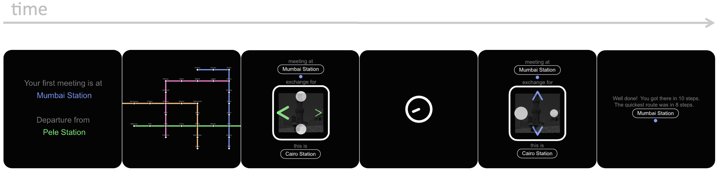
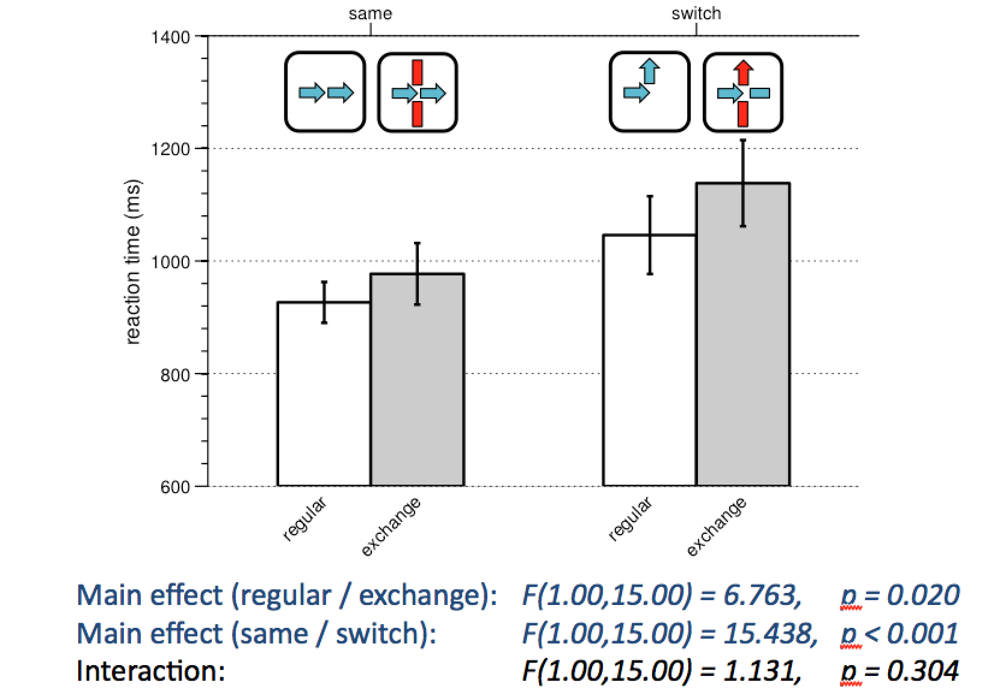
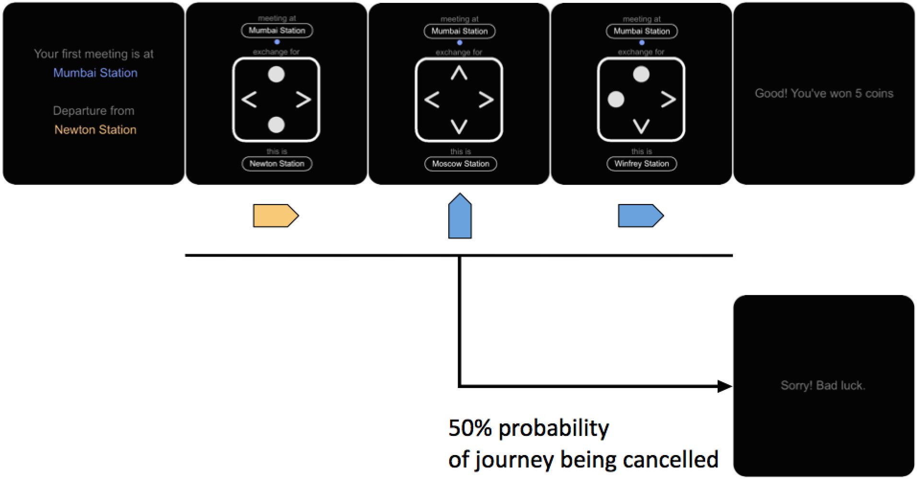
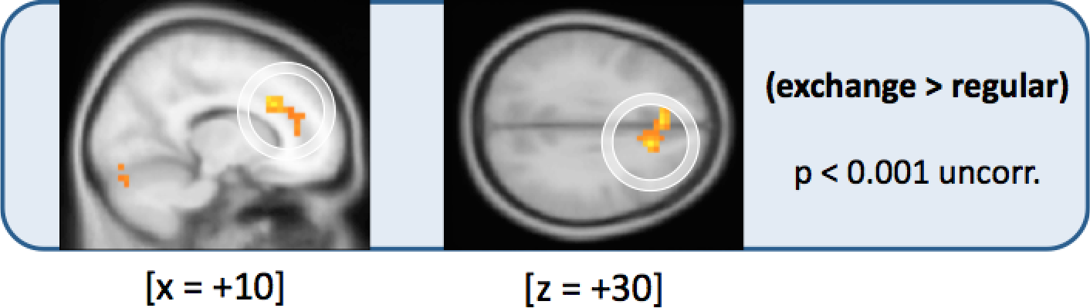
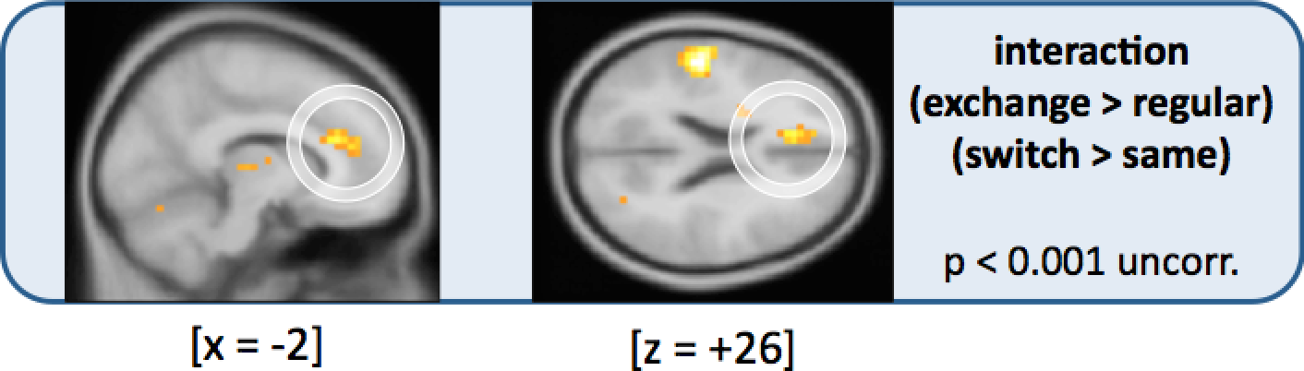
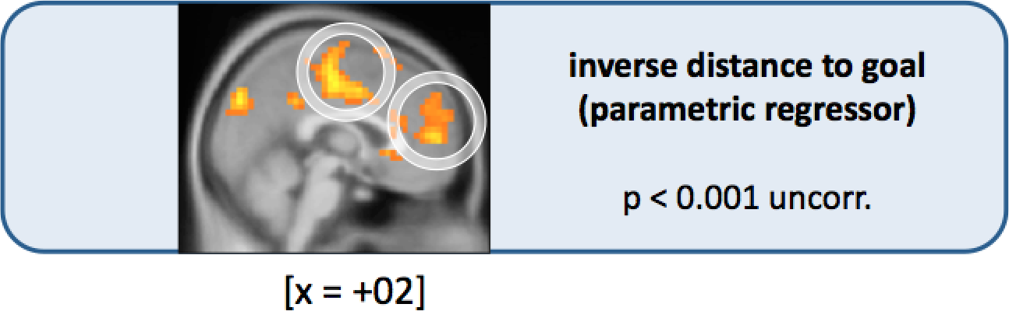
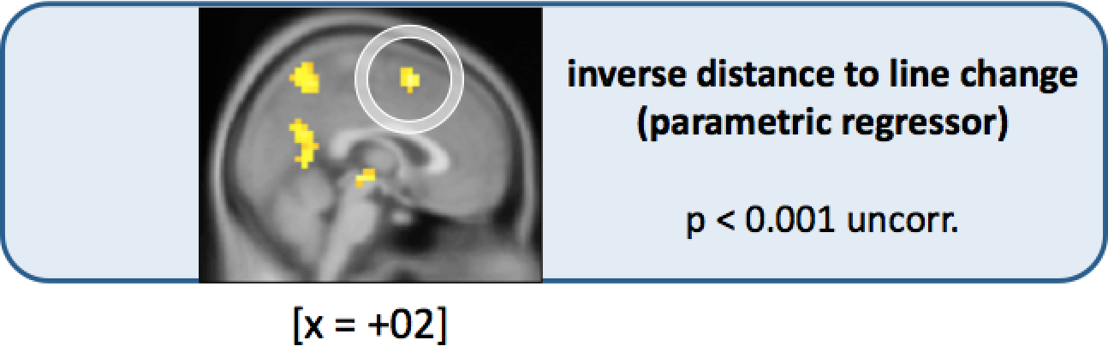
Subway
training
scanning
Figure 1. Task design
Participants performed two sessions : one outside the scanner (learning the map of a subway network) and one inside the scanner.
Figure 2. Behavioural results
There is a behavioural cost (i.e. slowing down) of decision-making in exchange stations (when there are more options) and when we change of action. These two costs don't interact.
Figure 3. Neural results (GLM analysis)
We modeled the BOLD signal using standard HRF functions over the relevant events in our experiment. A GLM analysis over the whole brain showed a main effect of currently being in an exchange station in the Anterior Cingulate Cortex (ACC). This activation interacted with line change (higher when changing). Additionally, we also found BOLD signal correlating with inverse distance to goal in both the ventromedial PFC and the dorsomedial PFC, and with inversed distance line change only in the dmPFC.

