Slide 1
Neural Mechanisms of Hierarchical Planning during Navigation
FMRIB Research In Progress,
October 30th 2013
J. Balaguer, D. Hassabis, H. Spiers, and
C. Summerfield.

Slide 2
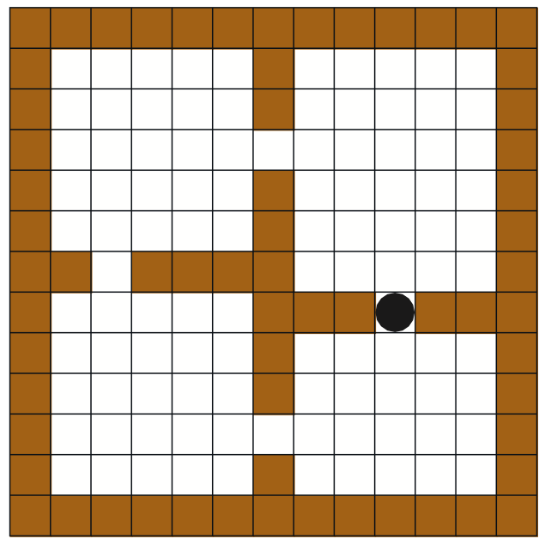
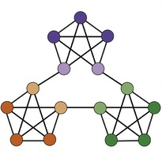
Motivation
Machine Learning:
Use of options
(Sutton et al, 1998)
Neuroscience:
Emergence of communities
(Schapiro et al, 2013)

Slide 3
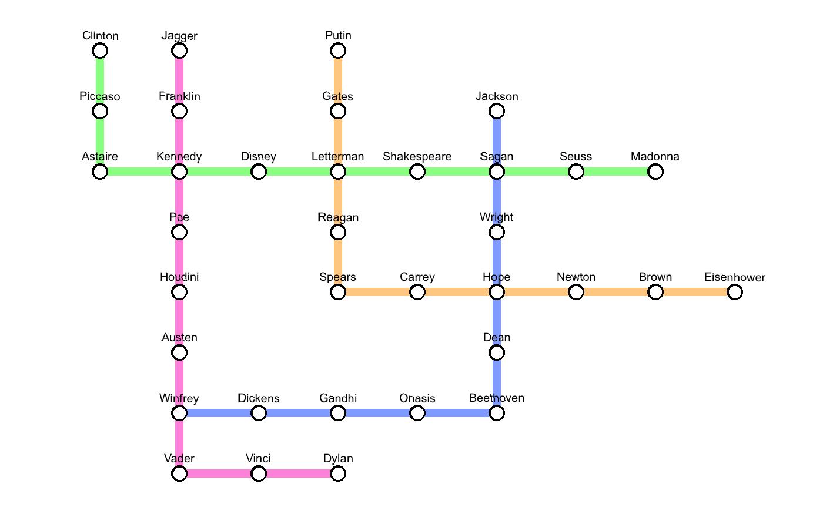
Task
Navigate through a familiar subway
– Minimum steps
– Bailing out
– Two levels of reward

Slide 4

Task

Slide 5
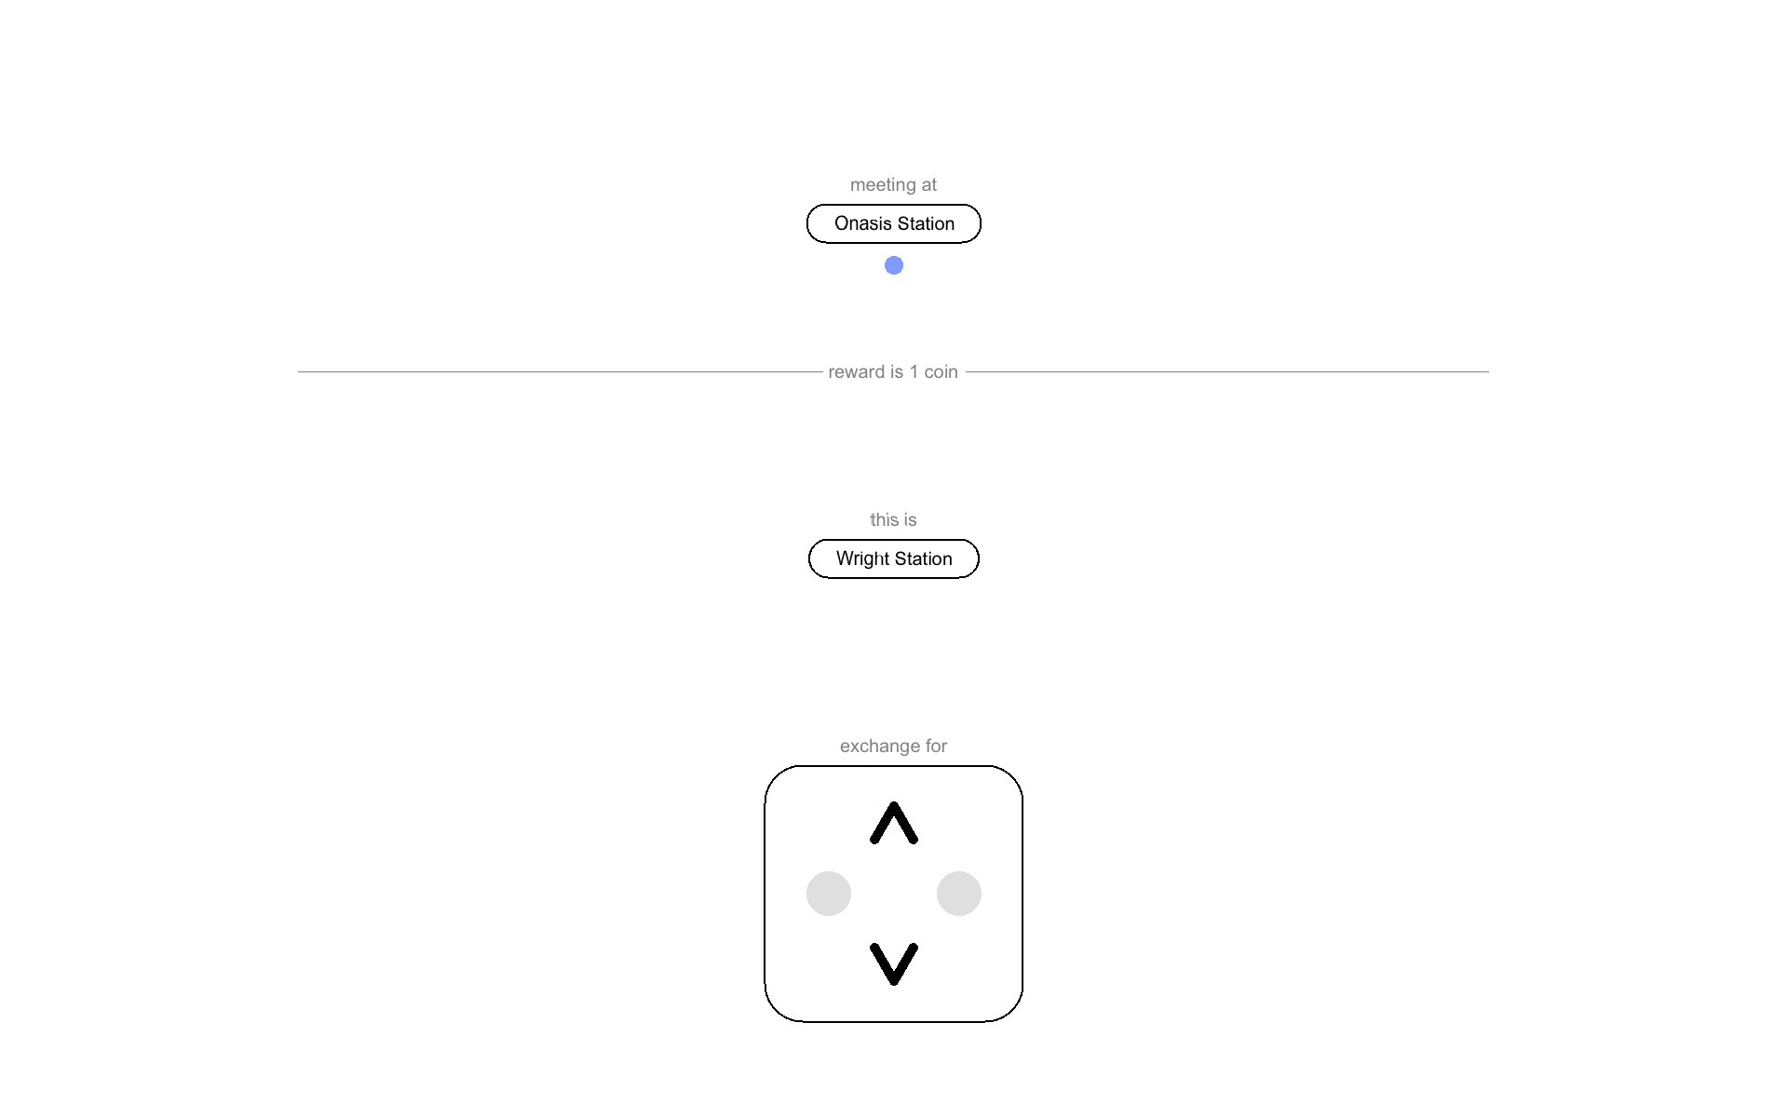
Task

Slide 6
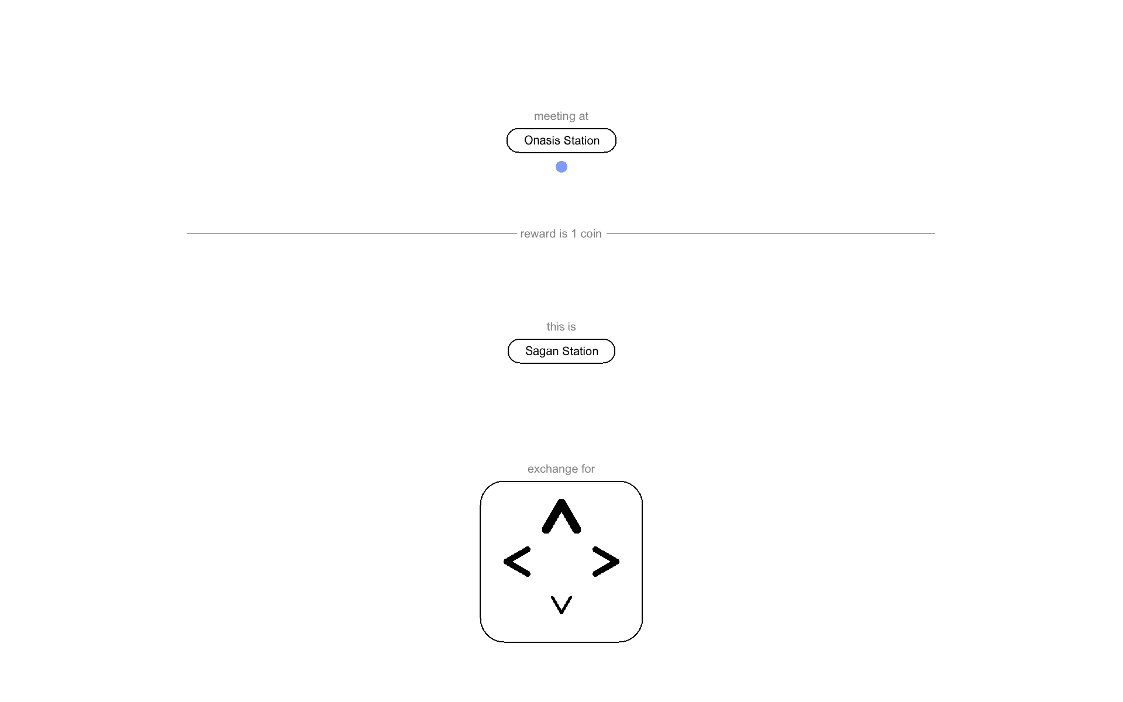
Task

Slide 7

Task

Slide 8
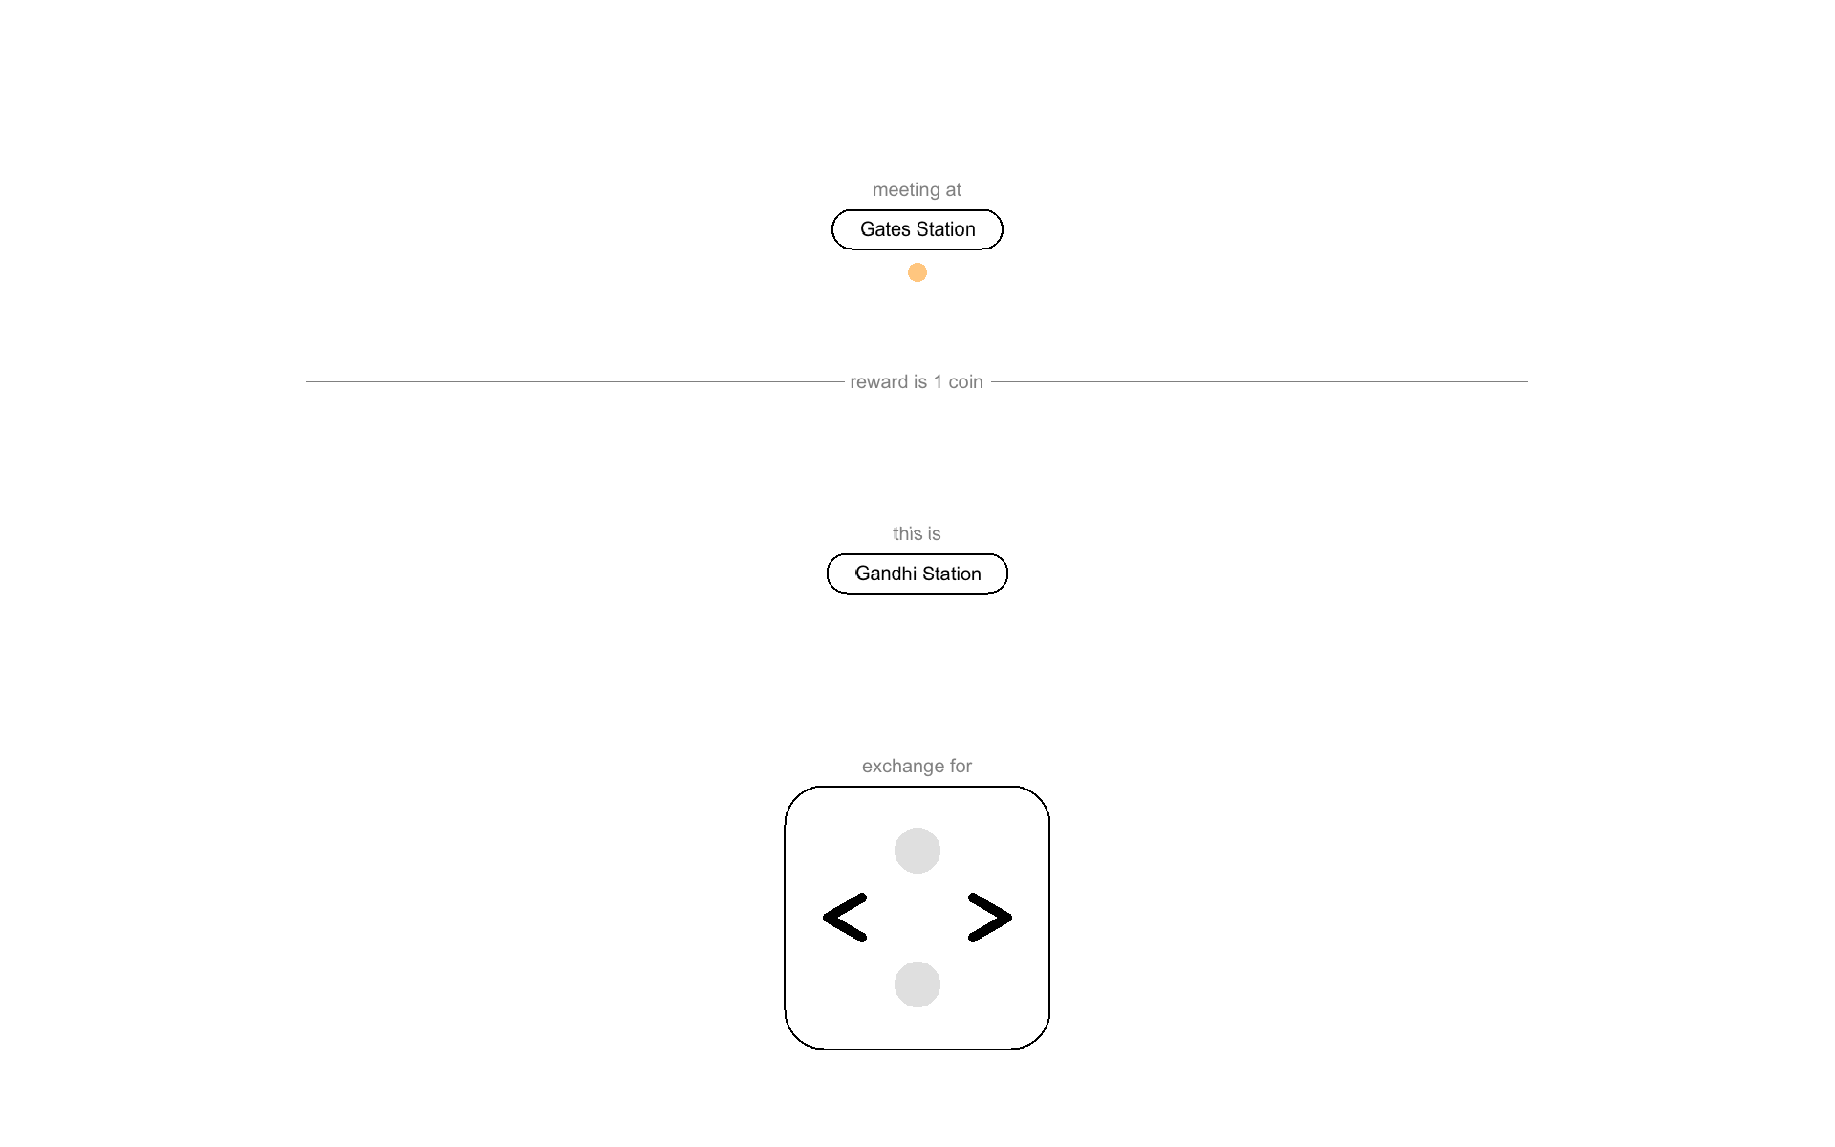
Task

Slide 9
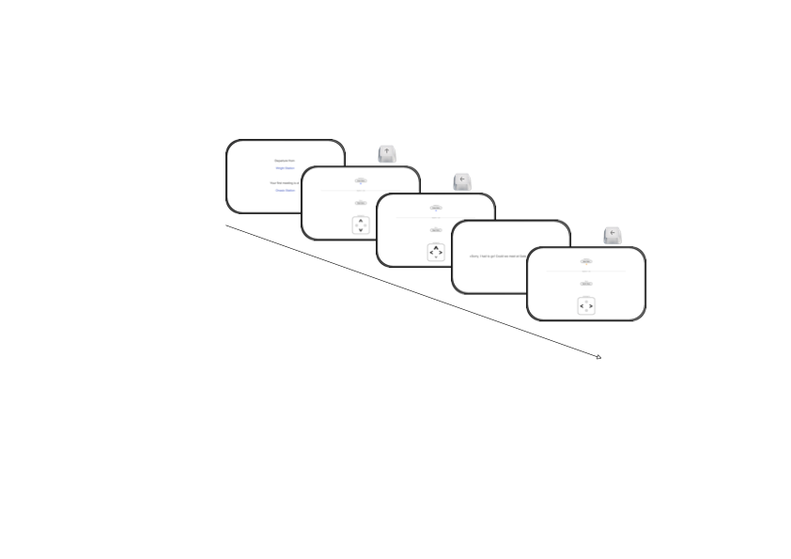
Task
BO!

Slide 10
Training
Differences
– Map shown at start
– Current line always shown (colour)
– Switching lines waiting time
– No rewards, no BO
– Evaluation of learning

Slide 11
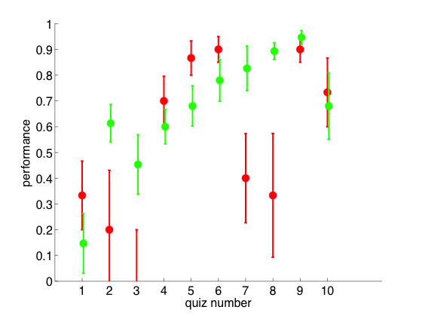
Training pilot
N = 9 (5 males, 20-28 years old)
departure from
regular stations
exchange stations

Slide 12
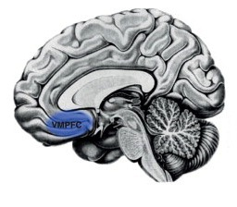
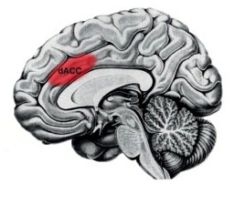
Neural Predictions
Background
vmPFC expected value of chosen option [Boorman, 2013]
dACC selection/maintenance of options [Holroyd and Yeung, 2012]
Predictions
reward modulated
vmPFC distance to goal
dACC distance to change

Slide 13
Scanner parameters
– VERIO 3T
– Standard EPI sequence
– TR = 2s
– TE = 30ms
– 64 x 64 x 36 voxels
– Fieldmap & T1 structural image
for normalisation

Slide 14
Thank you.

