Slide 1

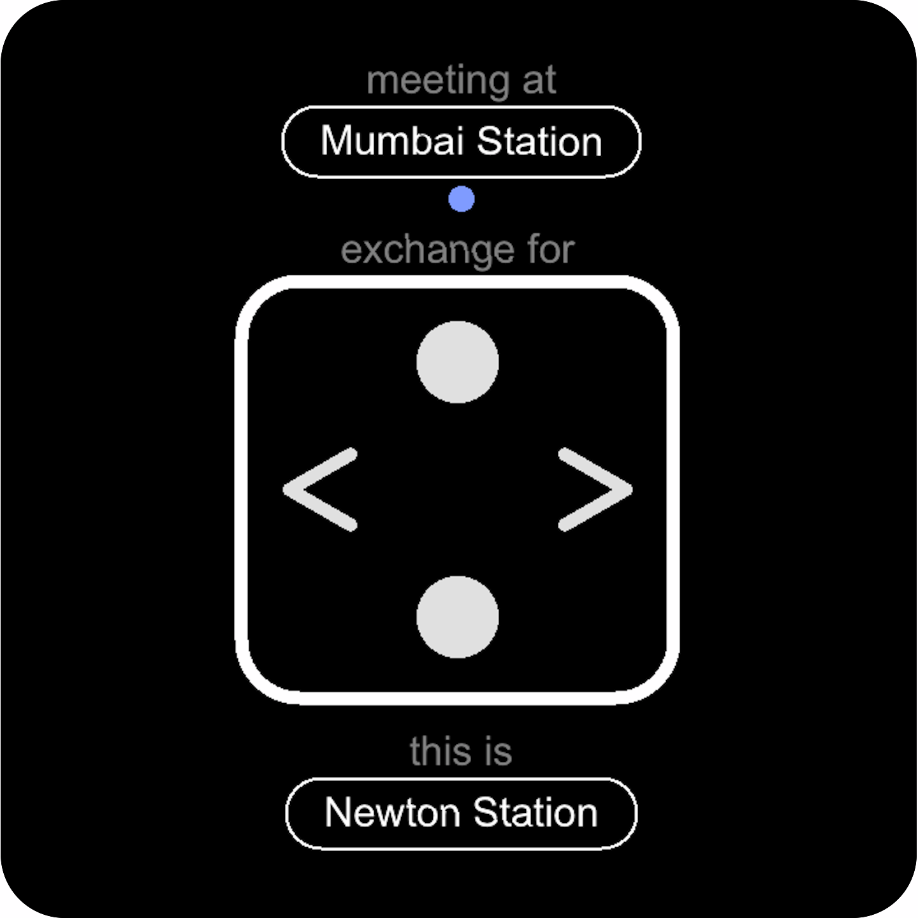
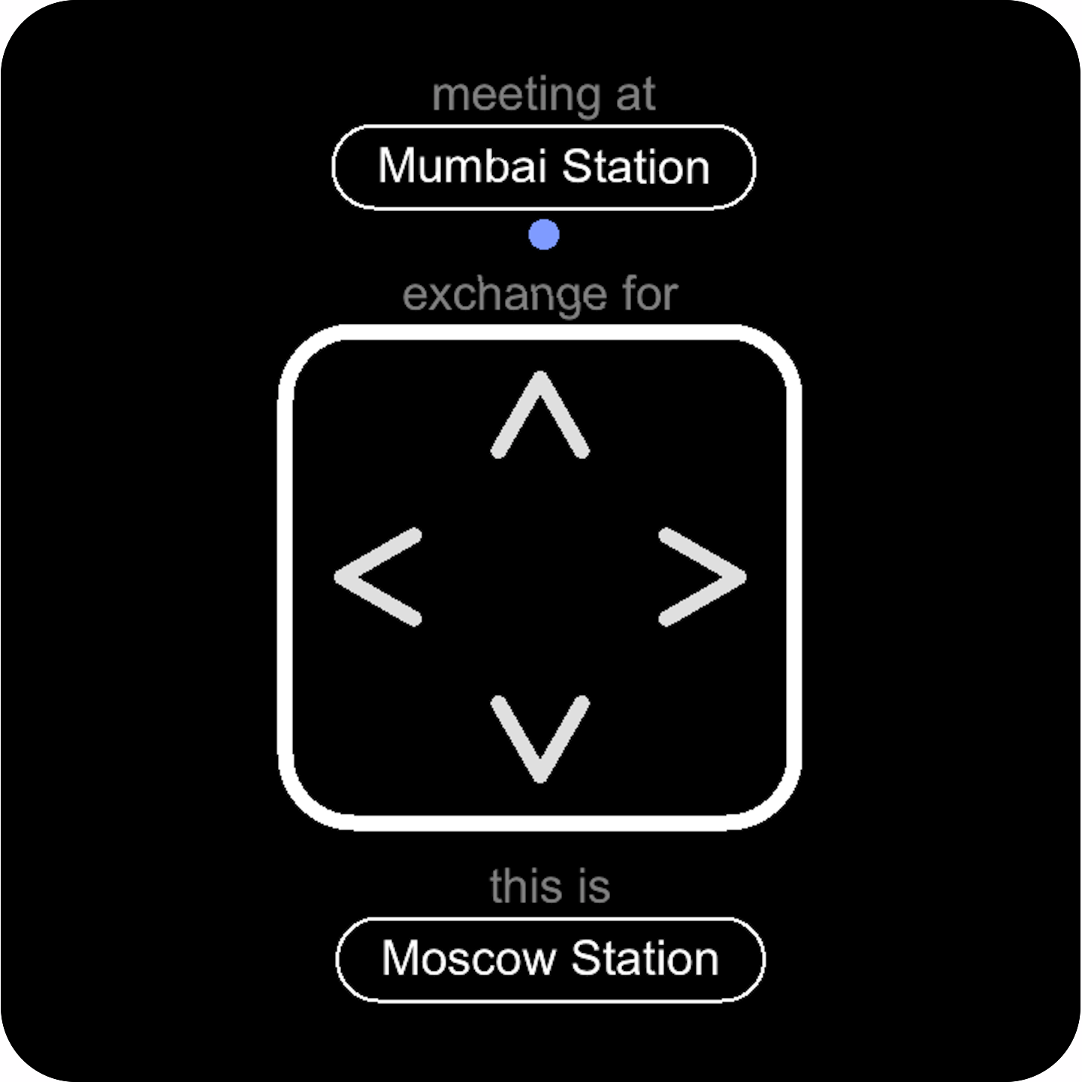
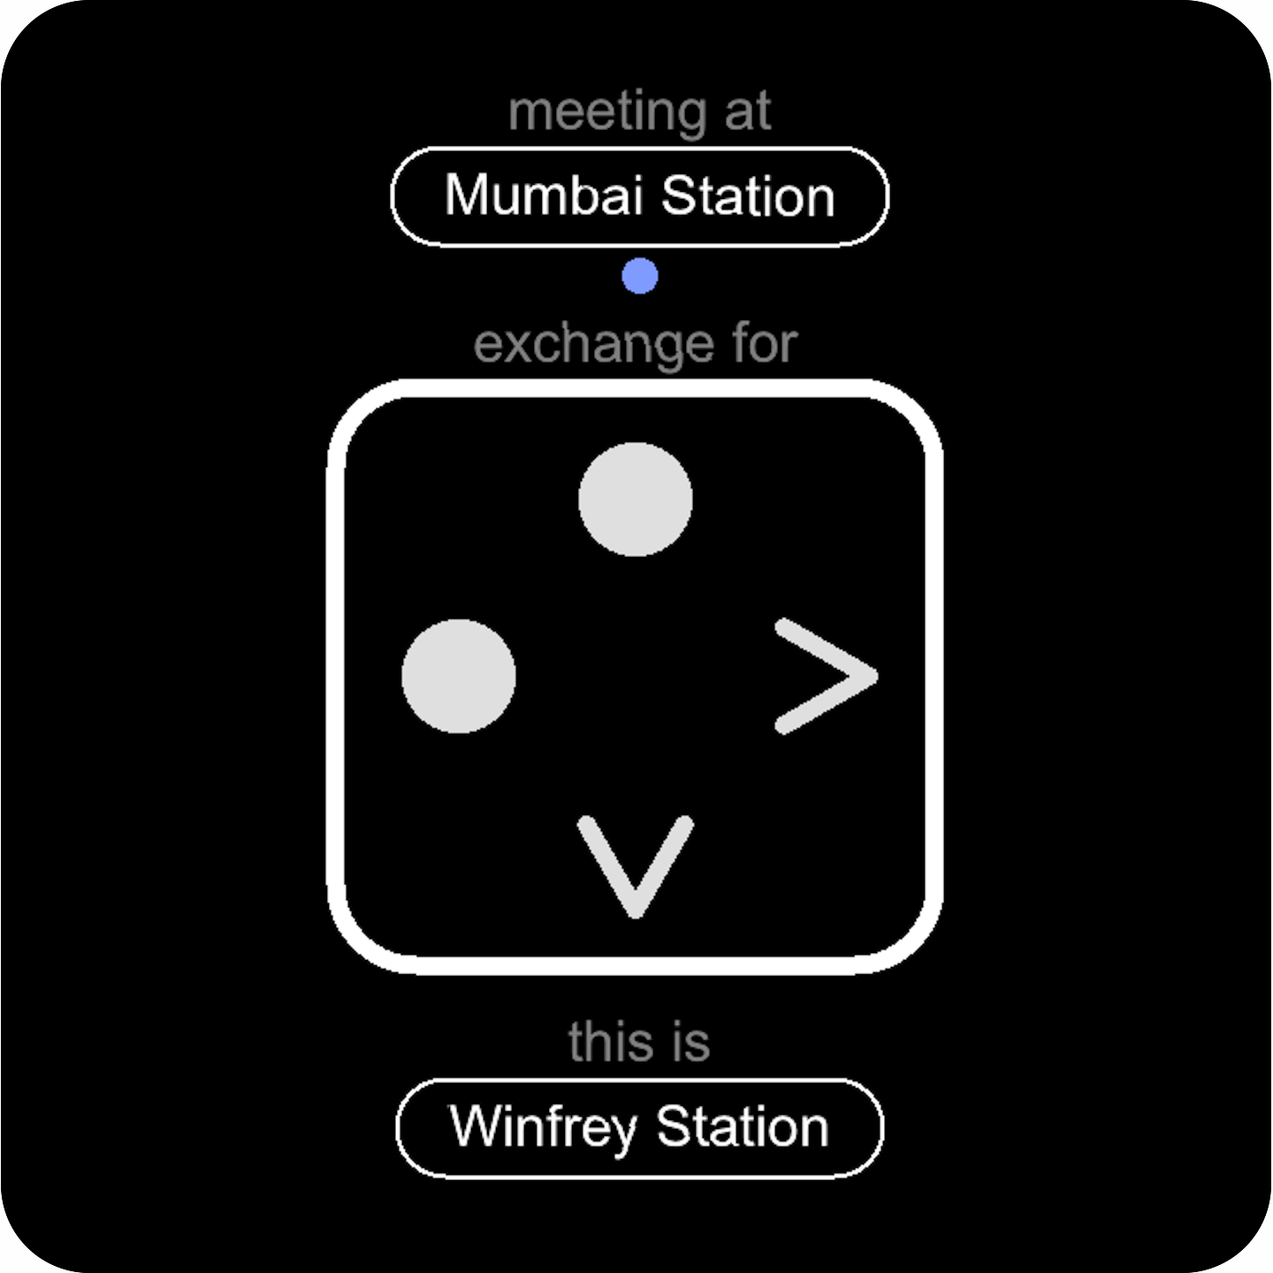


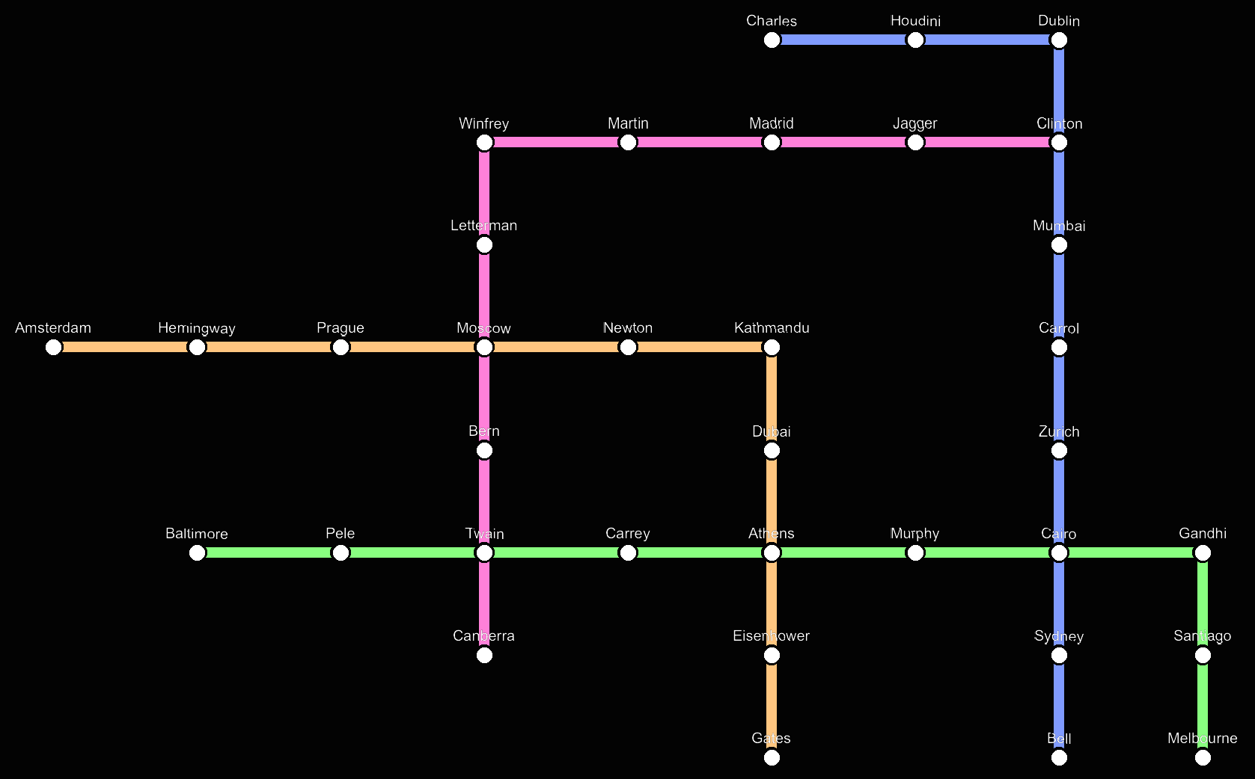
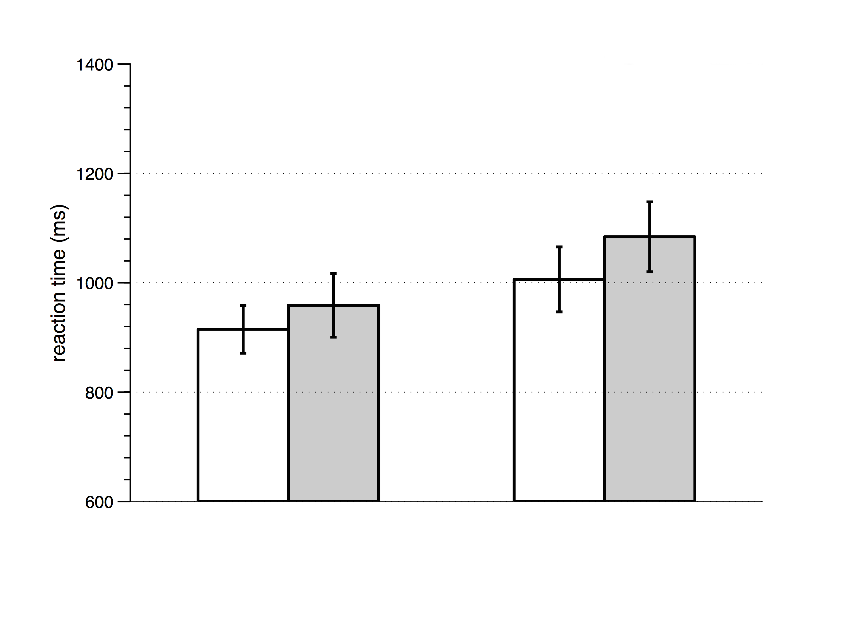
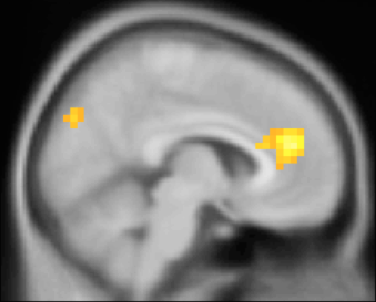
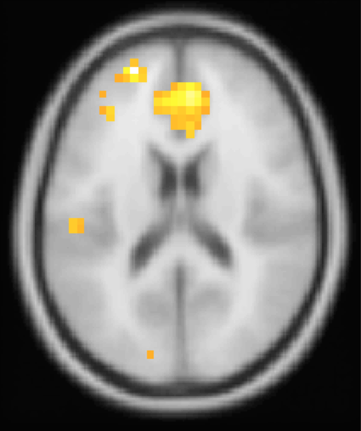
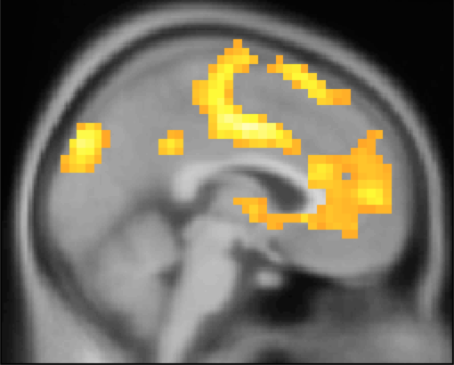
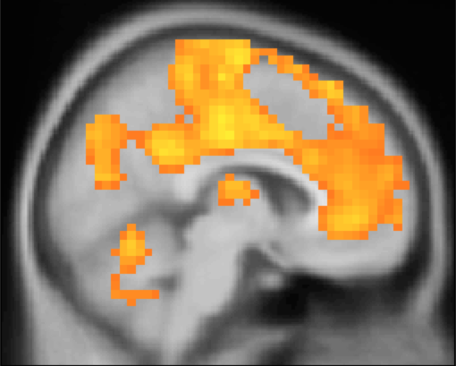
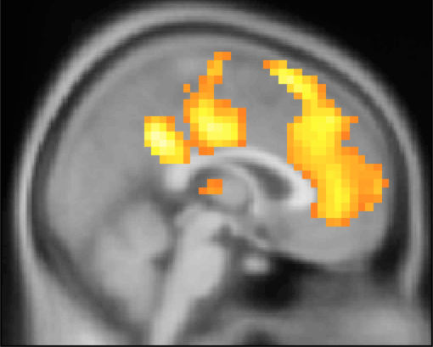
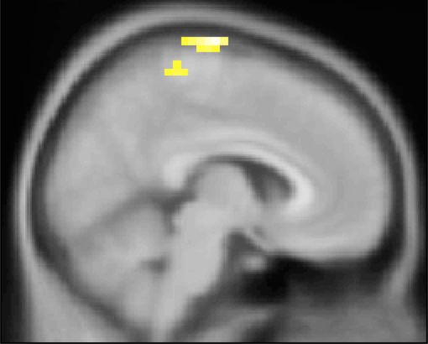

Neural Mechanisms of Hierarchical Planning during Navigation
Balaguer Jan¹, Hassabis Demis², Spiers Hugo², Summerfield Chris¹
1 University of Oxford, Oxford, UK. 2 University College London, London, UK.
1
Introduction
3
Design
Planning, or making multiple decisions in order to achieve a goal, is computationally costly. Efficient planning can be achieved by exploiting hierarchical representations.
It has been shown that humans spontaneously chunk abstract spaces into multiple contexts in a hierarchical fashion ¹.
However, it is still unknown whether humans plan hierarchically, and if so, which brain regions are involved.
3 ± 3.5
3 ± 2
3 ± 2
3 ± 2
2 ± 3.5
time (secs)
yellow line
blue line
2
Methods
N = 19 participants (age 25.3±4.0, 11 males) performed a navigation task within a virtual subway network (station = state and line = context) with which they were familiar from earlier training, while undergoing functional Magnetic Resonance Imaging (fMRI). Completed journeys were financially rewarded after participation (journeys could be randomly cancelled on every step, with fixed probability, motivating efficient navigation). The map was shown during a preliminary training session but not during the scanning session. Possible directions (actions) were North / South / East / West. Regular, exchange and elbow stations allowed us to disentangle between effects due to number of possible directions, direction switch, and line switch.
around 50% journeys cancelled
4
Results 1 – rACC signals context switch
rACC
p < 10⁻³
***
main effect
(switch > stay)
Greater activation was found in more rostral portions of the anterior cingulate cortex (rACC) for switches of context, as shown by its sensitivity to the interaction [switch > stay exchange] > [switch > stay regular].
This result is in contrast with Reaction Times (RT), for which main effects of [switch > stay] and [exchange > regular] are significant, but not the interaction.
p < 0.05
*
main effect
(exchange > regular)
interaction
x = +6
z = +18
F_{MAX} = 5.81, p < 10⁻³
BOLD activity during navigation
Reaction Times (RT)
5
Results 2 – vmPFC tracks distance to goal but not reward
vmPFC
BOLD activity in the ventromedial prefrontal cortex (vmPFC) inversely correlates with distance to goal.
Strikingly, it was consistently activated at the end of each journey (feedback time), independently of the outcome (positive or negative).
inverse of distance to goal
x = -2
F_{MAX} = 4.09 p < 10⁻³
x = +6
x = +2
x = +6
positive feedback
negative feedback
positive > negative
F_{MAX} = 5.35 p < 10⁻³
F_{MAX} = 6.00 p < 10⁻³
p < 10⁻³
Distance to goal
Feedback
6
References
Discussion
This results provide evidence that humans exploit hierarchical structures during navigation, dividing the space into multiple contexts.
The rACC plays a key role in signalling context switching in pursuit of reward.
Additionally, we report evidence for a new role of the vmPFC in tracking distance to goal but not reward outcome.
1. Schapiro et al. (2013)
Neural representations of events arise from temporal community structure, Nature Neuroscience
2. Hyafil, Summerfield, Koechlin (2009)
Two mechanisms for task switching in the prefrontal cortex, Journal of Neuroscience
3. Kolling et al. (2012)
Neural mechanisms of foraging, Science
4. Koechlin, Summerfield (2006)
An information theoretical approach to prefrontal cortex, Trends in Cognitive Sciences
5. Wan Lee, Shimojo, O'Doherty (2014)
Neural Computations underlying arbitration between model-based and model-free learning,
Neuron
Correspondence : jdobalaguer@gmail.com

