Slide 1
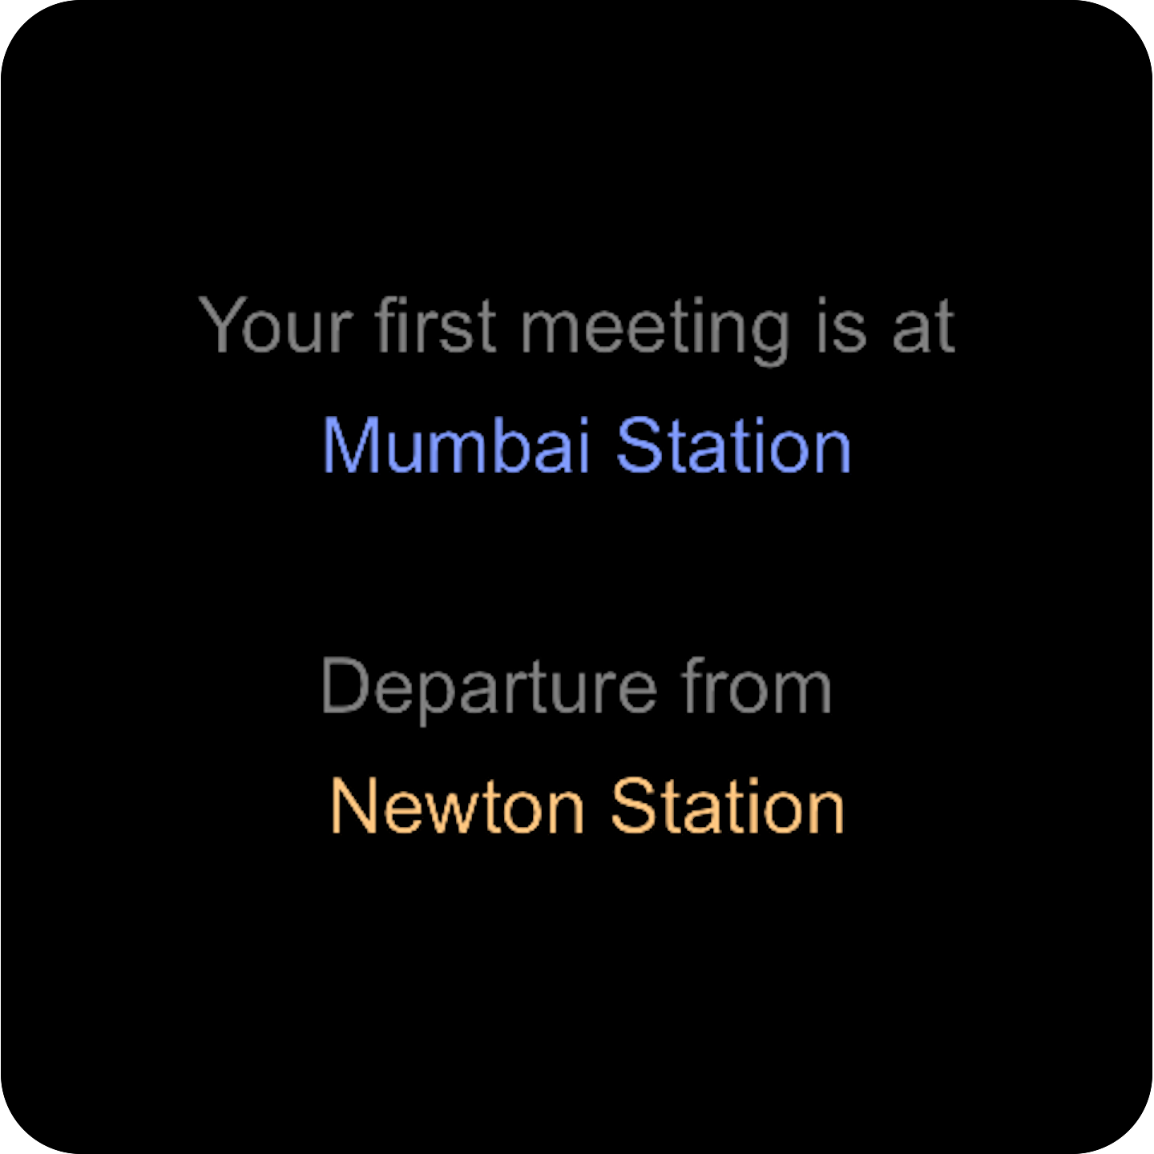
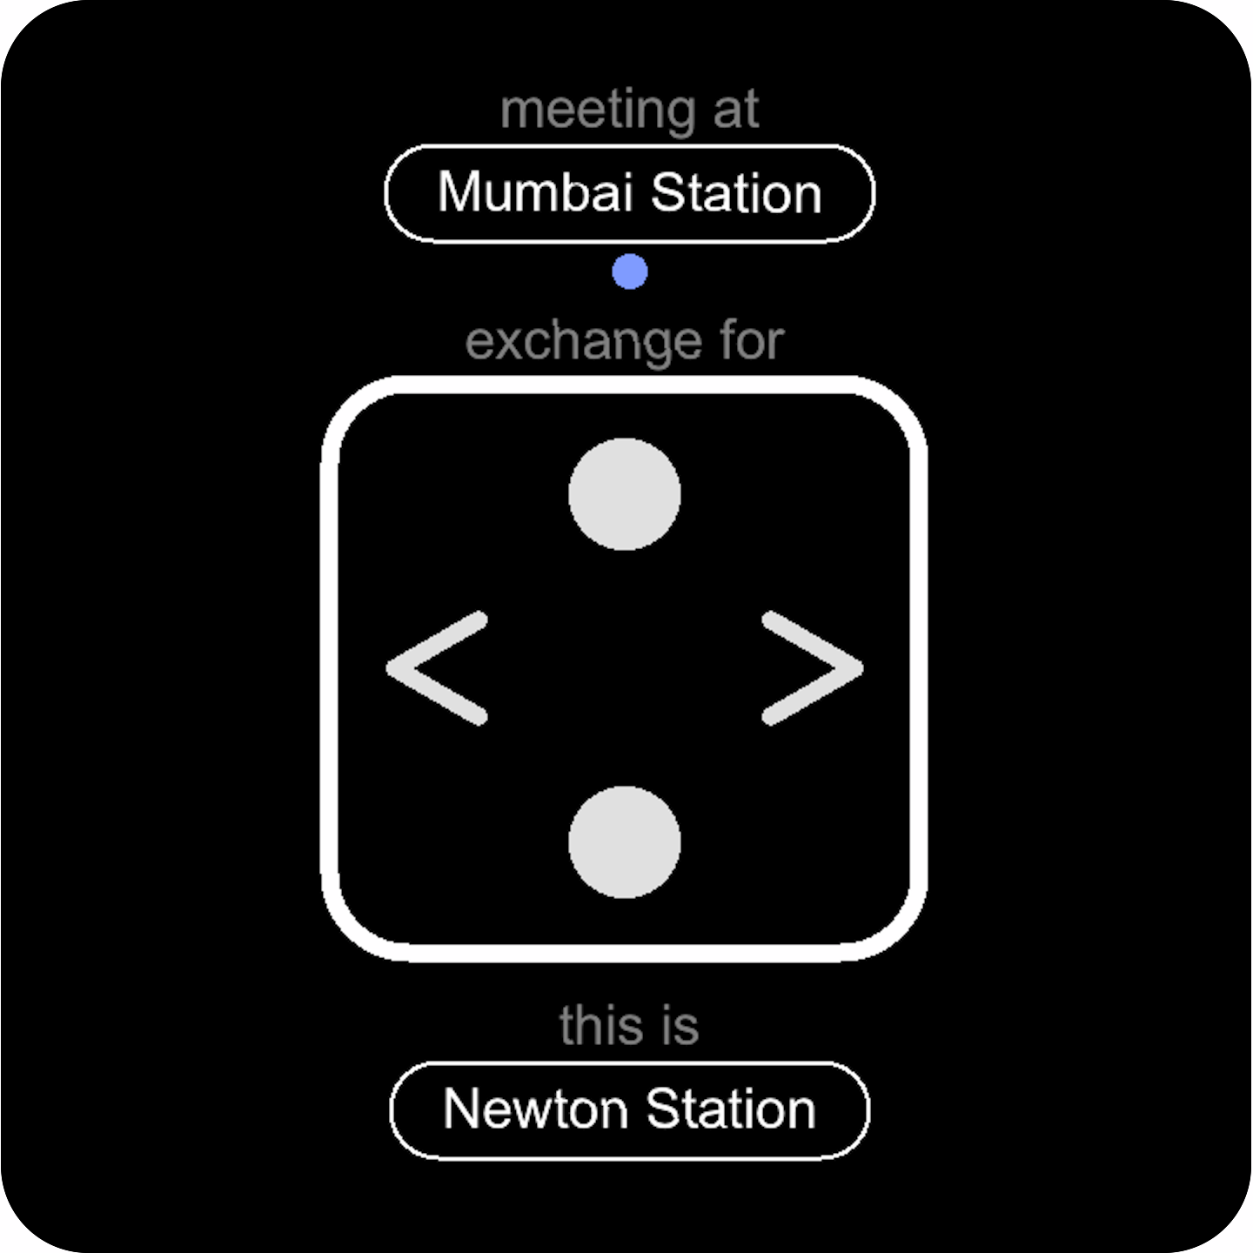
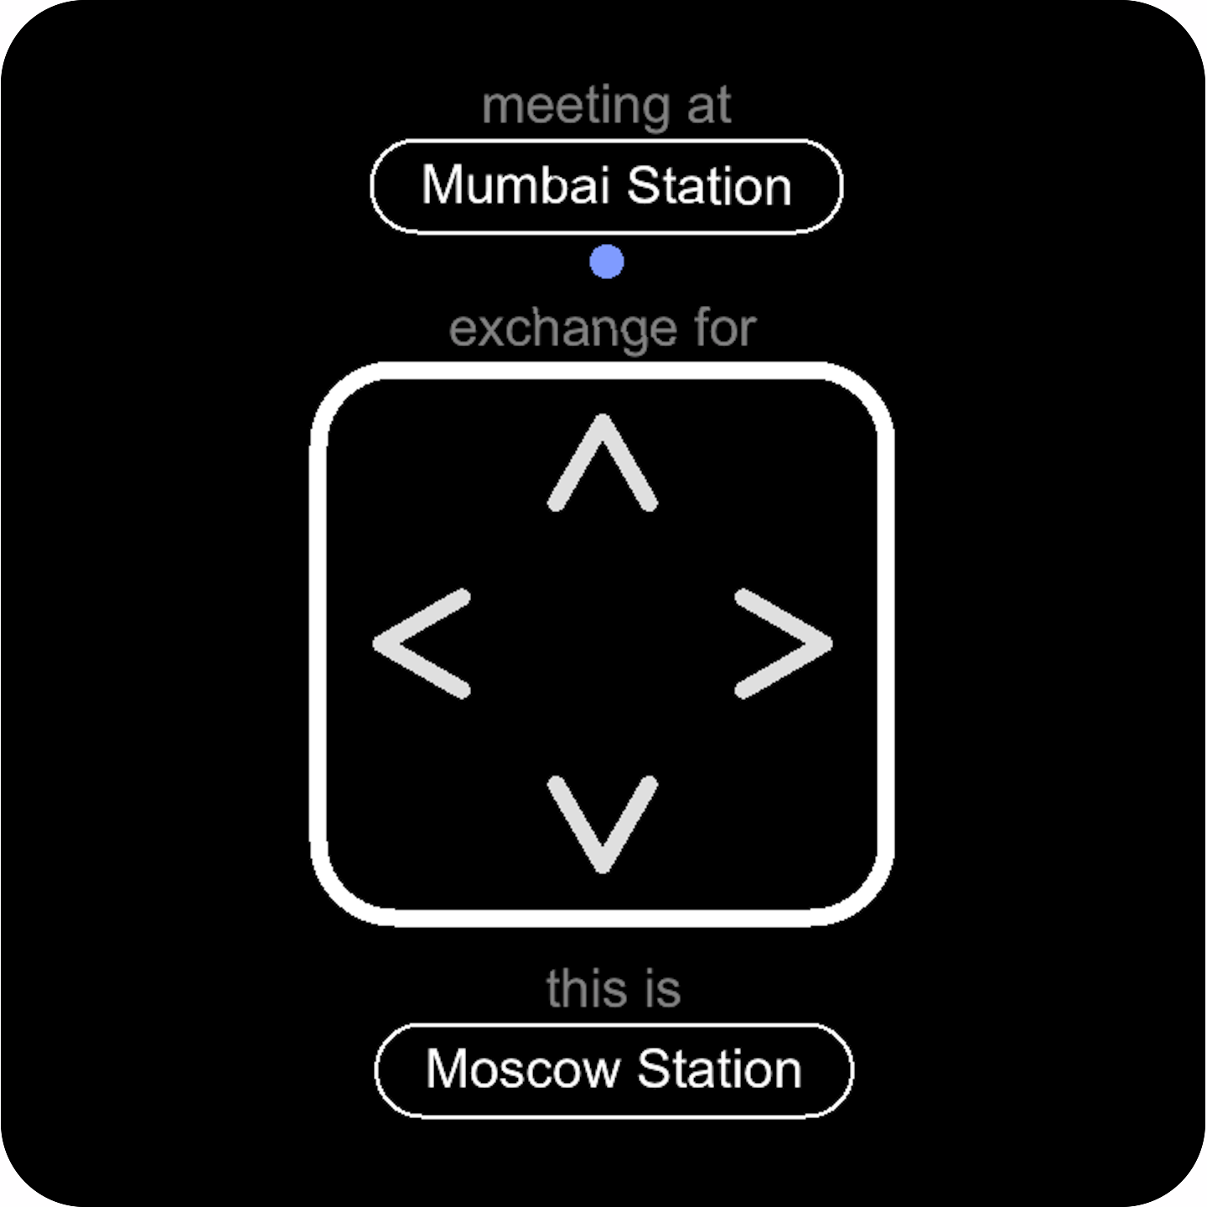
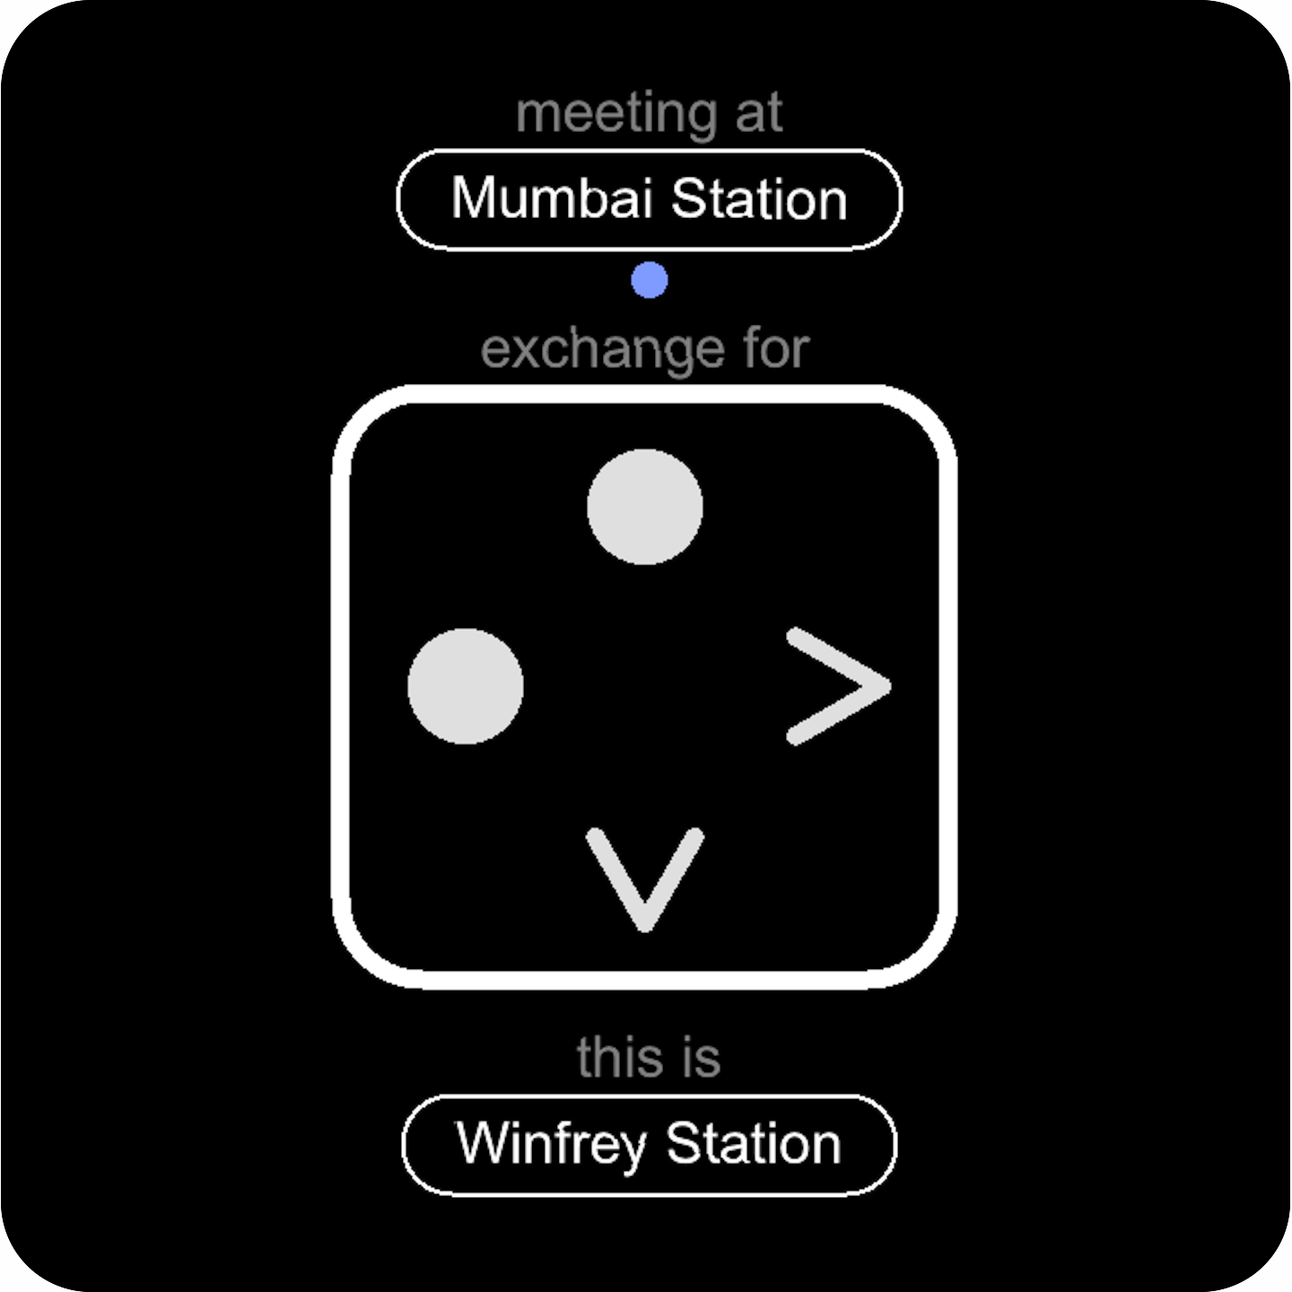
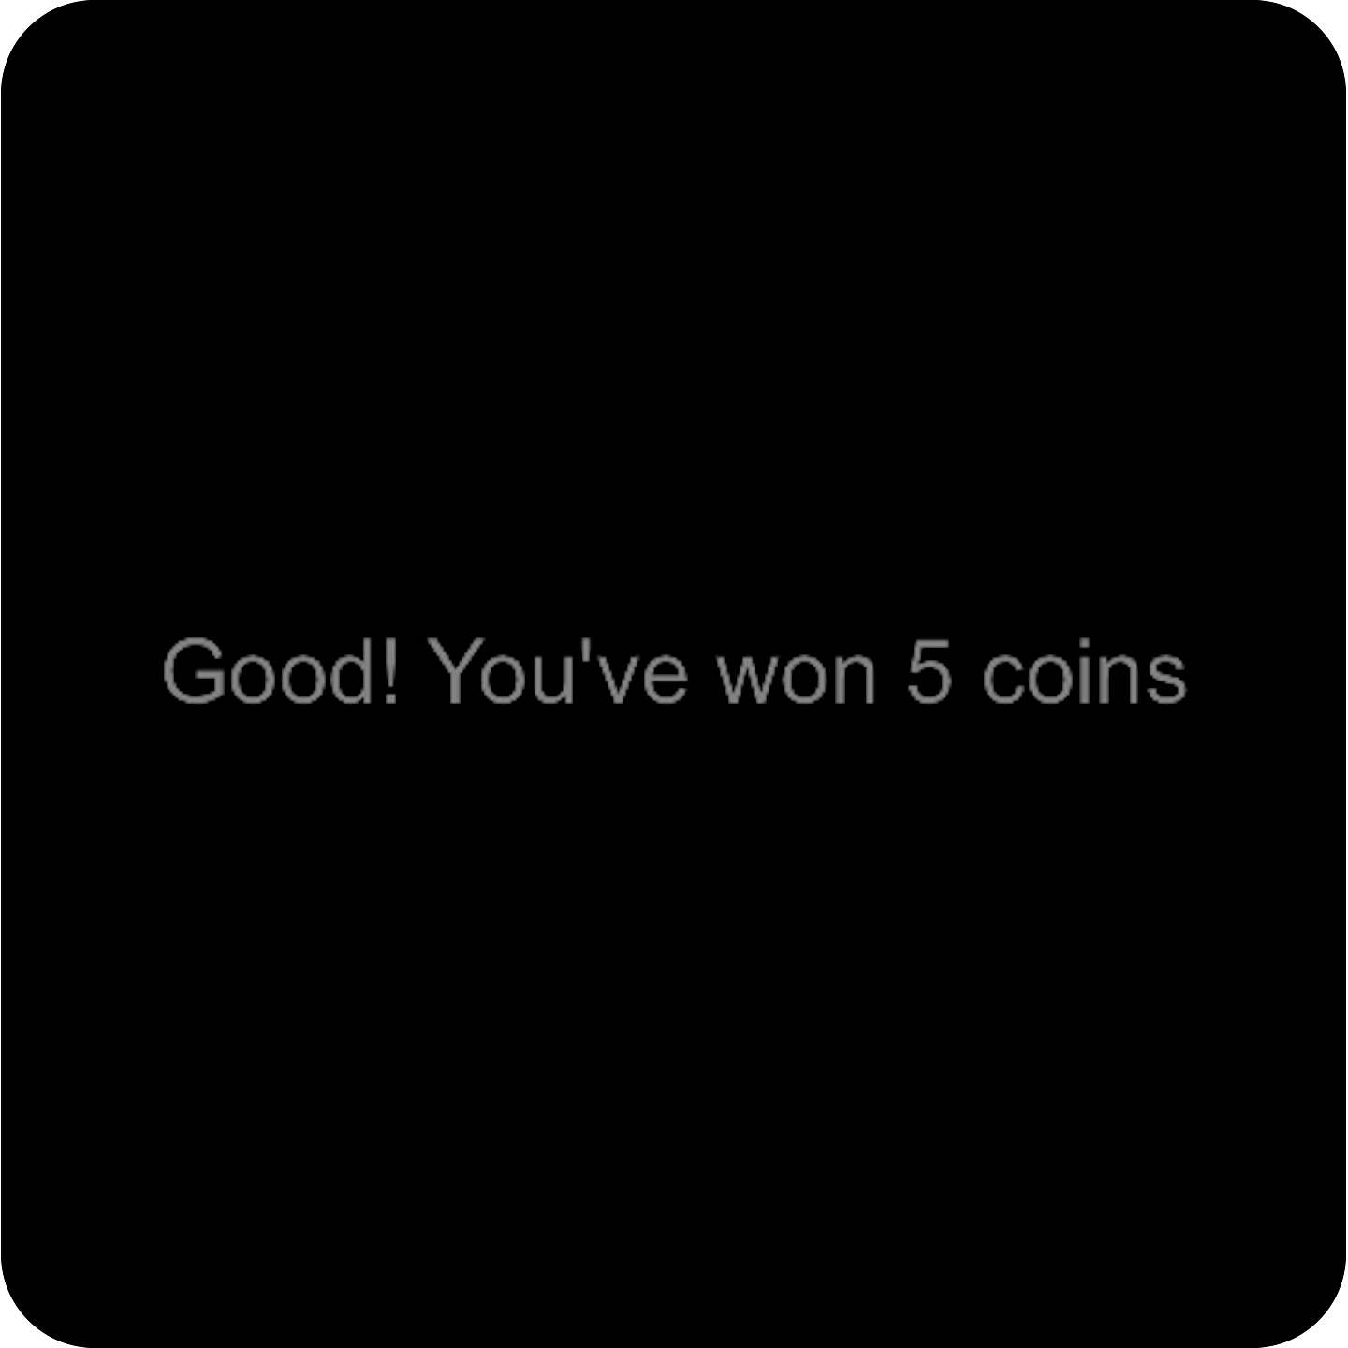
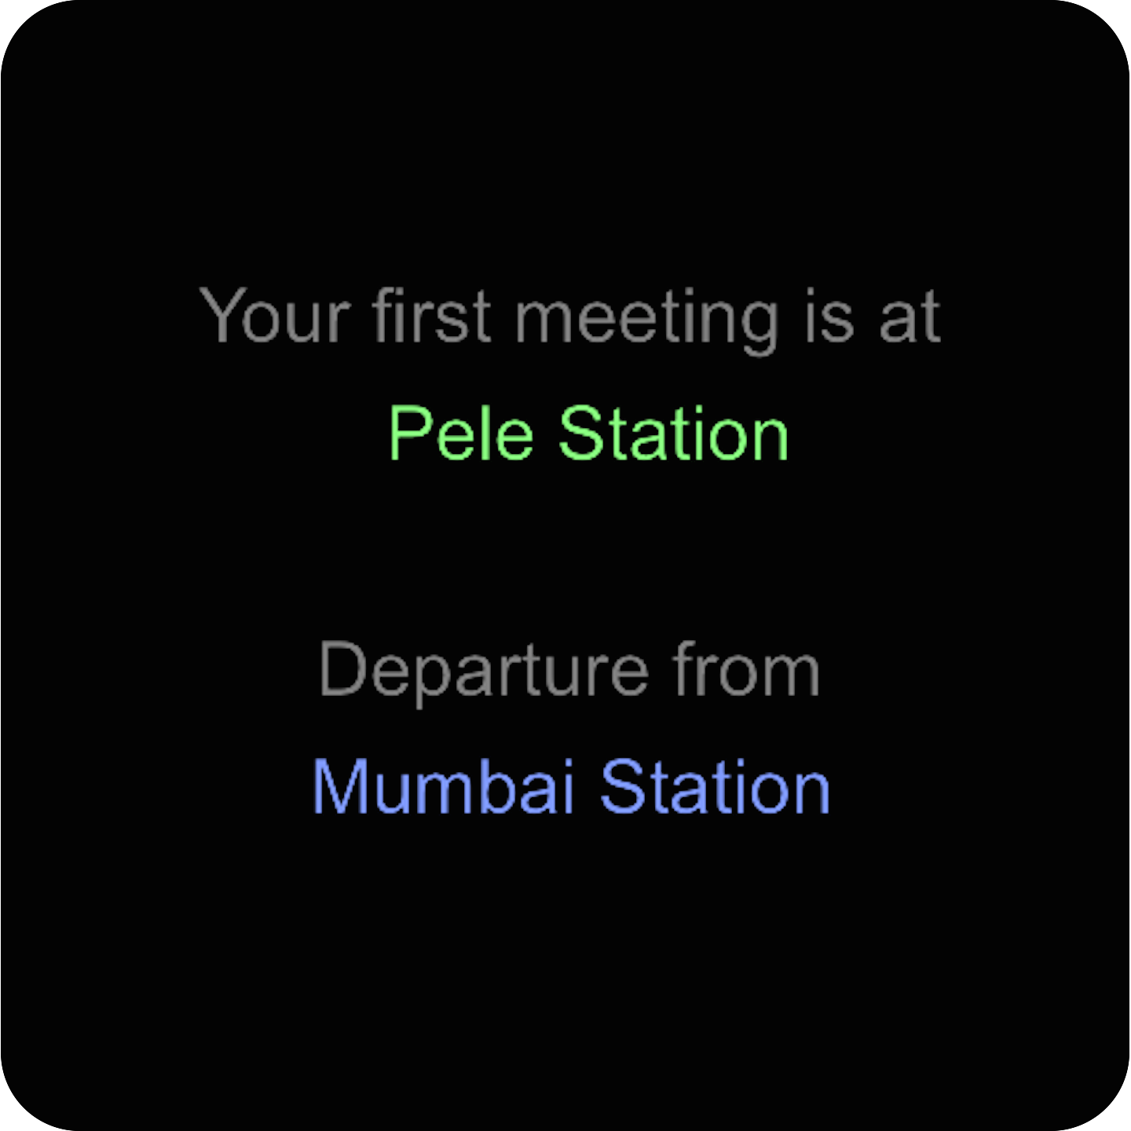
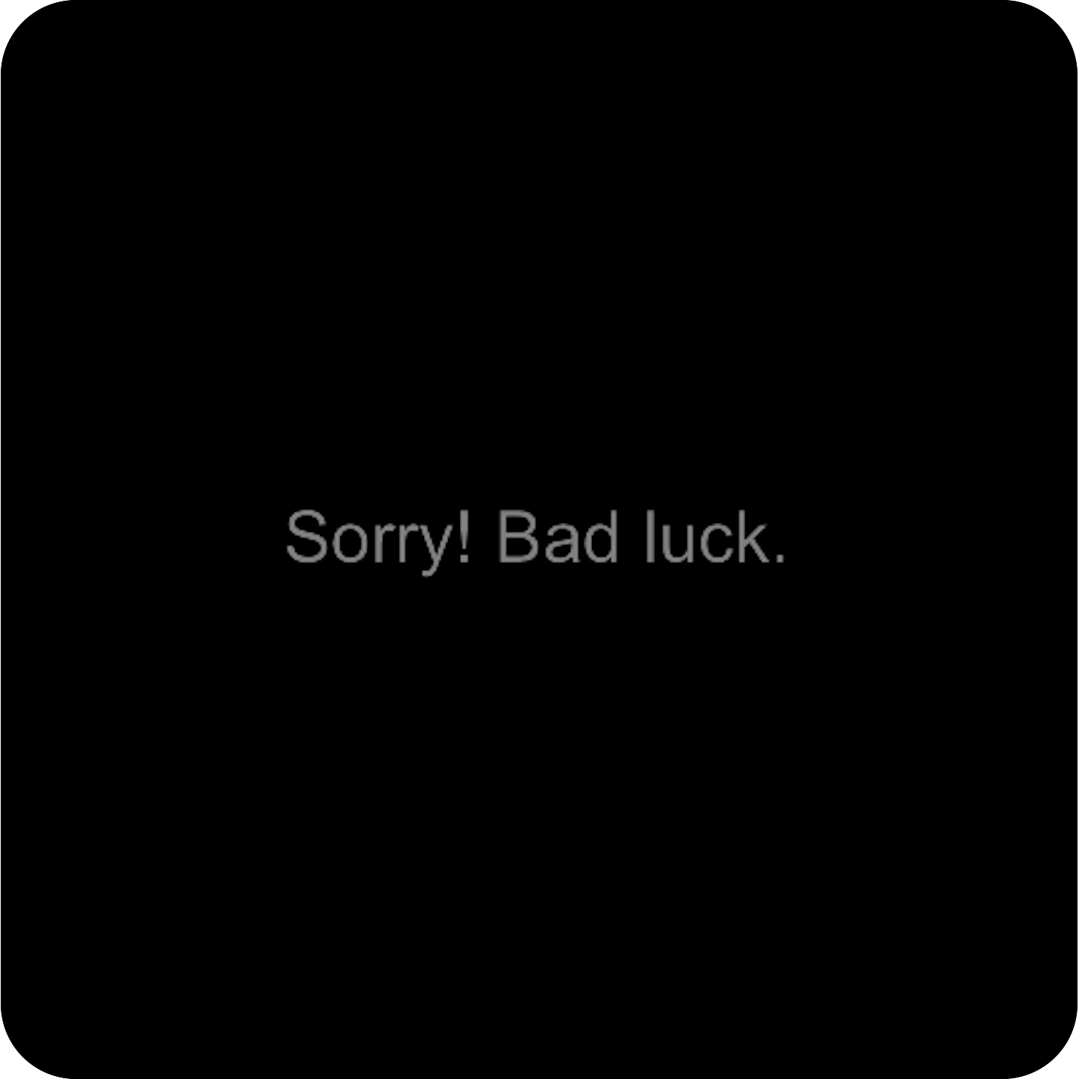
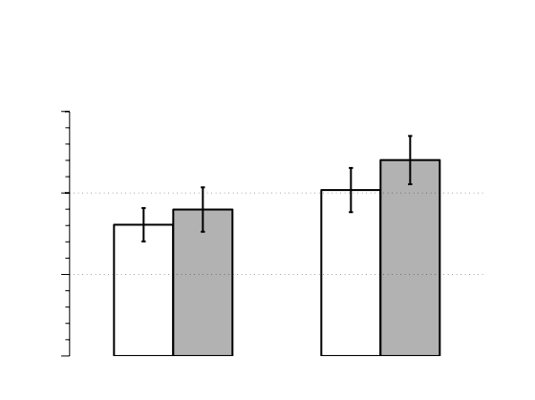
A
3 ± 3.5
3 ± 2
3 ± 2
3 ± 2
2 ± 3.5
3 ± 3.5
time (seconds)
…
yellow line
blue line
50% journeys cancelled
B
1200
1000
Reaction time (ms)
800
600
Regular
Exchange
Elbow
Exchange
Stay
Switch
Exchange

