Slide 1
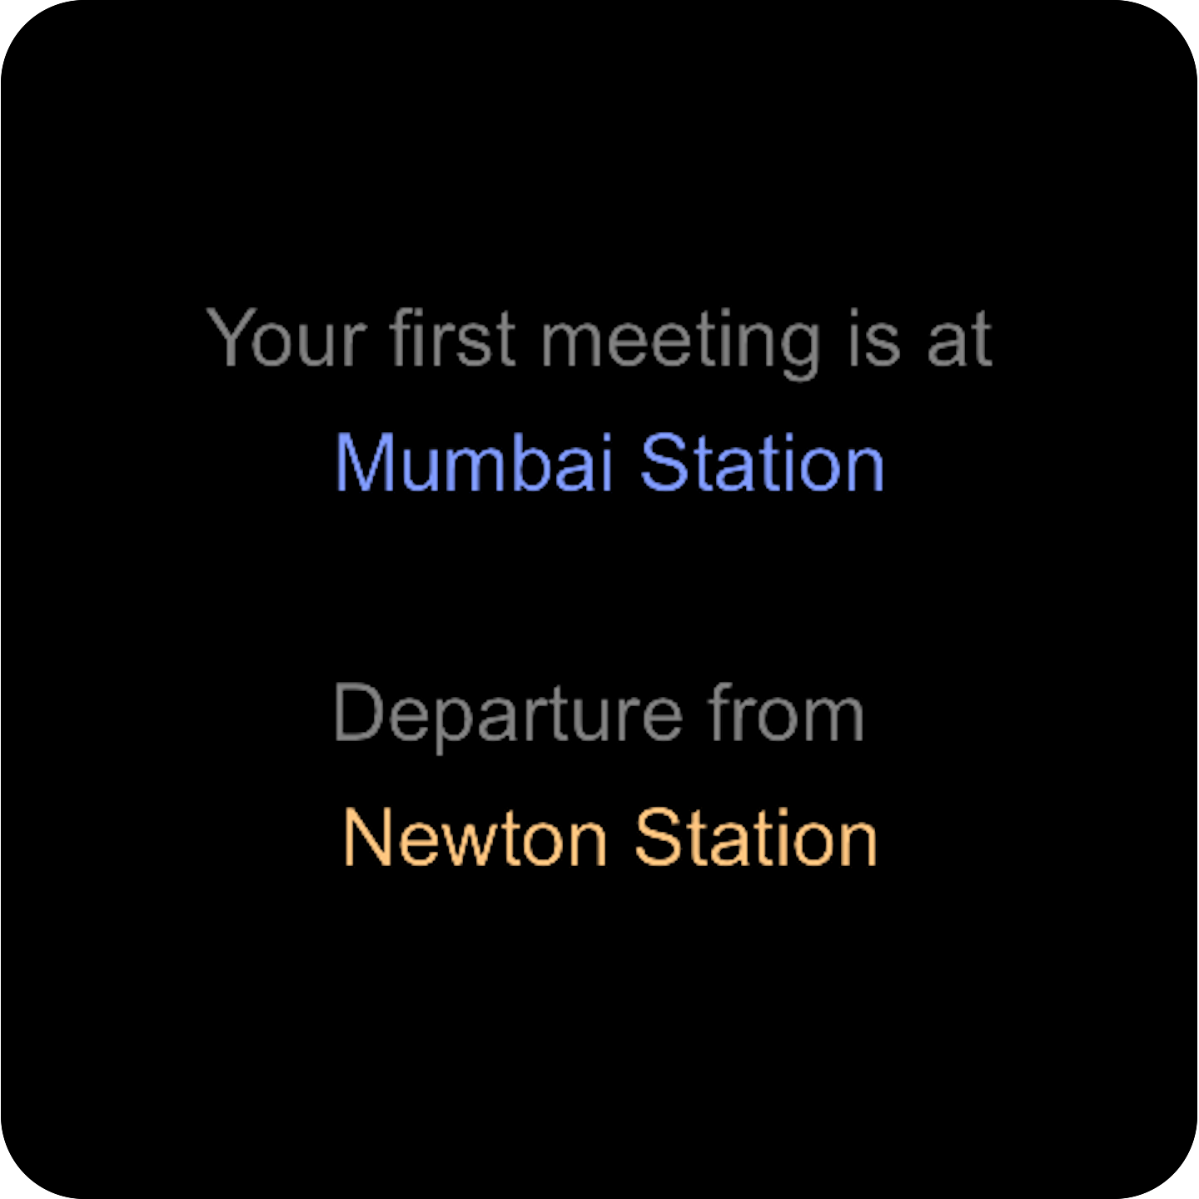
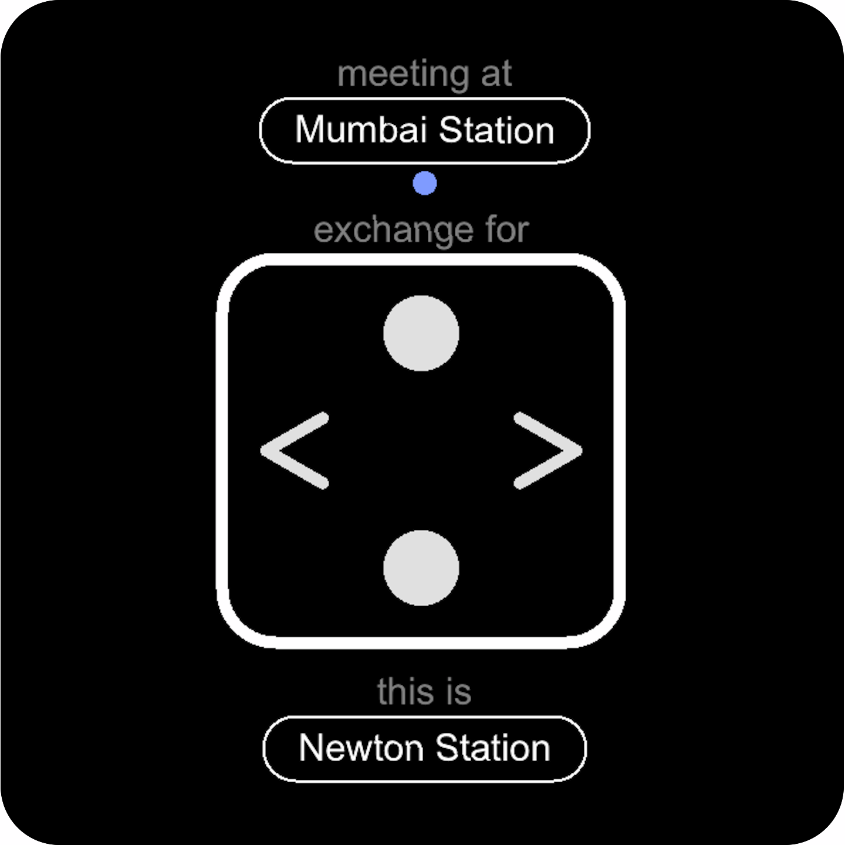
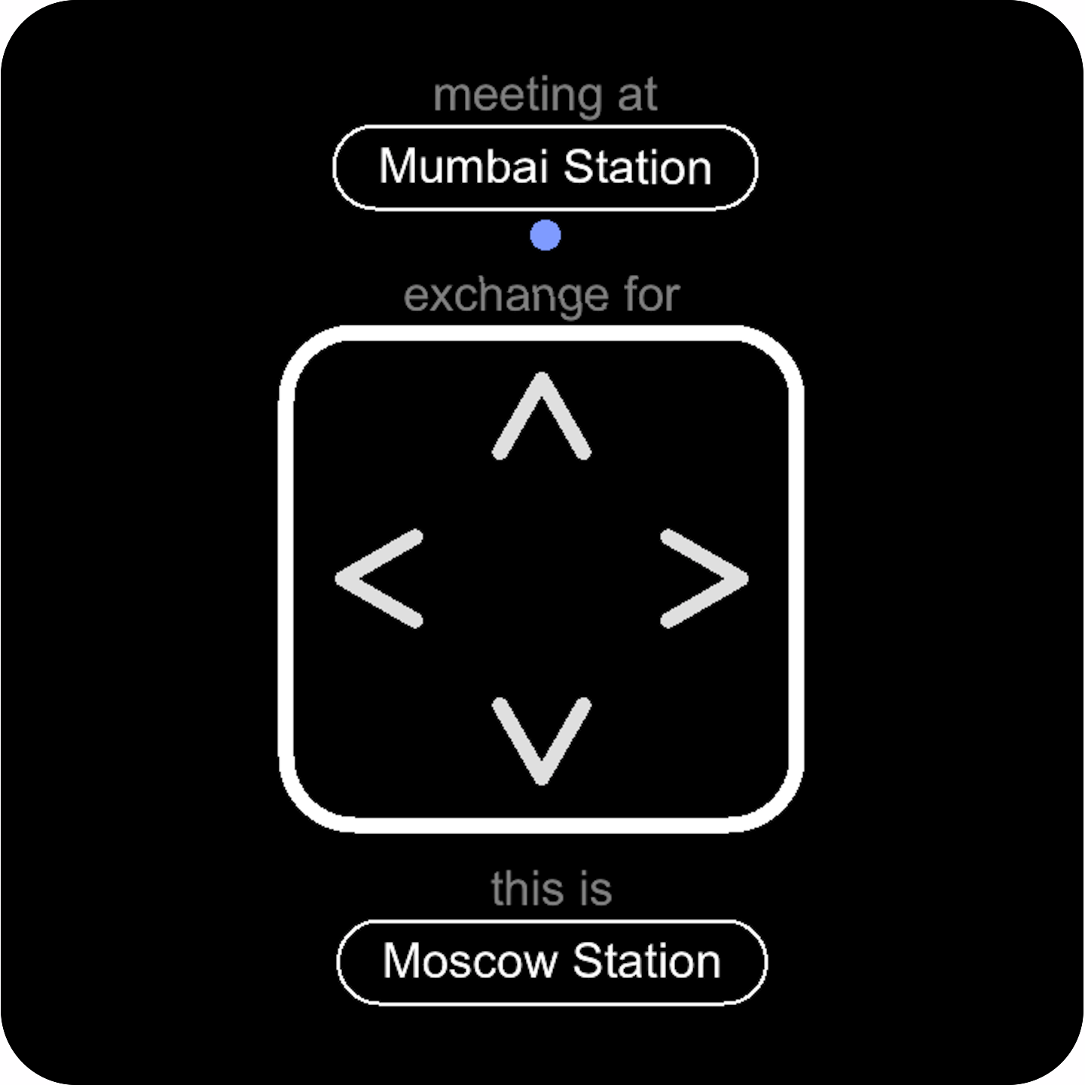
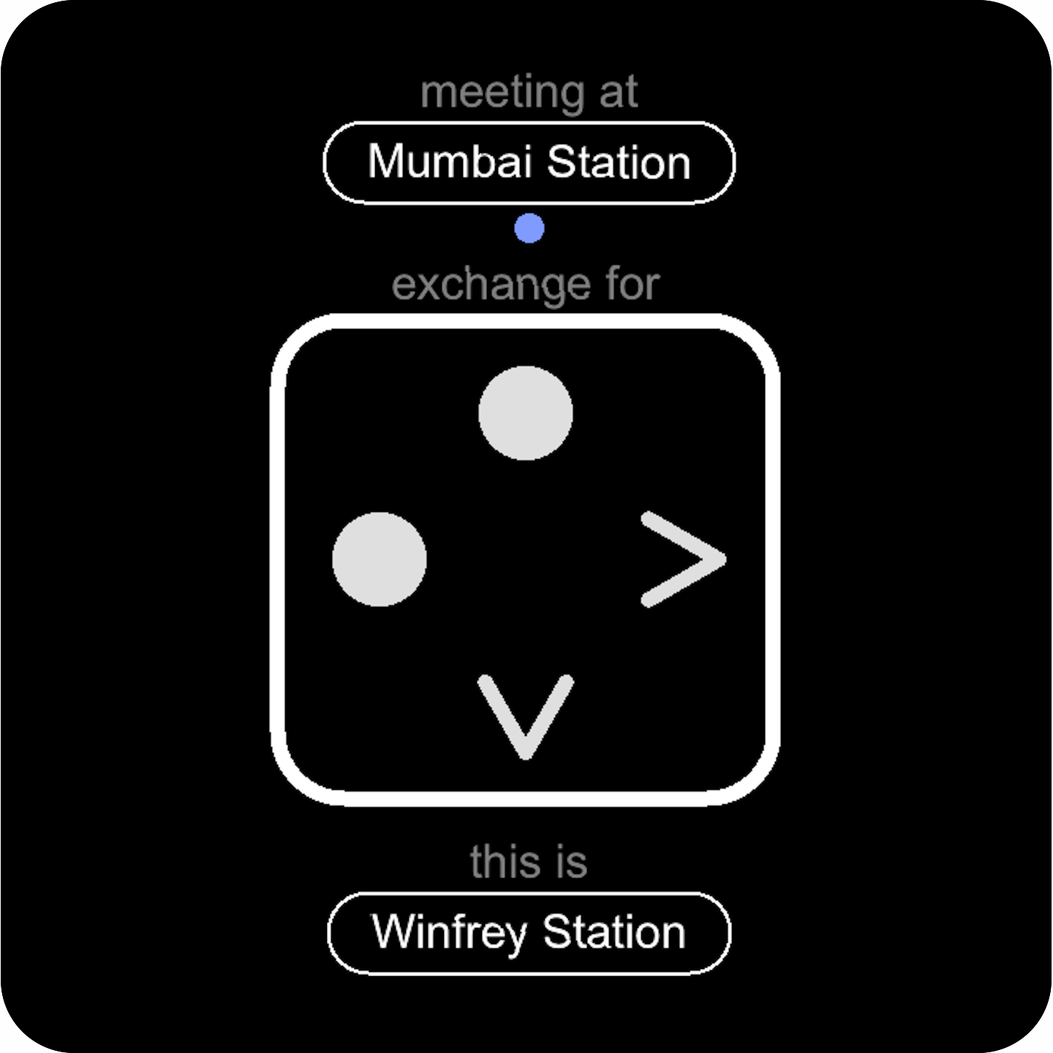
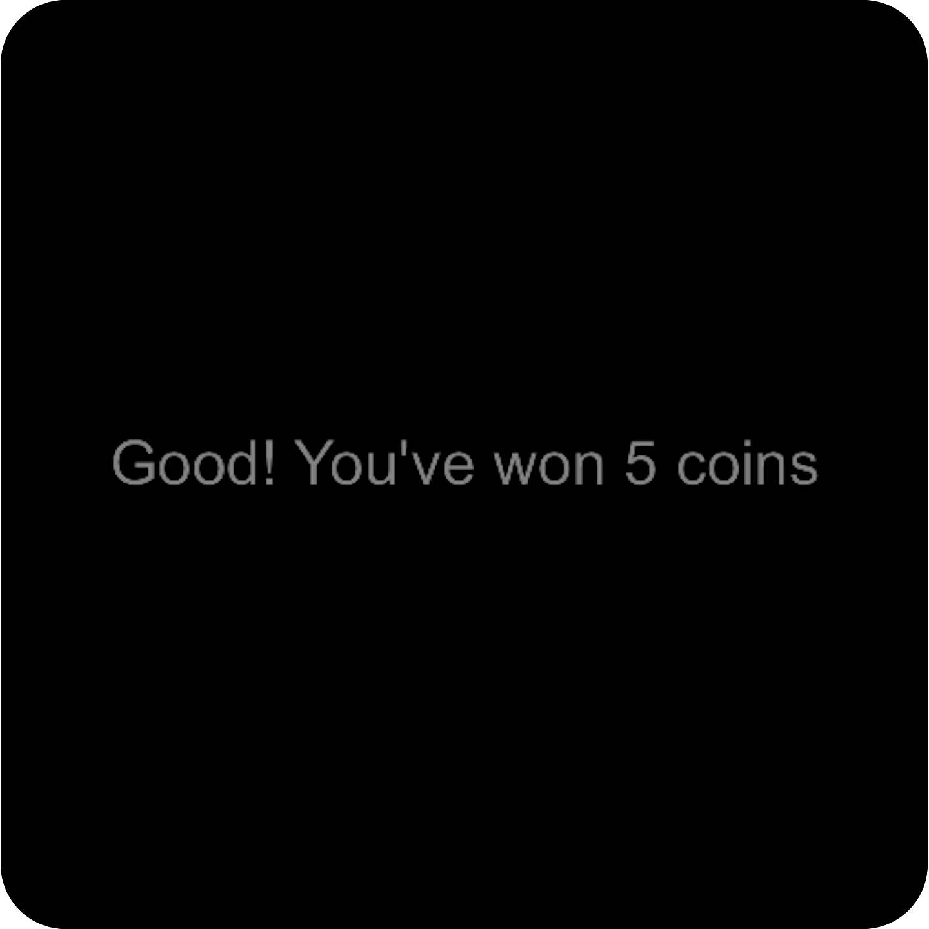
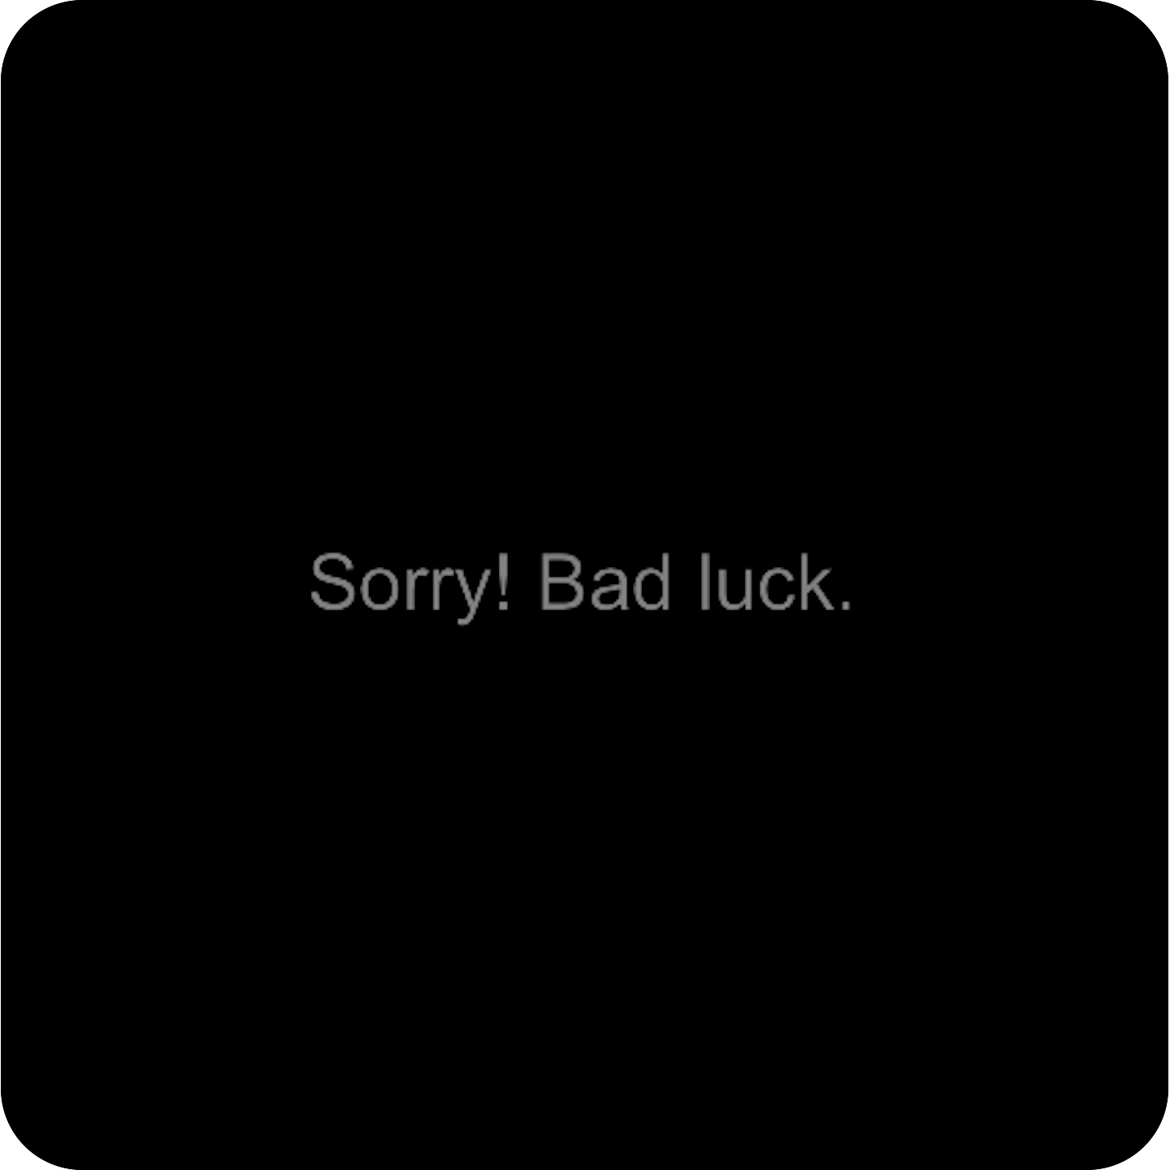
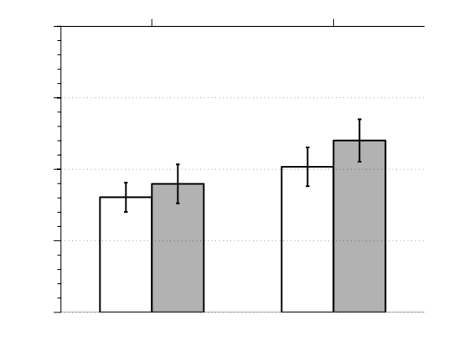
A
3 ± 3.5
3 ± 2
3 ± 2
3 ± 2
2 ± 3.5
time (seconds)
yellow line
blue line
around 50% journeys cancelled
B
Regular
Exchange
Elbow
Exchange
Stay
Switch
Exchange

