Slide 1
Subway
2014/09/04

Slide 2
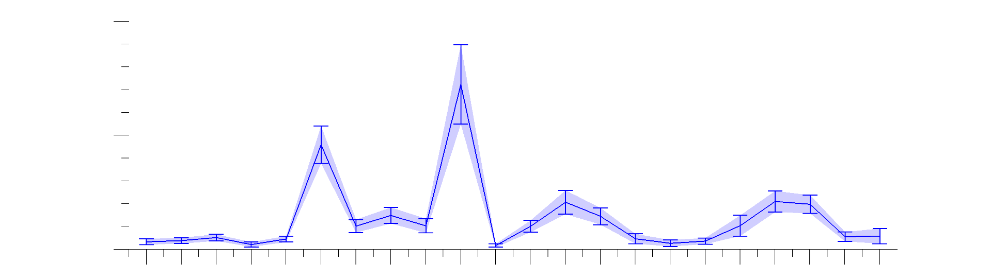
Participants
22 Participants, but :
¬ 3 participants only had 3 sessions of 15 minutes (instead of 4).
¬ Two participants, with 4 blocks, have poor performance.
¬ The graph below shows how much longer participants took to complete journeys, compared to optimal.
Double length 2.00
1.50
Optimal length 1.00
Participants

Slide 3
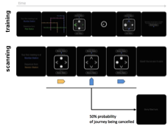
Design

Slide 4
Design
Problems with the design :
¬ It would have been better not to show all the lines in exchange stations (as they give a different perception).
¬ One (over 4) of the exchange stations has only 3 options.
¬ 90% of the journeys require changing lines, while 10% don't. This was an error in the implementation, as the intention was to have 50% and 50% to decorrelate elbow stations from changing lines Sorry! 😐
However, it turns up that elbow stations were used in both kinds of block, and since half of the blocks were cancelled, not the 90% of the blocks reached the subgoal. (That was lucky!).
In total, then : 53% of the blocks involve at least an elbow station
81% an exchange station
66% a line change

Slide 5
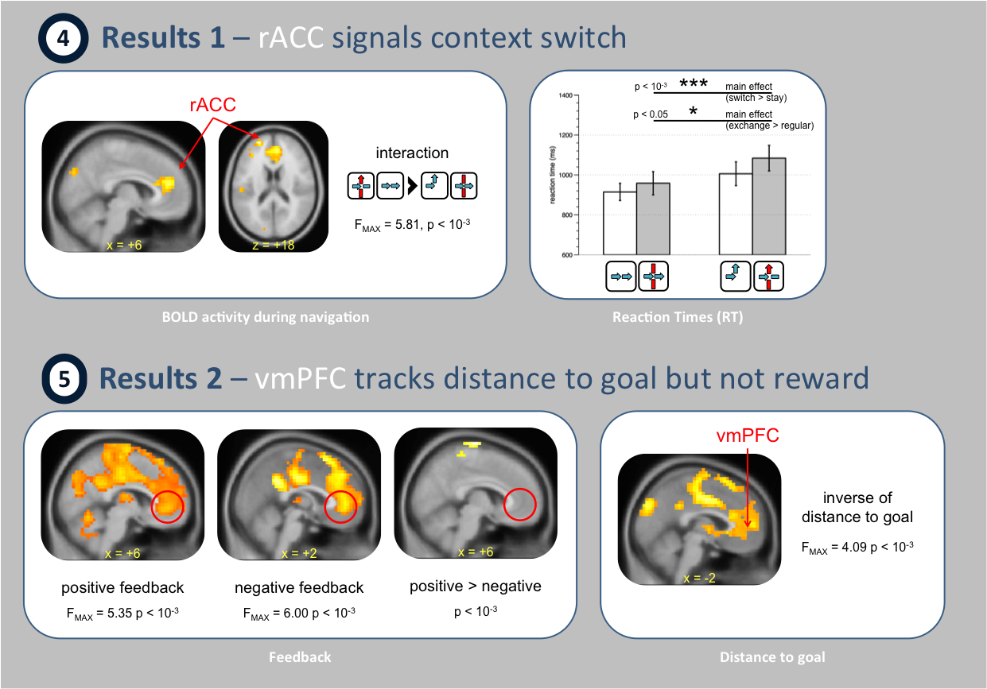
Initial Results

Slide 6
Initial Results
What has changed since then :
Improvements (Good!)
¬ We tried improving pre-processing, with no or little effect.
¬ Now we're pooling the data.
This is supposed to increase statistical power.
¬ Most regressors have been recalculated, mainly because the previous data was getting messy.
¬ The current code to run SPM is slightly more flexible, but based on the initial code for subway. The GLM and stats don't change.
It's also the one Keno is also using to analyse Boring.

Slide 7
Initial Results
What has changed since then :
Results (Bad)
After adding improvements (all at once) some effects disappeared:
¬ weaker or no activation in X*S (which was supposed to reflect C)
¬ activation found in mPFC when reaching the goal
(we didn't see this before).
¬ I haven't had a chance to look at distance to subgoal yet.
Results (Good)
¬ Distance to goal is still present and looks pretty similar.
Moreover, the statistics within the "vmPFC" has improved (now 5.28)

Slide 8
Complications
I think Subway has a much more complicated design than first thought.
There are many reasons why this getting much more complicated, both in analysis and interpretation, than other experiments. Boring doesn't have many of these problems, which makes it a better design (even though it can't address as many questions).
Say you want to look at the effect in a particular kind of station. There will be noise driven by:
Navigation:
¬ Going backwards, and/or revisit the same station
¬ Two kinds of journey (within or between lines)
¬ Sequential effects in response (minority of switches S)
¬ Probability of a journey being cancelled
Map:
¬ Face/Place stations
¬ Any effects due to memory
Motivation:
¬ Two kinds of stake
¬ Cumulative reward (also in boring)

Slide 9
New results
GLM :
Sessions merged within participants
Regressors :
¬ Cue (beginning of the block)
¬ Trial Hard (block between lines)
modulation: X, S, X*S, inv(dist_to_goal)
¬ Trial Easy (block within a line)
modulation: X, S, inv(dist_to_goal)
¬ Feedback (end of block)

Slide 10
New results
GLM :
Sessions merged within participants
Regressors :
¬ Cue (beginning of the block)
modulation: easy_vs_hard (from a different regression)
¬ Trial Hard (block between lines)
modulation: X, S, X*S, inv(dist_to_goal)
¬ Trial Easy (block within a line)
modulation: X, S, inv(dist_to_goal)
¬ Feedback (end of block)
modulation: goal_reached

Slide 11
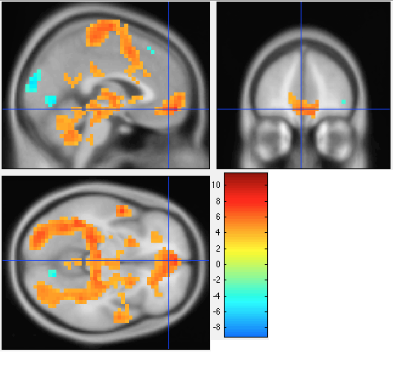
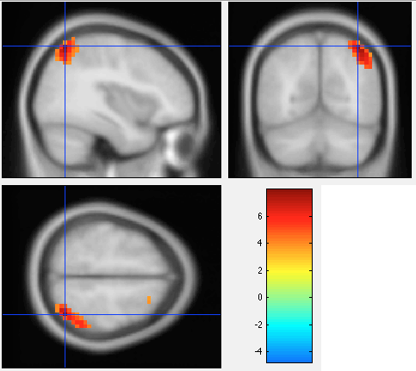
New results
Results : Cue : Onset :
Results : Cue : Easy vs Hard :
vmPFC
occipital
motor
cuneus
temporal
right angular gyrus +7.90
and no vmPFC activity

Slide 12
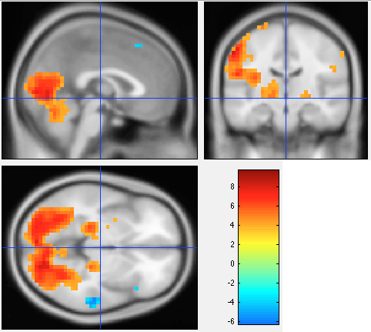
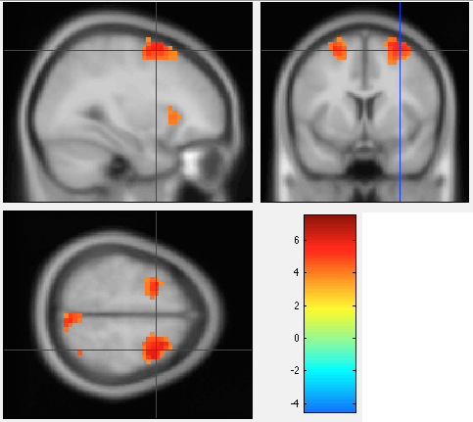
New results
Results : Hard : Onset :
Results : Hard : Exchange :
occipital +9.69
left motor +7.94
right temporal +5.72
and hippocampus + 7.90
and (pre)cuneus +5.34
and left occipital +7.43

Slide 13
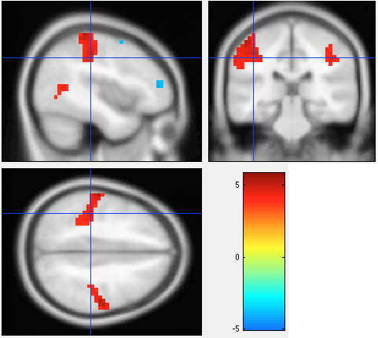
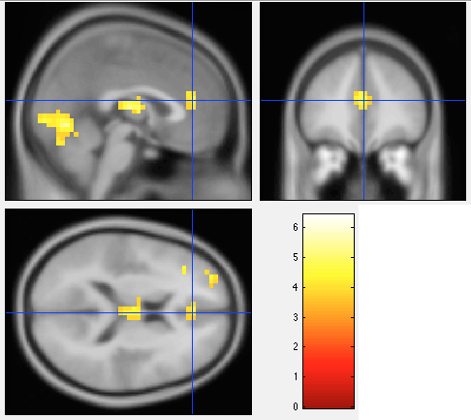
New results
Results : Hard : Switch:
Results : Hard : X*S :
motor +5.80
and SMA -4.97
and dlPFC -4.82
rACC +5.34
cerebellum +6.43
~thalamus +5.26

Slide 14
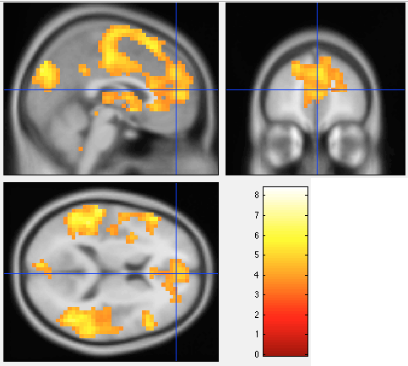
New results
Results : Hard : Distance to goal:
mPFC +5.28
(pre)SMA +6.12
cuneus +6.45
temporal +6.81
thalamus +4.47
and amygdala + 5.39
and right precentral +8.40

Slide 15
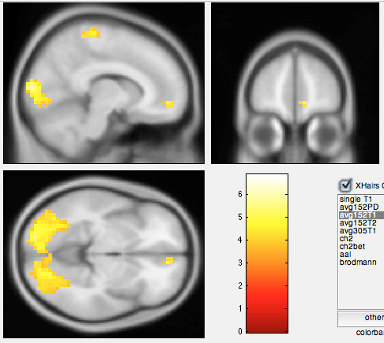
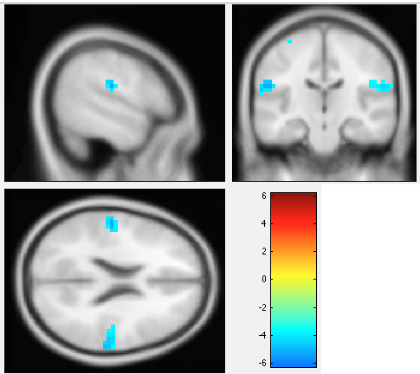
New results
Results : Easy : Onset :
Results : Easy : Exchange :
mPFC +4.58
occipital +6.81
precentral +6.70
and left insula +6.15
~supramarginal -5.24
and precuneus +6.12
and motor +5.57
and right fusiform -6.19

Slide 16
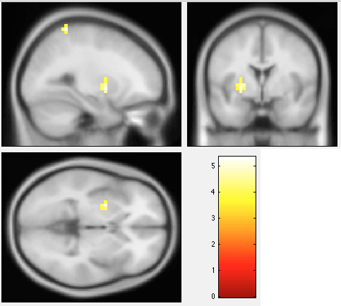
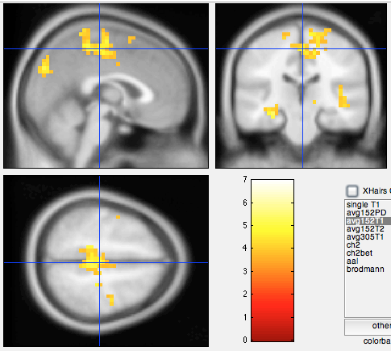
New results
Results : Easy : Switch :
Results : Easy : Distance goal :
left putamen +5.35
left parietal +5.24
left hippocampus +5.28
SMA +5.14
cuneus +5.39
temporal +5.91

Slide 17
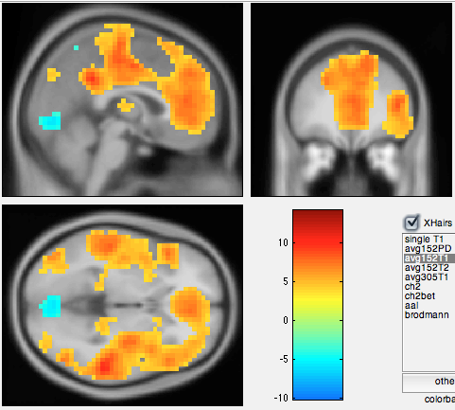
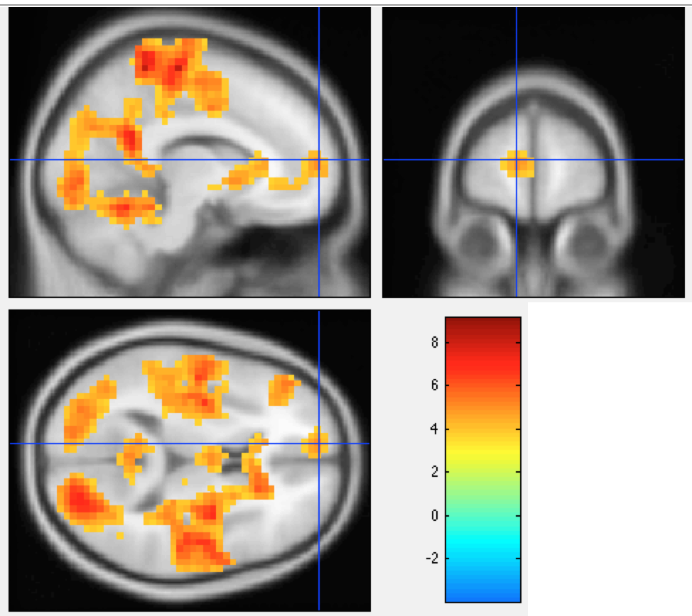
New results
Results : Feedback : Onset :
Results : Feedback : Goal :
calcarine/lingual -7.38
temporal +10.64
mPFC +7.36
PCC +9.29
and ...
~mPFC +4.92
motor +8.02

Slide 18
Notation
Stations:
R regular station
X exchange station
L elbow station
Response:
S switching action (in opposition to going straight)
C change line (i.e. «X & S»)
I exchange and no change line (i.e. «X & ~S»)
Exceptions:
O null action (staying in the same station)
B going backwards

