Slide 1
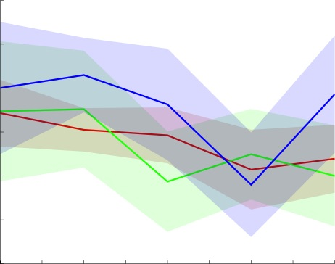
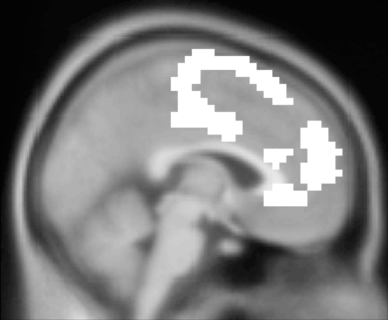
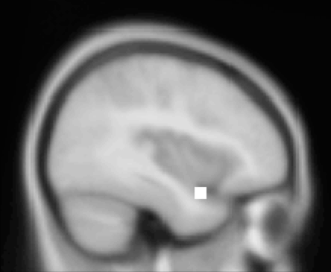
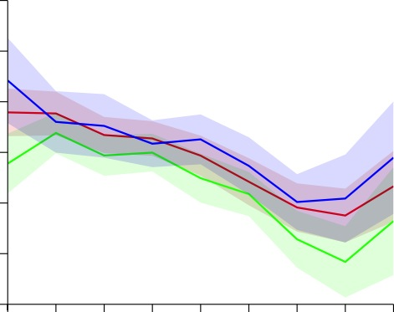
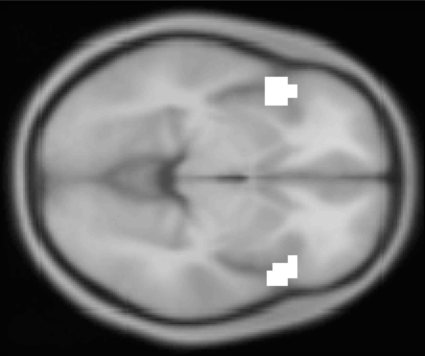
+2
medial PFC
+1
left temporal pole
beta (easy)
inferior frontal gyrus
0
+2
+1
beta (hard)
0
-1
1
2
3
4
5
6
7
8
9
Distance to goal
(functional masks)

Slide 2
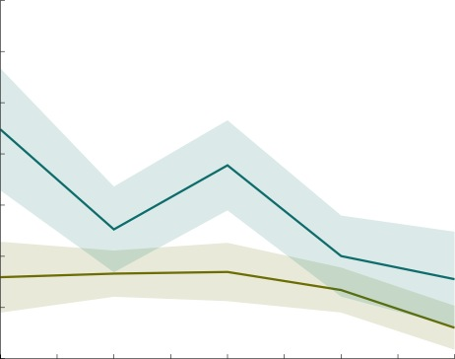
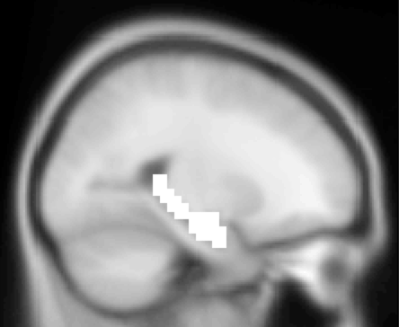
+1.4
easy
hard
+1
beta
left hippocampus
(anatomical mask)
0
1
2
3
4
5
Distance to goal

Slide 3
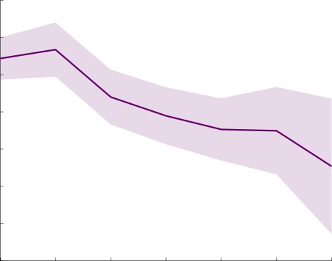
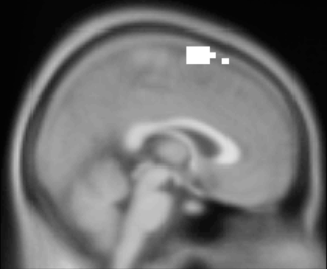
+2
Supp Motor Area
+1
0
beta (hard)
-1
(functional mask)
0
1
2
3
4
5
6
distance to sub-goal

