Slide 1
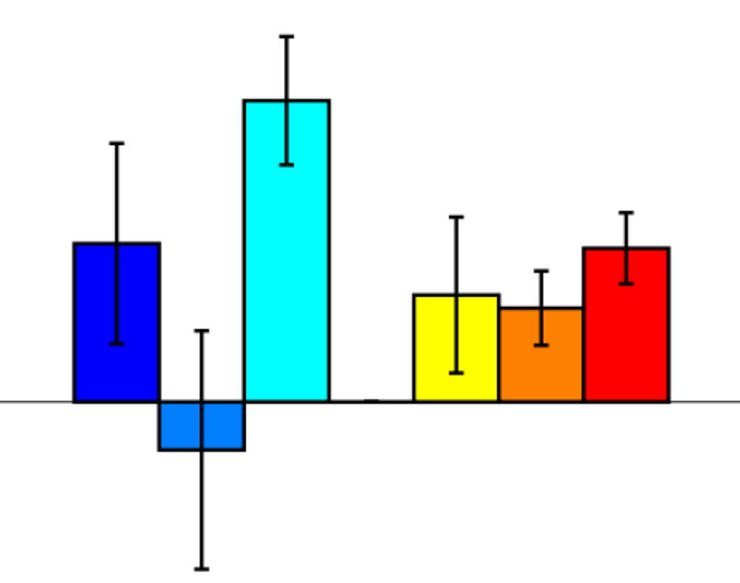
EASY &
DIFF LINE
Time “T-1”
EASY &
SAME LINE
HARD &
DIFF LINES
HARD
HARD &
SAME LINES
EASY
Time “T”
EASY
HARD

