Slide 1

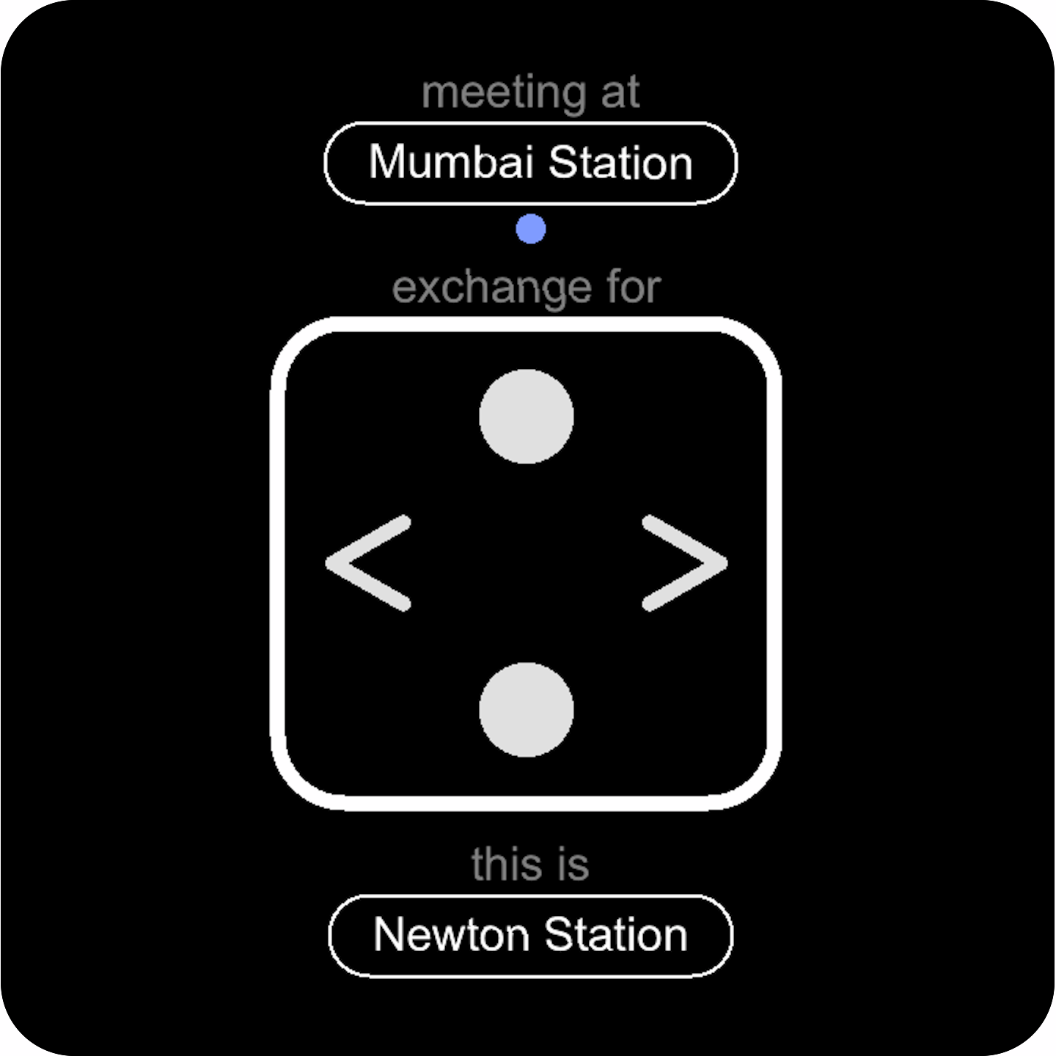
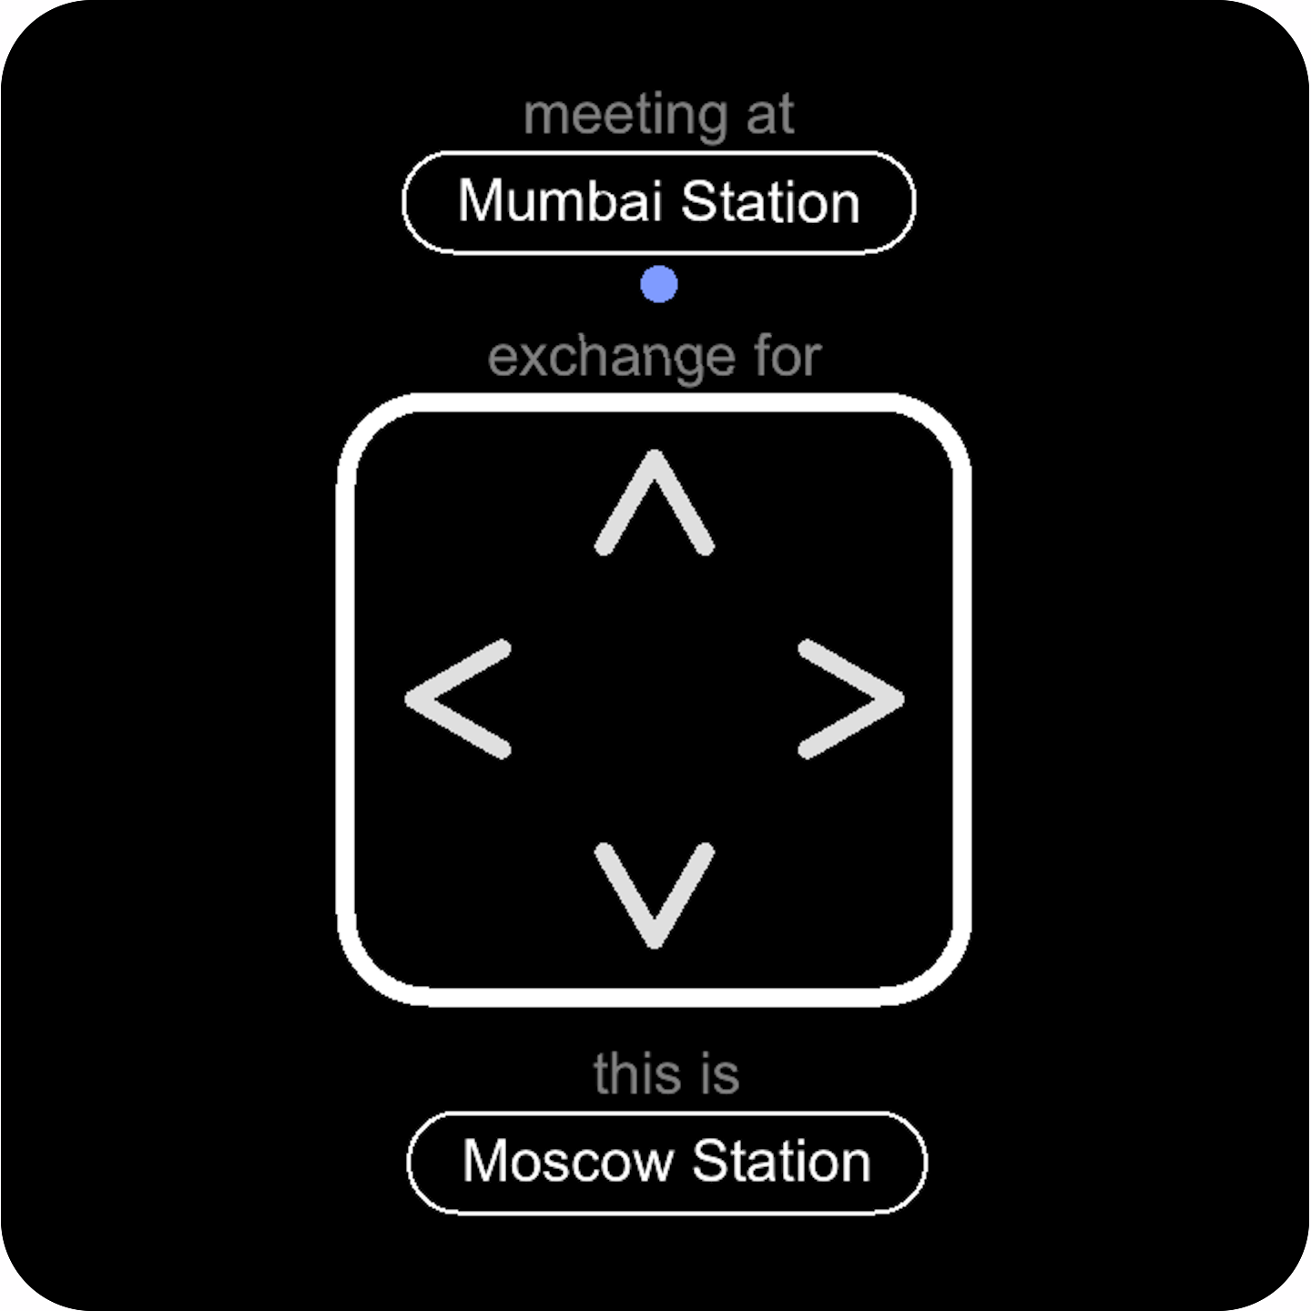
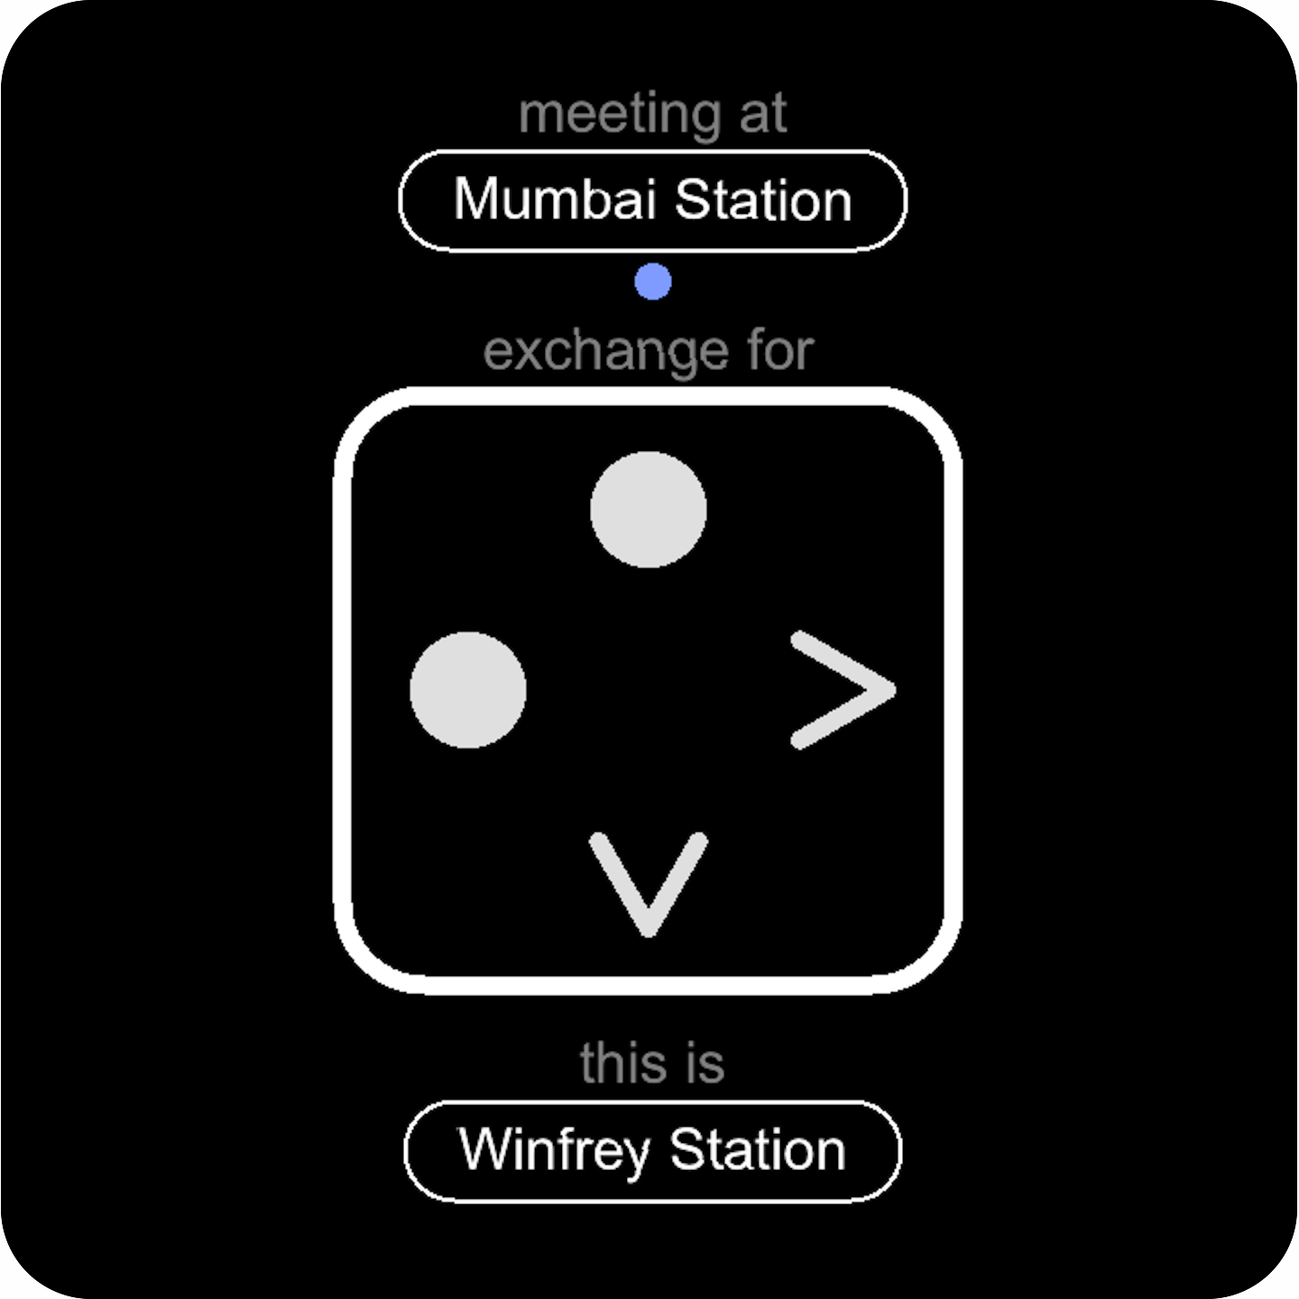

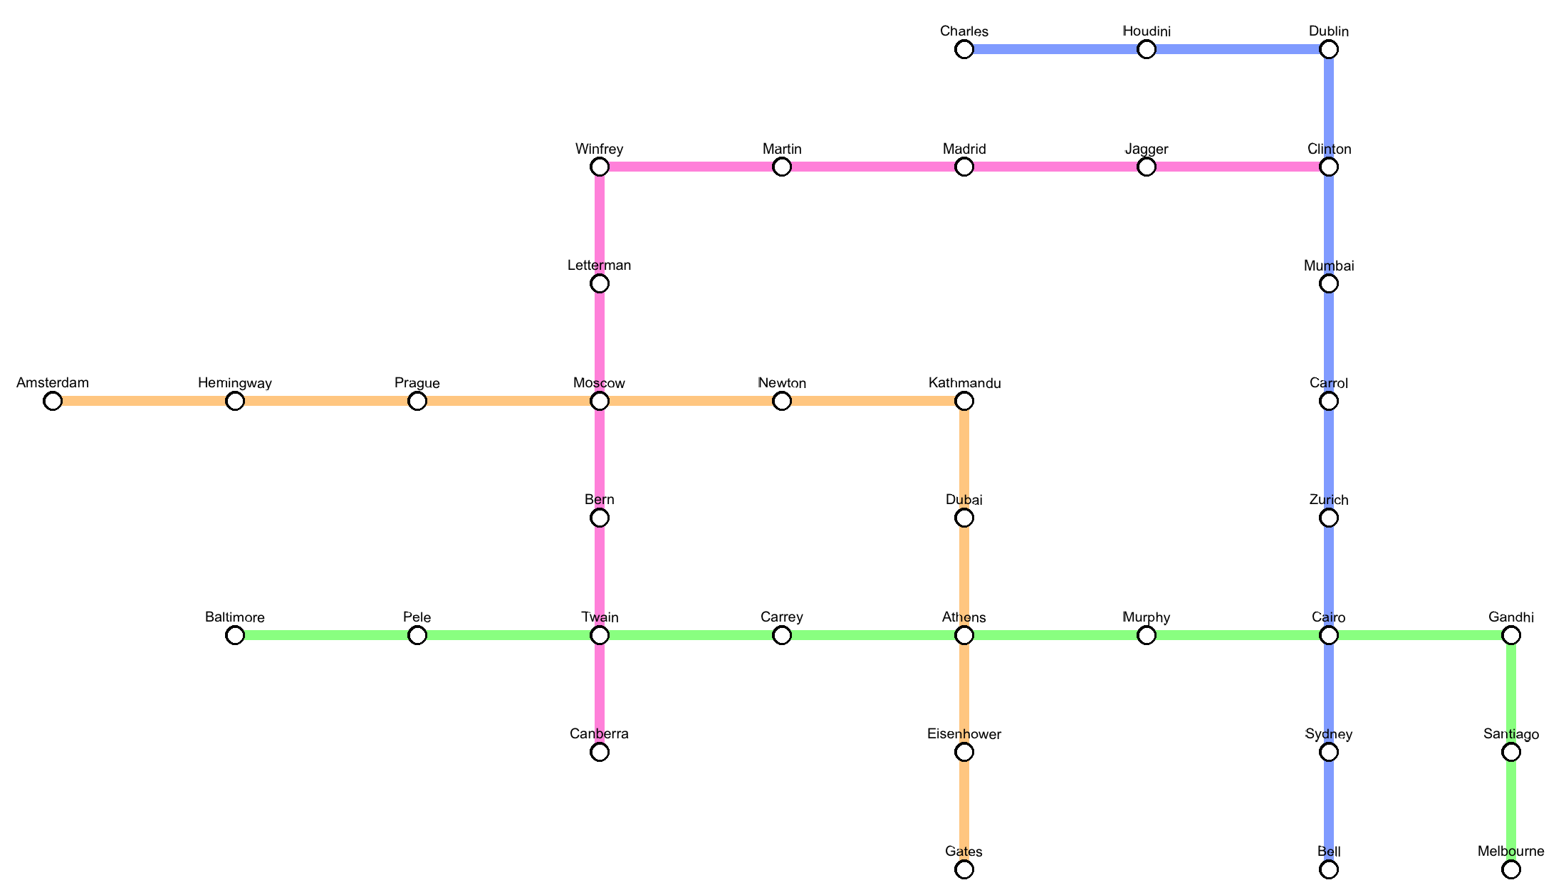

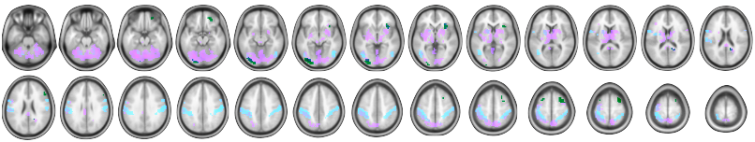
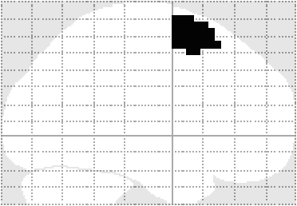
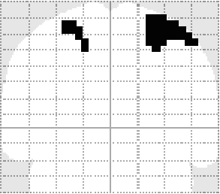
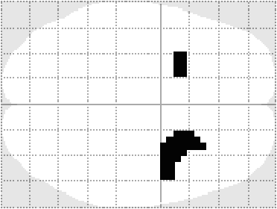
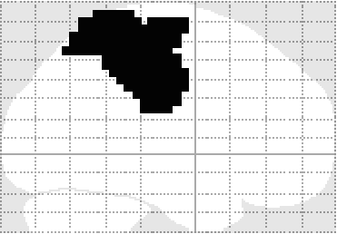
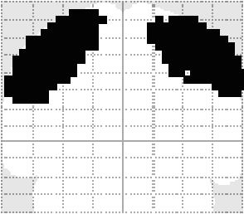
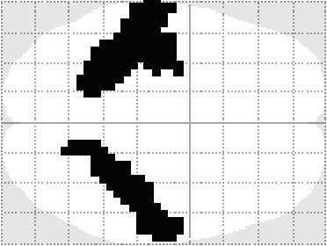
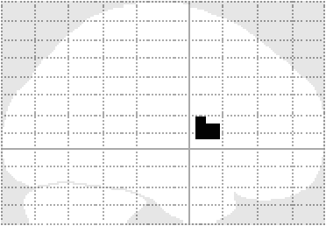
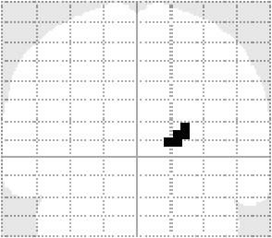
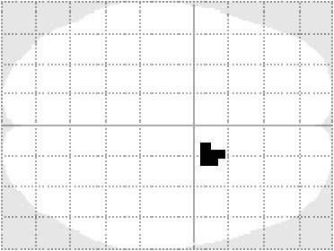

hierarchical planning during navigation
¹ Jan Balaguer, ² Demis Hassabis, ² Hugo Spiers, ¹ Chris Summerfield
¹ University of Oxford
² University College London
juan.delojobalaguer@psy.ox.ac.uk
Introduction
Task design
Hierarchical representations alleviate the complexity of planning over multiple states. Using fMRI, we looked for the neural correlates of subgoal states (e.g. line changes) within a navigation task. 20 healthy participants planned their way within a virtual underground network they had previously been familiarised with.
3 ± 3.5
3 ± 2
3 ± 2
3 ± 2
2 ± 3.5
time (secs)
Main effects
50% probability
of journey being cancelled
Reaction times
***
1200
slow-down before
line change
speed-up
after line change
exchange station :
>
1100
**
>
1000
response switch :
Reaction times (ms)
*
line change :
>
900
800
PPI analysis
700
?
mask
ROI analysis
Steps around each condition
dlPFC
IPL
caudate
** *
**
dorsolateral prefrontal
**
dlPFC
**
β (a.u.)
seed
IPL
*
**
*
*
0
*
**
**
**
inferior parietal lobule
*** ** **
caudate
**
Conclusions
β (a.u.)
We have found unique signatures of a hierarchical representations in the brain while performing a navigation task. Specifically:
IPL signals a switch of response.
dlPFC signals exchange stations, but predicts the line change in advance
caudate combines information from these two regions in order to change lines
these regions are functionally connected during a line change (PPI analysis).
0
right caudate
*
*
β (a.u.)
0
?
Steps around each condition

