Slide 1
Git Fundamentals

Slide 2
Why would I use Git?
I actually thought the same thing.
Consider a small programming project, such as a web application.
  General development workflow?
  Collaborating with a friend?
  Testing features?

Slide 3

Common Approach
What might be an issue of doing it this way, even if it works?
Learning the basics of Git can help you a lot.

Slide 4
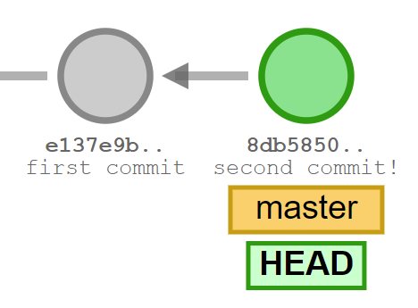
Understanding Git - Commits
In its simplest form, Git is a content tracker.
GitHub, GitLab etc. themselves are not Git. You can think of them as fancy service wrappers around it.
By executing a commit, you create a new blob (file content as binary) and a SHA1 hash as a reference.
This also has a reference to the parent blob.

Slide 5
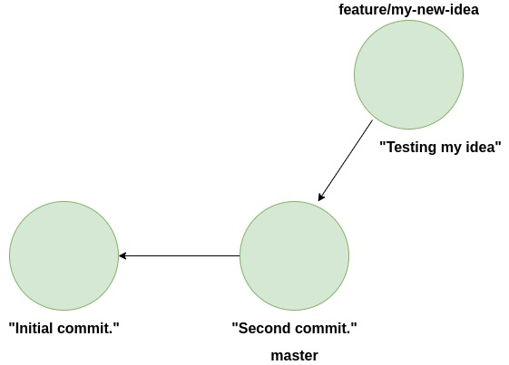
Understanding Git - Branching
Branching lets you make changes without affecting your current work.
Think of branching as switching to another workspace, these changes don’t affect other work until you explicitly allow them to.

Slide 6
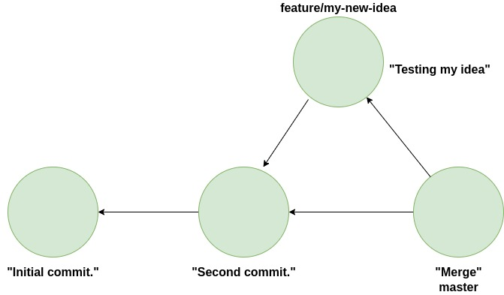
Understanding Git - Merging

