Slide 1
Git Fundamentals

Slide 2
What is Git?
You’ll commonly see it referred to as a distributed version control system. What actually is that?
  Distributed: A system that is distributed will have components run on separate computers, typically over a network.
  Version Control System: Think v1, v2 etc.
Git is distributed as it allows every user to make local changes, before sending them to a remote server.
In its simplest form, Git is a content tracker.
GitHub, GitLab etc. themselves are not Git. You can think of them as fancy service wrappers around it.

Slide 3
Why would I use Git?
I actually thought the same thing.
Consider a small programming project, such as a web application.
  General development workflow?
  Collaborating with a friend?
  Testing features?

Slide 4

Common Approach
What might be an issue of doing it this way, even if it works?
Learning the basics of Git can help you a lot.

Slide 5
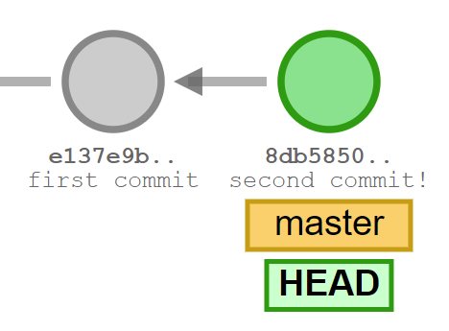
Understanding Git - Commits
By executing a commit, you create a new blob (file content as binary) and a SHA1 hash as a reference.
This also has a reference to the parent blob.

Slide 6
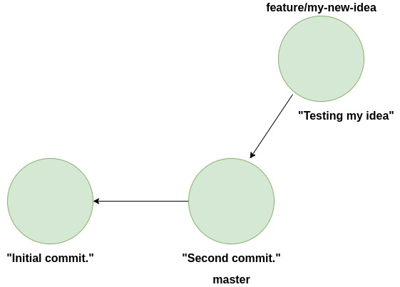
Understanding Git - Branching
Branching lets you make changes without affecting your current work.
Think of branching as switching to another workspace, these changes don’t affect other work until you explicitly allow them to.

Slide 7
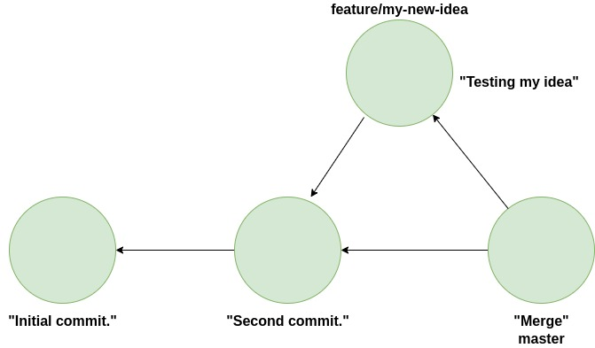
Understanding Git - Merging
If you branch out, how do you get the changes back into the ‘master’ branch?

Slide 8
Practical
Initialise a repository.
Commits
Branching
Merging
The ‘.gitignore’ file.
Extras: stash, log, graph + UI tools.

