Slide 1
CUSTOMER ACTIVITY ANALYTICS
A working operator path built through a controlled human-agent system
Five-day, production-shaped demonstrator for a Swissquote interview exercise
PRODUCT PROOF
METHOD PROOF
Customer activity, evidence, analysis and history
Specifications, work graph, ratchets and review
Nicolas Cazin · final reviewer deck
submission-v1 at final freeze
Notes:
ANCHOR
The exercise produced a product result and a delivery-system result.
SCRIPT
I will start with the answer. Customer Activity Analytics runs a complete customer-activity review path. The same work also exercises a controlled way for one accountable engineer to coordinate several AI agents through specifications, GitHub work state, deterministic checks and review evidence.
DO NOT SAY
Do not start with frameworks, algorithms or issue numbers. Do not claim production readiness.
TRANSITION
The next slide states both results before the supporting detail.
TIME
00:20
LIKELY QUESTION
What exactly did the exercise produce?
DIRECT ANSWER
A production-shaped application demonstrator and a reviewable engineering method for building it with AI assistance.
SOURCES
GitHub issue #229
README.md
docs/assignment/Inception/Inception.md
https://barbaraminto.com/
https://www.assertion-evidence.com/

Slide 2
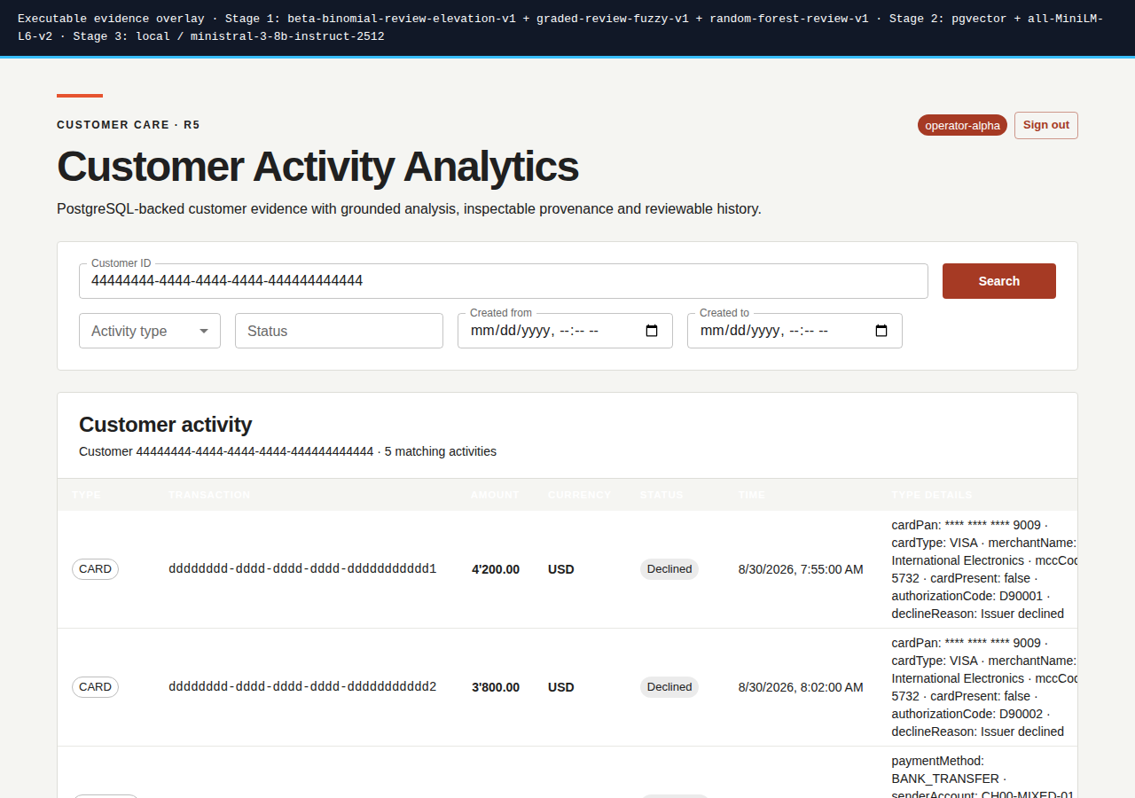
ANSWER FIRST
R5 proves the full local-model operator path and the controlled delivery system
R5 · AUTHENTIC CI CAPTURE
Product proof
1
R5 combines authenticated review, three detector artifacts, pgvector grounding and local LM Studio synthesis.
Method proof
2
One human coordinated parallel agents through specifications, GitHub checks and reviewed evidence.
The human remains accountable for both customer review and accepted engineering change
CUSTOMER ACTIVITY ANALYTICS
2
Notes:
ANCHOR
Two results answer the exercise before any architecture detail.
SCRIPT
The first result is visible in the R5 browser capture. The authenticated operator can inspect source activity, run all three Stage 1 detectors through Composite, retrieve synthetic policy with pgvector and all-MiniLM-L6-v2, synthesize through the local LM Studio adapter and reopen the persisted result. The second result is visible in the repository and its GitHub work graph.
DO NOT SAY
Do not imply that AI agents accept their own work. The human accepts the change and the operator retains the decision.
TRANSITION
I will first show the operator loop, then explain the trust architecture and finally the delivery control plane.
TIME
00:45
LIKELY QUESTION
Why present the engineering process as a result?
DIRECT ANSWER
The role is a pilot. The repeatable delivery cell matters alongside the application because other engineers could later use the same controlled pattern.
SOURCES
docs/assignment/Inception/Inception.md sections 1, 24 and 28
GitHub issue #229
docs/reviewer/screenshot-manifest.md
R5 workflow run 34020857953
R5 source SHA f6b989af9574a8d54249e29ffff2045129d8f127

Slide 3






CUSTOMER ACTIVITY ANALYTICS LOOP
The operator moves from source facts to a recommendation and back to reviewable history
01
02
03
04
05
Identify
Review
Analyze
Inspect
Reopen
Authenticated operator
Activity facts and source risk
Bounded evidence pipeline
Grounding and provenance
Persisted review context
A later review resumes from retained context
The recommendation remains advisory. The operator keeps the decision.
CUSTOMER ACTIVITY ANALYTICS
3
Notes:
ANCHOR
The product is a human review loop with memory.
SCRIPT
The main reading direction is left to right. The loop closes only after a completed analysis has been persisted. A later operator review reopens the same customer context, recommendation, grounding and provenance instead of starting from an isolated generated sentence.
DO NOT SAY
Do not describe this as an automated customer decision or as continuous transaction monitoring.
TRANSITION
The browser exposes the same chain directly.
TIME
00:45
LIKELY QUESTION
Where is the human in the loop?
DIRECT ANSWER
The operator decides how to use the recommendation. The system supplies a reviewable trail and never writes generated content back as source risk truth.
SOURCES
docs/assignment/SRS/SRS.md
docs/assignment/SDD/diagrams/activity-customer-review.puml
docs/assignment/SDD/diagrams/activity-grounded-analysis.puml
Lucide icon library, ISC license

Slide 4
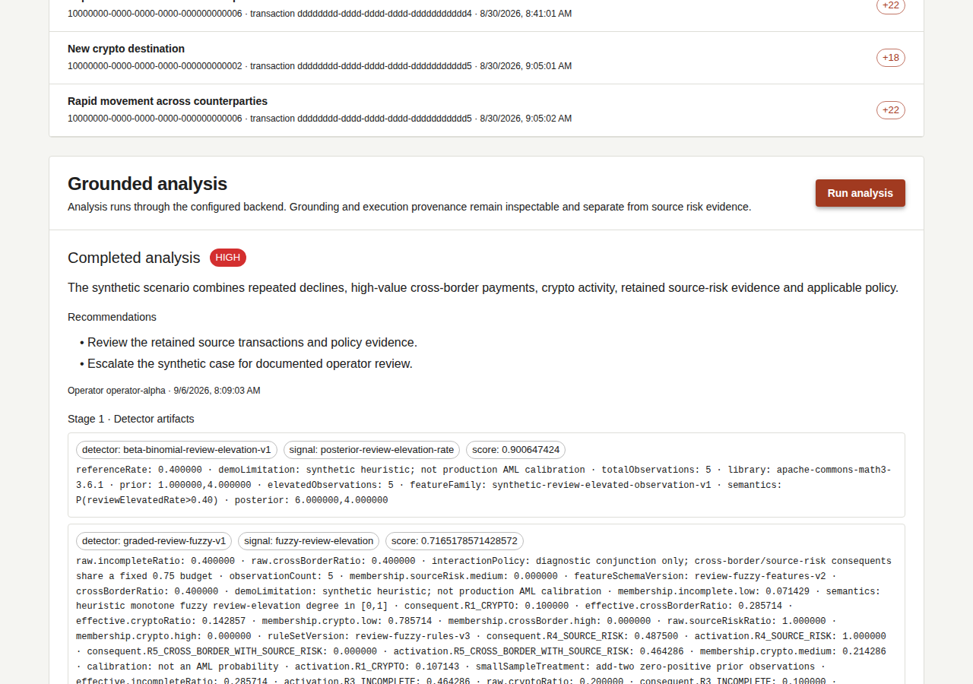
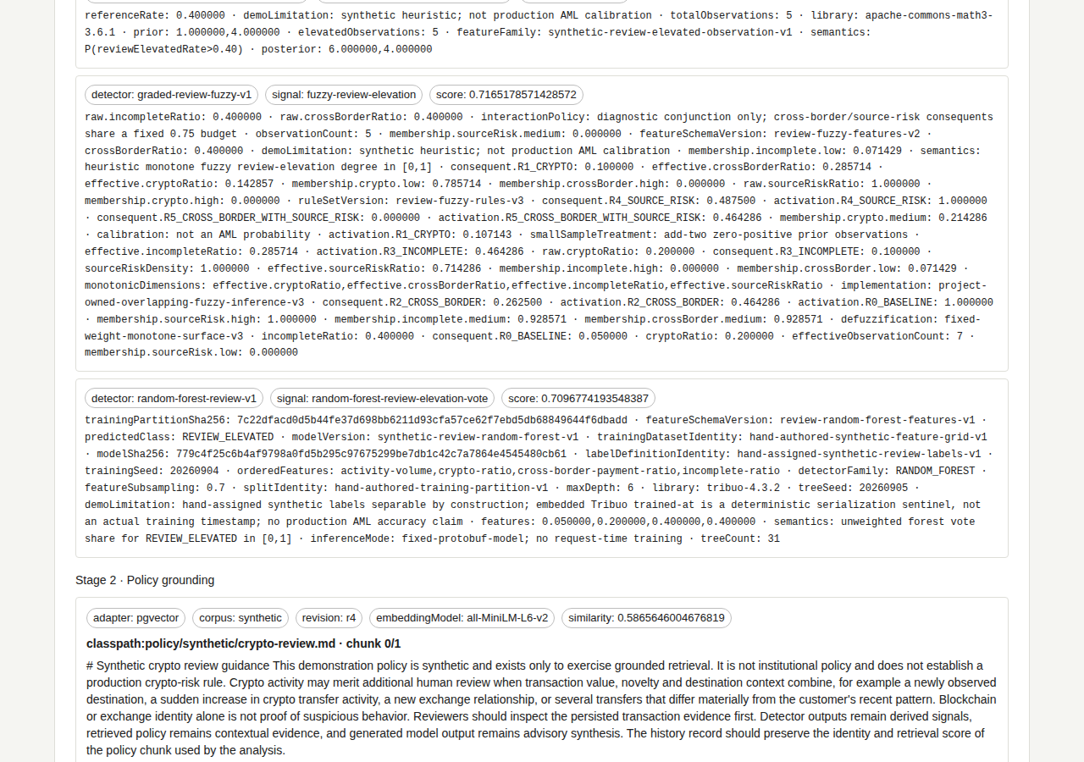
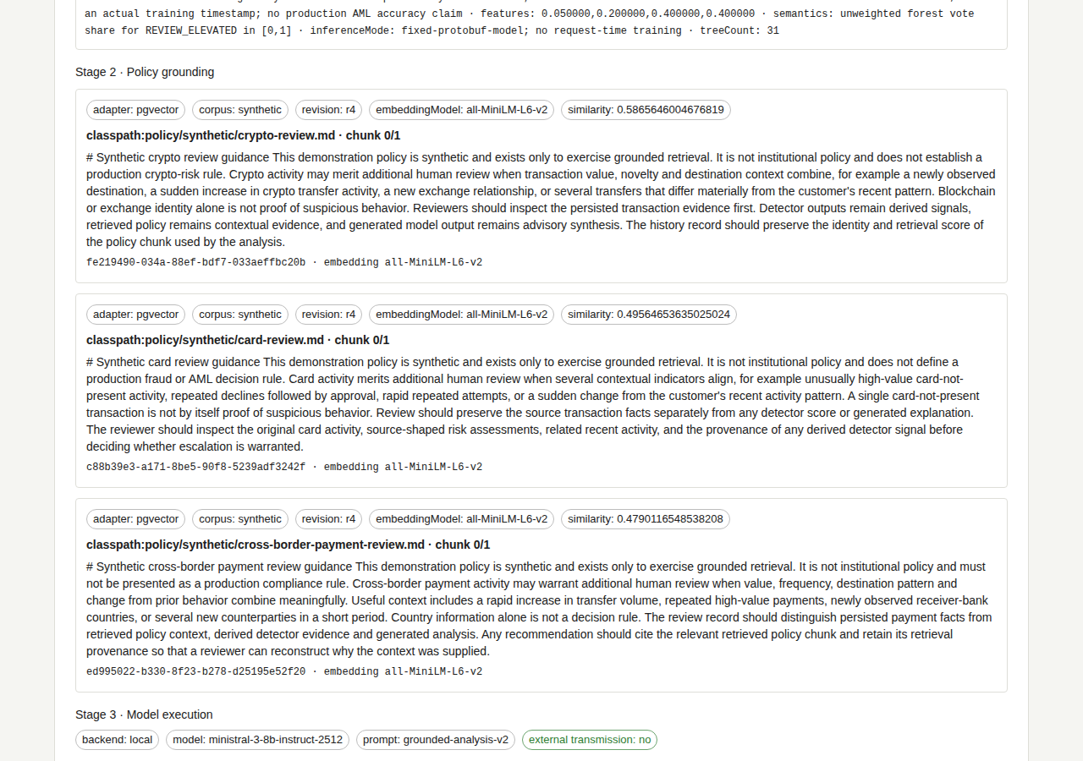
EXECUTABLE PRODUCT EVIDENCE
R5 exposes three detector artifacts, policy grounding and local-model provenance
1 BAYESIAN + FUZZY
2 FUZZY + FOREST
3 POLICY + LOCAL MODEL
CI uses a deterministic LM Studio contract double. The WatchInfra rehearsal proves the same immutable candidate against the real process and Developer Logs.
CUSTOMER ACTIVITY ANALYTICS
4
Notes:
ANCHOR
The retained R5 capture and the manual rehearsal prove complementary boundaries.
SCRIPT
Presenter rail: log in as operator-alpha, search customer 444, inspect the structured activities and source risk evidence, run analysis, show the request in LM Studio Developer Logs, then show the three Stage 1 artifacts, pgvector grounding, backend local, the Ministral model, external transmission no and retained history after reload.
DO NOT SAY
Do not present the CI contract double as the real LM Studio process. Do not compare every backend during the live path. Do not read UUIDs aloud.
TRANSITION
The next slide explains why those visible sections remain distinct inside the application.
TIME
04:30 including browser switch
LIKELY QUESTION
How do I know this path is not a mockup?
DIRECT ANSWER
The image comes from an authenticated Playwright flow against the packaged R5 topology and its deterministic OpenAI-compatible contract double. The separate WatchInfra rehearsal proves the immutable candidate against the real LM Studio process.
SOURCES
docs/reviewer/screenshot-manifest.md
docs/reviewer/demo-fallback.md
R5 workflow run 34020857953
Artifact 9985493952
Source SHA f6b989af9574a8d54249e29ffff2045129d8f127

Slide 5









APPLICATION DATA FLOW
Trust comes from separating detection, grounding and synthesis
01
02
03
04
05
06
07
SOURCE
DETECT
RETRIEVE
ENVELOPE
SYNTHESIZE
VALIDATE
PERSIST
Customer snapshot
and source risk
Derived signals
with provenance
Relevant synthetic
policy chunks
Bounded typed
evidence context
Structured result
through one port
Evidence references
must be supported
Completed result
and history
Any failure remains explicit before persistence
Source facts stay authoritative and separate from derived evidence
Only a valid completed result reaches reviewable history
CUSTOMER ACTIVITY ANALYTICS
5
Notes:
ANCHOR
Each stage answers a different question and produces a different evidence type.
SCRIPT
Stage 1 produces advisory detector signals. Stage 2 retrieves contextual policy. The application assembles a bounded AnalysisEvidenceEnvelope. Stage 3 returns one provider-neutral structured result. A grounding validator rejects unsupported evidence references before persistence. Only a valid completed result reaches history.
DO NOT SAY
Do not describe detector scores as source risk truth. Do not describe policy retrieval as model training.
TRANSITION
These stages stay replaceable because the application owns the ports between them.
TIME
01:00
LIKELY QUESTION
Why not send all transactions directly to one language model?
DIRECT ANSWER
The staged flow keeps source facts, derived signals, policy context and generated wording independently testable and attributable.
SOURCES
backend/src/main/java/dev/specgraph/reference/analysis/AnalysisService.java
docs/assignment/SDD/SDD.md sections 6 and 9
docs/assignment/ADR/ADR-002-provider-neutral-analysis.md
Lucide icon library, ISC license

Slide 6












IMPLEMENTATION LANDSCAPE
Bounded mechanisms share one analytical pipeline
STATUS · 6 SEPTEMBER 2026
LANDED
OPTIONAL
EXCLUDED
STAGE 1 · DETECT & SCORE
STAGE 2 · GROUND
STAGE 3 · SYNTHESIZE
RiskSignalDetectorPort
stable application contract
PolicyKnowledgePort
AnalysisModelPort
No-op
Bayesian
Fuzzy logic
Random Forest
Static policy
Deterministic
offline baseline
offline acceptance baseline
baseline
sequential
graded rules
Tribuo · 31 trees
vote share
OpenAI
pgvector + all-MiniLM-L6-v2
explicit external opt-in
COMPOSITE
Ordered dispatch; every child artifact remains visible
local semantic retrieval
with source metadata
Local / LM Studio
CALIBRATED LATE FUSION
R5 interview path
Excluded: the dataset cannot support an honest comparison
PolicyEvidence + provenance
Typed selector · delivered
One AnalysisService · bounded evidence · provider-neutral result · unchanged operator contract
CUSTOMER ACTIVITY ANALYTICS
6
Notes:
ANCHOR
The analytical pipeline supports several implementations without becoming several applications.
SCRIPT
Read the slide left to right. R5 executes Bayesian, fuzzy and Random Forest through Composite while preserving all three artifacts. The packaged Tribuo forest contains 31 uniformly weighted trees. Stage 2 retrieves only synthetic policy fragments through pgvector and all-MiniLM-L6-v2. Stage 3 uses the local LM Studio adapter as the interview path; deterministic remains the acceptance baseline and OpenAI remains an explicit external opt-in.
DO NOT SAY
Do not call the Composite a calibrated ensemble. Do not call the Random Forest vote share a calibrated probability. The dataset-ceiling analysis reached a no-go for production performance benchmarking.
TRANSITION
The next slide shows the ports that make this portfolio replaceable without moving application semantics.
TIME
01:15
LIKELY QUESTION
Why introduce several analytical implementations in a five-day pilot?
DIRECT ANSWER
They test different uncertainty and failure assumptions behind one bounded contract. The stable port lets the team compare or replace them without duplicating orchestration, grounding, persistence or the operator journey.
SOURCES
docs/assignment/SDD/SDD.md and docs/assignment/SDD/diagrams/
https://github.com/jdoe-dev-159753/specgraph-reference-app/pull/263
https://github.com/jdoe-dev-159753/specgraph-reference-app/issues/223
https://github.com/jdoe-dev-159753/specgraph-reference-app/pull/384
docs/analysis/dataset-ceiling.md
https://github.com/jdoe-dev-159753/specgraph-reference-app/pull/326
docs/assignment/Presentation/appendix/submodels.md from PR #423 / issue #268
RiskSignalDetectorPort, PolicyKnowledgePort and AnalysisModelPort

Slide 7



HEXAGONAL SUBSTITUTION MAP
Stable ports let adapters evolve without moving application semantics
APPLICATION CORE
Customer review and analysis use cases own the domain contracts, failure semantics and orchestration
Operator
ContextPort
Customer
ActivityPort
Risk Signal
DetectorPort
Policy
Knowledge
Port
Analysis
ModelPort
Analysis
HistoryPort
Spring Security
Static baseline
Hibernate/JPA
Flyway schema
No-op · Bayesian · Fuzzy
Random Forest
pgvector + MiniLM
Static baseline
LM Studio interview path
Deterministic · OpenAI
Hibernate/JPA
Flyway schema
Framework and provider types stop at the adapter boundary
CUSTOMER ACTIVITY ANALYTICS
7
Notes:
ANCHOR
The architecture spends complexity only at boundaries expected to change.
SCRIPT
The application core owns use cases and project values. Identity, activity storage, detection, retrieval, synthesis and history each connect through a project-owned port. The adapters can change independently while failure semantics and the operator contract stay stable.
DO NOT SAY
Do not present hexagonal architecture as a visual pattern or as proof of production readiness. Its value here is concrete substitution and test isolation.
TRANSITION
The delivery rings used those seams to replace capability incrementally.
TIME
00:55
LIKELY QUESTION
Why was this architecture justified for a short exercise?
DIRECT ANSWER
Detector, retrieval and model choices change at different rates. Stable ports prevented those experiments from redefining the application contract.
SOURCES
docs/assignment/ADR/ADR-001-modular-monolith-hexagonal.md
docs/assignment/ADR/ADR-002-provider-neutral-analysis.md
docs/assignment/SDD/diagrams/hexagonal-architecture.puml
Lucide icon library, ISC license

Slide 8
CONCENTRIC DELIVERY
Six delivery rings kept one deployable shell reviewable throughout the build
R5
R0
Deployable hollow shell
R4
Same browser, API, ports and packaging
R3
R1
Synthetic customer review
R2
First meaningful operator path
R1
R2
Relational substitution
R0
PostgreSQL and source-shaped evidence
R3
Analysis and history
Deterministic end-to-end baseline
R4
Authentication and real retrieval
Stable authenticated foundation
R5
Full interview runtime
Composite + pgvector + local LM Studio
CUSTOMER ACTIVITY ANALYTICS
8
Notes:
ANCHOR
Every ring preserved a coherent demonstrable application.
SCRIPT
R0 established the real shell. R1 made customer review meaningful. R2 changed storage. R3 added deterministic analysis and history. R4 added authentication and real retrieval. R5 delivers the full interview runtime: all three detectors through Composite, pgvector grounding, local LM Studio synthesis, visible provenance and retained history. Rings describe capability maturity. J1 to J5 remain the calendar dimension.
DO NOT SAY
Do not describe the forest vote share as calibrated or the synthetic fixture as production evidence. Calibrated fusion remains excluded.
TRANSITION
The same discipline governed the parallel work through GitHub.
TIME
00:50
LIKELY QUESTION
Why keep earlier rings after R4 exists?
DIRECT ANSWER
They prove that adapters changed without replacing the shell and provide executable checkpoints for compatibility and demonstration fallback.
SOURCES
docs/assignment/SDD/diagrams/delivery-rings.dot
docs/assignment/Inception/Inception.md section 18
README.md section Delivery rings

Slide 9




ENGINEERING CONTROL PLANE
GitHub mediated every hand-off between one accountable human and parallel agents
AGENT A
bounded implementation
AGENT B
HUMAN
GITHUB
independent review
CONTROL PLANE
Prioritizes and accepts
work state + evidence
AGENT C
verification or docs
NATIVE WORK GRAPH
The semantics can map to existing enterprise vocabulary. This exercise does not claim enterprise application integration.
Issues, PRs, relations, milestones and lifecycle
Delivery priority · Discovery disposition
CUSTOMER ACTIVITY ANALYTICS
9
Notes:
ANCHOR
GitHub supplied the shared state that neither chat transcripts nor one agent memory could provide.
SCRIPT
The human chose priorities, resolved trade-offs and accepted results. Agents received bounded work, published change and evidence, and reviewed each other through the same durable graph. Native GitHub relations carried ownership and dependency. Two typed Project fields added only the planning dimensions GitHub does not represent natively.
DO NOT SAY
Do not claim enterprise integration. Do not present labels or prose as lifecycle state. Do not imply that an agent can merge its own unreviewed result.
TRANSITION
The same graph can be projected for different management conversations.
TIME
01:00
LIKELY QUESTION
Why use GitHub as the control plane instead of a custom agent dashboard?
DIRECT ANSWER
GitHub already owns review, code identity, issues, pull requests and most work relationships. Reusing it reduced custom machinery and kept the human in familiar controls.
SOURCES
AGENTS.md
docs/assignment/Inception/Inception.md section 22
https://github.com/jdoe-dev-159753/specgraph-harness/issues/28
scripts/work_graph_guard.py
Lucide icon library, ISC license

Slide 10




MANAGEMENT PROJECTIONS
One work graph supports delivery, schedule and scope conversations
CONCEPTUAL PROJECTIONS
WORKGRAPH
DELIVERY
#121
#123
TODO
IN PROGRESS
DONE
ROOT
#122
Hierarchy, dependencies and PR ownership
MILESTONES
BURN-UP
J1
J2
J3
J4
J5
completed work and evolving scope
CUSTOMER ACTIVITY ANALYTICS
10
Notes:
ANCHOR
The graph supports four views without creating four sources of truth.
SCRIPT
WorkGraph answers structure and dependency. Delivery answers current execution. Milestones answer time sequencing. Burn-up separates completed work from changing scope. These conceptual projections explain the management model without disclosing a private Project capture.
DO NOT SAY
Do not present these diagrams as a live Project snapshot. Do not infer priority from the Kanban or milestone dates.
TRANSITION
The next slide shows how deterministic feedback constrains the work before human acceptance.
TIME
00:45
LIKELY QUESTION
Why keep multiple views if the underlying items are the same?
DIRECT ANSWER
Each view answers a different management question while preserving one underlying issue and pull-request graph.
SOURCES
AGENTS.md sections Delivery priority, Discovery disposition and Project status
GitHub issue #49
Lucide icon library, ISC license

Slide 11





AGENT QUALITY FEEDBACK
Fast feedback catches defects early and exact-head CI remains authoritative
BEFORE
AFTER EDIT
PRE-COMMIT
PR CHECKS
FROZEN HEAD
ACCEPT
AGENTS.md policy
and bounded context
Earliest supported
quality hook
Shared lint and
type-check command
Design map, tests,
security and E2E
One current-SHA
Codex review
Human merge with
expected head SHA
CURRENT
HARNESS ROADMAP
HARNESS ROADMAP
CURRENT
CURRENT
CURRENT
A failure returns the change to the shortest useful correction loop
Hooks optimize latency. GitHub checks and the reviewed frozen SHA own merge authority.
CUSTOMER ACTIVITY ANALYTICS
11
Notes:
ANCHOR
The feedback hierarchy separates speed from authority.
SCRIPT
Repository instructions constrain generation before tool use. The harness roadmap experiments with the earliest supported post-edit hook and a shared pre-commit command. Those faster layers reduce correction latency but remain bypassable. The reference application already uses exact-head design, test, security, Playwright and work-graph gates. One fresh Codex review binds to the frozen head. The human accepts only that reviewed SHA.
DO NOT SAY
Do not present the post-edit or pre-commit harness experiments as landed here. Do not call a pre-use hook a type checker for code that does not exist yet.
TRANSITION
This control loop leads to the scale hypothesis for the pilot.
TIME
00:55
LIKELY QUESTION
Why use both deterministic checks and an AI review?
DIRECT ANSWER
Checks own mechanically decidable rules. AI review focuses on ambiguity, architecture, counterexamples and missing evidence. The human reconciles findings and accepts the final head.
SOURCES
AGENTS.md section Freeze, validation, review and merge sequencing
.github/workflows/application-ci.yml
.github/workflows/work-graph-guard.yml
https://github.com/jdoe-dev-159753/specgraph-harness/issues/74
https://github.com/jdoe-dev-159753/specgraph-harness/issues/35
Lucide icon library, ISC license

Slide 12




CONCLUSION
The pilot validates a delivery cell while production scale remains the next test
CURRENTLY DEMONSTRATED
NEXT PILOT HYPOTHESIS
CELL A
Customer Activity Analytics
CELL B
SHARED
HUMAN
GITHUB
AGENTS
Another product team
CONTROL PLANE
One accountable engineer coordinates bounded work and accepts evidence-backed change
Enterprise process fit
CELL C
Operational scale and HA
Another engineer
Measured model quality
One operator retains the final review decision
The next decision should be based on measured reuse, quality and operating cost across several real delivery cells
CUSTOMER ACTIVITY ANALYTICS
12
Notes:
ANCHOR
The credible conclusion is a scale experiment, not a production claim.
SCRIPT
This pilot demonstrates one complete delivery cell: an accountable engineer, bounded agents, a GitHub control plane, deterministic acceptance and one reviewable product path. The next test is whether the same method improves several real teams while fitting Swissquote process vocabulary, operational constraints and quality expectations.
DO NOT SAY
Do not claim production AML performance, regulatory adequacy, enterprise integration, high availability or measured productivity improvement.
TRANSITION
Invite questions and use the appendix for mechanism-level drill-down.
TIME
00:35
LIKELY QUESTION
What would you test before scaling this role?
DIRECT ANSWER
Measure delivery throughput, escaped defects, review effort, model quality and operating cost across several bounded product increments, then adapt the control plane to existing enterprise systems.
SOURCES
docs/assignment/Inception/Inception.md success criterion
GitHub issue #229 audience and narrative
GitHub issue #74
GitHub issue #250
Lucide icon library, ISC license

Slide 13
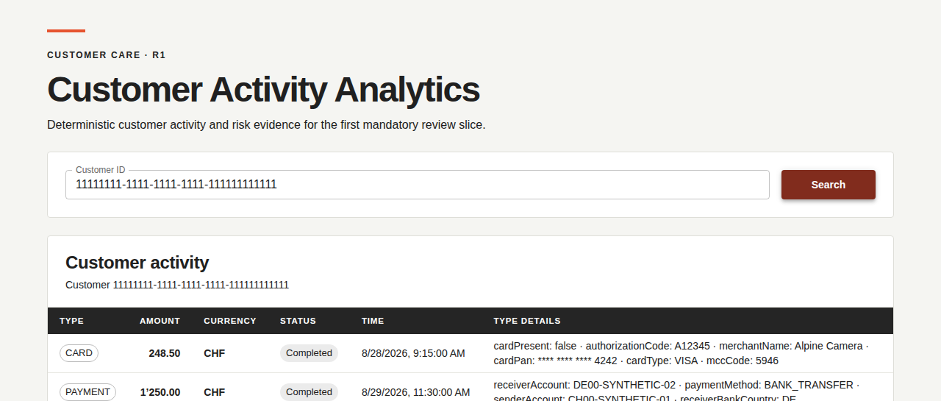
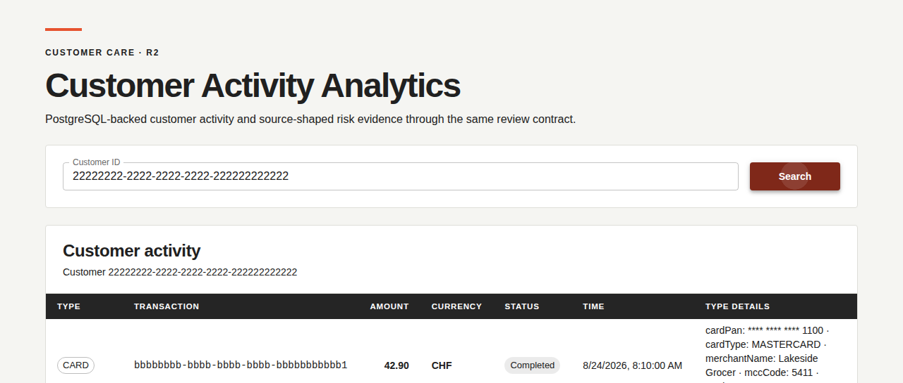
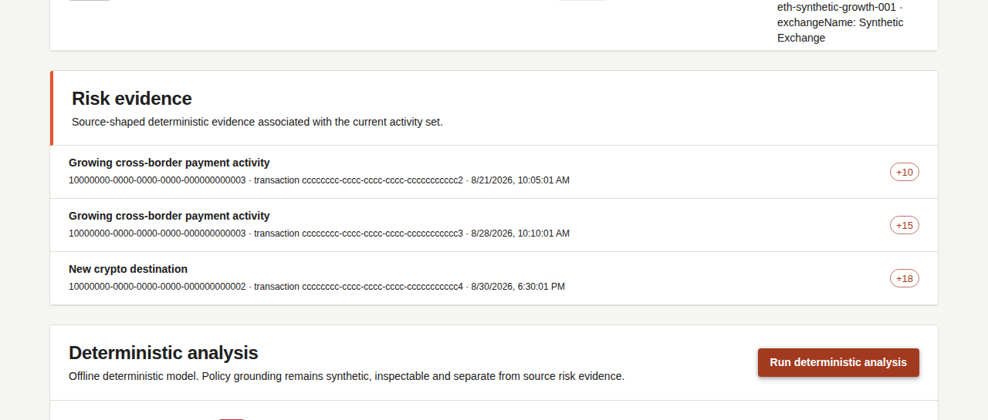
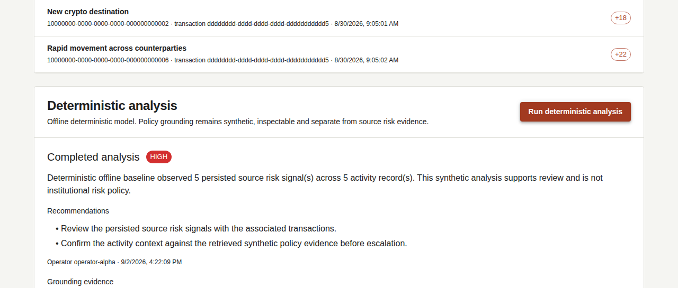
APPENDIX A · BROWSER EVIDENCE
Authentic Playwright captures document the capability growth from R1 to R5
R1
Synthetic review
R2
PostgreSQL substitution
R3
Analysis and history
R4
Auth + real retrieval
R5
Composite + local LM Studio
TECHNICAL APPENDIX
A
Notes:
ANCHOR
These are crops from authentic Playwright screenshots, not reconstructed mockups.
SCRIPT
R1 shows synthetic customer review. R2 shows storage substitution through the same visible contract. R3 adds deterministic analysis and history. R4 adds authenticated operator identity and real pgvector retrieval. R5 adds all three detector artifacts, local-model provenance and retained history. The R5 image is a pixel-preserving crop of the authentic workflow PNG; its manifest keeps the original digest and source identity.
DO NOT SAY
Do not treat image recency as newer than the source SHA in the manifest. Do not present these crops as GitHub Project views.
TRANSITION
Return to the relevant main slide or continue to the architecture appendix.
TIME
As needed
LIKELY QUESTION
Why trust these screenshots?
DIRECT ANSWER
The workflows assert the ring-specific behavior before retaining the Playwright artifact, and the manifest records run, artifact, digest, customer and source revision.
SOURCES
docs/reviewer/screenshot-manifest.md
R1/R2/R3 artifact 9844165175
R4 artifact 9856114241
R5 artifact 9985493952
R5 PNG SHA-256 7503a8da09678241d8d06064d3927961c0ec758a14c0254531f18a2c19411a05

Slide 14
APPENDIX B · DECISION RECORD
Eight ADRs concentrate the durable choices and their trade-offs
ADR-001
Modular monolith and strict hexagonal boundaries
ADR-005
One prebuilt application image per checkpoint
ADR-002
Provider-neutral analysis and trust boundary
ADR-006
Compose OCI and multi-platform distribution
ADR-003
PostgreSQL and pgvector as one persistent store
ADR-007
Hibernate/JPA adapters with Flyway-owned schema
ADR-004
Preferred Java, Spring and React stack
ADR-008
Customer Activity Analytics public identity
https://github.com/jdoe-dev-159753/specgraph-reference-app/tree/main/docs/assignment/ADR
TECHNICAL APPENDIX
B
Notes:
ANCHOR
ADRs preserve the why behind choices that would otherwise look arbitrary.
SCRIPT
Open the individual links when a reviewer challenges a trade-off. The ADRs cover module shape, AI trust boundaries, persistence, stack reuse, packaging, distribution, relational access and public product identity. They record rejected alternatives and consequences rather than repeating the SDD.
DO NOT SAY
Do not treat ADRs as current execution evidence. Tests, code and workflow results own current behavior.
TRANSITION
Use the submodel slides only for mechanism-level questions.
TIME
As needed
LIKELY QUESTION
Why eight ADRs for a five-day exercise?
DIRECT ANSWER
Only choices with durable alternatives received an ADR. The records make substitution and later review cheaper without turning every implementation detail into architecture.
SOURCES
docs/assignment/ADR/
docs/assignment/SDD/SDD.md section 13

Slide 15
APPENDIX C · BETA-BINOMIAL DETECTOR
Three elevated observations shift the posterior toward higher review rates
Illustrative test case: 3 elevated observations out of 4
Beta(1, 4) updated to Beta(4, 5)
probability density f(p)
reference p = 0.40
4
prior Beta(1, 4), mean 0.20
3
posterior Beta(4, 5), mean 0.44
shaded posterior mass
P(p > 0.40) = 0.594
2
1
0.0
0.2
0.4
0.6
0.8
1.0
latent review-elevated rate p
The shaded tail is P(p > 0.40), not a probability of fraud or money laundering
TECHNICAL APPENDIX
C
Notes:
ANCHOR
The plot shows how evidence changes the whole distribution, not only the final scalar.
SCRIPT
The blue curve is the explicit Beta one-four prior. This test case maps three of four activities to review-elevated observations, producing Beta four-five. The red posterior shifts its mean from 0.20 to 0.44. The shaded area above the fixed 0.40 reference equals 0.594 and becomes the emitted signal.
DO NOT SAY
Do not call the result a probability of fraud or money laundering. Do not claim production calibration.
TRANSITION
The fuzzy alternative expresses graded thresholds instead of a binary observation mapping.
TIME
00:60 if asked
LIKELY QUESTION
What does the Bayesian score mean?
DIRECT ANSWER
It means the posterior probability that this synthetic review-elevated observation rate exceeds the fixed 0.40 reference, under the explicit Beta prior and mapping.
SOURCES
backend/src/main/java/dev/specgraph/reference/analysis/BayesianSequentialRiskSignalDetectorAdapter.java
backend/src/test/java/dev/specgraph/reference/analysis/BayesianSequentialRiskSignalDetectorAdapterTests.java
https://docs.scipy.org/doc/scipy/reference/generated/scipy.stats.beta.html

Slide 16
APPENDIX D · FUZZY INFERENCE
Four right-shoulder functions map ratios to graded rule activation
Crypto activity
Cross-border payments
1
membership μ(x)
1
membership μ(x)
fully active
fully active
graded
graded
0
0
a = 0.00
b = 0.35
1.00
0.00
a = 0.10
b = 0.60
1.00
x = crypto activities / all activities
x = foreign payments / all activities
Incomplete activity
Source-risk density
1
membership μ(x)
1
membership μ(x)
fully active
fully active
graded
graded
0
0
0.00
a = 0.10
b = 0.50
1.00
0.00
a = 0.10
b = 0.60
1.00
x = incomplete activities / all activities
x = source-risk records / all activities
LINEAR MEMBERSHIP
Rule R5 = min(μ cross-border, μ source-risk)
μ(x) = 0 when x ≤ a
μ(x) = (x−a)/(b−a) when a < x < b
μ(x) = 1 when x ≥ b
Output = weighted mean of singleton consequents
Synthetic thresholds for the demonstrator, not validated Swissquote policy
TECHNICAL APPENDIX
D
Notes:
ANCHOR
These are linear right-shoulder membership functions, not probability distributions.
SCRIPT
The implementation calls this function rising. Values at or below a receive zero membership. The interval from a to b gives graded activation. Values at or above b receive full activation. The cross-border plus source-risk rule takes the minimum of both memberships. A monotonic weighted singleton mean then combines the baseline and positive rules.
DO NOT SAY
Do not call fuzzy membership a statistical probability. Do not claim these synthetic thresholds are institutional policy.
TRANSITION
The next slide explains why calibrated arbitration remains outside the final scope.
TIME
00:60 if asked
LIKELY QUESTION
Are the plateau values validated risk thresholds?
DIRECT ANSWER
No. They are synthetic demonstration parameters chosen to give a bounded monotonic response. A production setting would need policy ownership, empirical evaluation and versioned approval.
SOURCES
backend/src/main/java/dev/specgraph/reference/analysis/FuzzyRiskSignalDetectorAdapter.java
backend/src/test/java/dev/specgraph/reference/analysis/FuzzyRiskSignalDetectorAdapterTests.java
https://www.mathworks.com/help/fuzzy/linearsshapedmf.html

Slide 17







FUSION SCOPE
Calibrated late fusion remains outside the final scope
EXCLUDED · DATASET CEILING NO-GO
DETERMINISTIC
source-shaped baseline
BAYESIAN
small-sample posterior
SEMANTIC
ALIGNMENT
LATE
FUSION
ONE SIGNAL
FUZZY
evidence retained
graded rule activation
aligned target and scale
weighting and arbitration
RANDOM FOREST
learned tree votes
The four-scenario fixture cannot identify a fusion gain or production performance ceiling.
TECHNICAL APPENDIX
E
Notes:
ANCHOR
The final scope excludes calibrated late fusion.
SCRIPT
Composite execution preserves unlike child evidence without combining scores. The dataset ceiling found four designed scenarios, no verified outcomes and generator leakage, so the project cannot measure a defensible fusion gain. Issue #254 therefore remains outside the delivered model portfolio.
DO NOT SAY
Do not present current Composite execution as calibrated fusion. Do not claim accuracy improvement without a frozen benchmark.
TRANSITION
The forest slide explains the delivered learned specialist.
TIME
00:55 if asked
LIKELY QUESTION
Why combine several weak detectors?
DIRECT ANSWER
Specialists can make different errors. Fusion is useful only if comparable semantics and evaluation show that those differences improve the final signal.
SOURCES
GitHub issue #224
GitHub issue #254 closed as not planned
docs/analysis/dataset-ceiling.md
docs/assignment/Presentation/appendix/submodels.md from PR #423 / issue #268
Lucide icon library, ISC license

Slide 18
APPENDIX F · DELIVERED R5 MECHANISM
The delivered Tribuo forest aggregates 31 bounded tree votes
DELIVERED · 31 TREES · FIXED MODEL
cross-border ratio > t₁
incomplete ratio > t₃
crypto ratio > t₅
crypto ratio > t₂
1
activity volume > t₄
1
cross-border ratio > t₆
1
0
1
0
1
0
1
Three representative trees shown
Forest output = mean of 31 uniform tree votes for REVIEW_ELEVATED
Vote share, not a calibrated probability · synthetic training only
TECHNICAL APPENDIX
F
Notes:
ANCHOR
The forest visual shows actual trees and the runtime aggregation semantics.
SCRIPT
Each of the 31 Tribuo trees splits the bounded four-feature vector and emits one class vote. The runtime averages uniformly weighted REVIEW_ELEVATED votes. The fixed protobuf model and manifest carry SHA-256, trainer and feature-contract provenance. The adapter remains behind RiskSignalDetectorPort, so Tribuo types do not enter downstream contracts.
DO NOT SAY
Do not call the vote share a calibrated probability. The dataset-ceiling no-go prevents production AML performance claims.
TRANSITION
Return to the implementation landscape after explaining this delivered mechanism.
TIME
00:55 if asked
LIKELY QUESTION
Why Random Forest after Bayesian and fuzzy detectors?
DIRECT ANSWER
It adds a learned non-neural baseline with different inductive assumptions while keeping the same bounded features and evidence contract.
SOURCES
GitHub issue #223
docs/analysis/dataset-ceiling.md
docs/assignment/Presentation/appendix/submodels.md from PR #423 / issue #268
RandomForestRiskSignalDetectorAdapter and packaged manifest

Slide 19







APPENDIX G
Stage 3 backend choice changes execution while preserving context and output contracts
TYPED SELECTION · DELIVERED
DETERMINISTIC
acceptance baseline
OPENAI
EVIDENCE
ENVELOPE
TYPED FACTORY
explicit external opt-in
ONE OUTPUT
identity and capability checks
severity, findings and provenance
source, detector and policy
LM STUDIO
R5 interview path
Grounding validator
and persisted history
R5 local path sends no customer or policy content to an external provider
Token estimate uses CL100K + 25% + margin, not the exact Ministral tokenizer
TECHNICAL APPENDIX
G
Notes:
ANCHOR
Stage 3 selection is a factory concern, not application semantics.
SCRIPT
The bounded envelope enters one delivered typed selection point. The R5 interview configuration selects LM Studio on the private network with an IP-literal endpoint restriction. Deterministic execution remains the acceptance baseline and OpenAI remains an explicit external opt-in. Every adapter returns the same structured result and model provenance. The grounding validator and history contract remain unchanged.
DO NOT SAY
Do not imply equivalent output quality across backends. Optional model execution does not change source-fact authority.
TRANSITION
The final appendix slide maps behaviors to the evidence level that proves them.
TIME
00:55 if asked
LIKELY QUESTION
Why retain the deterministic backend after adding a live model?
DIRECT ANSWER
It keeps mandatory verification reproducible, isolates retrieval and orchestration failures, and provides a supported fallback without changing the operator workflow.
SOURCES
AnalysisModelPort
AnalysisEvidenceEnvelope
GitHub issues #163, #251 and #253
docs/assignment/Presentation/appendix/submodels.md from PR #423 / issue #268
Lucide icon library, ISC license

Slide 20



APPENDIX H · VERIFICATION EVIDENCE
Each behavior maps to the highest boundary that can prove it
REVIEWER-VISIBLE BEHAVIOR
EVIDENCE BOUNDARY
Operator can log in and reopen history
Playwright against the packaged topology
Retrieved policy chunks remain attributable
PostgreSQL and pgvector integration
Adapters preserve the application contract
Port contract tests across substitutions
Scores remain bounded and repeatable
Unit and property tests
Traceability: SRS and design IDs, test markers, workflow artifact and exact source SHA
TECHNICAL APPENDIX
H
Notes:
ANCHOR
Evidence strength follows the behavior being claimed.
SCRIPT
Unit and property tests own value and algorithm invariants. Port contracts own substitution. Integration tests own real database, security and retrieval semantics. Playwright and deployment evidence own visible composition. Stable requirement and design IDs, test markers, workflow artifacts and exact source SHAs keep the path traceable.
DO NOT SAY
Do not use a test count or an old green workflow as a quality claim. Evidence remains bound to its behavior and source revision.
TRANSITION
Return to the main conclusion.
TIME
As needed
LIKELY QUESTION
Why retain browser evidence if integration tests pass?
DIRECT ANSWER
Authentication, navigation, visible provenance and later history are operator-visible behaviors that lower test layers cannot prove in composition. When the live path is unavailable, the retained Playwright screenshots and source-bound manifest are the mandatory fallback; video is optional.
SOURCES
docs/assignment/VV/VV.md
docs/assignment/VV/verification.yaml
docs/reviewer/screenshot-manifest.md
docs/reviewer/demo-fallback.md
Lucide icon library, ISC license

