Slide 1
CUSTOMER ACTIVITY ANALYTICS
A working operator path built through a controlled human-agent system
Five-day build target; R5 reached at J+7, followed by submission hardening
PRODUCT PROOF
METHOD PROOF
Customer activity, evidence, analysis and history
Specifications, work graph, ratchets and review
Nicolas Cazin · working deck v0.8
submission-v1 at final freeze
Notes:
ANCHOR
The exercise produced a product result and a delivery-system result.
SCRIPT
I will start with the answer. The demonstrator runs a complete Customer Care review path. The same work also exercises a controlled way for one accountable engineer to coordinate several AI agents through specifications, GitHub work state, deterministic checks and review evidence.
DO NOT SAY
Do not start with frameworks, algorithms or issue numbers. Do not claim production readiness.
TRANSITION
The next slide states both results before the supporting detail.
TIME
00:20
LIKELY QUESTION
What exactly did the exercise produce?
DIRECT ANSWER
A production-shaped application demonstrator and a reviewable engineering method for building it with AI assistance.
SOURCES
GitHub issue #229
README.md
docs/assignment/Inception/Inception.md
https://barbaraminto.com/
https://www.assertion-evidence.com/

Slide 2
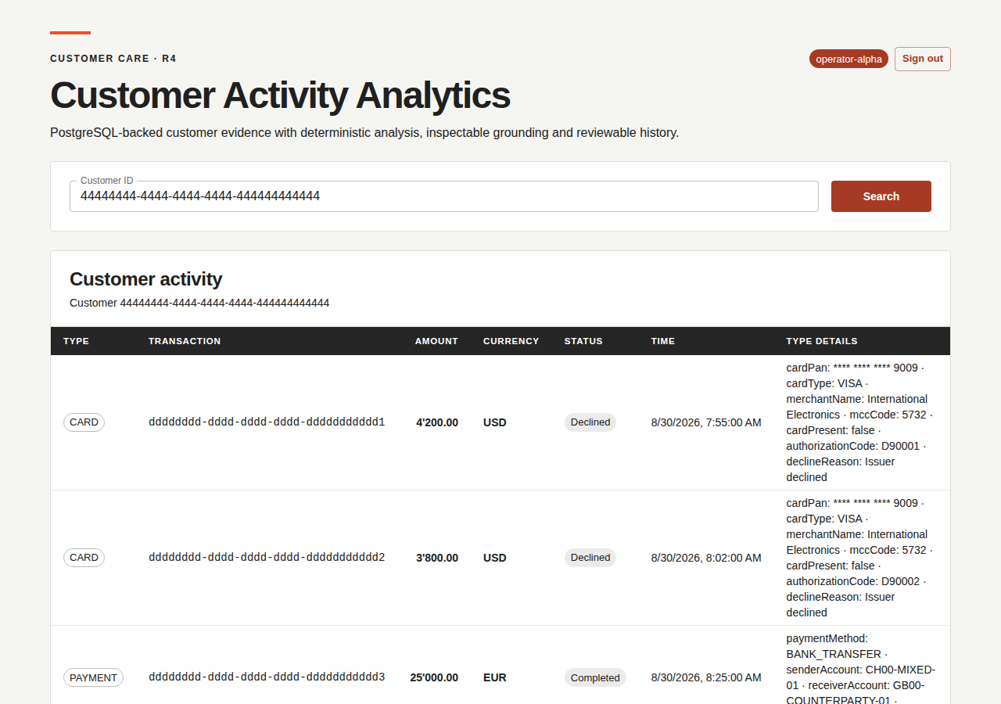
ANSWER FIRST
The pilot produced a working operator path and a controlled delivery system
Product proof
1
An authenticated operator inspects activity, runs grounded analysis and reopens persisted history.
Method proof
2
One human coordinated agents through specifications, GitHub state, deterministic gates and review evidence.
Human accountability covers customer review and accepted change
CUSTOMER ACTIVITY ANALYTICS
2
Notes:
ANCHOR
Two results answer the exercise before any architecture detail.
SCRIPT
The first result is visible in the browser. The second is visible in the repository and its GitHub work graph. The two belong together because a financial-services demonstration needs reviewable evidence for both the recommendation and the way the software change was accepted.
DO NOT SAY
Do not imply that AI agents accept their own work. The human accepts the change and the operator retains the decision.
TRANSITION
I will first show the operator loop, then explain the trust architecture and finally the delivery control plane.
TIME
00:40
LIKELY QUESTION
Why present the engineering process as a result?
DIRECT ANSWER
The role is a pilot. The repeatable delivery cell matters alongside the application because other engineers could later use the same controlled pattern.
SOURCES
docs/assignment/Inception/Inception.md sections 1, 24 and 28
GitHub issue #229
Authentic R4 Playwright artifact 9856114241

Slide 3






CUSTOMER CARE LOOP
The operator moves from source facts to a recommendation and back to reviewable history
01
02
03
04
05
Identify
Review
Analyze
Inspect
Reopen
Authenticated operator
Activity facts and source risk
Bounded evidence pipeline
Grounding and provenance
Persisted review context
A later review resumes from retained context
The recommendation remains advisory. The operator keeps the decision.
CUSTOMER ACTIVITY ANALYTICS
3
Notes:
ANCHOR
The product is a human review loop with memory.
SCRIPT
The main reading direction is left to right. The loop closes only after a completed analysis has been persisted. A later operator review reopens the same customer context, recommendation, grounding and provenance instead of starting from an isolated generated sentence.
DO NOT SAY
Do not describe this as an automated customer decision or as continuous transaction monitoring.
TRANSITION
The browser exposes the same chain directly.
TIME
00:40
LIKELY QUESTION
Where is the human in the loop?
DIRECT ANSWER
The operator decides how to use the recommendation. The system supplies a reviewable trail and never writes generated content back as source risk truth.
SOURCES
docs/assignment/SRS/SRS.md
docs/assignment/SDD/diagrams/activity-customer-review.puml
docs/assignment/SDD/diagrams/activity-grounded-analysis.puml
Lucide icon library, ISC license

Slide 4
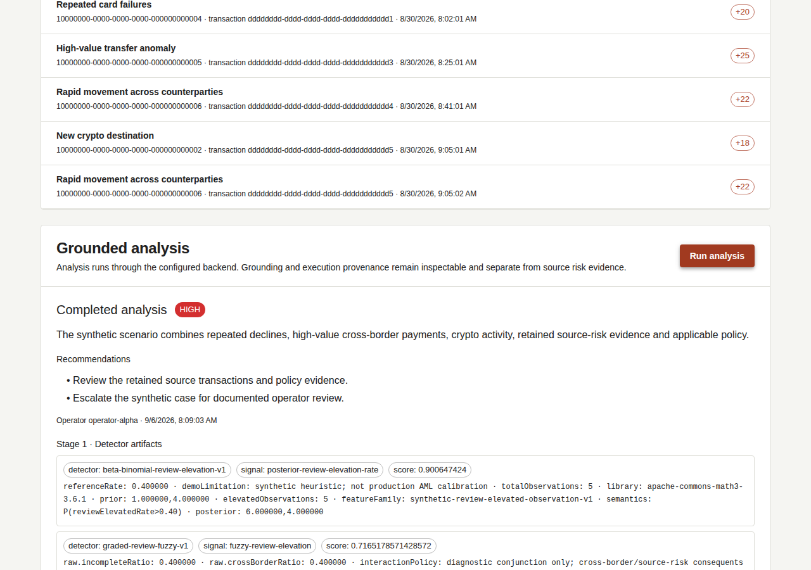
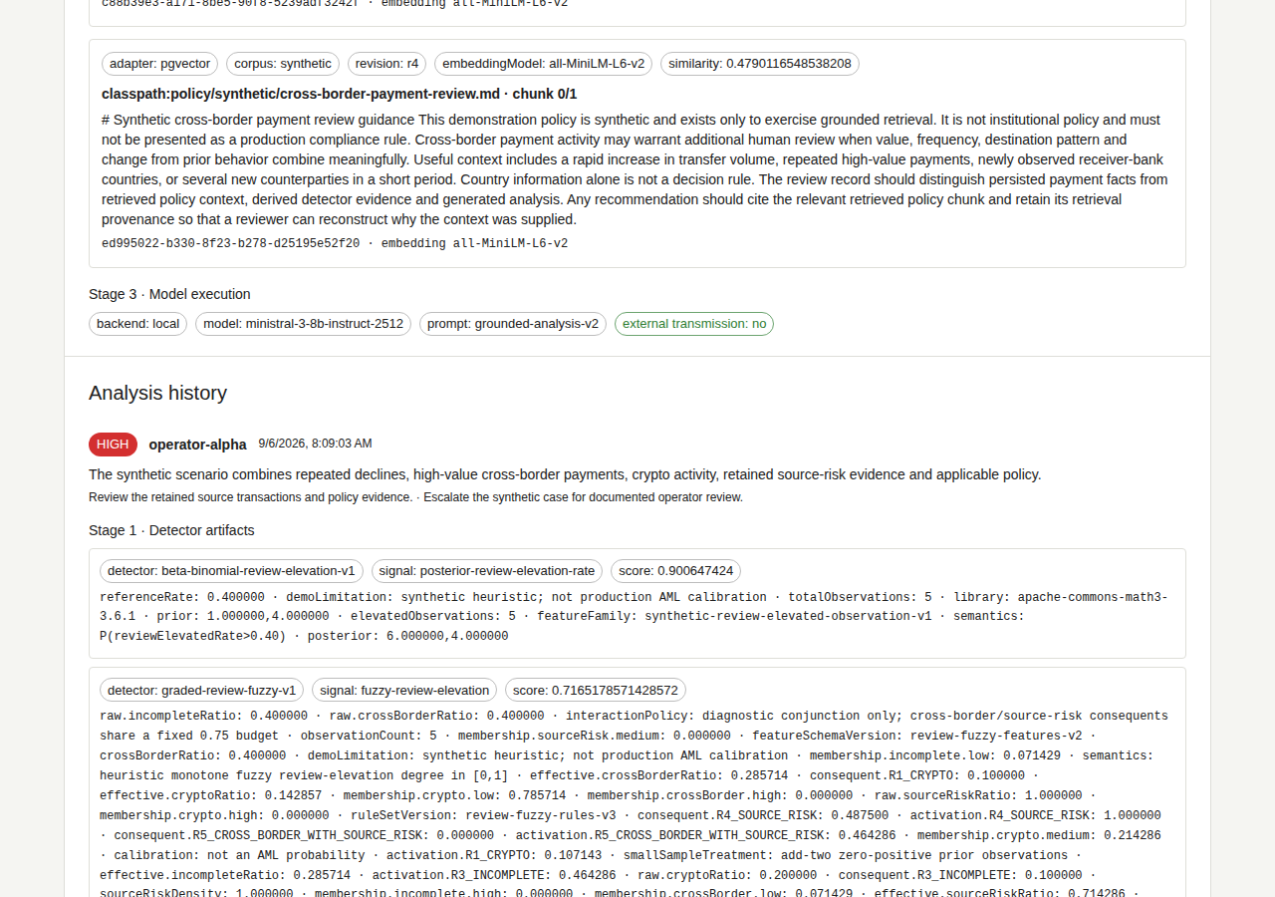
DELIVERED INTERVIEW DEMONSTRATOR
R5 closes the live loop from WatchInfra to LM Studio and back to browser history
1 ANALYSIS RESULT
2 LOCAL PROVENANCE
Bayesian + fuzzy + Random Forest · pgvector + MiniLM · Ministral through LM Studio · external transmission: no
CUSTOMER ACTIVITY ANALYTICS
4
Notes:
ANCHOR
R5 is the delivered full interview configuration, not a roadmap placeholder.
SCRIPT
WatchInfra runs the registered OCI Compose package. The authenticated operator reviews customer 444 and starts analysis. Stage 1 preserves separate Bayesian, fuzzy and Random Forest artifacts. Stage 2 retrieves synthetic policy through PostgreSQL, pgvector and local MiniLM embeddings. Stage 3 sends the bounded request to Ministral through LM Studio, records local provenance and externalTransmission=false, then persists the completed result and history.
DO NOT SAY
Do not present the CI screenshot as a capture of the real LM Studio Developer Logs. The screenshot comes from the publication workflow's contract double; the user separately completed the same candidate against the real local model and observed the request in LM Studio.
TRANSITION
The next slide explains why those visible sections remain distinct inside the application.
TIME
03:45 including browser switch
LIKELY QUESTION
How do I know R5 reached the real local model?
DIRECT ANSWER
The publication workflow proved the packaged browser path and retained this screenshot. The WatchInfra rehearsal then sent the same candidate to the real Ministral process, appeared in LM Studio Developer Logs and returned the generated result to the browser.
SOURCES
GitHub PR #439
GitHub issues #398 and #427
R5 proof workflow 34020857953
Artifact 9985493952
Executable source f6b989af9574a8d54249e29ffff2045129d8f127
docs/reviewer/screenshots/R5_lmstudio_ensemble_customer_444.png
docs/reviewer/r5-runtime.md

Slide 5









APPLICATION DATA FLOW
Trust comes from separating detection, grounding and synthesis
01
02
03
04
05
06
07
SOURCE
DETECT
RETRIEVE
ENVELOPE
SYNTHESIZE
VALIDATE
PERSIST
Customer snapshot
and source risk
Derived signals
with provenance
Relevant synthetic
policy chunks
Bounded typed
evidence context
Structured result
through one port
Evidence references
must be supported
Completed result
and history
Any failure remains explicit before persistence
Source facts stay authoritative and separate from derived evidence
Only a valid completed result reaches reviewable history
CUSTOMER ACTIVITY ANALYTICS
5
Notes:
ANCHOR
Each stage answers a different question and produces a different evidence type.
SCRIPT
Stage 1 produces advisory detector signals. Stage 2 retrieves contextual policy. The application assembles a bounded AnalysisEvidenceEnvelope. Stage 3 returns one provider-neutral structured result. A grounding validator rejects unsupported evidence references before persistence. Only a valid completed result reaches history.
DO NOT SAY
Do not describe detector scores as source risk truth. Do not describe policy retrieval as model training.
TRANSITION
These stages stay replaceable because the application owns the ports between them.
TIME
00:50
LIKELY QUESTION
Why not send all transactions directly to one language model?
DIRECT ANSWER
The staged flow keeps source facts, derived signals, policy context and generated wording independently testable and attributable.
SOURCES
backend/src/main/java/dev/specgraph/reference/analysis/AnalysisService.java
docs/assignment/SDD/SDD.md sections 6 and 9
docs/assignment/ADR/ADR-002-provider-neutral-analysis.md
Lucide icon library, ISC license

Slide 6












IMPLEMENTATION LANDSCAPE
The analytical pipeline is a portfolio — not one model
STATUS · 6 SEPTEMBER 2026
DELIVERED
FOLLOW-UP
PLANNED
STAGE 1 · DETECT & SCORE
STAGE 2 · GROUND
STAGE 3 · SYNTHESIZE
RiskSignalDetectorPort
stable contract
PolicyKnowledgePort
AnalysisModelPort
No-op
Bayesian
Fuzzy logic
Random Forest
Static
Deterministic
offline policy baseline
offline acceptance baseline
baseline
sequential
graded rules
weighted ensemble
of trees
OpenAI
pgvector + MiniLM
explicit external opt-in
COMPOSITE
Ordered dispatch; every child artifact remains visible
local retrieval
with source metadata
LM Studio
CALIBRATED LATE FUSION
local R5 · delivered
Target: normalize semantics → weight → emit one additional artifact
PolicyEvidence + provenance
Explicit backend selection · delivered
One AnalysisService · bounded evidence · provider-neutral output · same operator contract
CUSTOMER ACTIVITY ANALYTICS
6
Notes:
ANCHOR
The analytical pipeline supports several implementations without becoming several applications.
SCRIPT
Read the slide left to right. Stage 1 now delivers Bayesian, fuzzy and Random Forest evidence through the Composite while preserving every child artifact. The forest is itself a weighted ensemble of tree models; that differs from the heterogeneous Composite. Calibrated late fusion remains a follow-up. Stage 2 delivers pgvector plus local MiniLM grounding. Stage 3 retains deterministic and opt-in OpenAI implementations and now also delivers the local LM Studio adapter through explicit backend selection.
DO NOT SAY
Do not call the Composite a calibrated ensemble. Do not call the Random Forest vote share a calibrated probability. Do not claim that fusion improves accuracy before reproducible benchmark evidence exists.
TRANSITION
The next slide shows the ports that make this portfolio replaceable without moving application semantics.
TIME
01:00
LIKELY QUESTION
Why introduce several analytical implementations in a five-day pilot?
DIRECT ANSWER
They test different uncertainty and failure assumptions behind one bounded contract. The stable port lets the team compare or replace them without duplicating orchestration, grounding, persistence or the operator journey.
SOURCES
docs/assignment/SDD/diagrams/hexagonal-architecture.svg
https://github.com/jdoe-dev-159753/specgraph-reference-app/pull/263
https://github.com/jdoe-dev-159753/specgraph-reference-app/issues/223
https://github.com/jdoe-dev-159753/specgraph-reference-app/pull/384
https://github.com/jdoe-dev-159753/specgraph-reference-app/issues/254
https://github.com/jdoe-dev-159753/specgraph-reference-app/pull/326
https://github.com/jdoe-dev-159753/specgraph-reference-app/pull/439
RiskSignalDetectorPort, PolicyKnowledgePort and AnalysisModelPort

Slide 7



HEXAGONAL SUBSTITUTION MAP
Stable ports let adapters evolve without moving application semantics
APPLICATION CORE
Customer review and analysis use cases own the domain contracts, failure semantics and orchestration
Operator
ContextPort
Customer
ActivityPort
Risk Signal
DetectorPort
Policy
Knowledge
Port
Analysis
ModelPort
Analysis
HistoryPort
Spring Security
Static baseline
Spring JDBC
Synthetic baseline
No-op · Bayesian · Fuzzy
Random Forest delivered
pgvector + MiniLM
Static baseline
Deterministic
Provider adapters
Spring JDBC
In-memory baseline
Framework and provider types stop at the adapter boundary
CUSTOMER ACTIVITY ANALYTICS
7
Notes:
ANCHOR
The architecture spends complexity only at boundaries expected to change.
SCRIPT
The application core owns use cases and project values. Identity, activity storage, detection, retrieval, synthesis and history each connect through a project-owned port. The adapters can change independently while failure semantics and the operator contract stay stable.
DO NOT SAY
Do not present hexagonal architecture as a visual pattern or as proof of production readiness. Its value here is concrete substitution and test isolation.
TRANSITION
The delivery rings used those seams to replace capability incrementally.
TIME
00:45
LIKELY QUESTION
Why was this architecture justified for a short exercise?
DIRECT ANSWER
Detector, retrieval and model choices change at different rates. Stable ports prevented those experiments from redefining the application contract.
SOURCES
docs/assignment/ADR/ADR-001-modular-monolith-hexagonal.md
docs/assignment/ADR/ADR-002-provider-neutral-analysis.md
docs/assignment/SDD/diagrams/hexagonal-architecture.puml
Lucide icon library, ISC license

Slide 8
CONCENTRIC DELIVERY
Six delivery rings kept one deployable shell reviewable throughout the build
R5
R0
Deployable hollow shell
R4
Same browser, API, ports and packaging
R3
R1
Synthetic customer review
R2
First meaningful operator path
R1
R2
Relational substitution
R0
PostgreSQL and source-shaped evidence
R3
Analysis and history
Deterministic end-to-end baseline
R4
Authenticated retrieval
R4 baseline retained
R5
Full interview demonstrator
Delivered composite + LM Studio path
CUSTOMER ACTIVITY ANALYTICS
8
Notes:
ANCHOR
Every ring preserved a coherent demonstrable application.
SCRIPT
R0 established the real shell. R1 made the customer review meaningful. R2 changed storage. R3 added deterministic analysis and history. R4 added authentication and real retrieval. R5 delivers the full interview path with composite detector evidence and local Ministral synthesis through LM Studio. Rings describe capability maturity. J1 to J5 remain the calendar dimension.
DO NOT SAY
Do not present calibrated late fusion or production AML quality as delivered. The R5 runtime itself is delivered and frozen by PR #439.
TRANSITION
The same discipline governed the parallel work through GitHub.
TIME
00:45
LIKELY QUESTION
Why keep earlier rings after R4 exists?
DIRECT ANSWER
They prove that adapters changed without replacing the shell and provide executable checkpoints for compatibility and demonstration fallback.
SOURCES
docs/assignment/SDD/diagrams/delivery-rings.dot
docs/assignment/Inception/Inception.md section 18
README.md section Delivery rings
GitHub PR #439

Slide 9




ENGINEERING CONTROL PLANE
GitHub mediated every hand-off between one accountable human and parallel agents
AGENT A
bounded implementation
AGENT B
HUMAN
GITHUB
independent review
CONTROL PLANE
Prioritizes and accepts
work state + evidence
AGENT C
verification or docs
NATIVE WORK GRAPH
The semantics can map to existing enterprise vocabulary. This exercise does not claim enterprise application integration.
Issues, PRs, relations, milestones and lifecycle
Delivery priority · Discovery disposition
CUSTOMER ACTIVITY ANALYTICS
9
Notes:
ANCHOR
GitHub supplied the shared state that neither chat transcripts nor one agent memory could provide.
SCRIPT
The human chose priorities, resolved trade-offs and accepted results. Agents received bounded work, published change and evidence, and reviewed each other through the same durable graph. Native GitHub relations carried ownership and dependency. Two typed Project fields added only the planning dimensions GitHub does not represent natively.
DO NOT SAY
Do not claim enterprise integration. Do not present labels or prose as lifecycle state. Do not imply that an agent can merge its own unreviewed result.
TRANSITION
The same graph can be projected for different management conversations.
TIME
00:50
LIKELY QUESTION
Why use GitHub as the control plane instead of a custom agent dashboard?
DIRECT ANSWER
GitHub already owns review, code identity, issues, pull requests and most work relationships. Reusing it reduced custom machinery and kept the human in familiar controls.
SOURCES
AGENTS.md
docs/assignment/Inception/Inception.md section 22
https://github.com/jdoe-dev-159753/specgraph-harness/issues/28
scripts/work_graph_guard.py
Lucide icon library, ISC license

Slide 10




MANAGEMENT PROJECTIONS
One work graph supports delivery, schedule and scope conversations
SCHEMATIC PREVIEW
WORKGRAPH
DELIVERY
#121
#123
TODO
IN PROGRESS
DONE
ROOT
#122
Hierarchy, dependencies and PR ownership
MILESTONES
BURN-UP
J1
J2
J3
J4
J5
completed work and evolving scope
CUSTOMER ACTIVITY ANALYTICS
10
Notes:
ANCHOR
The graph supports four views without creating four sources of truth.
SCRIPT
WorkGraph answers structure and dependency. Delivery answers current execution. Milestones answer time sequencing. Burn-up separates completed work from changing scope. These deliberately schematic previews explain the view semantics; native GitHub issue, pull-request and Project state remains authoritative.
DO NOT SAY
Do not present these four schematics as current screenshots. Do not infer priority from the Kanban or milestone dates.
TRANSITION
The next slide shows how deterministic feedback constrains the work before human acceptance.
TIME
00:40
LIKELY QUESTION
Why keep multiple views if the underlying items are the same?
DIRECT ANSWER
Each view answers a different management question while preserving one underlying issue and pull-request graph.
SOURCES
AGENTS.md sections Delivery priority, Discovery disposition and Project status
GitHub issue #49
Private Project views shown as schematic context, not execution evidence
Lucide icon library, ISC license

Slide 11





AGENT QUALITY FEEDBACK
Fast feedback catches defects early and exact-head CI remains authoritative
BEFORE
AFTER EDIT
PRE-COMMIT
PR CHECKS
FROZEN HEAD
ACCEPT
AGENTS.md policy
and bounded context
Earliest supported
quality hook
Shared lint and
type-check command
Design map, tests,
security and E2E
One current-SHA
Codex review
Human merge with
expected head SHA
CURRENT
HARNESS ROADMAP
HARNESS ROADMAP
CURRENT
CURRENT
CURRENT
A failure returns the change to the shortest useful correction loop
Hooks optimize latency. GitHub checks and the reviewed frozen SHA own merge authority.
CUSTOMER ACTIVITY ANALYTICS
11
Notes:
ANCHOR
The feedback hierarchy separates speed from authority.
SCRIPT
Repository instructions constrain generation before tool use. The harness roadmap experiments with the earliest supported post-edit hook and a shared pre-commit command. Those faster layers reduce correction latency but remain bypassable. The reference application already uses exact-head design, test, security, Playwright and work-graph gates. One fresh Codex review binds to the frozen head. The human accepts only that reviewed SHA.
DO NOT SAY
Do not present the post-edit or pre-commit harness experiments as landed here. Do not call a pre-use hook a type checker for code that does not exist yet.
TRANSITION
The next two slides quantify delivered scope and feedback-loop speed.
TIME
00:50
LIKELY QUESTION
Why use both deterministic checks and an AI review?
DIRECT ANSWER
Checks own mechanically decidable rules. AI review focuses on ambiguity, architecture, counterexamples and missing evidence. The human reconciles findings and accepts the final head.
SOURCES
AGENTS.md section Freeze, validation, review and merge sequencing
.github/workflows/application-ci.yml
.github/workflows/work-graph-guard.yml
https://github.com/jdoe-dev-159753/specgraph-harness/issues/74
https://github.com/jdoe-dev-159753/specgraph-harness/issues/35
Lucide icon library, ISC license

Slide 12
MEASURED DELIVERY SCALE
R5 reached J+7; final hardening delivered 32,281 authored LOC
22×
HISTORICAL R5 MILESTONE · REPLAY THE OBSERVED EXECUTION
Human alone
140–170 workdays · midpoint 155
R5 replay compression at J+7
Human + AI
7 calendar days to R5
155 ÷ 7 = 22.1 · historical R5 milestone
What 115 meant: reproduce the final scope after the design is known. It excludes discarded paths, repeated reviews, failed-CI recovery and coordination, so it remains a lower bound.
49,992
328
29,414
62,578
changed lines in the complete corpus
files changed on main
net lines added on cited range
lines of cumulative PR churn
R5 @ J+7: 22× replay · final: 32,281 authored LOC / 15 languages
CUSTOMER ACTIVITY ANALYTICS
12
Notes:
ANCHOR
The 22× comparison is the historical R5-at-J+7 replay; the hardened final submission is measured separately at 32,281 authored LOC across 15 languages.
SCRIPT
R5 reached the complete interview path in seven calendar days. Replaying the observed PR, CI, review, correction and documentation work as human effort gives 140 to 170 workdays, midpoint 155, hence 22 times for that milestone. The later hardening tail brought the final submission to 32,281 authored LOC across 15 languages. That is a separate delivery-scale measure, not a reason to inflate the 22-times figure. The acceleration came from the control system around the agents: graph-bounded context, typed work state, deterministic ratchets, independent evidence and review, and retained execution history.
DO NOT SAY
Do not present 22 times as the elapsed-time compression of the final hardened submission or as a controlled productivity experiment. It is a parametric replay estimate for the R5-at-J+7 milestone.
TRANSITION
The next slide separates throughput from the speed of individual feedback loops.
TIME
00:40
LIKELY QUESTION
How do 22 times and 32,281 authored LOC relate?
DIRECT ANSWER
They measure different things. Twenty-two times is the historical R5-at-J+7 replay estimate. 32,281 authored LOC across 15 languages is the final delivery-scale measure after the hardening and freeze tail.
SOURCES
Git range 766ca0936e2ac544ed7d7e6393cba898284a0021..a2c3fd4cecdeb6f96e45b16af860520b355bb27e
git diff --numstat: 29,823 additions - 409 deletions = 29,414 net lines
GitHub PR and workflow snapshot, 6 September 2026
Dynamic PR granularity model, 49,992 changed lines
Human speed assumptions: 58 to 105 effective lines per hour by work class
Replay range: 140 to 170 human workdays

Slide 13

FEEDBACK-LOOP VELOCITY
AI assistance shortened reaction time between machine checks
OBSERVED WITH AI ASSISTANCE
HUMAN ALONE, PARAMETRIC ESTIMATE
PR opened to merged
1.0 h
Exact workflow replay
Median P75 7.5 h P95 15.9 h
140 to 170 workdays
Central estimate: 155
Failed CI to next attempt
5.6 min
Median P75 13.5 min P95 33.2 min
Normalized output rate
Workflow execution
1.25 min
323 lines per workday
Median success 4.0 min failure 2.1 min
Observed: 7,142 lines per calendar day
Issue opened to closed
3.0 h
Failure recovery estimate
Median P75 11.3 h P95 85.7 h
Human alone: 60 to 120 min
Observed: 5.6 min
Acceleration occurred between checks: diagnosis, correction, next SHA
CUSTOMER ACTIVITY ANALYTICS
13
Notes:
ANCHOR
The strongest measured gain appears between a machine signal and the next attempted correction.
SCRIPT
Across the observed window, merged pull requests reached merge in one hour at the median. A failed workflow received another attempt on the same branch and workflow after 5.6 minutes at the median. The workflow itself remained mechanical, with a 1.25-minute median in the most recent 1,000-run sample. Human-only values are estimates: the user-supplied interruption model assigns 45 minutes of context recovery, then diagnosis and editing add roughly 15 to 75 minutes.
DO NOT SAY
Do not compare raw PR counts without accounting for their median 212 additions. Do not claim that AI accelerated the CI runner itself. Do not treat issue closure as proof of defect resolution quality.
TRANSITION
The conclusion frames these measurements as a basis for a controlled multi-team pilot.
TIME
00:50
LIKELY QUESTION
Where did AI save time if CI still took the same time?
DIRECT ANSWER
The observed compression sits between checks: interpreting feedback, locating the relevant code, producing a correction and submitting the next SHA. Median failed-CI recovery was 5.6 minutes, while the human-only parameter range is 60 to 120 minutes.
SOURCES
GitHub PR snapshot: 97 merged PRs created since 30 August 2026
GitHub issue snapshot: 306 issues closed
GitHub Actions snapshot: 7,922 runs
Most recent 1,000 workflow runs for duration percentiles
116 failed-run follow-up pairs on the same branch and workflow
Human-only recovery model: 45-minute context recovery plus diagnosis and edit time

Slide 14




CONCLUSION
The pilot validates a delivery cell while production scale remains the next test
CURRENTLY DEMONSTRATED
NEXT PILOT HYPOTHESIS
CELL A
Customer Care
CELL B
SHARED
HUMAN
GITHUB
AGENTS
Another product team
CONTROL PLANE
One accountable engineer coordinates bounded work and accepts evidence-backed change
Enterprise process fit
CELL C
Operational scale and HA
Another engineer
Measured model quality
One operator retains the final review decision
The next decision should be based on measured reuse, quality and operating cost across several real delivery cells
CUSTOMER ACTIVITY ANALYTICS
14
Notes:
ANCHOR
The credible conclusion is a scale experiment, not a production claim.
SCRIPT
This pilot demonstrates one complete delivery cell: an accountable engineer, bounded agents, a GitHub control plane, deterministic acceptance and one reviewable product path. The next test is whether the same method improves several real teams while fitting Swissquote process vocabulary, operational constraints and quality expectations.
DO NOT SAY
Do not claim production AML performance, regulatory adequacy, enterprise integration, high availability or measured productivity improvement.
TRANSITION
Invite questions and use the appendix for mechanism-level drill-down.
TIME
00:35
LIKELY QUESTION
What would you test before scaling this role?
DIRECT ANSWER
Measure delivery throughput, escaped defects, review effort, model quality and operating cost across several bounded product increments, then adapt the control plane to existing enterprise systems.
SOURCES
docs/assignment/Inception/Inception.md success criterion
GitHub issue #229 audience and narrative
GitHub issue #74
GitHub issue #250
Lucide icon library, ISC license

Slide 15
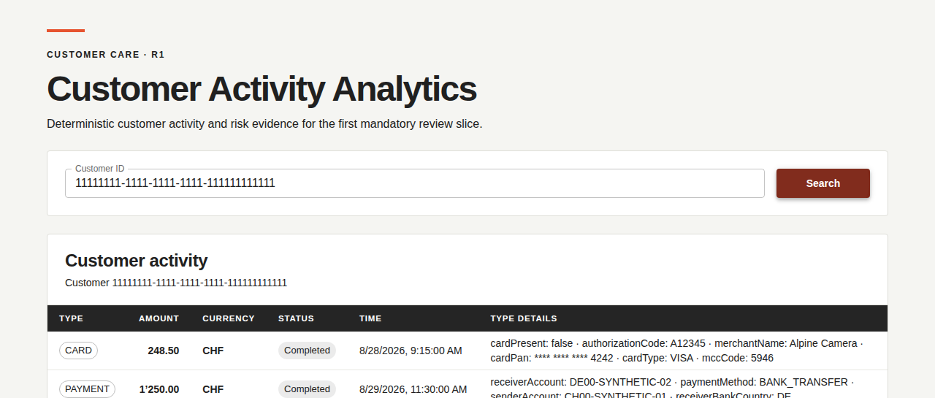
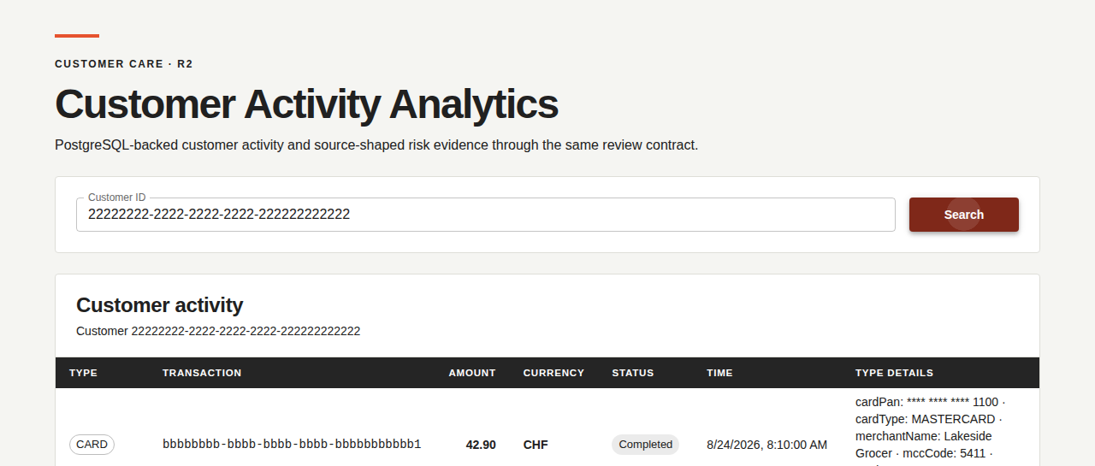
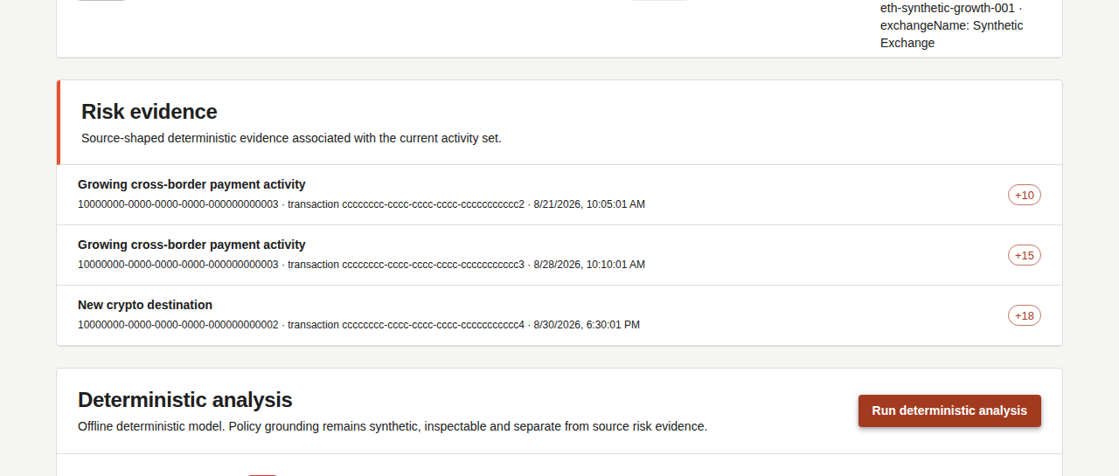
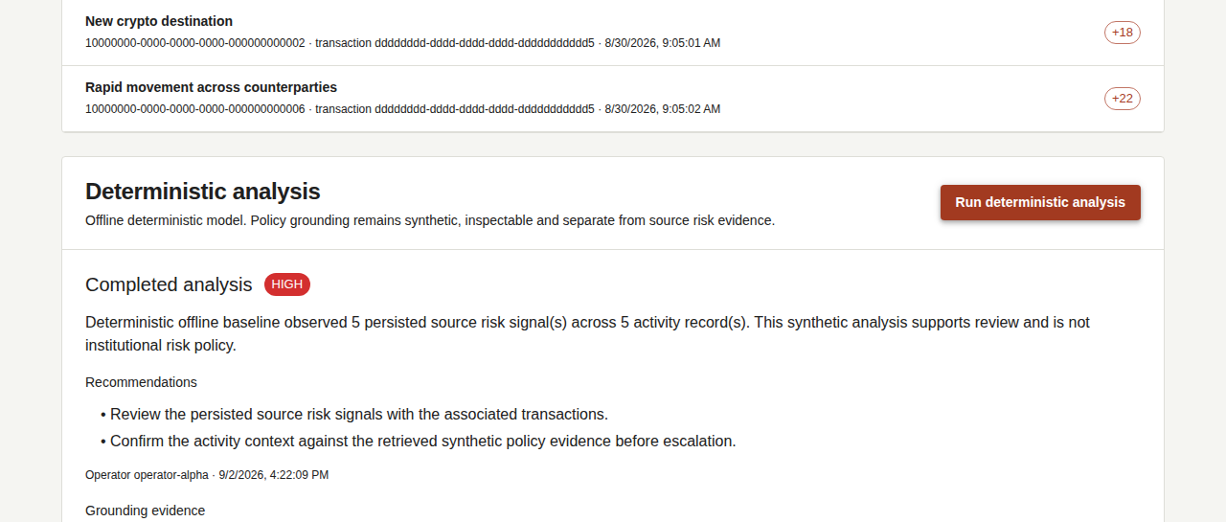
APPENDIX A · BROWSER EVIDENCE
Authentic Playwright captures document the capability growth from R1 to R5
R1
Synthetic review
R2
PostgreSQL
R3
Analysis + history
R4
Auth + retrieval
R5
FULL LM STUDIO DEMONSTRATOR
DELIVERED
TECHNICAL APPENDIX
A
Notes:
ANCHOR
These are crops from authentic Playwright screenshots, not reconstructed mockups.
SCRIPT
R1 shows the synthetic customer review. R2 shows storage substitution through the same visible contract. R3 adds deterministic analysis and history. R4 adds authenticated operator identity and real pgvector retrieval. The large R5 panel shows the completed local-model analysis, Stage 3 local provenance and persisted history. The R1-to-R3 source PNGs remain in the named Actions artifact; the manifest identifies and digests that artifact. Only the explicitly promoted R4 and R5 source PNGs are repository-owned.
DO NOT SAY
Do not treat image recency as newer than the source SHA in the manifest. Do not present these crops as GitHub Project views.
TRANSITION
Return to the relevant main slide or continue to the architecture appendix.
TIME
As needed
LIKELY QUESTION
Why trust these screenshots?
DIRECT ANSWER
The workflows assert the ring-specific behavior before retaining the Playwright artifact, and the manifest records run, artifact, digest, customer and source revision.
SOURCES
docs/reviewer/screenshot-manifest.md
R1/R2/R3 artifact 9844165175
R4 artifact 9856114241
R5 proof workflow 34020857953
R5 artifact 9985493952
docs/reviewer/screenshots/R5_lmstudio_ensemble_customer_444.png

Slide 16
APPENDIX B · DECISION RECORD
Eight ADRs concentrate the durable choices and their trade-offs
ADR-001
Modular monolith and strict hexagonal boundaries
ADR-005
One prebuilt application image per checkpoint
ADR-002
Provider-neutral analysis and trust boundary
ADR-006
Compose OCI and multi-platform distribution
ADR-003
PostgreSQL and pgvector as one persistent store
ADR-007
Explicit relational adapters with Spring JDBC
ADR-004
Preferred Java, Spring and React stack
ADR-008
Customer Activity Analytics product identity
https://github.com/jdoe-dev-159753/specgraph-reference-app/tree/main/docs/assignment/ADR
TECHNICAL APPENDIX
B
Notes:
ANCHOR
ADRs preserve the why behind choices that would otherwise look arbitrary.
SCRIPT
Open the individual links when a reviewer challenges a trade-off. The ADRs cover module shape, AI trust boundaries, persistence, stack reuse, packaging, distribution, relational access and reviewer-facing product identity. They record rejected alternatives and consequences rather than repeating the SDD.
DO NOT SAY
Do not treat ADRs as current execution evidence. Tests, code and workflow results own current behavior.
TRANSITION
Use the submodel slides only for mechanism-level questions.
TIME
As needed
LIKELY QUESTION
Why eight ADRs for a five-day exercise?
DIRECT ANSWER
Only choices with durable alternatives received an ADR. The records make substitution and later review cheaper without turning every implementation detail into architecture.
SOURCES
docs/assignment/ADR/
docs/assignment/SDD/SDD.md section 13

Slide 17
APPENDIX C · BETA-BINOMIAL DETECTOR
Three elevated observations shift the posterior toward higher review rates
Illustrative test case: 3 elevated observations out of 4
Beta(1, 4) updated to Beta(4, 5)
probability density f(p)
reference p = 0.40
4
prior Beta(1, 4), mean 0.20
3
posterior Beta(4, 5), mean 0.44
shaded posterior mass
P(p > 0.40) = 0.594
2
1
0.0
0.2
0.4
0.6
0.8
1.0
latent review-elevated rate p
The shaded tail is P(p > 0.40), not a probability of fraud or money laundering
TECHNICAL APPENDIX
C
Notes:
ANCHOR
The plot shows how evidence changes the whole distribution, not only the final scalar.
SCRIPT
The blue curve is the explicit Beta one-four prior. This test case maps three of four activities to review-elevated observations, producing Beta four-five. The red posterior shifts its mean from 0.20 to 0.44. The shaded area above the fixed 0.40 reference equals 0.594 and becomes the emitted signal.
DO NOT SAY
Do not call the result a probability of fraud or money laundering. Do not claim production calibration.
TRANSITION
The fuzzy alternative expresses graded thresholds instead of a binary observation mapping.
TIME
00:60 if asked
LIKELY QUESTION
What does the Bayesian score mean?
DIRECT ANSWER
It means the posterior probability that this synthetic review-elevated observation rate exceeds the fixed 0.40 reference, under the explicit Beta prior and mapping.
SOURCES
backend/src/main/java/dev/specgraph/reference/analysis/BayesianSequentialRiskSignalDetectorAdapter.java
backend/src/test/java/dev/specgraph/reference/analysis/BayesianSequentialRiskSignalDetectorAdapterTests.java
https://docs.scipy.org/doc/scipy/reference/generated/scipy.stats.beta.html

Slide 18
APPENDIX D · FUZZY INFERENCE
One overlapping partition turns prior-adjusted ratios into graded activation
Shared low / medium / high partition over every effective ratio
1
LOW
MEDIUM
HIGH
0
0.00
0.10
0.30
0.60
1.00
CRYPTO
INCOMPLETE
CROSS-BORDER
SOURCE RISK
weight 0.10
weight 0.10
weight 0.2625
weight 0.4875
1 · PRIOR-ADJUSTED FEATURE
3 · FIXED MONOTONE SURFACE
r_eff = positives / (observations + 2)
score = clamp₀₋₁(0.05 + 0.10·crypto + 0.10·incomplete
+ 0.2625·cross-border + 0.4875·source-risk)
2 · ACTIVATION
degree = 0.5 × μmedium + μhigh
Coupled min(cross-border, source-risk) is retained for diagnosis
Add-two zero-positive prior · thresholds 0.10 / 0.30 / 0.60
Its consequent weight is 0: no double counting · not an AML probability
TECHNICAL APPENDIX
D
Notes:
ANCHOR
The delivered v3 detector applies one overlapping low-medium-high partition to four prior-adjusted feature ratios.
SCRIPT
Each effective ratio divides its positive count by the observation count plus two zero-positive prior observations. The shared partition is low through 0.10, peaks at medium at 0.30 and reaches high at 0.60. Activation equals one half of the medium membership plus the high membership. The final bounded surface adds a 0.05 baseline and fixed weights of 0.10, 0.10, 0.2625 and 0.4875 for crypto, incomplete, cross-border and source-risk activation. The coupled minimum remains visible in provenance with zero consequent weight so the same evidence is not counted twice.
DO NOT SAY
Do not call fuzzy membership or the final score a statistical probability. Do not claim these synthetic thresholds are institutional policy or calibrated AML parameters.
TRANSITION
The next conditional slide explains how different detector families could be arbitrated after their semantics become comparable.
TIME
00:60 if asked
LIKELY QUESTION
Why add two observations and use overlapping memberships?
DIRECT ANSWER
The add-two prior prevents tiny samples from saturating the detector, while the partition makes changes continuous and inspectable. Both are versioned heuristic choices, not learned or institutionally validated parameters.
SOURCES
backend/src/main/java/dev/specgraph/reference/analysis/FuzzyRiskSignalDetectorAdapter.java
backend/src/test/java/dev/specgraph/reference/analysis/FuzzyRiskSignalDetectorAdapterTests.java

Slide 19






APPENDIX E · CONDITIONAL DESIGN TARGET
Late fusion requires comparable semantics before signals can be combined
R5 · NOT YET MEASURED
DETERMINISTIC
source-shaped baseline
BAYESIAN
small-sample posterior
SEMANTIC
ALIGNMENT
LATE
FUSION
ONE SIGNAL
FUZZY
evidence retained
graded rule activation
aligned target and scale
weighting and arbitration
RANDOM FOREST
learned tree votes
Hypothesis: complementary blind spots may improve robustness. A frozen benchmark must measure that gain.
TECHNICAL APPENDIX
E
Notes:
ANCHOR
Late fusion is a future arbitration stage, not the current Composite behavior.
SCRIPT
Each detector specializes in a different view of the same bounded facts. After score semantics and calibration become comparable, a late-fusion stage could weight or arbitrate those signals. The fused output should retain the child evidence so disagreement and provenance remain inspectable. The expected benefit is complementary error behavior, but this project has not yet measured an accuracy or generalization gain.
DO NOT SAY
Do not present current Composite execution as calibrated fusion. Do not claim accuracy improvement without a frozen benchmark.
TRANSITION
The forest slide explains one candidate specialist.
TIME
00:55 if asked
LIKELY QUESTION
Why combine several weak detectors?
DIRECT ANSWER
Specialists can make different errors. Fusion is useful only if comparable semantics and evaluation show that those differences improve the final signal.
SOURCES
GitHub issue #224
GitHub issue #254
GitHub issue #268
Lucide icon library, ISC license

Slide 20
APPENDIX F · DELIVERED R5 DETECTOR
A Random Forest averages many bounded tree votes behind the same detector port
R5 · DELIVERED
cross-border ratio > t₁
incomplete ratio > t₃
crypto ratio > t₅
crypto ratio > t₂
1
activity volume > t₄
1
cross-border ratio > t₆
1
0
1
0
1
0
1
Forest output = mean of tree votes for REVIEW_ELEVATED
Vote share, not a calibrated probability · synthetic training only
TECHNICAL APPENDIX
F
Notes:
ANCHOR
The forest visual shows actual trees and the runtime aggregation semantics.
SCRIPT
Each tree splits the bounded feature vector and emits one class vote. The runtime model averages votes for REVIEW_ELEVATED. Training is offline with a fixed seed and packaged model provenance. The adapter remains behind RiskSignalDetectorPort, so downstream grounding and synthesis do not know Tribuo types.
DO NOT SAY
Do not call the vote share a calibrated probability. Do not claim production AML validity from synthetic training.
TRANSITION
Return to the fusion target only if the reviewer asks how this specialist would combine with others.
TIME
00:55 if asked
LIKELY QUESTION
Why Random Forest after Bayesian and fuzzy detectors?
DIRECT ANSWER
It adds a learned non-neural baseline with different inductive assumptions while keeping the same bounded features and evidence contract.
SOURCES
GitHub issue #223
GitHub PR #439
RiskSignalDetectorPort
RandomForestRiskSignalDetectorAdapter

Slide 21







APPENDIX G · BACKEND DATA FLOW
Stage 3 backend choice changes execution while preserving context and output contracts
R5 · DELIVERED
DETERMINISTIC
landed baseline
OPENAI
EVIDENCE
ENVELOPE
TYPED FACTORY
optional adapter
ONE OUTPUT
identity and capability checks
severity, findings and provenance
source, detector, policy
LM STUDIO
delivered local R5
Validated output
persisted to history
Default path sends no customer or policy content outside the local system
TECHNICAL APPENDIX
G
Notes:
ANCHOR
Stage 3 selection is a factory concern, not application semantics.
SCRIPT
The bounded envelope enters one typed selection point. Deterministic execution remains the mandatory baseline. OpenAI remains opt-in. R5 delivers LM Studio as the local substitution. Every adapter returns the same structured result and model provenance. The grounding validator and history contract remain unchanged.
DO NOT SAY
Do not imply that local execution proves model quality. The delivered claim covers runtime selection, bounded structured exchange, provenance and the browser-visible result.
TRANSITION
The final appendix slide maps behaviors to the evidence level that proves them.
TIME
00:55 if asked
LIKELY QUESTION
Why retain the deterministic backend after adding a live model?
DIRECT ANSWER
It keeps mandatory verification reproducible, isolates retrieval and orchestration failures, and provides a supported fallback without changing the operator workflow.
SOURCES
AnalysisModelPort
AnalysisEvidenceEnvelope
GitHub PR #439
GitHub issue #251
docs/reviewer/r5-runtime.md
Lucide icon library, ISC license

Slide 22



APPENDIX H · VERIFICATION EVIDENCE
Each behavior maps to the highest boundary that can prove it
REVIEWER-VISIBLE BEHAVIOR
EVIDENCE BOUNDARY
Operator can log in and reopen history
Playwright against the packaged topology
Retrieved policy chunks remain attributable
PostgreSQL and pgvector integration
Adapters preserve the application contract
Port contract tests across substitutions
Scores remain bounded and repeatable
Unit and property tests
Traceability: SRS and design IDs, test markers, workflow artifact and exact source SHA
TECHNICAL APPENDIX
H
Notes:
ANCHOR
Evidence strength follows the behavior being claimed.
SCRIPT
Unit and property tests own value and algorithm invariants. Port contracts own substitution. Integration tests own real database, security and retrieval semantics. Playwright and deployment evidence own visible composition. Stable requirement and design IDs, test markers, workflow artifacts and exact source SHAs keep the path traceable.
DO NOT SAY
Do not use a test count or an old green workflow as a quality claim. Evidence remains bound to its behavior and source revision.
TRANSITION
Return to the main conclusion.
TIME
As needed
LIKELY QUESTION
Why retain browser evidence if integration tests pass?
DIRECT ANSWER
Authentication, navigation, visible provenance and later history are operator-visible behaviors that lower test layers cannot prove in composition.
SOURCES
docs/assignment/VV/VV.md
docs/assignment/VV/verification.yaml
docs/reviewer/screenshot-manifest.md
Lucide icon library, ISC license

