Slide 1
CS 4398 SPRING 2026
D1
D2
Space – Debris Tracking Application
SC
A dashboard that loads debris catalogs, applies constant-velocity screening, and turns encounter metrics into operator-readable alerts.
D4
D3
D5
Ethan Bogart, Megan Botha, Jared Beasley
CSV
TCA
MVC
catalog input
closest approach
architecture
id, position vector, velocity vector
minimum separation and relative velocity
model, controller, view separation
01

Slide 2
APP PURPOSE
The app narrows a debris catalog into a short risk queue.
It is a screening dashboard for a mission-operations view.
Inputs
Processing
Outputs
CSV catalog
Spacecraft state
Analysis window
Validate schema
Propagate motion
Compute encounter metrics
Ranked alert table
Close-approach timeline
Plots, geometry, CSV export
>
>
02

Slide 3
IMPLEMENTED CAPABILITIES
App Functionality Process
Load
Validate
Analyze
Rank
Present
DebrisCatalogLoader reads CSV headers and aliases.
>
CatalogValidator and InputValidator reject malformed data.
>
EncounterAnalyzer calculates TCA, separation, and relative velocity.
>
RiskScoreCalculator creates a transparent severity score.
>
DashboardView / GuiDashboardView refresh tables and plots.
03

Slide 4
MVC ARCHITECTURE
MVC separates orbital math from user actions and display updates
View
Controller
Model
user actions
model calls
DashboardView
GuiDashboardView
DashboardPresenter
>
DashboardController
>
DebrisTrackingModel
services.py
entities.py
Handles load catalog, spacecraft parameters, analysis config, run analysis, and CSV export.
Displays catalog count, alerts, timeline, distance plots, geometry, and errors.
Owns catalog, spacecraft state, analysis configuration, ranked results, events, and export.
04

Slide 5
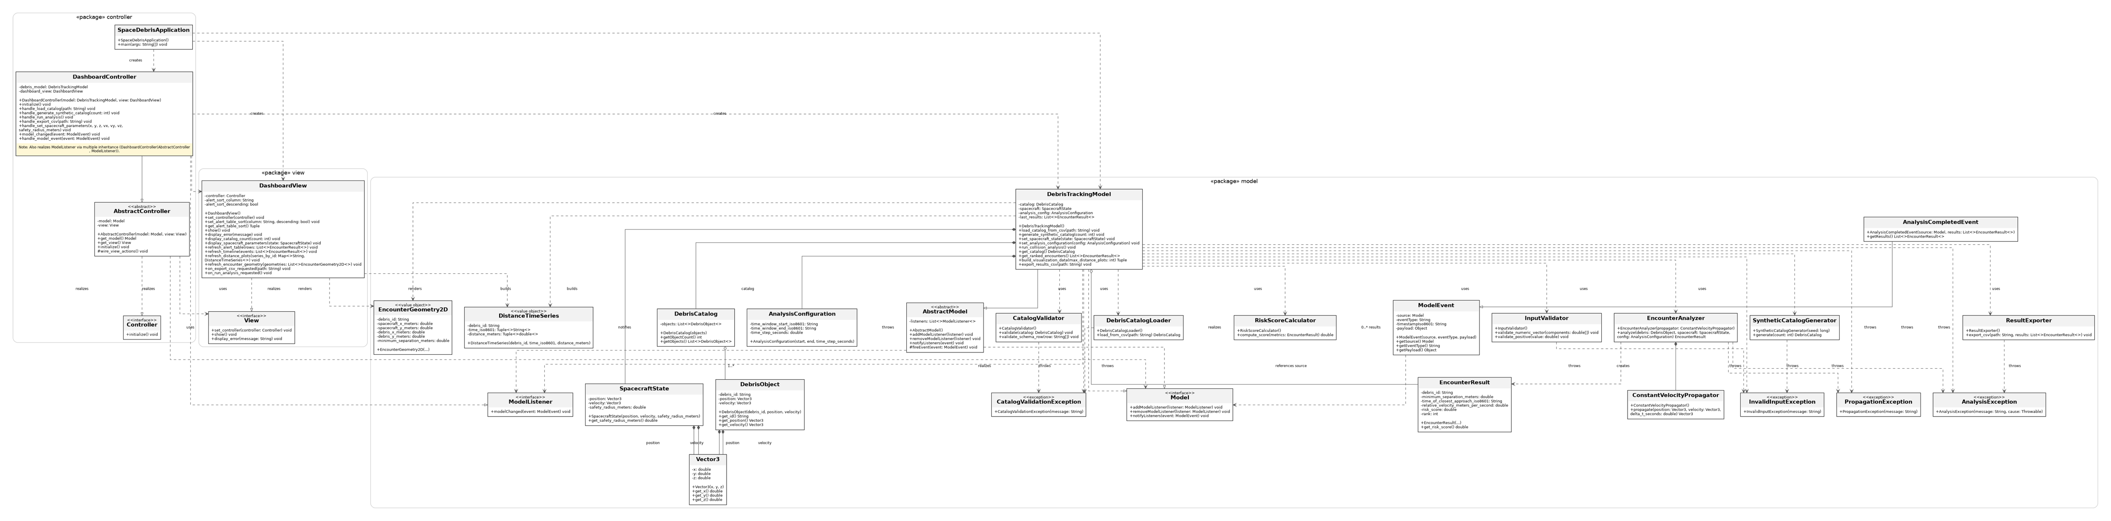
UML Diagram
Class Diagram Structure
05

Slide 6
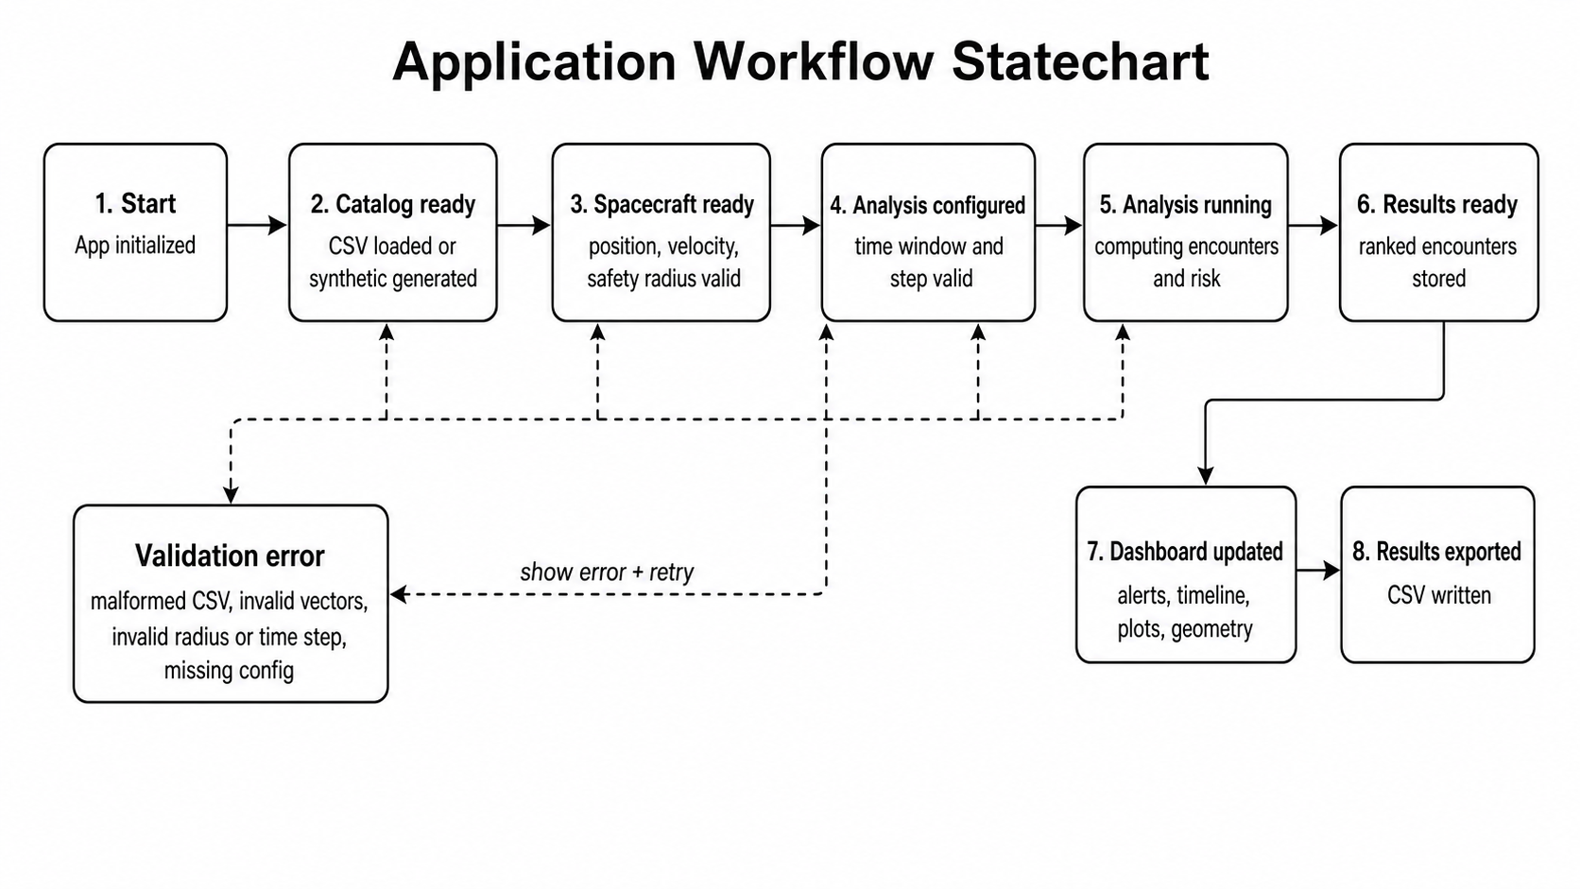
STATECHART
Application Workflow State chart
05

Slide 7
ANALYSIS MODEL
How it Tracks
Relative state
r = debris - spacecraft
v = debris - spacecraft
Closest approach
TCA = clamp(-(r dot v)/|v|^2)
Propagate to TCA
p(t) = p0 + velocity * t
Rank by score
min separation + relative speed
>
>
>
Risk formula used in code
Test Example
score = min(1.0, 1000 / max(min_sep_m, 1) + 0.1 * (relative_velocity_mps / 10000))
A debris object starting 100 m ahead and closing at 2 m/s reaches TCA at 50 seconds with 0 m separation.
06

Slide 8
DASHBOARD OUTPUTS
Five Output Results from Dashboard
Ranked alerts
Close-approach timeline
Distance plots
Sortable rows by rank, risk, separation, relative velocity, or TCA.
Chronological scan of predicted TCAs and severity.
Sampled separation over time for the top ranked objects.
XY encounter geometry
CSV export
Spacecraft/debris positions at closest approach.
Reusable ranked results table for reports or follow-up analysis.
07

Slide 9
TESTING
Acceptance Test Cases
Test Case
Acceptance condition
Evidence
Load debris catalog
Given a valid CSV with id/x/y/z/vx/vy/vz, when loaded, then object count and IDs are preserved.
test_catalog_loading
Reject bad catalog data
Given missing columns, non-numeric values, duplicates, or empty catalogs, then validation raises clear exceptions.
test_catalog_loading
Validate spacecraft inputs
Given finite numeric vectors and positive safety radius, state is set; invalid values preserve prior state or fail.
test_spacecraft_parameters
Compute collision metrics
Given known relative motion, then TCA, minimum separation, and relative velocity match expected values.
test_collision_analysis
Rank and visualize results
Given multiple objects, then risk order, ranks, sampled distance series, and dashboard refreshes are produced.
test_collision_analysis + test_visualization
08

Slide 10
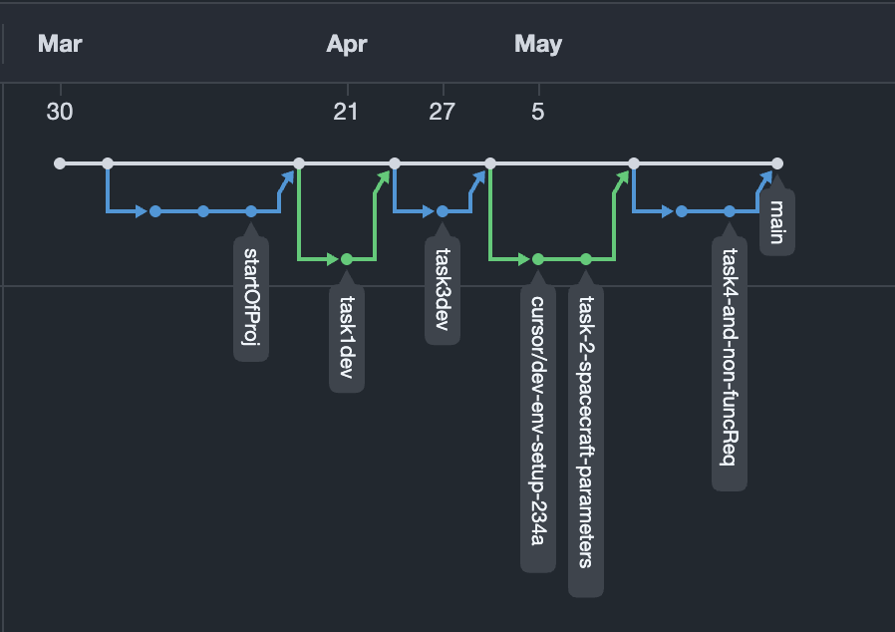
GITHUB
Network
09

