Slide 1
컴퓨터 알고리즘
담당 : 김경중

Slide 2
분할정복
문제의 입력사례를 2개 이상의 작은 입력사례로 분할
하향식(Top-down) 문제풀이 방식
재귀호출로 구현한 후 개선

Slide 3
이분검색
Locate key x in an array of size n sorted in non-decreasing order
Compare x with the middle element – if equal, done – quit. Else
Divide the Array into two sub-arrays approximately half as large
If x is smaller than the middle item, select left sub-array
If x is larger than the middle item, select right sub-array
Conquer (solve) the sub-array: Is x in the sub-array using recursion until the sub-array is sufficiently small?
Obtain the solution to the array from the solution to the subarray

Slide 4
분할정복 재귀알고리즘
나누는 방법
종료조건
답을 구하는 방법

Slide 5
이분검색

Slide 6
꼬리재귀 (tail-recursion)
호출 이후에 더 이상 연산이 없는 재귀호출
반복 알고리즘으로 변환 용이
컴파일러에서 자동 변환 가능
메모리 절약
함수호출 시간절약

Slide 7
최악 시간복잡도 분석
n is a power of 2 and x > S[n]
W(n) = W(n/2) + 1 for n>1 and n power of 2
W(1) = 1
W(n/2) = the number of comparisons in the recursive call
1 comparison at the top level
Example B1 in Appendix B:
W(n) = lg n + 1
n not a power of 2
W(n) = ⎣lg n ⎦ +1 ε θ(lg n)

Slide 8

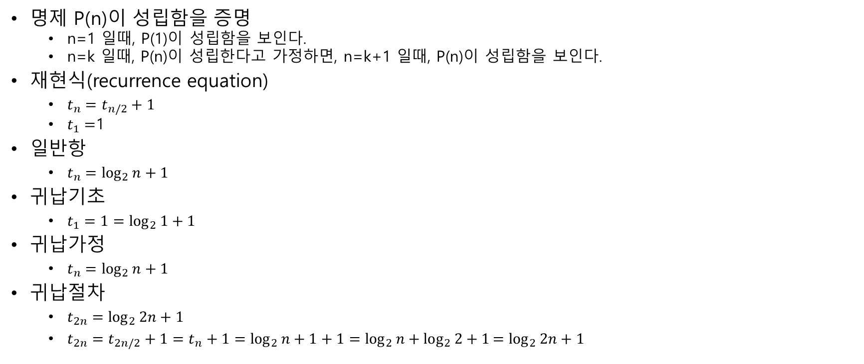

수학적 귀납법을 이용한 재현식의 해 구하기
명제 P(n)이 성립함을 증명
n=1 일때, P(1)이 성립함을 보인다.
n=k 일때, P(n)이 성립한다고 가정하면, n=k+1 일때, P(n)이 성립함을 보인다.
재현식(recurrence equation)
$t_{n}=t_{n/2}+1$
$t_{1}=$1
일$반항$
$t_{n}=\log_{2}{n}+1$
귀납기초
$t_{1}=1=\log_{2}{1}+1$
귀납가정
$t_{n}=\log_{2}{n}+1$
귀납절차
$t_{2n}=\log_{2}{2n}+1$
$t_{2n}=t_{2n/2}+1=t_{n}+1=\log_{2}{n}+1+1=\log_{2}{n}+\log_{2}{2}+1{=log}_{2}{2n}+1$
W(n) = w(n/2) +1

Slide 9
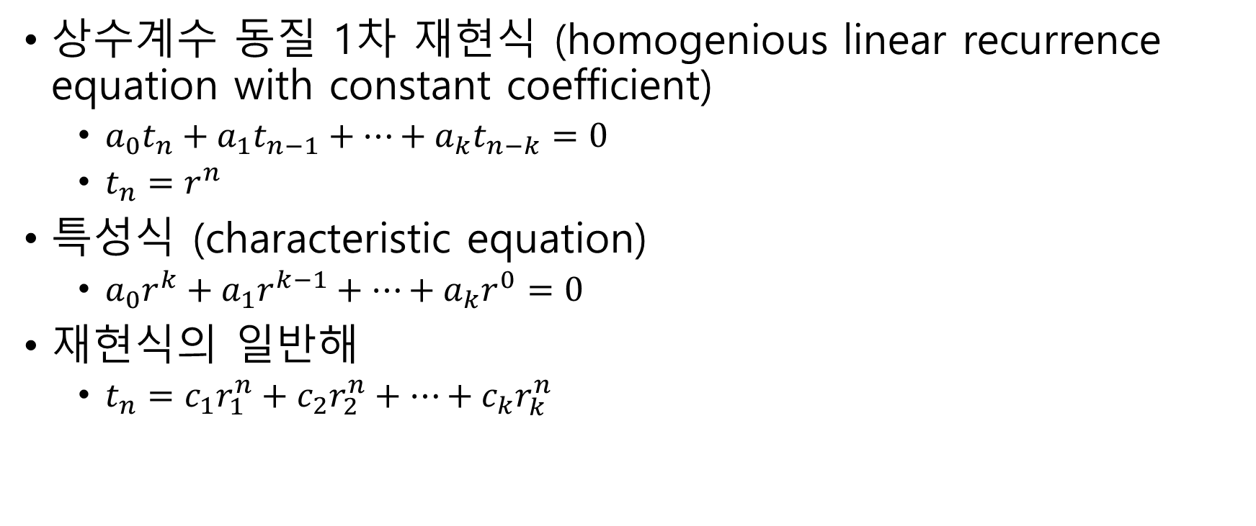
특성식을 이용한 재현식의 해 구하기
상수계수 동질 1차 재현식 (homogenious linear recurrence equation with constant coefficient)
$a_{0}t_{n}+a_{1}t_{n−1}+…+a_{k}t_{n−k}=0$
$t_{n}=r^{n}$
특성식 (characteristic equation)
$a_{0}r^{k}+a_{1}r^{k−1}+…+a_{k}r^{0}=0$
재현식의 일반해
$t_{n}=c_{1}r_{1}^{n}+c_{2}r_{2}^{n}+…+c_{k}r_{k}^{n}$

Slide 10

피보나치 수열
재현식
$t_{n}−t_{n−1}$ $−t_{n−2}=0$
$t_{0}=0$
$t_{1}=1$
특성식
$r^{2}−r^{1}−r^{0}=0$
$r^{2}−r−1=0$
$r=\frac{1±\sqrt{5}}{2}$
재현식의 일반해
$t_{n}=c_{1}{\left(\frac{1+\sqrt{5}}{2}\right)}^{n}+c_{2}{\left(\frac{1−\sqrt{5}}{2}\right)}^{n}$
초기 조건을 이용하여 상수 c1, c2 구함
$c_{1}=\frac{1}{\sqrt{5}},c_{2}=−\frac{1}{\sqrt{5}}$
재현식의 특정해
$t_{n}=\frac{{\left[(1+\sqrt{5})/2\right]}^{n}−{\left[(1−\sqrt{5})/2\right]}^{n}}{\sqrt{5}}$

Slide 11
합병정렬
Sort an array S of size n (for simplicity, let n be a power of 2)
Divide S into 2 sub-arrays of size n/2
Conquer (solve) recursively sort each sub-array until array is sufficiently small (size 1)
Combine merge the solutions to the sub-arrays into a single sorted array

Slide 12
합병정렬

Slide 13
합병정렬

Slide 14
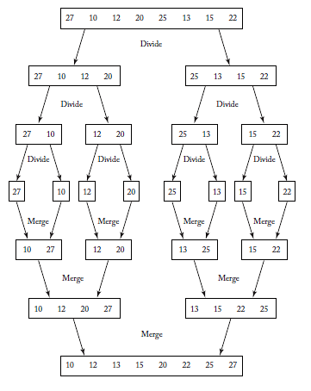
Figure 2.2

Slide 15
Merge
Merges the two arrays U and V created by the recursive calls to mergesort
Input size
h the number of items in U
m the number of items in V
Basic operation:
Comparison of U[I] to V[j]
Worst case:
Loop exited with one index at exit point and the other one less than the exit point

Slide 16
Worst-Case Time Complexity Analysis
W(n) = time to sort U + time to sort V + time to merge
W(n) = W(h) + W(m) + h+m-1
First analysis assumes n is a power of 2
h = ⎣n/2⎦ = n/2
m = n – h = n – n/2 = n/2
h + m = n/2 + n/2 = n
W(n) = W(n/2) + W(n/2) + n – 1
= 2W(n/2) + n-1 for n > 1 and n a power of 2
W(1) = 0
From B19 in Appendix B
W(n)=nlgn-(n-1) ε θ(nlgn)

Slide 17
Worst-Case Analysis Mergesort
n not a power of 2
W(n)=W(⎣n/2⎦) + W(⎡n/2⎤) + n-1
From Theorem B4:
W(n) ε Θ(nlgn)

Slide 18
제자리 정렬

Slide 19
빠른정렬(Quick Sort)
Array recursively divided into two partitions and recursively sorted
Division based on a pivot
pivot divides the two sub-arrays
All items < pivot placed in sub-array before pivot
All items >= pivot placed in sub-array after pivot

Slide 20
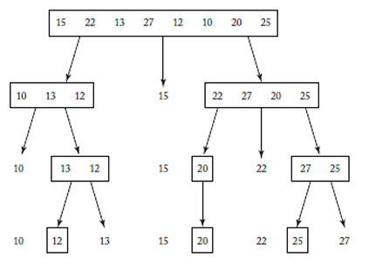
Figure 2.3

Slide 21
Basic operation
Comparison of S[i] with pivotitem
Input size n

Slide 22
Partition
T(n) = n - 1

Slide 23
Worst-Case Complexity Analysis of Quicksort
Array is sorted in non-decreasing order
Array is repeatedly sorted into an empty sub-array which is less than the pivot and a sub-array of n-1 containing items greater than pivot
If there are k keys in the current sub-array, k-1 key comparisons are executed

Slide 24
Worst-Case Complexity Analysis of Quicksort
T(n) is specified because analysis is for the every-case complexity for the class of instances already sorted in non-decreasing order
T(n) = time to sort left sub-array + time to sort right sub-array + time to partition
T(n) = T(0) + T(n-1) + n – 1
T(n) = T(n – 1) + n – 1 for n > 0
T(0) = 0
From B16
T(n) = n(n-1)/2

Slide 25
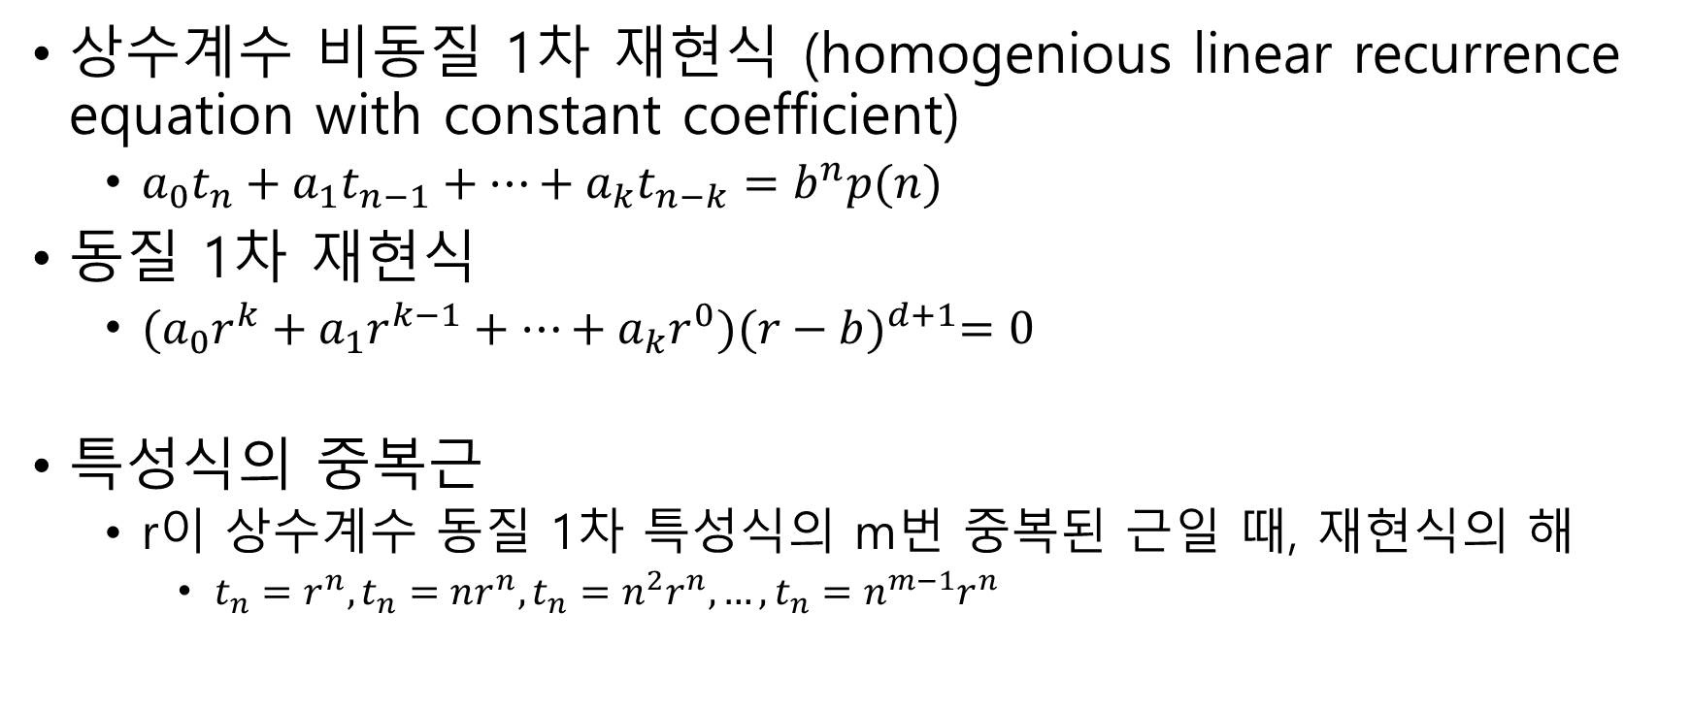
특성식을 이용한 재현식의 해 구하기
상수계수 비동질 1차 재현식 (homogenious linear recurrence equation with constant coefficient)
$a_{0}t_{n}+a_{1}t_{n−1}+…+a_{k}t_{n−k}=b^{n}p(n)$
동질 1차 재현식
$(a_{0}r^{k}+a_{1}r^{k−1}+…+a_{k}r^{0}){(r−b)}^{d+1}=0$
특성식의 중복근
r이 상수계수 동질 1차 특성식의 m번 중복된 근일 때, 재현식의 해
$t_{n}=r^{n},t_{n}=nr^{n},t_{n}=n^{2}r^{n},…,t_{n}=n^{m−1}r^{n}$

Slide 26
치환을 이용하여 재현식의 해 구하기
T(n) = T(n – 1) + n – 1
=T(n-2) + n-2 + n-1
=T(n-3) + n-3 + n-2 + n-1
=T(0) + 0 + 1 + … + n-1
= n(n-1)/2

Slide 27

빠른정렬
재현식
$t_{n}−t_{n−1}=n−1, for n>0$
$t_{0}=0$
특성식
$r^{1}−r^{0}=0$
$r=1$
재현식으로부터 b, d를 구한다
$n−1=1^{n}\left(n^{1}−1\right)$
특성식
${(r−1)}^{3}=0$
재현식의 일반해
$t_{n}=c_{1}1^{n}+c_{2}n1^{n}+c_{3}n^{2}1^{n}$= $c_{1}+c_{2}n+c_{3}n^{2}$
추가 초기조건
$t_{1}=0,t_{2}=1$
초기 조건을 이용하여 상수 c1, c2, c3 구함
$c_{1}=0,c_{2}=−\frac{1}{2}.c_{2}=\frac{1}{2}$
재현식의 특정해
$t_{n}=\frac{n(n−1)}{n}$

Slide 28
Worst Case
At least n(n-1)/2
Use induction to show it is the worst case
W(n)<=n(n-1)/2

Slide 29
Worst Case
At least n(n-1)/2
Use induction to show it is the worst case
W(n)<=n(n-1)/2

Slide 30
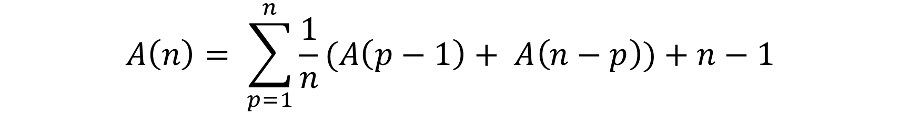
Average-Case Time Complexity of Quicksort
Value of pivotpoint is equally likely to be any of the numbers from 1 to n
Average obtained is the average sorting time when every possible ordering is sorted the same number of times
An= p=1n1n(Ap-1+ An-p+n-1)
1/n is the probability pivotpoint is p
Solving equation and using B22
A(n) ε θ(nlgn)

