Slide 1
Implementing a Flow Afterburner for sHIJING

Slide 2
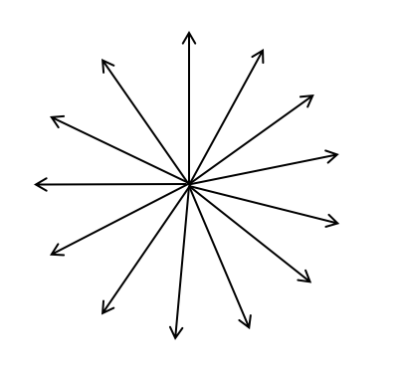

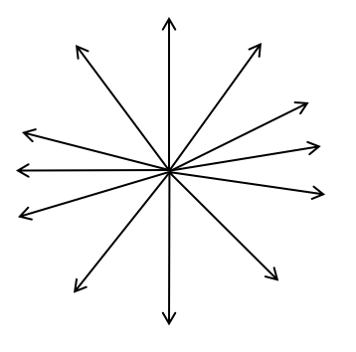
Statement of the Problem
sHIJING
We want to write an afterburner that takes sHIJING output, in the form of a HepMC text file, and modifies the uniform azimuthal distribution of particles to have flow modulations.
This needs to be done in a pT- and centrality-dependent manner.
Local correlations (like jets) need to be preserved
HepMC File Event Record
Flow Afterburner
Modified HepMC Event Record

Slide 3
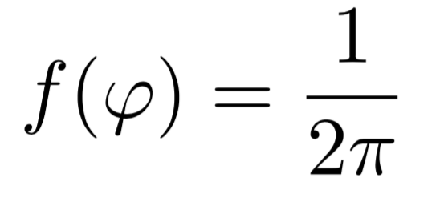
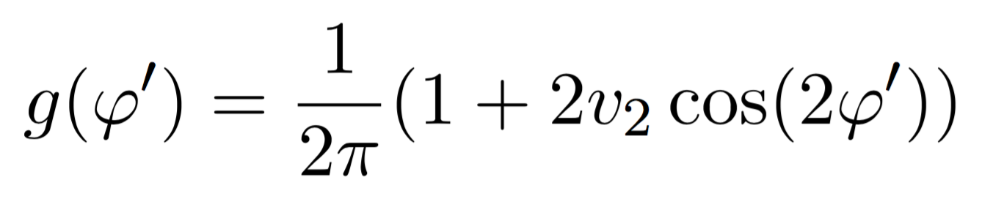
(Mathematical) Statement of the Problem
Let the azimuthal angle φ of particles at a given p_{T} be a random variable distributed uniformly in [0, 2π]
We want to find a mapping y :φ → φ’ where φ’ is a new random variable distributed according to
Such a mapping guarantees that local particle correlations (e.g., jets) are preserved, while constructing a global flow correlation of strength v_{2.}

Slide 4
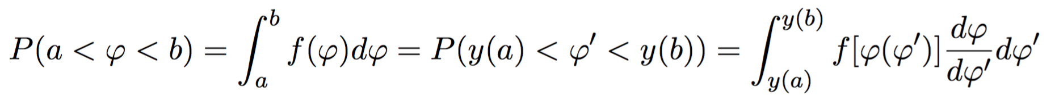
(Mathematical) Statement of the Problem
The probability of φ being between values a and b is given by:

Slide 5
(Mathematical) Statement of the Problem
The probability of φ being between values a and b is given by:
But, given the mapping y :φ → φ’, it should also be equal to the probability of φ’ being between y(a) and y(b)

Slide 6
Transforming Probability Density Distributions
The probability of φ being between values a and b is given by:
But, given the mapping y :φ → φ’, it should also be equal to the probability of φ’ being between y(a) and y(b)
This is akin to integration by substitution of variables

Slide 7
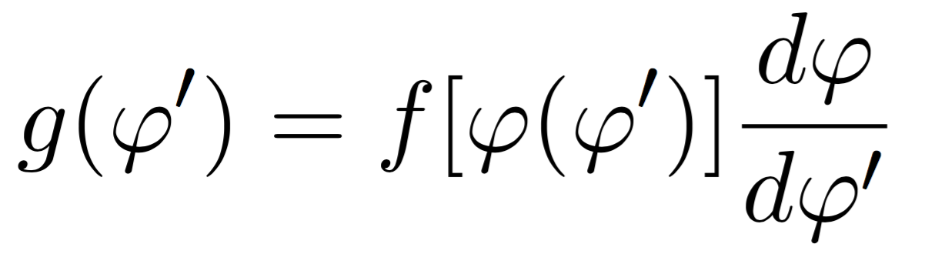
Transforming Probability Density Distributions
Comparing the integrands of the expressions in the previous slide, we see that the
probability distributions and the mapping should satisfy the following differential
equation, which must be solved for φ’(φ)

Slide 8
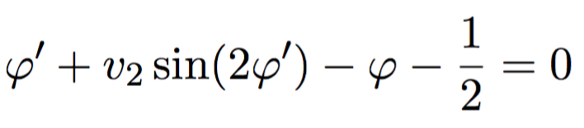
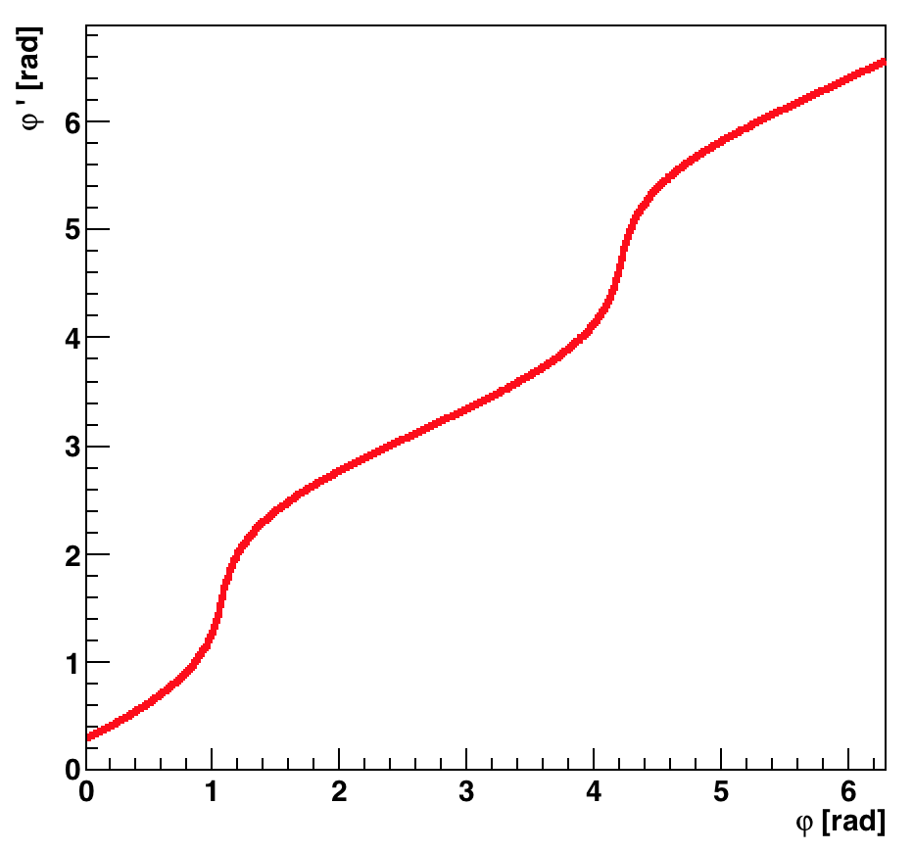
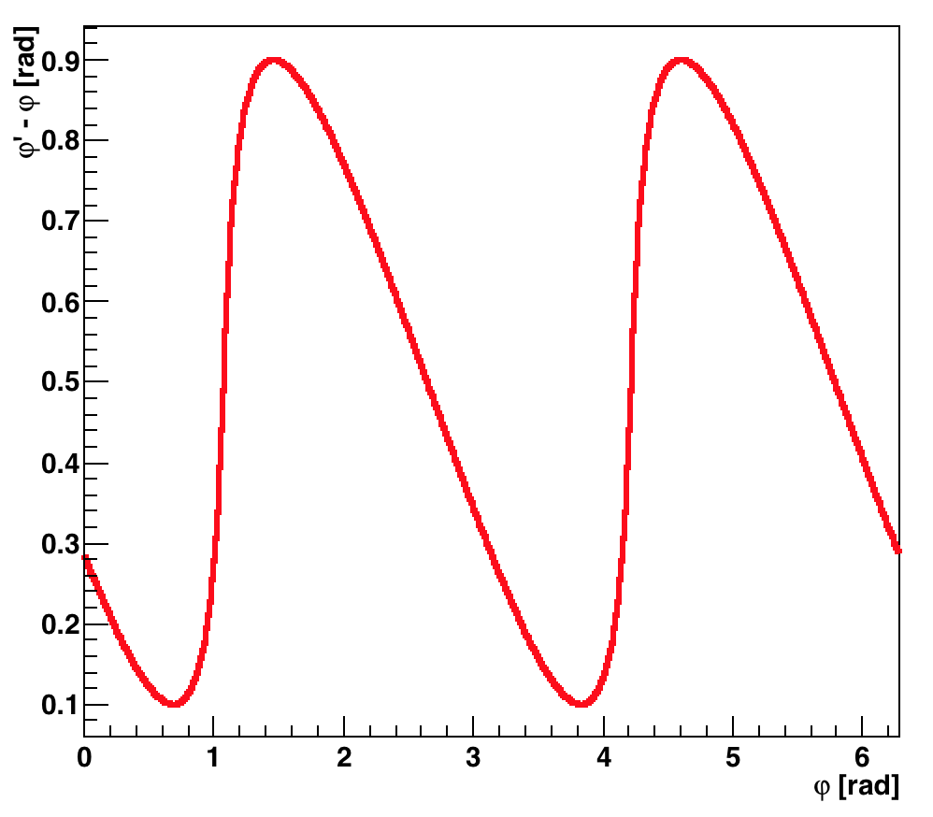
Transforming Probability Density Distributions: A Toy Problem
In our case, with and v₂ = 0.4, we obtain the following transcendental equation
which can be solved numerically for φ’, as shown below:

Slide 9
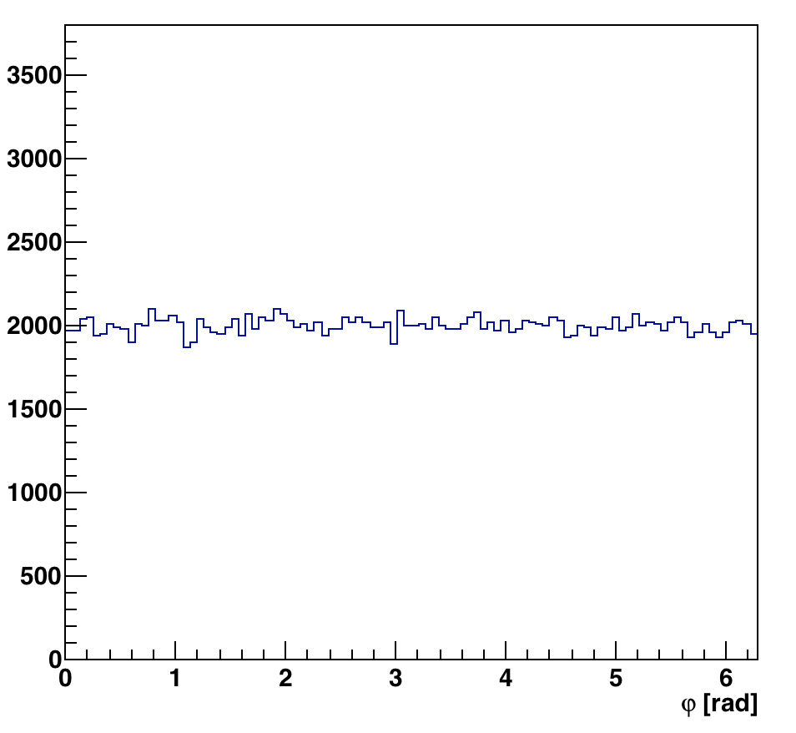
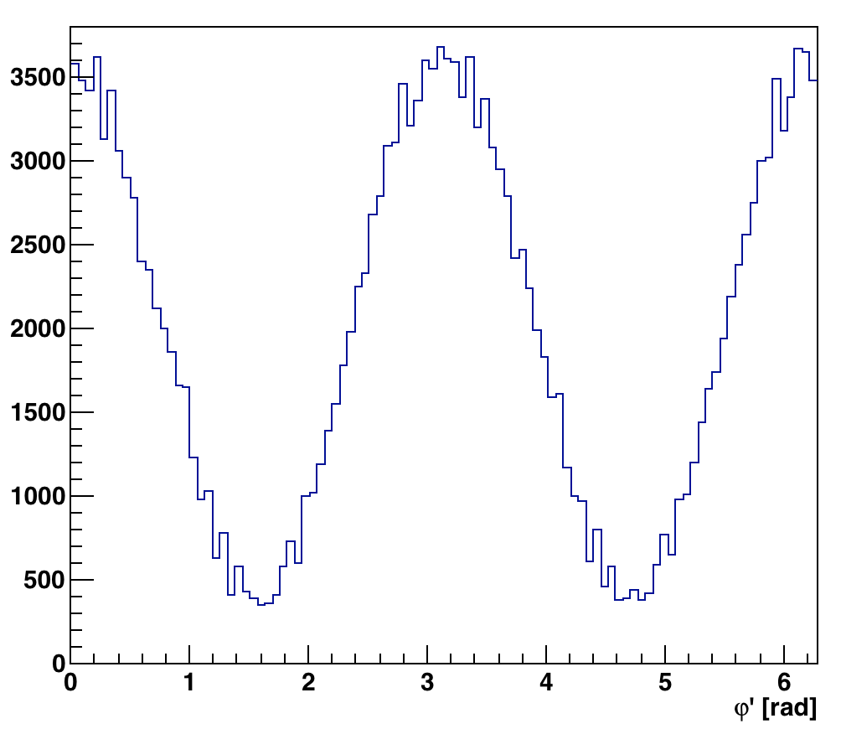
Transforming Probability Density Distributions: A Toy Problem
1 + 2 x 0.4 x Cos(2φ)
The mapping is applied to every single particle, originally with uniform azimuthal distribution, obtaining the new azimuthal distribution shown on the right.

Slide 10
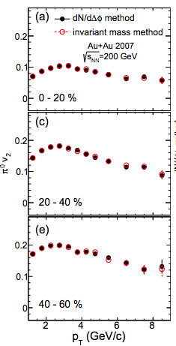
Centrality-Dependent v₂ for Identified Pions in Au+Au Collisions

Slide 11
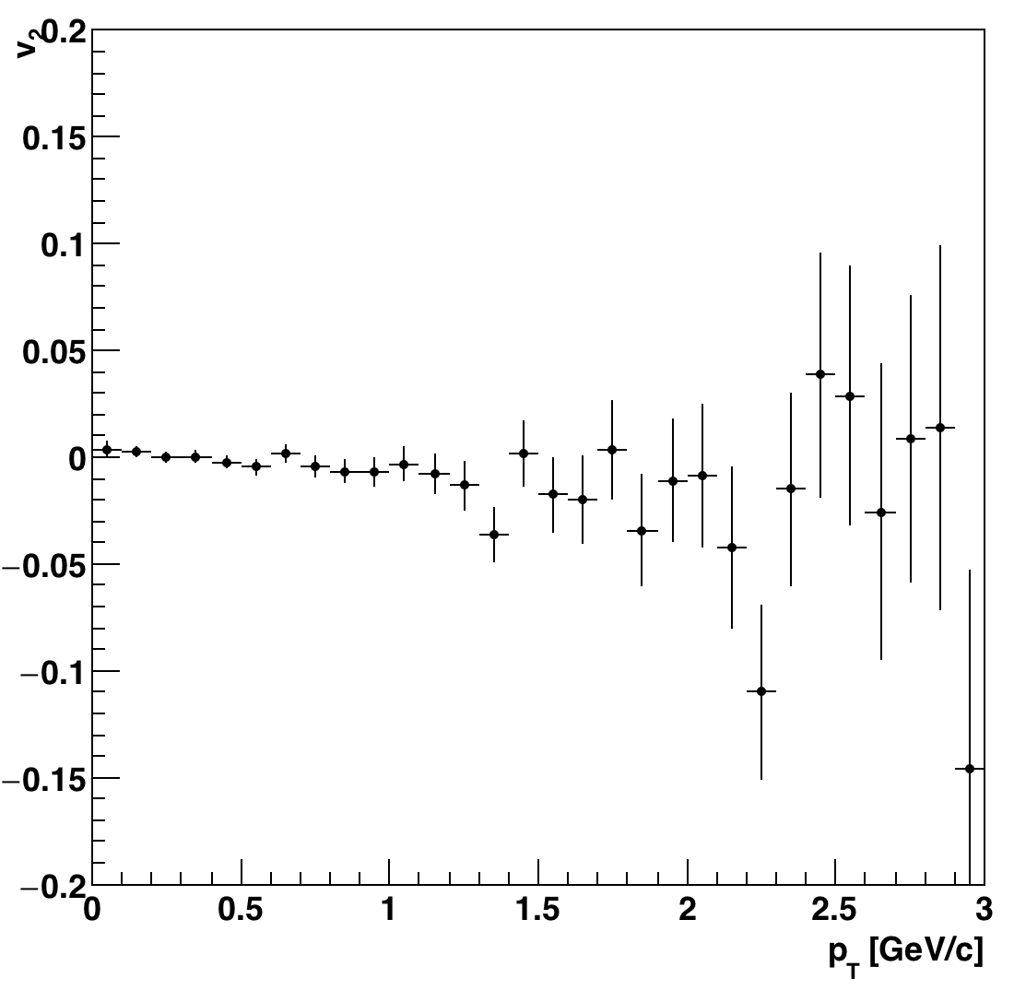
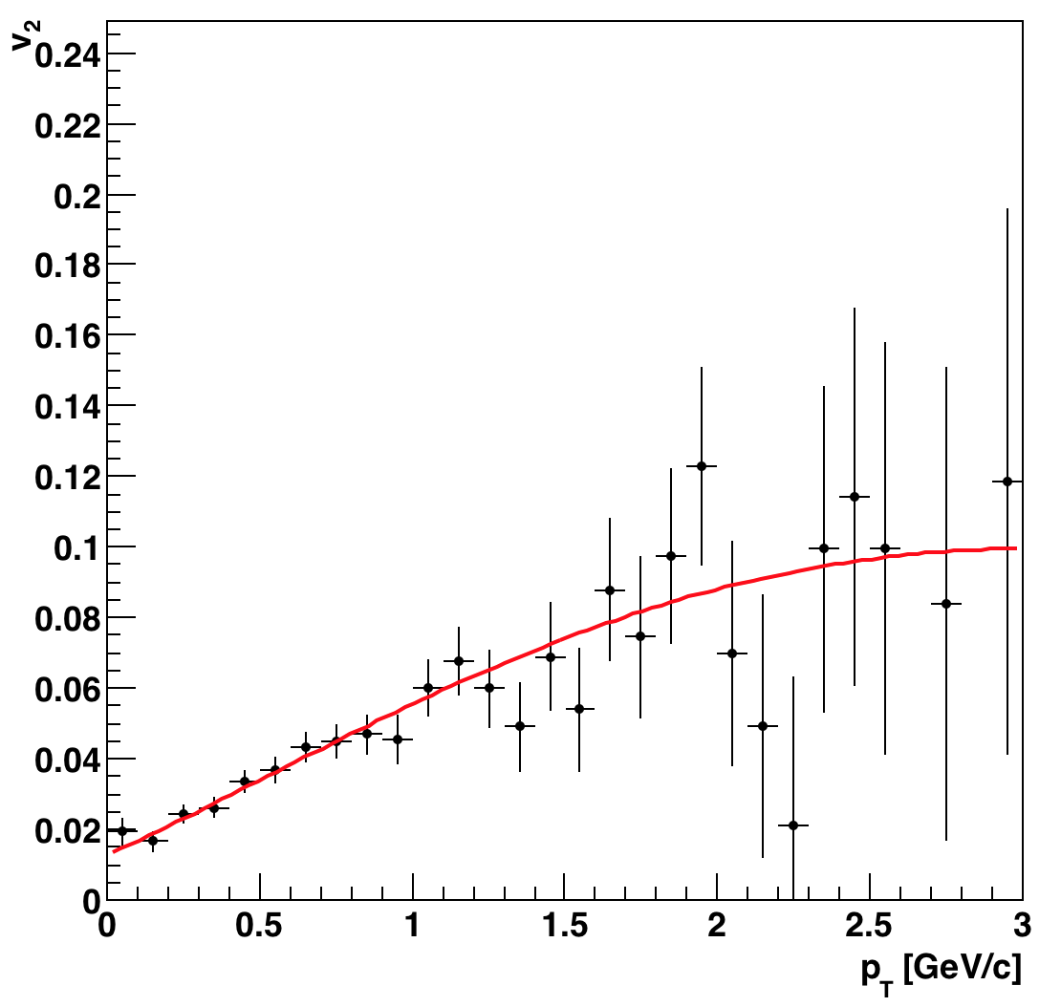
Centrality-Dependent v₂ for Identified Pions in Au+Au Collisions

