Slide 1


Computer Networks X_400487
Lecture 7
Chapter 5: The Network Layer—Part 1
Lecturer: Jesse Donkervliet

Slide 2
Recap Data Link Layer
Data link layer (partially) answers the following questions:
How create frames from bits/bytes?
How to detect/correct transmission errors?
How to efficiently multiplex frames from multiple stations over a single channel?
MAC sublayer
Q: What kind of efficiency?
…
…
Data Link
Data Link
Physical
Physical
channel

Slide 3
Recap Data Link Layer
Data link layer (partially) answers the following questions:
How create frames from bits/bytes?
How to detect/correct transmission errors?
How to efficiently multiplex frames from multiple stations over a single channel?
MAC sublayer
Q: What kind of efficiency?
…
…
Data Link
Data Link
Q: What kind of device is this?
Data Link
Physical
Physical
Bridge / Switch
Physical
channel

Slide 4
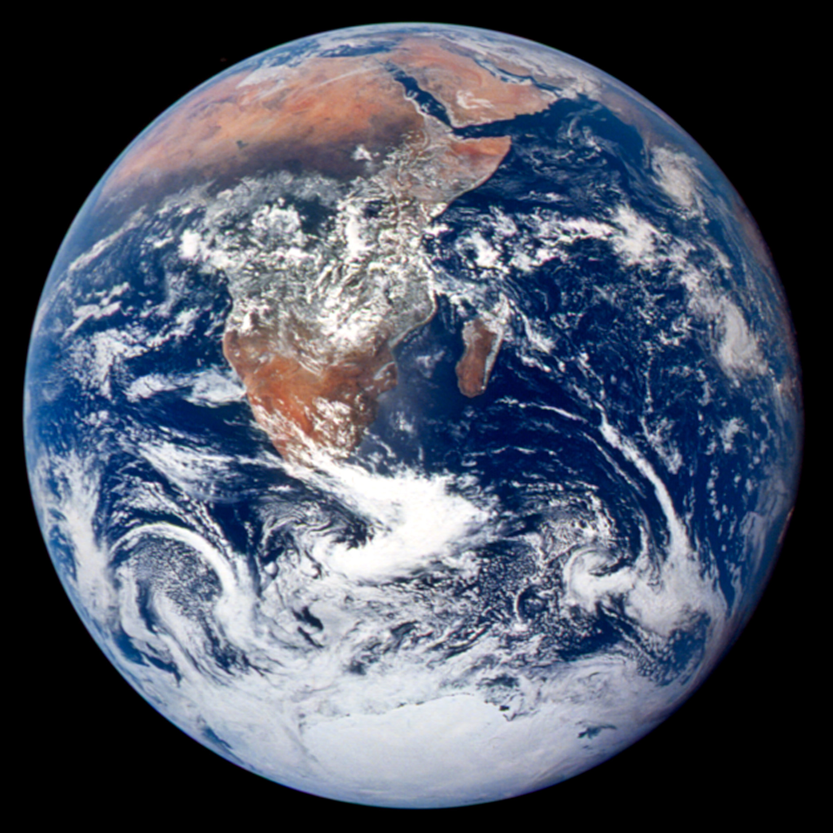

Slide 5
What Else Do We Need?
Data link layer not enough for a world-wide internet (=network of networks)
Switches not built for large networks (e.g., hash table size)
Protocols tailored to physical medium: bad idea to use one such protocol for all types of networks
Hashmap of all addresses requires very large memory. Searching memory reduces performance.
Q: How to solve this?
Add new layer of abstraction: the Network Layer

Slide 6

The Network Layer
Lowest layer concerned with “end-to-end” delivery
B
The network layer (partially) answers the following questions:
How to get from A to B?
How to connect multiple networks?
How to manage network resources?
How to prevent network congestion?
How to provide Quality of Service?
A

Slide 7
The Network Layer
TCP/IP form the “narrow waist” of the Internet
Application
HTTP
RTP
DNS
SMTP
…
Heart of the networking model, together with the transport layer (next week)
Layers below it do not know about end-to-end delivery
Layers above it do not know about the topology of the network
Both layers above and below do not know about routing
Transport
TCP
UDP
Network
IP
ICMP
Link
Ethernet
802.11
DSL
SONET
…
*Although switching is similar to routing…

Slide 8
The Network Layer
Network layer provides new features through new protocols and a new device (the router)
Q: Why have Data Link and Physical Layer twice?
Router performs store-and-forward packet switching
Router
…
…
Network
Network
Network
Data Link
Data Link
Data Link
Data Link
Data Link
Physical
Physical
Physical
Physical
Physical
channel

Slide 9
The Network Layer
Lowest layer concerned with “end-to-end” delivery
B
The network layer (partially) answers the following questions:
How to get from A to B?
How to connect multiple networks?
How to manage network resources?
How to prevent network congestion?
How to provide Quality of Service?
Today’s lecture
Next lecture
A

Slide 10
Today’s Lecture
Routing Algorithms
Internetworking

Slide 11
Routing
Finding a path through a network

Slide 12
Important Properties for Routing
Correctness
Simplicity
Robustness
Stability
Fairness
Efficiency
These properties can (and often do) conflict with each other.

Slide 13
How to find a route?
We will look at three key ideas:
Distance vector routing
Link state routing
Hierarchical routing

Slide 14
Routing tables
For each packet, we need to know on which link to forward it.
For this we use a routing table
Routing table for C.
We are directly connected to A
To | Distance | Line
A | 7 | A
B | 59 | A
C | 0 | -
D | 75 | E
E | 1 | E
F | 103 | E
We are station C
If packet should go to D, minimum distance is 75. Forward to E

Slide 15
Routing tables
For each packet, we need to know on which link to forward it
For this we use a routing table
Routing table for C.
To | Distance | Line
A | 7 | A
B | 59 | A
C | 0 | -
D | 75 | E
E | 1 | E
F | 103 | E
We are indirectly connected to B

Slide 16
Distance Vector Routing
Links to other machines
A
C
Send your distance vector to your neighbors
Update your routing table based on incoming distance vectors
Distance from A to B is 1
Distance from C to A is 7
Routing table for C.
Distance vector A
A, 0
B, 1
C, 7
D, 152
E, 8
F, 110
To | Distance | Line
A | 7 | A
B | 59 | A
C | 0 | -
D | 75 | E
E | 1 | E
F | 103 | E
Q: How to update our routing table?

Slide 17
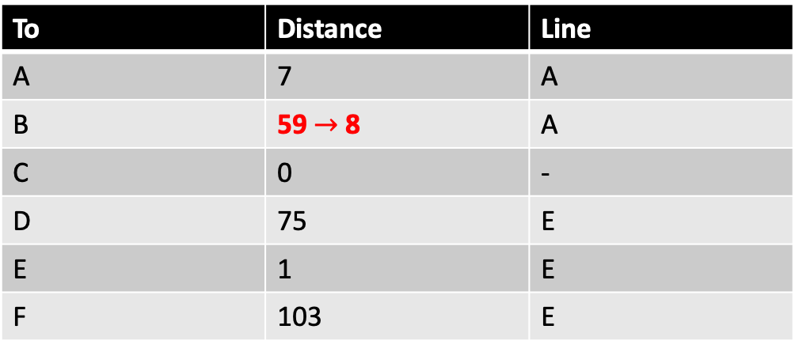
Distance Vector Routing
Links to other machines
A
C
Send your distance vector to your neighbors
Update your routing table based on incoming distance vectors
Routing table for C.
Distance vector A
A, 0
B, 1
C, 7
D, 152
E, 8
F, 110
To | Distance | Line
A | 7 | A
B | 59 $→$8 | A
C | 0 | -
D | 75 | E
E | 1 | E
F | 103 | E
Q: What can go wrong when using this algorithm?

Slide 18
Distance Vector Routing Good News Propagation
A
4
1
C
B
Distance vector A
A, -
B, 4
C, 1
1000
Distance vector B
A, 4
B, -
C, 5
Distance vector C
A, 1
B, 5
C, -

Slide 19
Distance Vector Routing Good News Propagation
A
4→2
1
C
B
Distance vector A
A, -
B, 4
C, 1
1000
Distance vector B
A, 4
B, -
C, 5
Distance vector C
A, 1
B, 5
C, -

Slide 20
Distance Vector Routing Good News Propagation
A
4→2
1
C
B
Distance vector A
A, -
B, 4→2
C, 1
1000
Distance vector B
A, 4
B, -
C, 5
Distance vector C
A, 1
B, 5
C, -

Slide 21
Distance Vector Routing Good News Propagation
A
4→2
1
C
B
Distance vector A
A, -
B, 4→2
C, 1
1000
Distance vector B
A, 4
B, -
C, 5
Distance vector C
A, 1
B, 5→3
C, -

Slide 22
Distance Vector Routing Bad News Propagation
A
4
1
C
B
Distance vector A
A, -
B, 4
C, 1
1000
Distance vector B
A, 4
B, -
C, 5
Distance vector C
A, 1
B, 5
C, -

Slide 23
Distance Vector Routing Bad News Propagation
A
4→2000
1
C
B
Distance vector A
A, -
B, 4
C, 1
1000
Distance vector B
A, 4
B, -
C, 5
Distance vector C
A, 1
B, 5
C, -

Slide 24
Distance Vector Routing Bad News Propagation
A
4→2000
1
C
B
Distance vector A
A, -
B, 4→6
C, 1
1000
Distance vector B
A, 4
B, -
C, 5
Distance vector C
A, 1
B, 5
C, -

Slide 25
Distance Vector Routing Bad News Propagation
A
4→2000
1
C
B
Distance vector A
A, -
B, 4→6
C, 1
1000
Distance vector B
A, 4
B, -
C, 5
Distance vector C
A, 1
B, 5→7
C, -

Slide 26
Distance Vector Routing Bad News Propagation
A
4→2000
1
C
B
Distance vector A
A, -
B, 6→8
C, 1
1000
Distance vector B
A, 4
B, -
C, 5
Distance vector C
A, 1
B, 5→7
C, -

Slide 27
Count to infinity problem When machine fails
Distance vector B
A, 1
B, -
C, 2
D, 1
A
Distance vector D
A, 2
B, 1
C, 1
D, -
Distance vector C
A, 3
B, 2
C, -
D, 1
D
B
C

Slide 28
Count to infinity problem When machine fails
Distance vector B
A, 999
B, -
C, 2
D, 1
Oh no, we cannot reach A!
We can still get there via D!
A
Distance vector D
A, 2
B, 1
C, 1
D, -
Distance vector C
A, 3
B, 2
C, -
D, 1
D
B
C

Slide 29
Count to infinity problem When machine fails
Let’s update our routing table.
Distance vector B
A, 3
B, -
C, 2
D, 1
We can still get there via D!
A
Distance vector D
A, 2
B, 1
C, 1
D, -
Distance vector C
A, 3
B, 2
C, -
D, 1
D: All my neighbors have a path to A > 2!
D
B
C

Slide 30
Count to infinity problem When machine fails
Let’s update our routing table.
Distance vector B
A, 3
B, -
C, 2
D, 1
We can still get there via D!
A
Distance vector D
A, 4
B, 1
C, 1
D, -
Distance vector C
A, 3
B, 2
C, -
D, 1
D: All my neighbors have a path to A > 2!
D
B
C

Slide 31
Count to infinity problem When machine fails
This will go on for a while…
Let’s update our routing table.
Distance vector B
A, 5
B, -
C, 2
D, 1
We can still get there via D!
A
Distance vector D
A, 4
B, 1
C, 1
D, -
Distance vector C
A, 5
B, 2
C, -
D, 1
D: All my neighbors have a path to A > 2!
D
B
C

Slide 32
Link state routing
Replaced distance vector routing in ARPANET in 1979
Does not suffer from the count to infinity problem, but is more complex
Uses a shortest path algorithm
Routers only send packets with information about their direct neighbors
These packets are flooded over the network
Routers built an overview of the network using these packets and run a shortest path algorithm

Slide 33
Flooding link state packets
Q: What can go wrong?
B can reach A and D with distance 1.
M
A
Q: What can go wrong with sequence numbers?
M
B
D
C
M
M

Slide 34
Link state routing Building a map of the network
This is us.
1
5
2
2
3

Slide 35
Link state routing Building a map of the network
This is us.
4
1
9
5
2
2
2: I’m connected to 3, 4, and 5
1
3
3
5

Slide 36
Link state routing Building a map of the network
This is us.
4: I’m connected to 2, 6, and 7
4
1
7
1
9
5
2
2
2
6
1
3
3
5

Slide 37



Link state routing Building a map of the network
This is us.
Q: Which route to take from 1 to 7?
9
4
1
10
7
1
10
9
5
2
8
5
2
2
3
6
Packets addressed to 7 should be routed via 3!
1
3
7
3
3
1
2
9
5
6
$$x$$
: cost to node $x$ is $y$.
Q: Which algorithm is used here?
$$y$$

Slide 38
Hierarchical routing
A1
Reducing routing table sizes for large networks.
A1’s RT size: 7 (all other nodes).

Slide 39
Hierarchical routing
A
A1
Reducing routing table sizes for large networks.
A1’s RT size: 7 (all other nodes).
A2
A3
C
B

Slide 40
Hierarchical routing
A
A1
Reducing routing table sizes for large networks.
A1’s RT size: 4 (A2, A3, B, C).
A2
A3
C
B

Slide 41
Today’s Lecture
Routing Algorithms
Internetworking
Real-World Routing in and between Autonomous Systems
Tunneling
Packet fragmentation

Slide 42
Internetworking
Q: Difference between a single network and a collection of networks?
Getting packets to their destination across multiple networks

Slide 43
Internetworking
Challenges for sending packets end-to-end over multiple networks:
Technological
Different protocols
Different maximum packet sizes
Different QoS guarantees
Political
Different costs
Privacy concerns
Competition/disputes

Slide 44
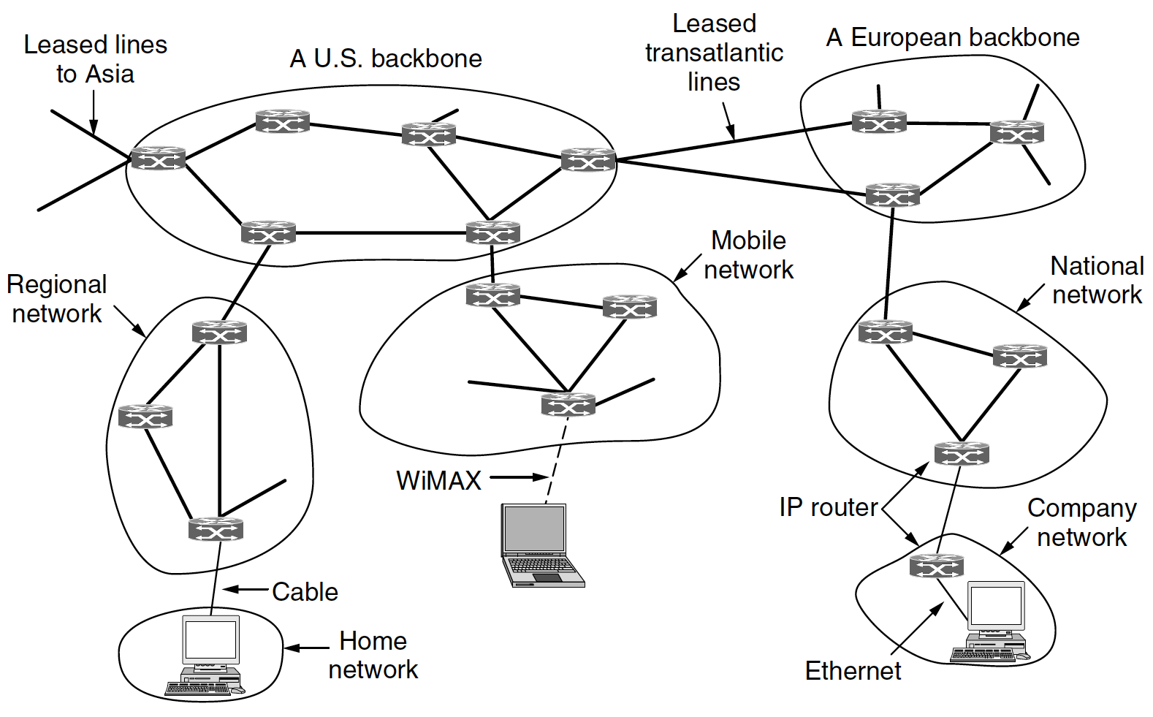
Structure of the Internet: A Network of Networks

Slide 45
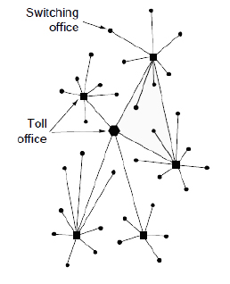
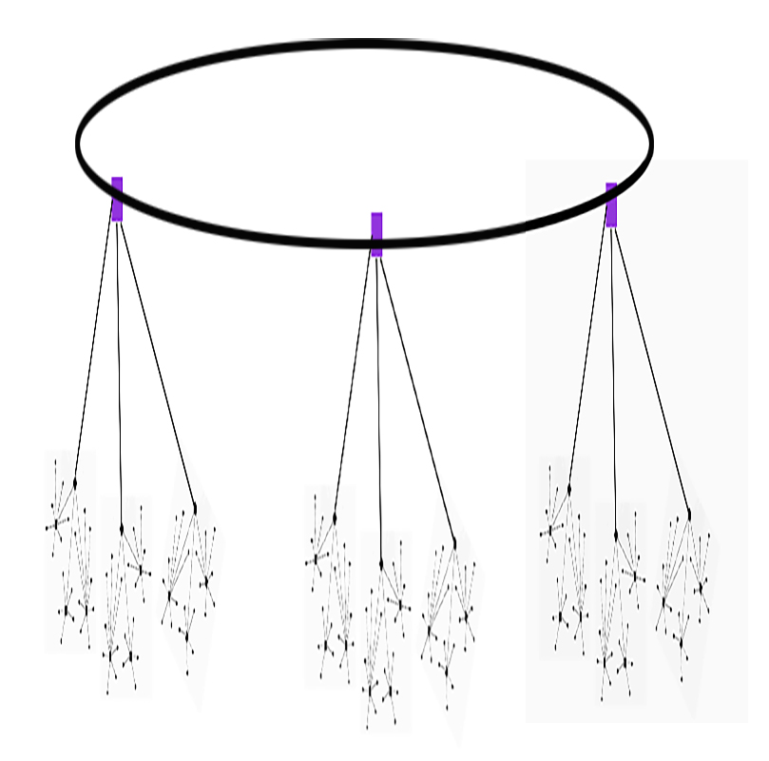
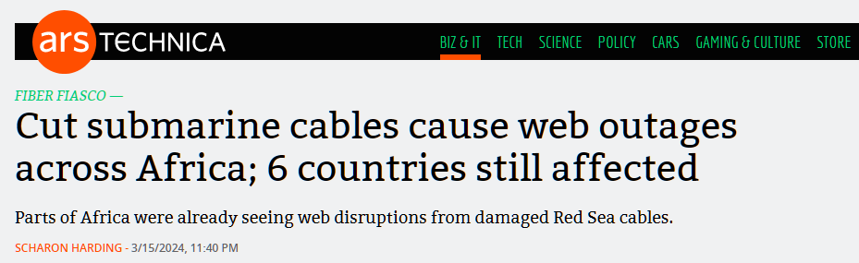
We’ve almost come full circle: A Hierarchical Topology
A multitree?

Slide 46
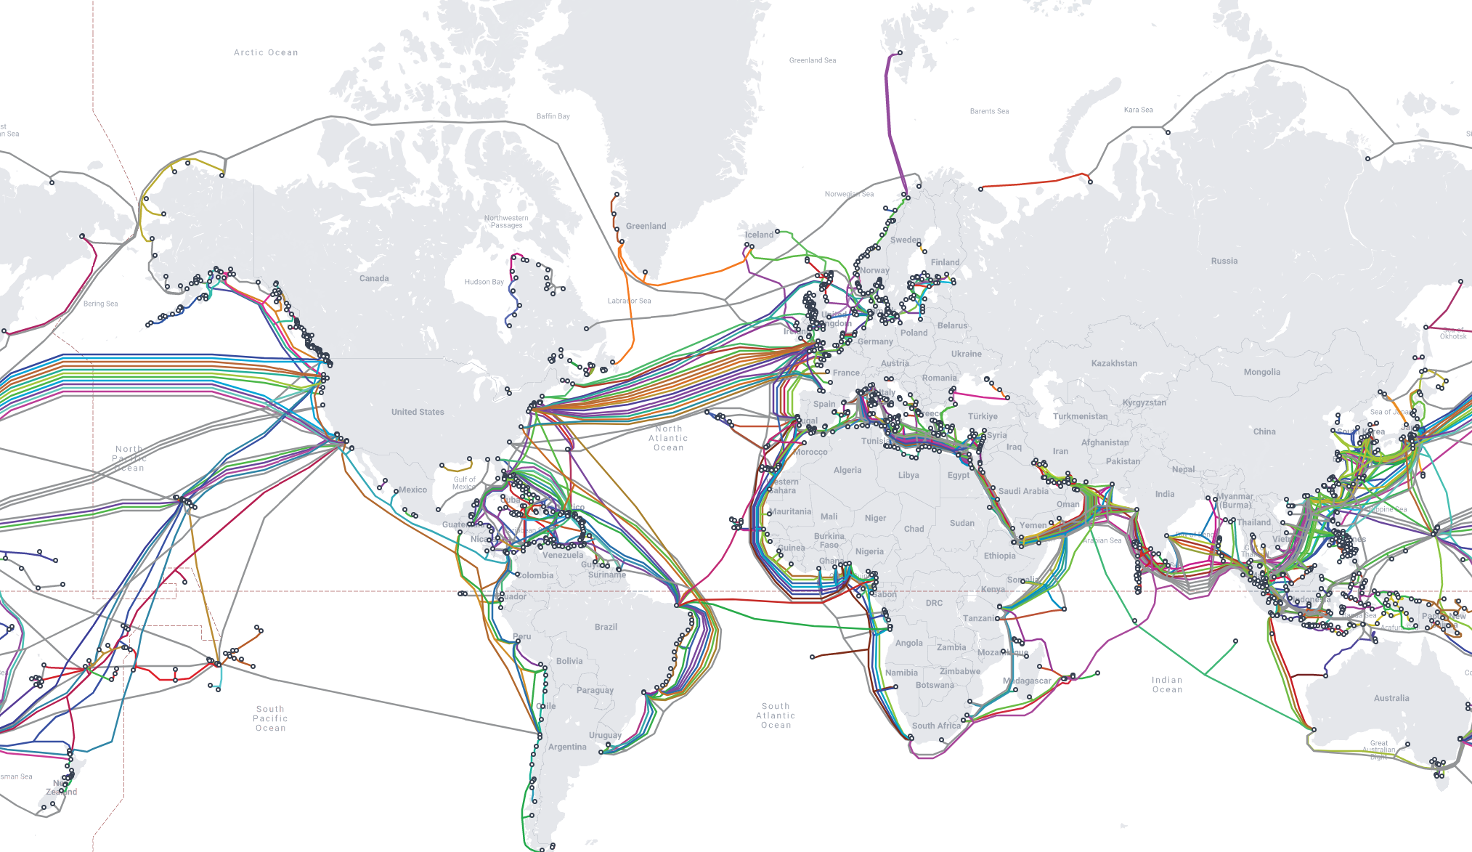

Slide 47
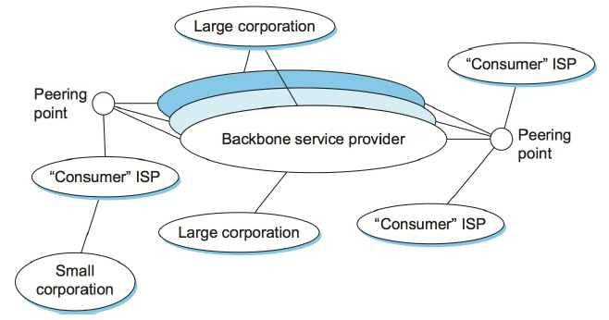
Structure of the Internet: A Network of Networks
Network of networks: yet another layer of abstraction
A large corporation using multiple points of attachment: multihoming
ISPs and (large) corporations are Autonomous Systems (AS)
Peering points (or Internet eXchange Points [IXPs]) connect ISPs and backbones
Homes and small businesses connect to the Internet via ISPs

Slide 48
Internetworking with Autonomous Systems
Involves two key ideas:
Routing inside an Autonomous System
Intradomain routing. Uses an Interior Gateway Protocol
Routing between Autonomous Systems
Interdomain routing. Uses an Exterior Gateway Protocol
We will look at the Open Shortest Path First (OSPF) protocol
We will look at the Border Gateway Protocol (BGP)

Slide 49
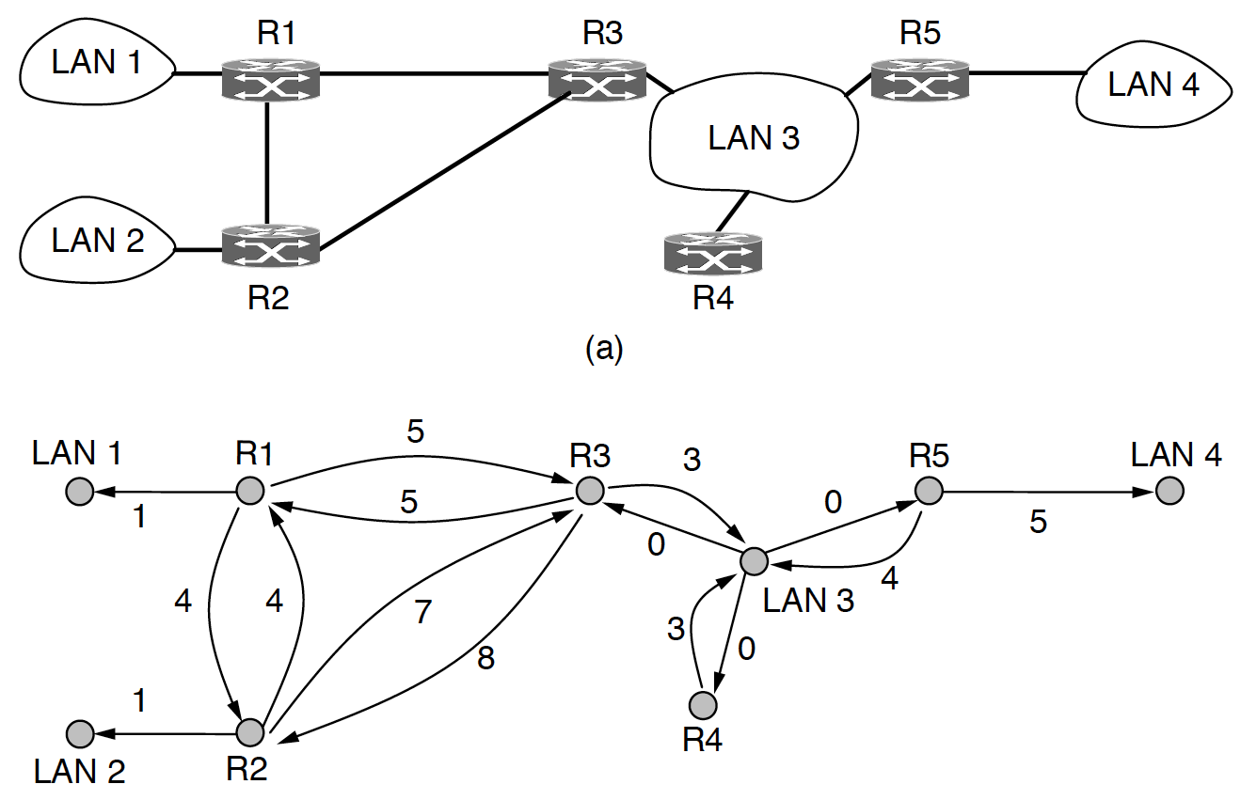
Open Shortest Path First (OSPF)
Example of an Interior Gateway Protocol
Routing within an Autonomous System.
Uses a form of link state routing
Builds a graph representation of the network
Broadcast LANs modeled as node with zero-cost links
Support multiple distance metrics (e.g., delay, physical distance)

Slide 50
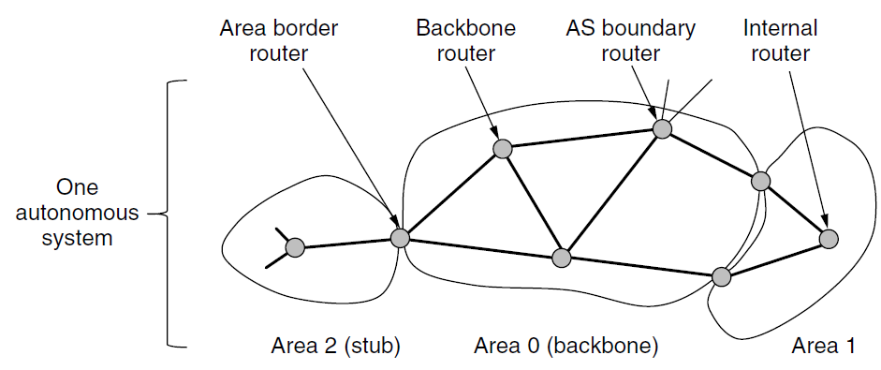
Open Shortest Path First (OSPF)
Example of an Interior Gateway Protocol
Boundary routers connect to another AS.
Uses both an Interior and Exterior Gateway Protocol
Routing within an Autonomous System.
Uses a hierarchy called “areas” to manage large networks
For destinations not in area: go through backbone
Area border router exchanges summarized routing info between areas
Routers only know topology of the area they are in
Q: Why support hierarchical routing?
All areas connected to Area 0 (backbone)

Slide 51
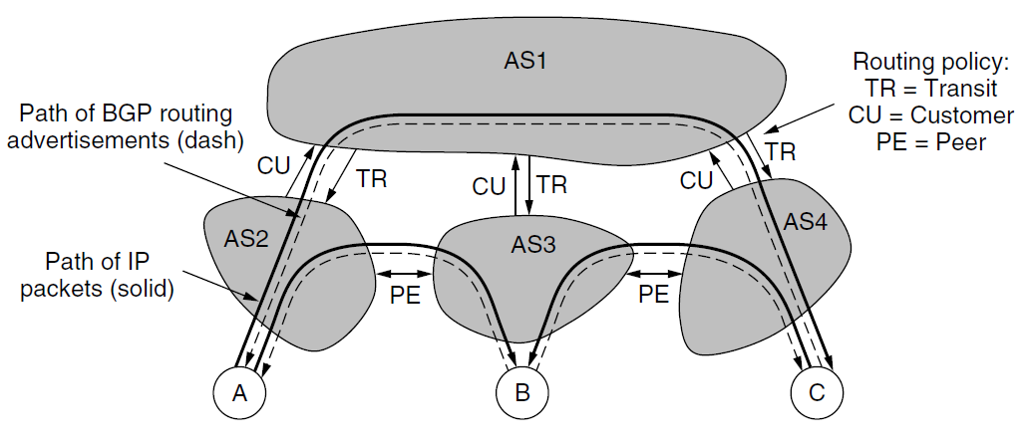
Border Gateway Protocol (BGP)
Example of an Exterior Gateway Protocol
Routing between (large) independent networks.
Supports arbitrary policies put in place by ISPs, companies, organizations, etc.
Q: Can you think of examples of such policies?
AS1 provides transit service
Autonomous Systems connect at IXPs
Stub networks do not need BGP: only one way to send outgoing packets

Slide 52
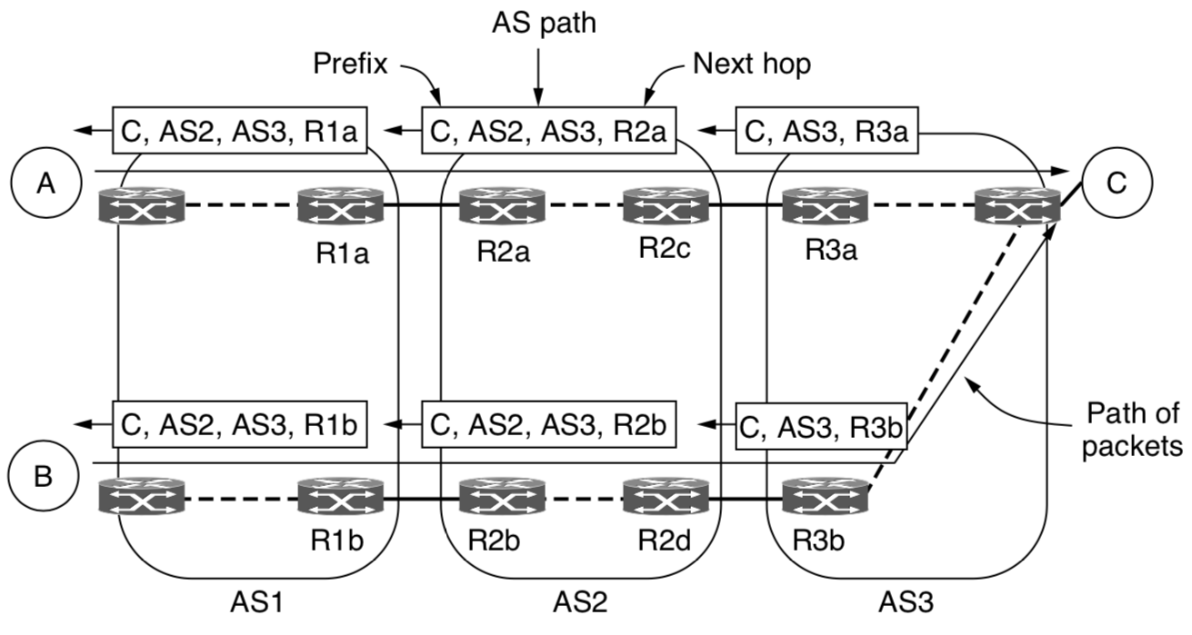
Border Gateway Protocol (BGP)
Example of an Exterior Gateway Protocol
Routing between (large) independent networks.
Uses a path vector protocol (form of distance vector routing)
Path Vectors
Routing based on policies
Examples:
Peer above transit
Hot potato routing
Shortest AS path

Slide 53



Connecting Networks with Different Protocols
If source and destination networks use different protocols, they cannot communicate.
Network A:
Uses ‘cars’ protocol.
Network B:
Uses ‘boats’ protocol.
Network C:
Uses ‘planes’ protocol.

Slide 54
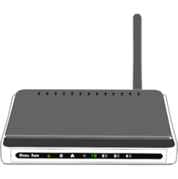
Tunneling
Used to route IPv6 packets over IPv4 networks
Q: Can you name a (dis)advantage?
If an intermediate network uses different protocols, they can communicate by tunneling.
Network type A
Network type A
source
destination
Routers support both types of network!
Network type B

Slide 55
Business as usual Packets in packets in packets in …
Data wrapped in headers from multiple networking layers.
data
Application layer
T
data
Transport layer
Network Layer
N
d
data
Data link layer
L
d
d
data
L
Medium Access Control
Physical layer
signals

Slide 56
Tunneling Packets in packets in packets in …
Data wrapped in headers from multiple networking layers.
Network-layer packet used as payload for other network-layer packet
data
Application layer
T
data
Transport layer
Network Layer
N
d
data
Data link layer
N
d
d
data
Medium Access Control
Physical layer
signals
L
d
d
d
data
L

Slide 57
Packet fragmentation Transparent fragmentation
Q: What can cause packet size limits?
Packet size can be limited by hardware, software, protocols, law, etc.
Q: Can you name a (dis)advantage?
M
M
Packet too large for link.
M
M
M
M
M
M
Max packet size: 10
Max packet size: 10
M
M
M
M
Max packet size: 3
Path Maximum Transmission Unit (MTU): 3

Slide 58
Packet fragmentation Nontransparent fragmentation
Used in IP!
Packet size can be limited by hardware, software, protocols, law, etc.
Q: Can you name a (dis)advantage?
M
M
M
Packet too large for link.
M
M
M
M
M
M
M
Max packet size: 10
Max packet size: 10
M
M
M
M
Max packet size: 3
Path Maximum Transmission Unit (MTU): 3

Slide 59
Avoiding packet fragmentation MTU discovery
Packet size can be limited by hardware, software, protocols, law, etc.
Packet too large. Try 3!
M
Packet too large for link.
M
Max packet size: 10
Max packet size: 10
Max packet size: 3
Path Maximum Transmission Unit (MTU): 3

Slide 60
Avoiding packet fragmentation MTU discovery
Used in IP!
Packet size can be limited by hardware, software, protocols, law, etc.
Q: Can you name a (dis)advantage?
M
M
M
M
M
M
Packet too large for link.
M
M
M
M
M
M
Max packet size: 10
Max packet size: 10
M
M
M
M
Max packet size: 3
Path Maximum Transmission Unit (MTU): 3

