Slide 1


Computer Networks X_400487
Lecture 9
Chapter 6: The Transport Layer—Part 1
Lecturer: Jesse Donkervliet

Slide 2
Transport layer
You are here
Application layer
Transport layer
Send segments between processes
Network Layer
Send packets over (multiple) networks
Data link layer
Send frames over single link
Medium Access Control
Physical layer
Send digital signals

Slide 3
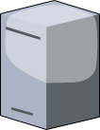

Recap of lower layers The physical layer
Moves bits over a physical channel.
Bit to send: 1
Bit received: 1
Physical channel
Bit to send: 0
Bit received: 0

Slide 4
Recap of lower layers The data link layer
Translates frames to and from bit/byte streams.
Provides error detection/correction and flow control.
000110
000110
101011
101011
111010
111010
101001
101001
…0111101111010110…

Slide 5
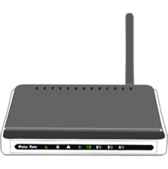
Recap of lower layers The network layer
Transmits packets across the network from a source host to a destination host
Provides congestion control together with the transport layer

Slide 6
Roadmap: Transport Layer
Transport layer responsibilities and challenges
Connection establishment and release
Revisiting reliable delivery and flow control
Congestion control and bandwidth allocation
TCP and UDP

Slide 7
The transport layer Provided services
Runs only on the host and destination
Provides a reliable data stream over an unreliable network.
Provides communication between processes.
Q: Does this resemble a layer we have seen?
Network

Slide 8












Transport layer only present at source and destination
Transport layer and up used only at endpoints
Home
Outside
Link and network layer headers inspected and updated throughout network
A
$$M$$
$$M$$
A
T
$$M$$
Router
$$M$$
T
N
$$M$$
$$M$$
N
N
$$M$$
$$M$$
N
D
$$M$$
$$M$$
D
D
$$M$$
$$M$$
D
P
P
P
P

Slide 9
Primitives used to offer this service
The interface exposed to the application layer
Listen – wait for another process to contact us.
Connect – connect to a process that is listening.
Send – send data over the established connection.
Receive – receive data over the established connection.
Disconnect – release the connection.
Connection-oriented service over (possibly) connectionless network!

Slide 10
Berkeley Socket primitives
The interface exposed to the application layer
Socket – create a new communication endpoint.
Bind – assign a local address to an endpoint (socket).
Listen.
Accept – passively establish an incoming connection.
Connect.
Send.
Receive.
Close.
Q: Which ones (not) used by UDP?
Used by TCP!

Slide 11
Berkeley Socket primitives
Socket – create a new communication endpoint.
Host
Q: How to connect to the right application?
Application
Application
Application
Application
Socket
Network
?
Used by TCP!
Incoming connection request

Slide 12
Berkeley Socket primitives
Socket – create a new communication endpoint.
Host
Q: How to connect to the right application?
Application
Application
Application
Application
BIND
Network
?
Used by TCP!
Incoming connection request

Slide 13
Addressing
TSAP = Transport Service Access Point
NSAP = Network Service Access Point
Internet uses IP addresses for NSAPs and ports for TSAPs
Host
Application layer
Application
Application
Transport layer
TSAP
Network layer
Network
NSAP
Data link layer
Physical layer
Network

Slide 14
Process servers
Application layer
Application
Application
Transport layer
Network layer

Slide 15

Process servers
Mail server is only started when needed.
Started by process server!
Application layer
Process Server
Mail Server
Transport layer
Network layer
Q: When not to use this approach?

Slide 16
Multiplexing: Multiple transport connections over one network connection
Application layer
Application
Application
Application
Transport layer
Network layer

Slide 17



Multiplexing: Multiple transport connections over one network connection
Examples
Application layer
Browser
Music streaming
Instant
messaging
Ports:
5527
5232
4872
4661
Transport layer
Q: Why not port 80?
Network address:
192.168.0.103
Network layer
Q: How does incoming connection know the correct port?
Server ports typically hardcoded!

Slide 18
Inverse multiplexing: One transport connection over multiple network connections
Application layer
Application
Q: Why would you use this?
Transport layer
Network layer
A form of multihoming: multiple paths to the same destination

Slide 19



















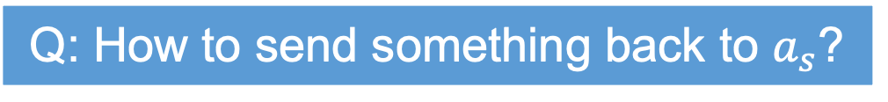


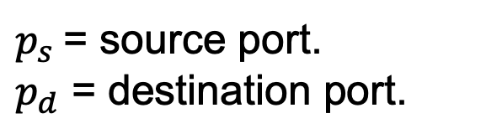




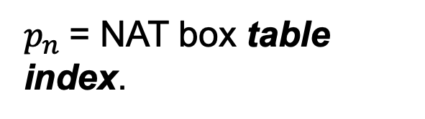
Network Address Translation (NAT)
Q: How to send something back to $a_{s}$?
$p_{s}$= source port.
$p_{d}$ = destination port.
$a_{s}$= source address.
$a_{d}$ = destination address.
$a_{n}$= NAT box address.
$$a_{s}$$
$$a_{d}$$
Home
Outside
$p_{n}$= NAT box table index.
$$p_{n}$$
:
$$a_{s}$$
$$p_{s}$$
NAT Box
$$a_{n}$$
$$M$$
$$M$$
A
A
T
$$p_{s}$$
$$p_{d}$$
$$p_{s}$$
$$p_{d}$$
T
T
$$p_{n}$$
$$p_{d}$$
$$p_{n}$$
$$p_{d}$$
T
N
$$a_{s}$$
$$a_{d}$$
$$a_{s}$$
$$a_{d}$$
N
N
$$a_{n}$$
$$a_{d}$$
$$a_{n}$$
$$a_{d}$$
N
D
D
D
D
NAT cheats by using TCP address field
P
P
P
P

Slide 20
Roadmap: Transport Layer
Transport layer responsibilities and challenges
Connection establishment and release
Connection establishment
Connection release
Revisiting reliable delivery and flow control
Congestion control and bandwidth allocation
TCP and UDP

Slide 21

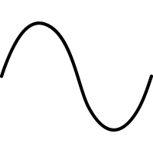





Connection Establishment
Q: Don’t the lower layers solve this problem?
How to distinguish original and retransmitted segments?
Time-out!
High-latency route via satellite.
Conn.
Buy sports car
Conn.
Retransmitted over low-latency path.
Buy sports car

Slide 22
Connection establishment using sequence numbers
If a segment comes in with a sequence number that we have already seen, we discard it.
How do we ensure that there are never multiple packets with the same sequence number?
If a machine crashes and reboots, what sequence number should it choose?
Q: Can you think of a subproblem we need to solve?

Slide 23
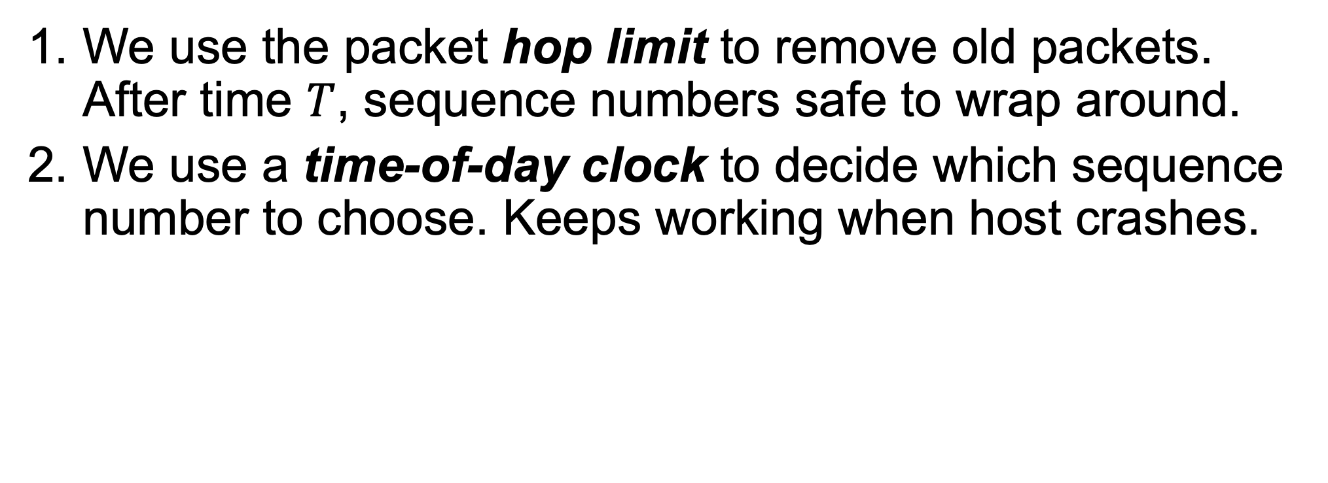
Connection establishment using sequence numbers
We use the packet hop limit to remove old packets. After time $T$, sequence numbers safe to wrap around.
We use a time-of-day clock to decide which sequence number to choose. Keeps working when host crashes.

Slide 24
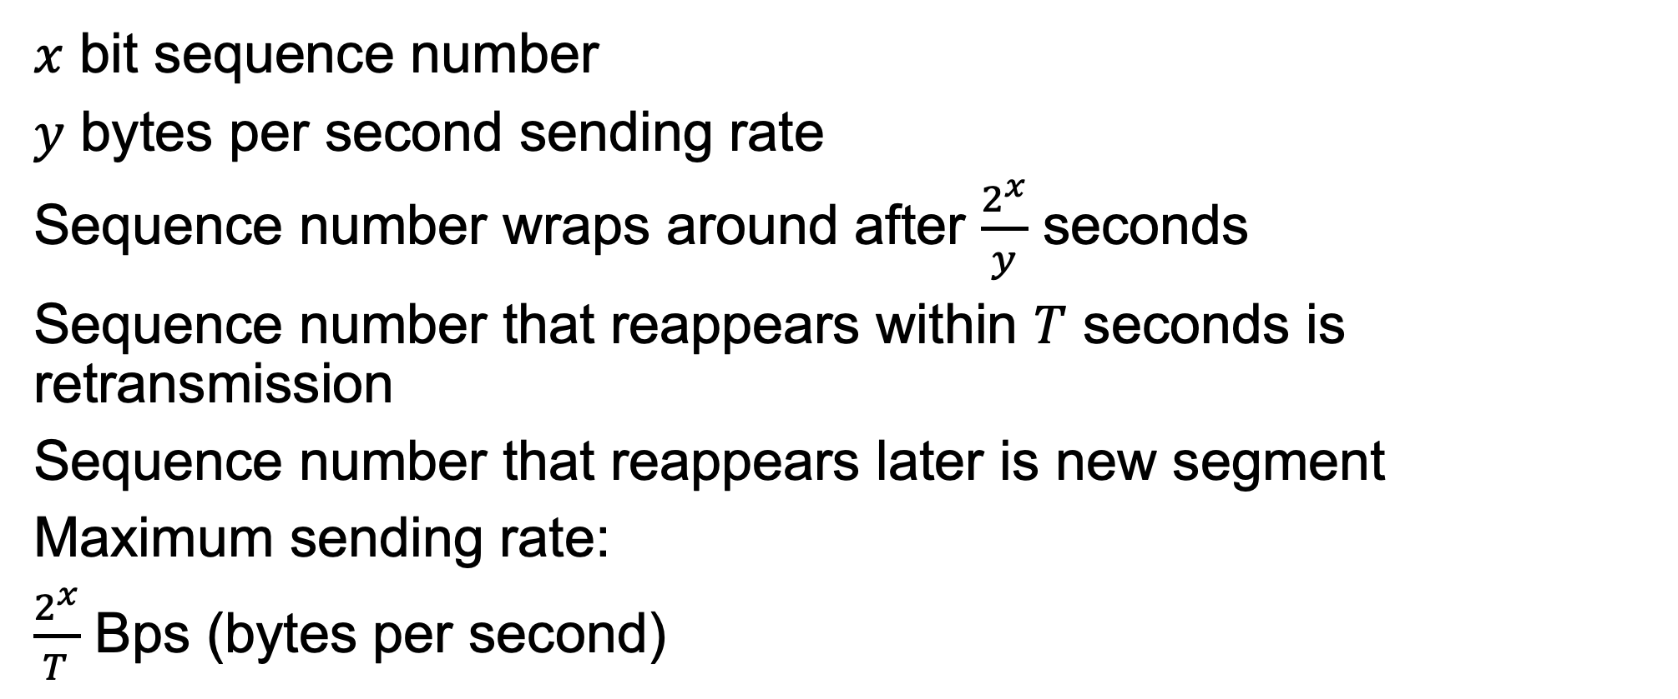
Sequence Number Limits Performance
000
001
010
011
100
101
110
111
000
001
010
011
100
101
110
111
$x$ bit sequence number
$y$ bytes per second sending rate
Sequence number wraps around after $\frac{2^{x}}{y}$ seconds
Sequence number that reappears within $T$ seconds is retransmission
Sequence number that reappears later is new segment
Maximum sending rate:
$\frac{2^{x}}{T}$ Bps (bytes per second)

Slide 25
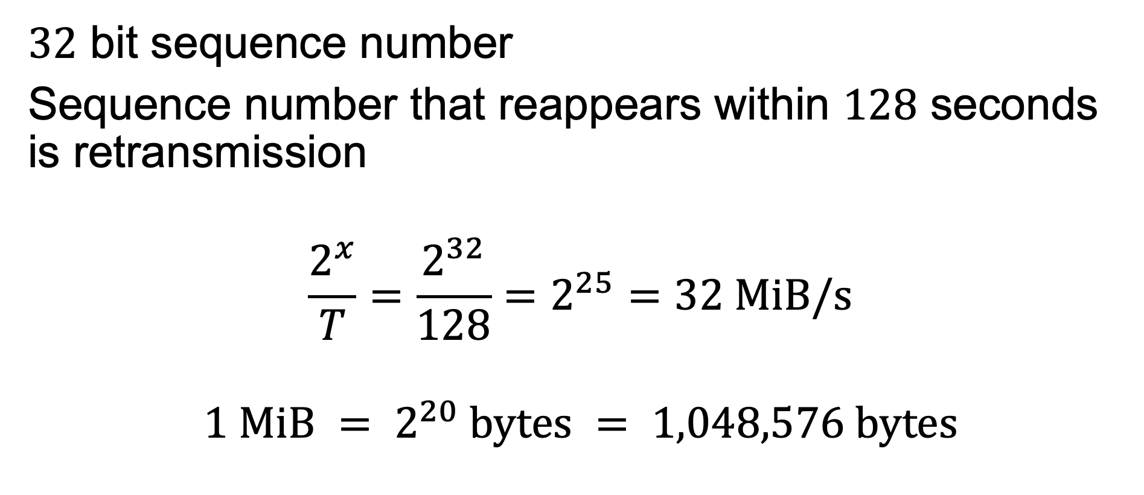
Sequence Number Limits Performance
000
001
010
011
100
101
110
111
000
001
010
011
100
101
110
111
$32$ bit sequence number
Sequence number that reappears within $128$ seconds is retransmission
$$\frac{2^{x}}{T}=\frac{2^{32}}{128}=2^{25}=32 \text{MiB}\text{/}\text{s}$$
$$1 \text{MiB} = 2^{20} \text{bytes} = 1,048,576 \text{bytes}$$
Q: What is the maximum sending rate?

Slide 26
Clock-based sequence numbers
Sequence numbers used.
❌
Sequence numbers
Sequence numbers to use increase with clock, regardless of sending rate.
Transmission
Time

Slide 27
Clock-based sequence numbers
Sequence numbers used.
❌
Sequence numbers
Time

Slide 28

Clock-based sequence numbers forbidden region
$$T$$
Q: Can we use sequence numbers here?
❌
Duplicate sequence number!
Sequence numbers
Forbidden region
Time

Slide 29
Clock-based sequence numbers forbidden region
$$T$$
Yes, but if we do not speed up we will hit the forbidden region from above!
Q: Can we use sequence numbers here?
Sequence numbers
Time
Q: Can a receiver always detect delayed duplicates?

Slide 30
Three-way handshake
TCP uses a (slightly different) three-way handshake!
Agreement on which sequence numbers to use.
Connection request (seq=x)
time
Ack (seq=y, ack=x)
Data (seq=x, ack=y)

Slide 31

Three-way handshake handles duplicates
Old duplicate packet.
Connection request (seq=x)
time
Ack (seq=y, ack=x)
Reject (ack=y)

Slide 32
Three-way handshake handles duplicates
Old duplicate packets.
Connection request (seq=x)
time
Ack (seq=y, ack=x)
Data (seq=x, ack=z)
Reject (ack=y)

Slide 33
Roadmap: Transport Layer
Transport layer responsibilities and challenges
Connection establishment and release
Connection establishment
Connection release
Revisiting reliable delivery and flow control
Congestion control and bandwidth allocation
TCP and UDP

Slide 34
Connection release
When the exchange is complete, the connection should be closed.
Two approaches:
Asymmetric disconnect.
Symmetric disconnect.

Slide 35

Asymmetric connection release
Connection ended by either participant without agreement.
May result in data loss!
Data
time
Data
Connection release!

Slide 36
Symmetric connection release
Participants agree to end connection.
More difficult than it sounds!

Slide 37



The two armies problem
Armies need to coordinate attack. If they attack alone, they lose.
Messages sent through the valley might be lost.

Slide 38
The two armies problem
Did they receive the message?
Did they receive the ACK?
message
ACK
No solution exists!

Slide 39
Symmetric connection release
Participants agree to end connection.
Release connection?
time
Release connection!
ACK

Slide 40
Symmetric connection release
Participants agree to end connection.
Release connection?
time
Release connection!
Release connection?

Slide 41
Symmetric connection release
Participants agree to end connection.
Q: How do we solve this in practice?
Release connection?
time
Release connection!
Release connection?

Slide 42
The two armies problem
Did they receive the message?
Did they receive the ACK?
The last party to send a message cannot know if it arrived
message
ACK
No solution exists!

