Slide 1

WIB Firmware Development for DAT ColdADC ENOB QC
Jillian Donohue on behalf of the BNL CE group
Date TBD
Notes:
Title: WIB Firmware Development for DAT ColdADC QC

Slide 2
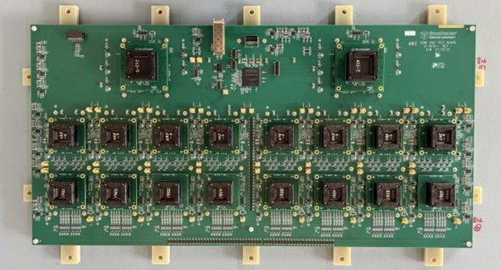
Outline
ColdADC ENOB QC requirements
Single channel buffer firmware
ENOB results
To-do list

Slide 3
ColdADC QC requirements
Requirements:
Sampling frequency ~2 MHz
Number of ADC bits: ≥ 12
Total power (of all ASICs): < 50 mW/channel
Noise contribution ≪ 1000 e- (negligible compared to LArASIC)
Specifications:
Crosstalk: < 1%
Differential Nonlinearity (DNL): Absolute value < 1
Integral Nonlinearity (INL): < 1(12-bit ADC unit)
Equivalent Number of Bits (ENOB) > 10.3
Overflow protection: When input signal exceeds the upper or lower ADC range, the output should be fixed at the maximum or minimum value.

Slide 4
ColdADC QC Procedure and Test Items based on DAT
Chip Placement
(manual or Robot)
Record input info
Input info: Date, Time, Location, Tester, DAT SN, Socket SN, Chip ID, and etc.
Placement checkout
(<1 min)
Basic functionality checkout to assure any chip is aligned in the socket, no short, no open pin
N
Power cycle at least 5 times with different configs
PASS?
Test I2C communication (Write/read registers)
Check power-on reset (verify default register values)
Y
Measure reference voltages
QC testing (RT & LN2)
Measure ring oscillator frequency
Verified doable on DAT
Perform auto calibration; check weights
Measure open channel noise (new DAT)
Measure DNL/INL (slow ramp or sine wave input)
Check overflow protection
Measure ENOB (optional)
Crosstalk (optional, performance to be evaluated)

Slide 5
ENOB requirements
> 4,000 [?] samples
Spy buffer only can store ~2000 samples per channel
Others?

Slide 6
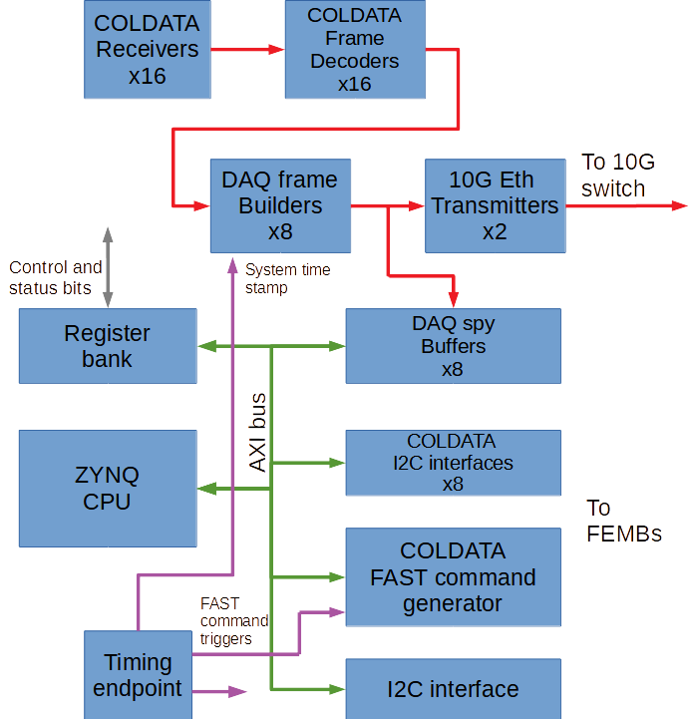
Firmware additions
Accumulators
x8
DAQ modified frame builders
x8
Histogram
AXI BRAM controller
Single channel buffer
Live data peek reg.

Slide 7
Single channel buffer firmware module
fbld_modified
Single channel buffer
Buffer full
deframed_data_aligned
state machine
16-bit channel data
Channel data
BRAM memory
2^13 32-bit regs.
AXI bus
rq_state x 8
User controls:
Trigger
Channel to analyze
(indicates data is verified & ready)

Slide 8
fbld_modified
Single channel buffer
Buffer full
deframed_data_aligned
state machine
16-bit channel data
Channel data
BRAM memory
2^13 32-bit regs.
AXI bus
rq_state x 8
User controls:
Trigger
Channel to analyze
(indicates data is verified & ready)

Slide 9
Repurposing histogram memory
Single channel buffer
Histogram
Reg-controlled mux
AXI bus
1
BRAM memory
2^13 32-bit regs.
AXI BRAM controller
R/W signals
0
hist_buf_sel

Slide 10
Results

Slide 11
WIB registers used – config register bank
Address, hex | Bits in register | Parameter name | Description
0xA00C0070 | 28:10 | accum_num_samples | Number of samples to accumulate
0xA00C0070 | 9:1 | accum_total_ch_sel | Accumulator channel readout selector. Channel X's accumulated total will appear in the register accum_ch_total if you write X to this register.
0xA00C0070 | 0 | accum_trig | Triggers accumulators to begin
0xA00C0074 | 1 | hist_buf_sel | Determines whether the AXI BRAM controller (0) or the single channel buffer (1) has access to port B of the histogram BRAM
0xA00C0074 | 0 | hist_buf_trig | Triggers histogram (0) or single channel buffer (1) to begin, depending on the value of hist_buf_sel
0xA00C0078 | 8:0 | hist_ch | Channel to take histogram (or single channel buffer) data for
0xA00C007C | 31:0 | hist_num_samples | Number of samples to count for histogram
0xA00C0078: Histogram channel to analyze, lemo_io_0 output selector
0xA00C007C: Histogram # samples
Latest production firmware uses config registers up to 0xA00C0044
Notes:
Can be changed if needed (secondary register bank to minimize use of main registers, could bring it down to 2ish registers (one config and one status)?)

Slide 12
WIB registers used – status register bank
Address, hex | Bits in register | Parameter name | Description
0xA00C00F0 | 23:10 | deframed_data_mon | Allows software to “peek” into the live channel data to aid the histogram test (hist_ch determines which channel)
0xA00C00F0 | 9 | hist_ready | Indicates that the histogram has finished taking samples
0xA00C00F0 | 8 | buf_done | Indicates that the single channel buffer has finished taking samples
0xA00C00F0 | 7:0 | accum_ready | Bit Z indicates that accumulator Z (connected to COLDATA Z) has finished taking samples
0xA00C00F4 | 31:0 | accum_ch_total | Displays the total accumulated in channel accum_total_ch_sel when its accumulator is finished
0xA00C00F8 | 31:0 | hist_out | Was used for peek-by-peek readout of histogram data, but no longer used.
Latest production firmware uses status registers up to 0xA00C00D8
Notes:
Can be changed if needed (secondary register bank to minimize use of main registers, could bring it down to 2ish registers (one config and one status)?)

Slide 13
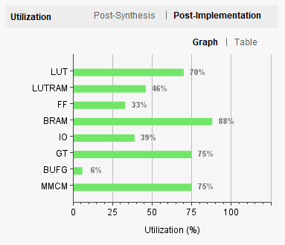
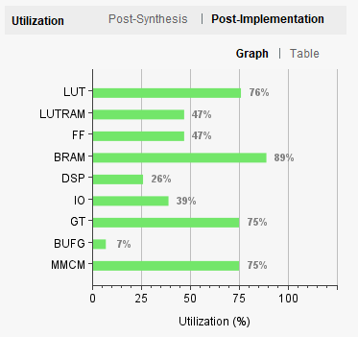
Resource utilization update
Production firmware:
QC firmware (difference from last version):
(+1%)
(+4%)

Slide 14
To-do list
1. Histogram study with a sine waveform instead of a ramp
2. ENOB study
3. Develop analysis scripts for ADC static performance metrics
DC-offset, input range, gain, DNL/INL, overflow protection, and etc.
4. Organize a QC procedure – scripts, database, etc.
Notes:
ENOB technically optional?

Slide 15
Summary
Histogram development & study with a slow ramp signal is done
DAT board has been deemed capable for ColdADC QC
All necessary QC items have been verified
New DAT revision will inject test pulse to each channel independently

Slide 17
Accumulators
x8
DAQ modified frame builders
x8
Histogram
AXI BRAM controller
Single channel buffer
Live data peek reg.

Slide 18
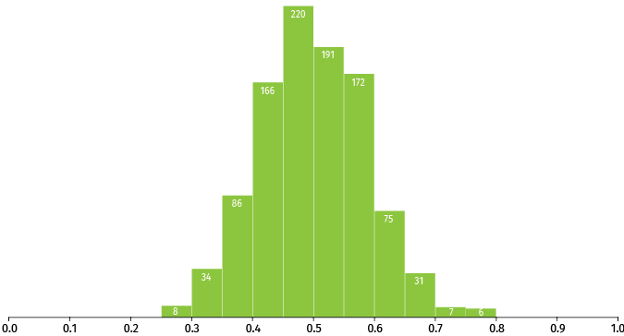
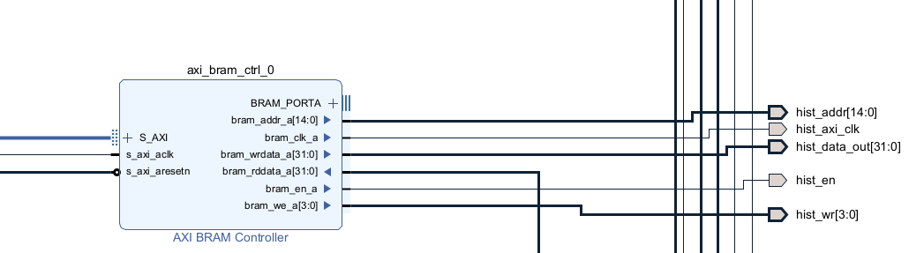

AXI memory mapping
To speed up readout of histogram data, I implemented a AXI BRAM controller in the firmware’s block design that accesses one side of the histogram dual-port block memory
histogram data
Port A
Histogram BRAM
Port B
Linux
AXI BRAM controller RO
AXI bus
Histogram
Direct R/W
2^14 x 16 bits = 32 KB BRAM
“Port B”
Notes:
Don’t need to explain in detail
AXI BRAM/Petalinux side CAN write, useful for debugging purposes, but it doesn’t need to in this application

Slide 19
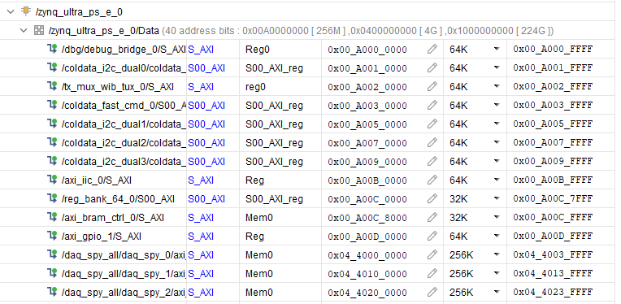
AXI memory mapping
Notes:
Reg_bank_64 originally spanned memory from A00C0000 until A00D0000. Reg_bank_64 uses only 128 bytes total of its 64KB allocated memory, so I decreased that allocation to 32K and squeezed in the AXI BRAM controller at A00C8000.
I couldn’t just squeeze it in between spy buffers because the kernel has to know that the memory is mapped to something, the spy buffers use all of their allocated space, and I didn’t want to have to change the kernel. This is also the reason I can only read out 1 channel at a time

Slide 20
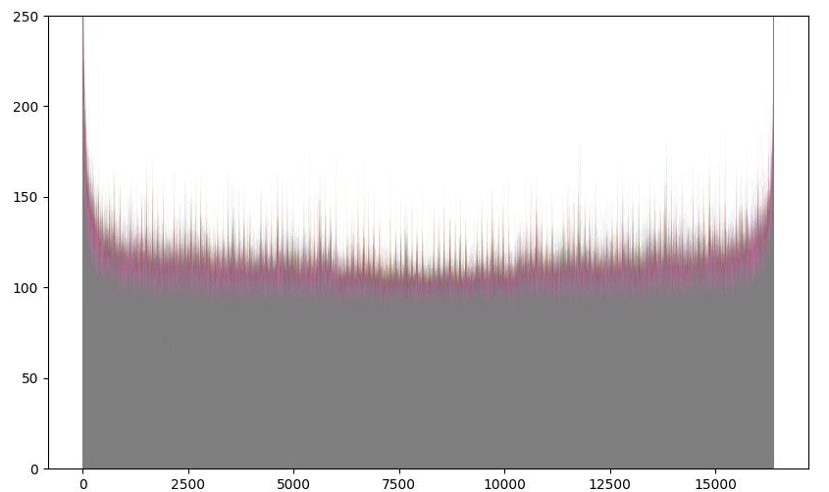
Histogram results
ColdADC code counts
1 second ramp from 0 to 2.2V, 1,639,000 samples/channel
Counts per code
ColdADC code
Notes:
To add: more detailed analysis?

Slide 21
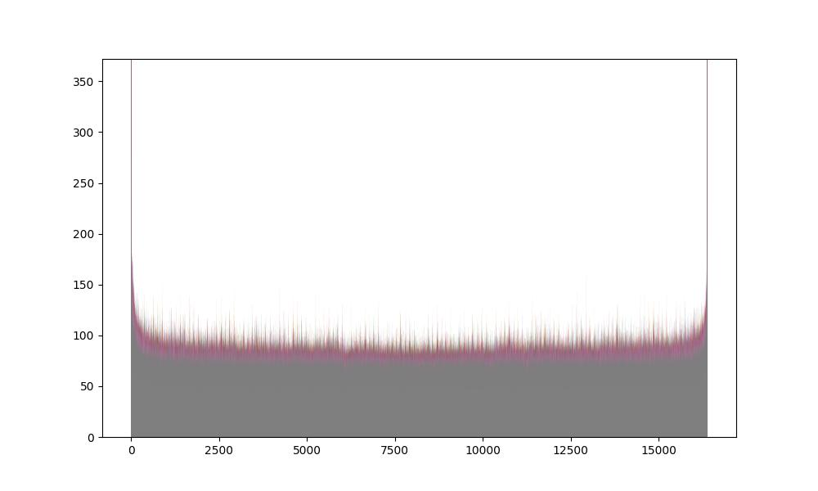
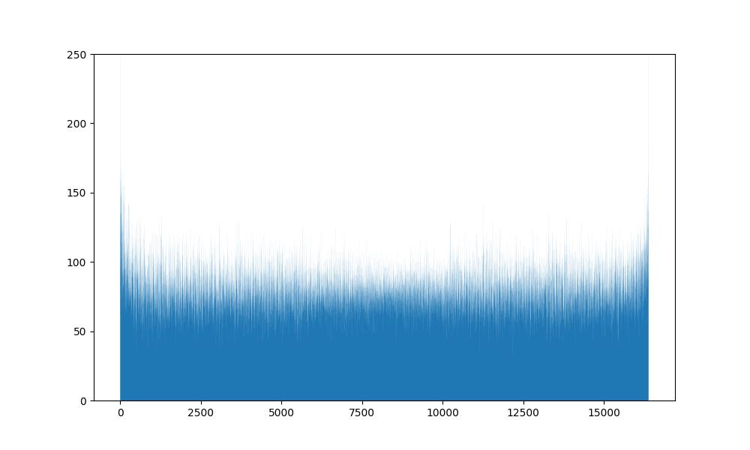
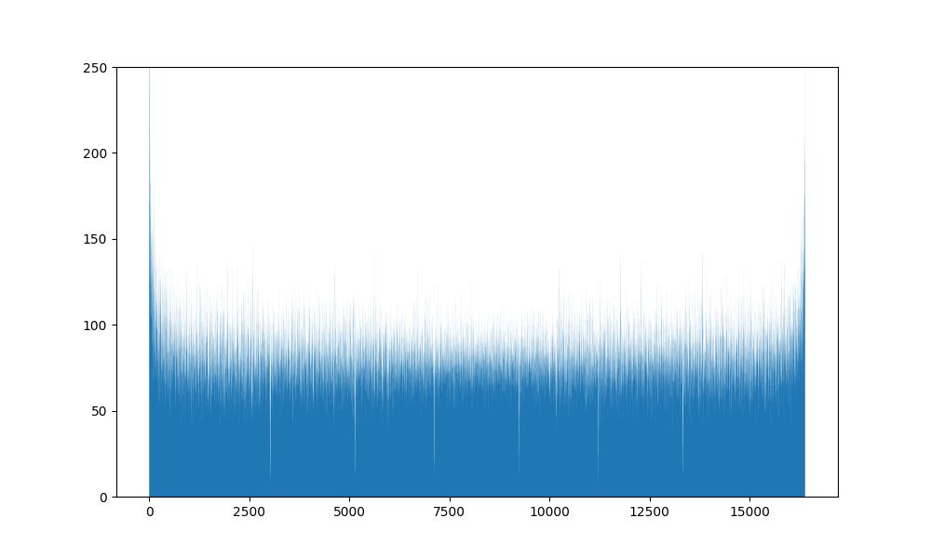
Histogram results
ColdADC code counts
1 second ramp from 0 to 2.2V, 1,639,000 samples/channel
Single channel, uncalibrated
Single channel, calibrated
One plot of a channel when ADC is calibrated
Counts per code
One plot of a channel when ADC is uncalibrated
Counts per code
ColdADC code
ColdADC code
Further analysis is undergoing to extract some ADC DNL/INL
Notes:
Missing codes should show up in uncalibrated

Slide 22
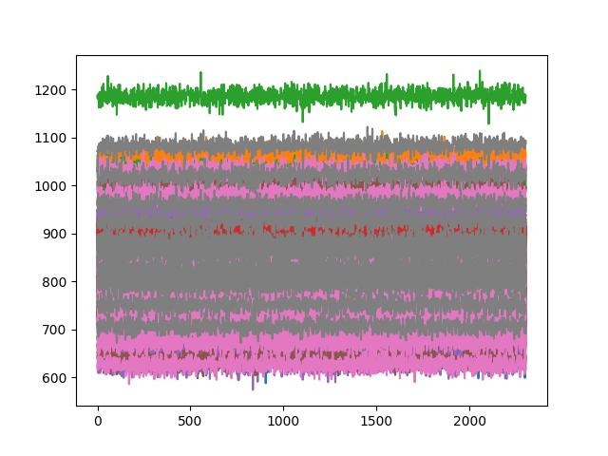
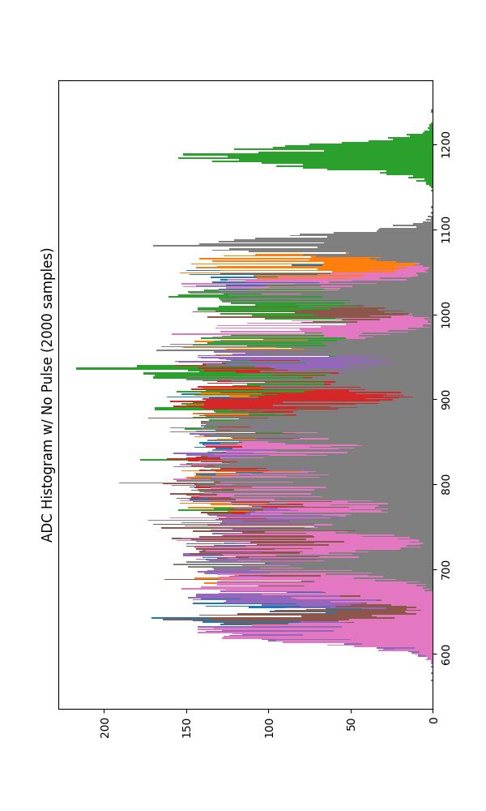
Spy buffer vs. histogram comparison
ColdADC Readout w/ No Pulse
Notes:
Early proof-of-concept histogram graphs (mostly just a fun demonstration)

Slide 23
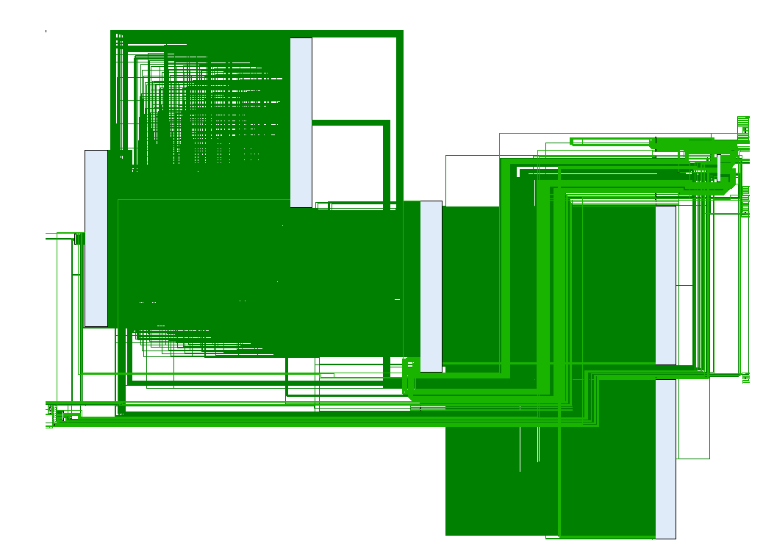
Backup slide: Vivado firmware schematic
fbld
Zynq
deframer
modified fbld
accumulator
histogram

Slide 24
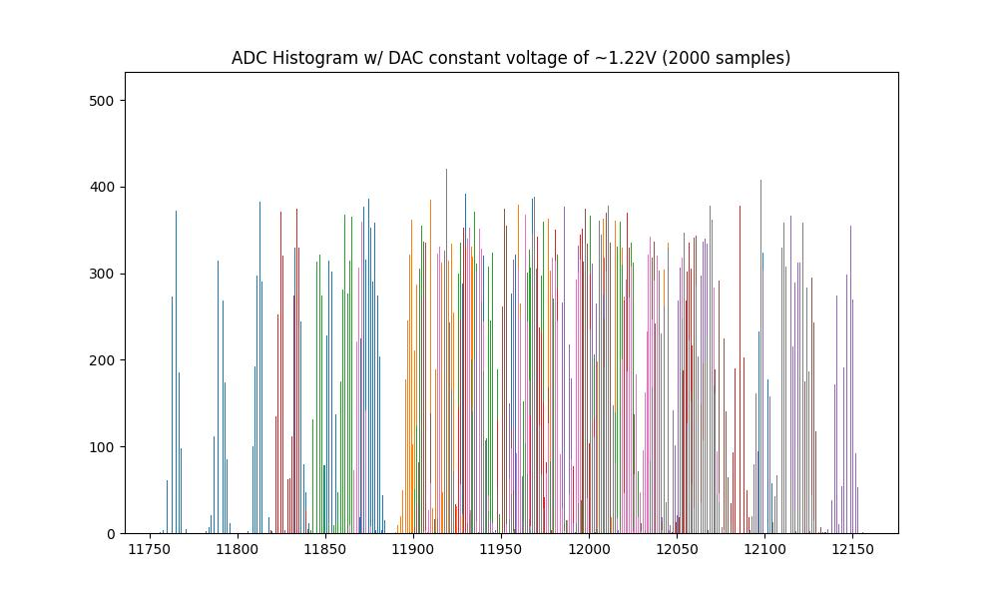

Slide 25
Accumulator software (still in development)
Procedure:
Set DAT registers so that ADC channels are connected to the ADC DAC
Set DAC to 0 LSB
Set number of samples to take
Trigger the accumulators
When accumulators finished, read channel totals out one by one
Set DAC to 1 LSB
…etc.
Command line:
root@dune-wib:~/BNL_CE_WIB_SW_QC# python3 adc_dac_cal.py
python3 adc_dac_plot.py tmp_data/ADCcal_02_10_2021_06_19_06.bin
Notes:
Channel X total will appear in the totals register if you write X to a certain other register

Slide 26
Histogram software (still in development)
Procedure (after hardware setup):
Set WIB register so that P8 LEMO input is sent over data cable to the DAT
Set DAT registers so that ADC channels are connected to WIB external signal
Set channel_to_analyze to 0
Wait until live channel monitor register equals 0x0000
Trigger histogram
When histogram indicates it’s finished, copy the histogram block of memory
Set channel_to_analyze to 1
…etc.
Save the copied data to a .bin file or similar
Command line:
root@dune-wib:~/BNL_CE_WIB_SW_QC# python3 adc_hist.py 1639000
python3 adc_hist_plot.py tmp_data/ADChist_22_09_2021_06_02_19.bin
Notes:
The way the histogram data is copied is the same way that the spy buffer data is copied (memcpy)
This greatly speeds up execution time compared to peek/poking one by one
Will go into how I implemented this later

Slide 27
Faster spy buffer decoding using DUNEDAQ C++ software
Initial WIB Ethernet (HERMES) frame decoding was done with Python (very slow)
Downloaded source code necessary for decoding frames to WIB
Compiled .so library file for WIB
Wrote script for generating a Windows or Linux library file for off-WIB analysis
Sped up decoding time of one frame from a few seconds to instantaneous
Notes:
What is the exact speedup figure?

