Slide 1
Cyber security breaches
An exploration of cases by Jordan Donovan

Slide 2
Introduction
Source of data
Investigation of Data
Findings
Why it matters
Conclusion

Slide 3

Source
Location
Type of Breach
Individuals Affected
Date
State
And more
Notes:
2010 – June 2014
Only records where 500 or more individuals were affected
29 different types of breaches
Date includes start and end date
Tidying this dataset only included a removal of two columns that was using the data from breach start date, and breach end date

Slide 4
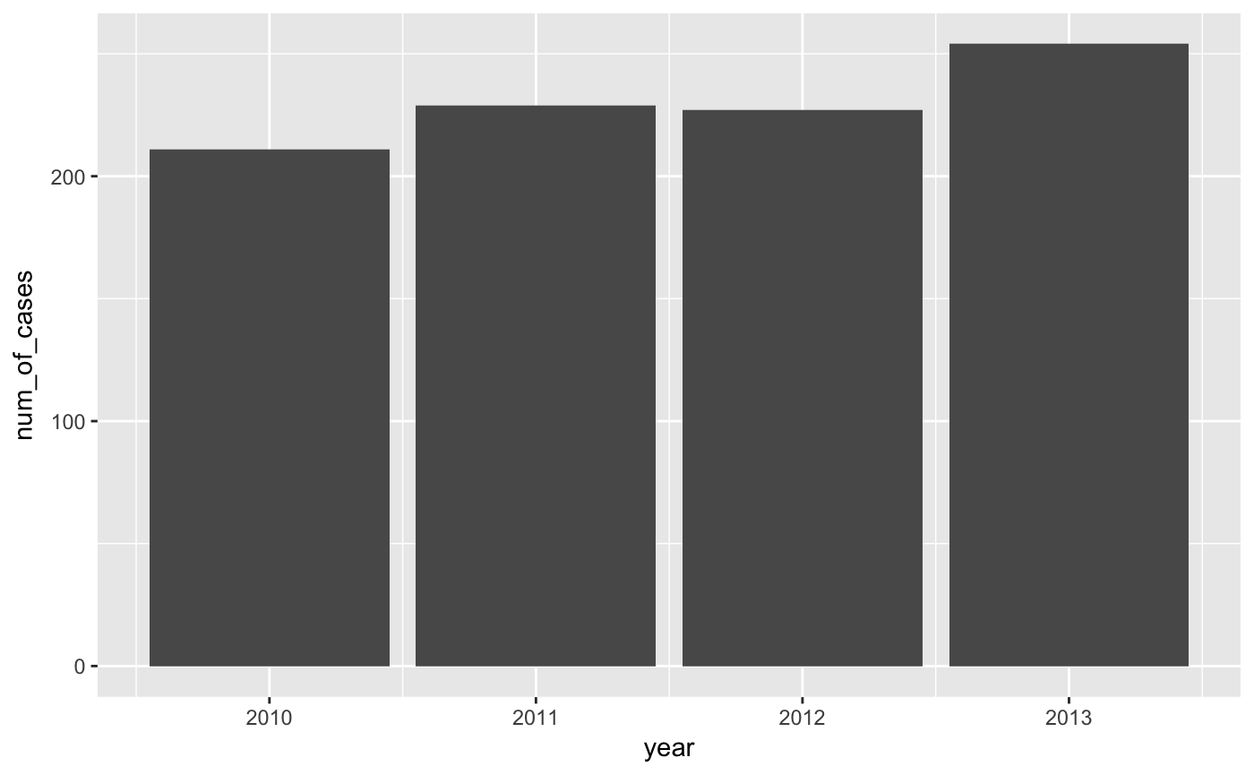
Investigation of Data - Time

Slide 5
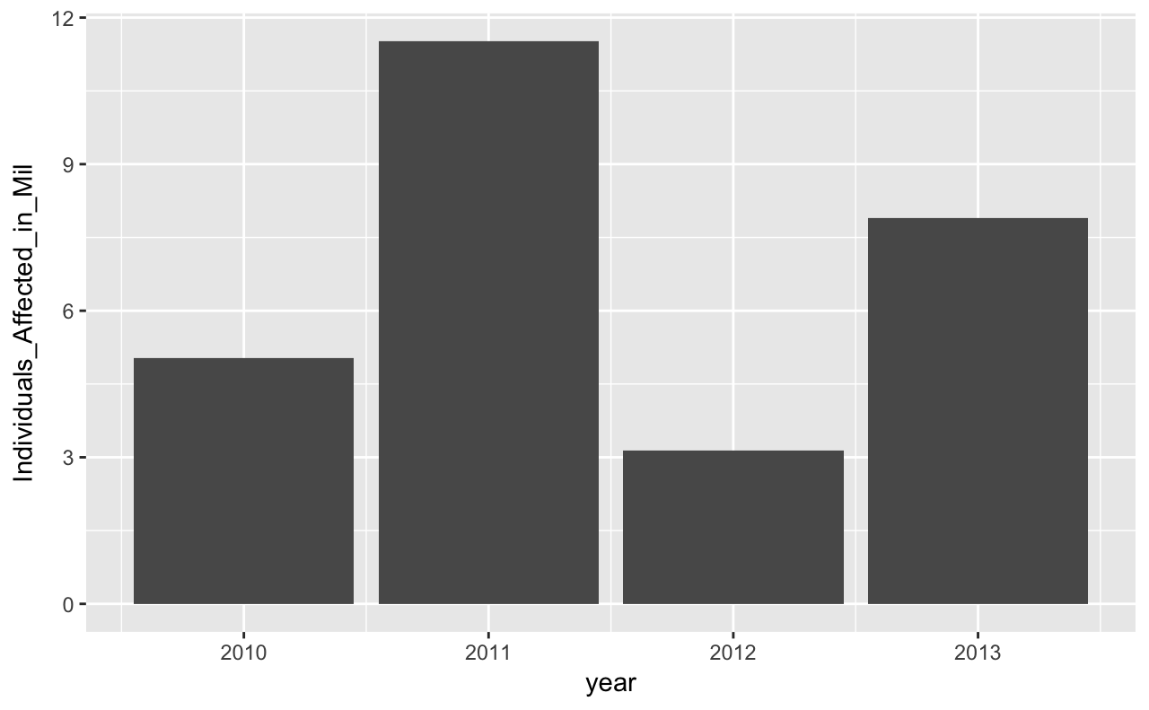
Investigation of Data - Time

Slide 6
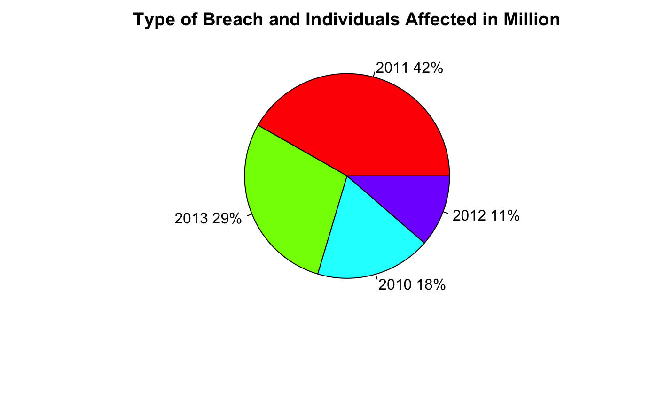
Investigation of Data - Time

Slide 7
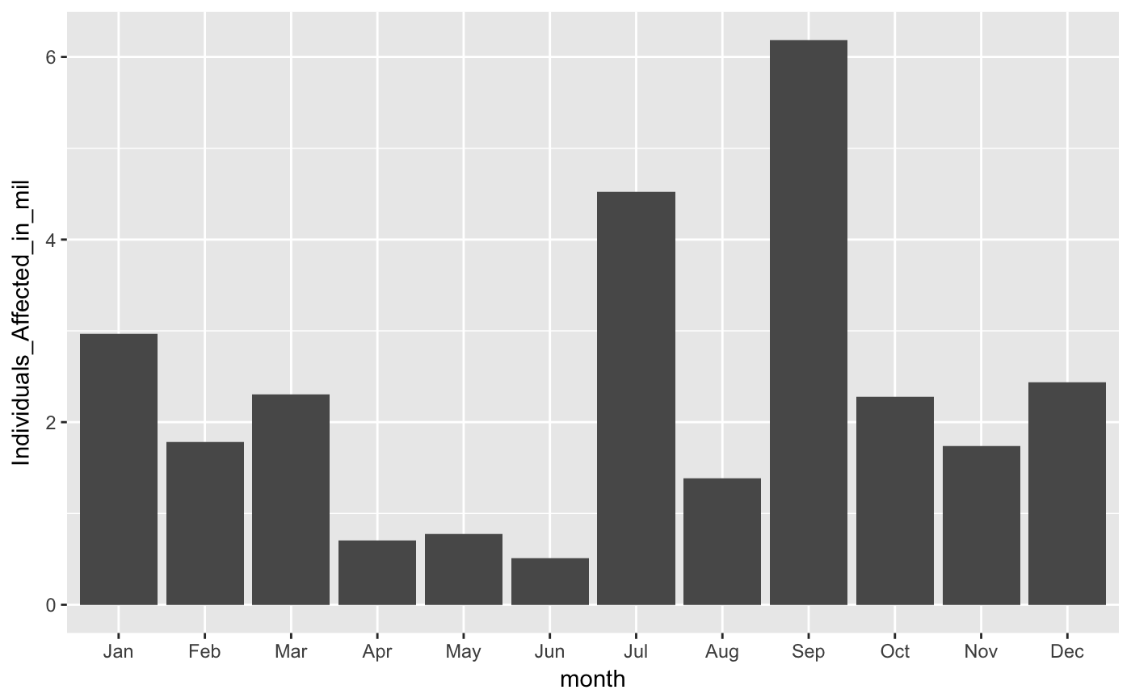
Investigation of Data - Time

Slide 8
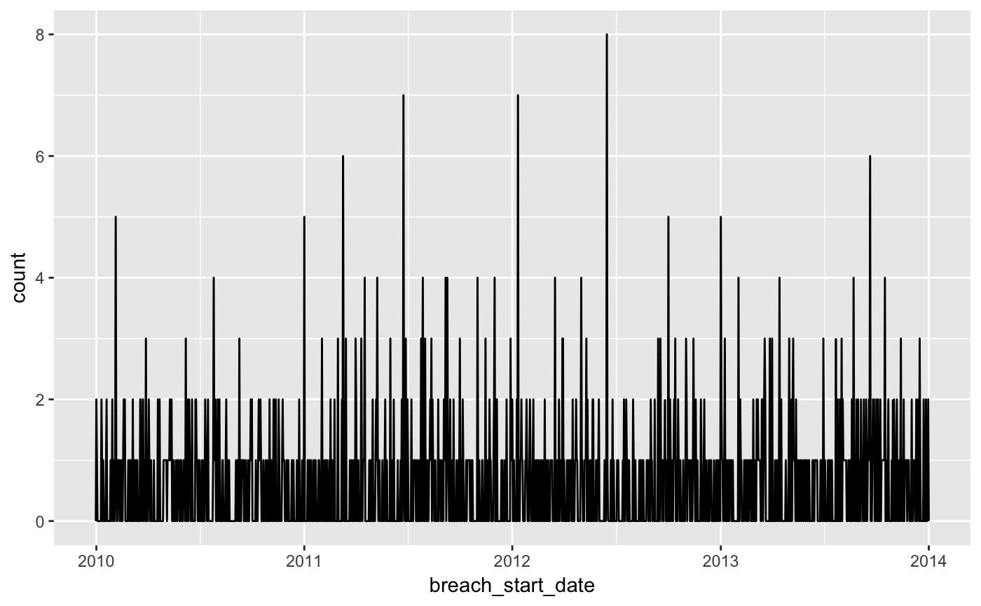
Investigation of Data - Time

Slide 9
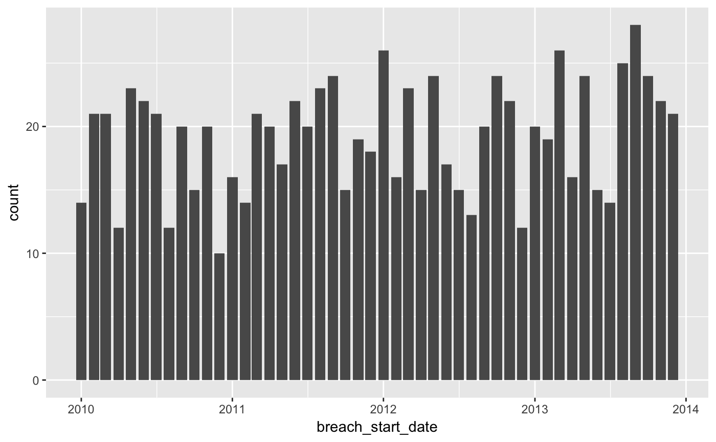
Investigation of Data - Time

Slide 10
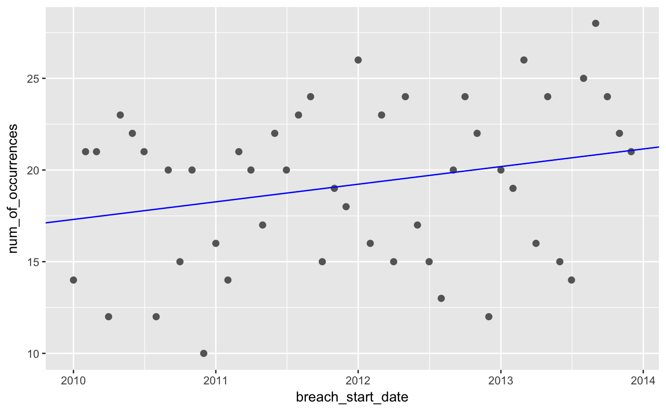
Investigation of Data - Time

Slide 11
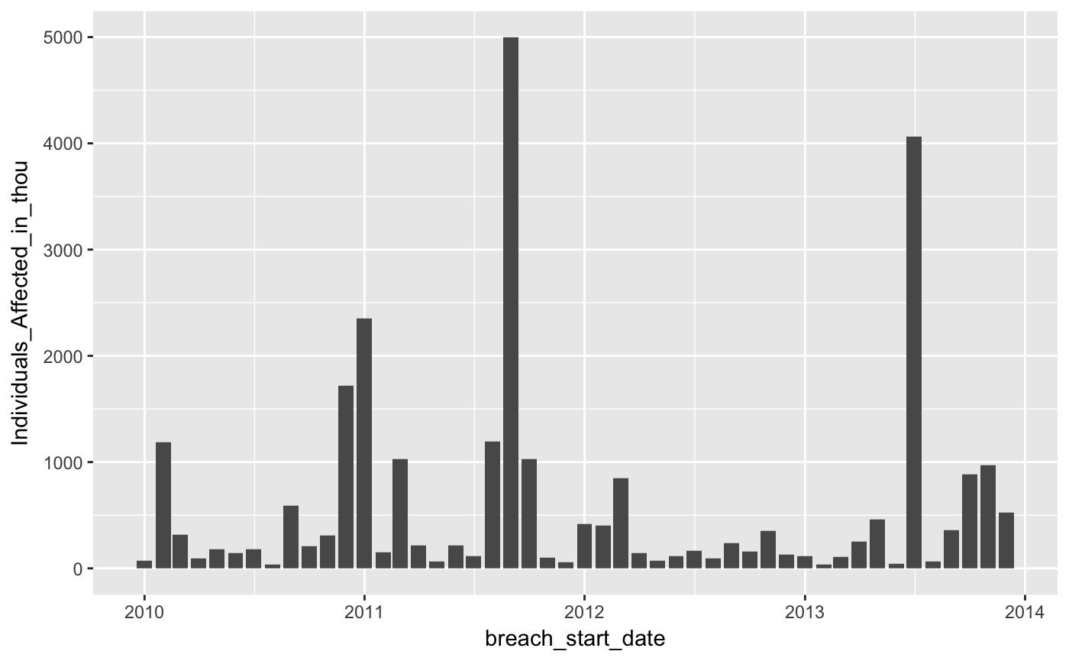
Investigation of Data - Time

Slide 12
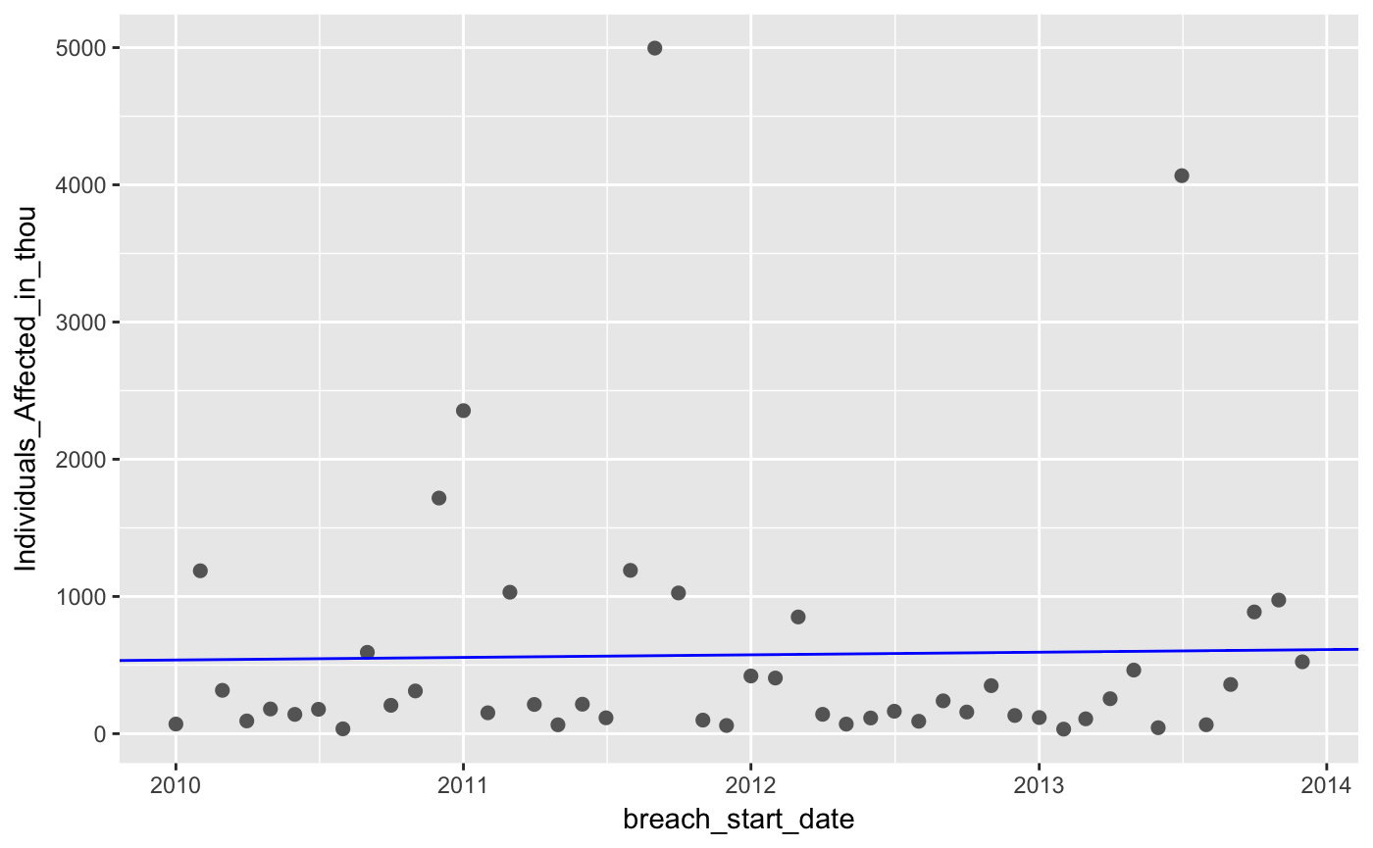
Investigation of Data - Time

Slide 13
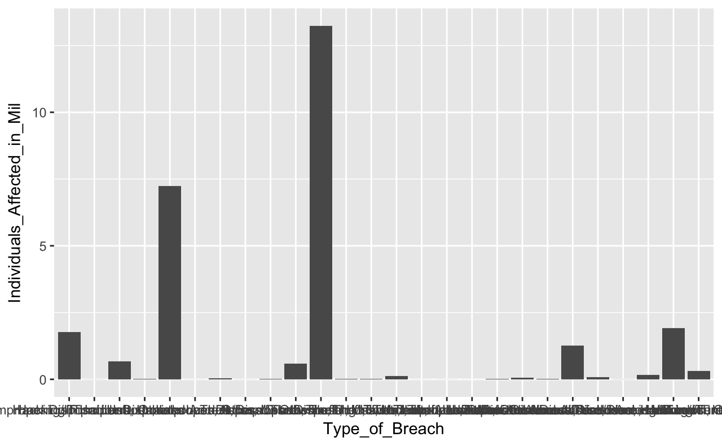
Investigation of Data - Type

Slide 14
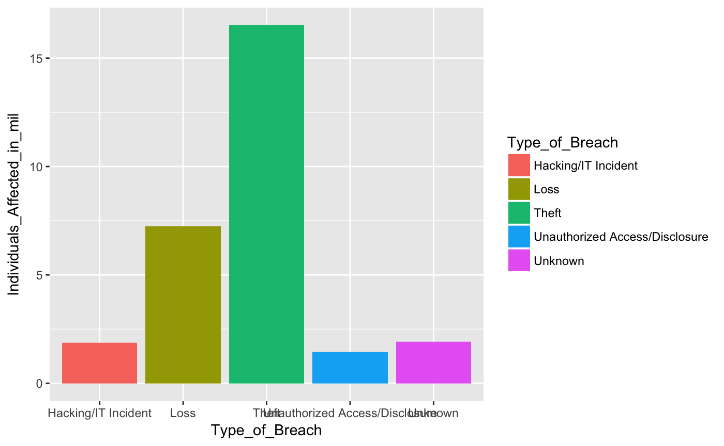
Investigation of Data - Type
Notes:
Now I’ve got a couple of directions that I would like to dive deeper into studying

Slide 15
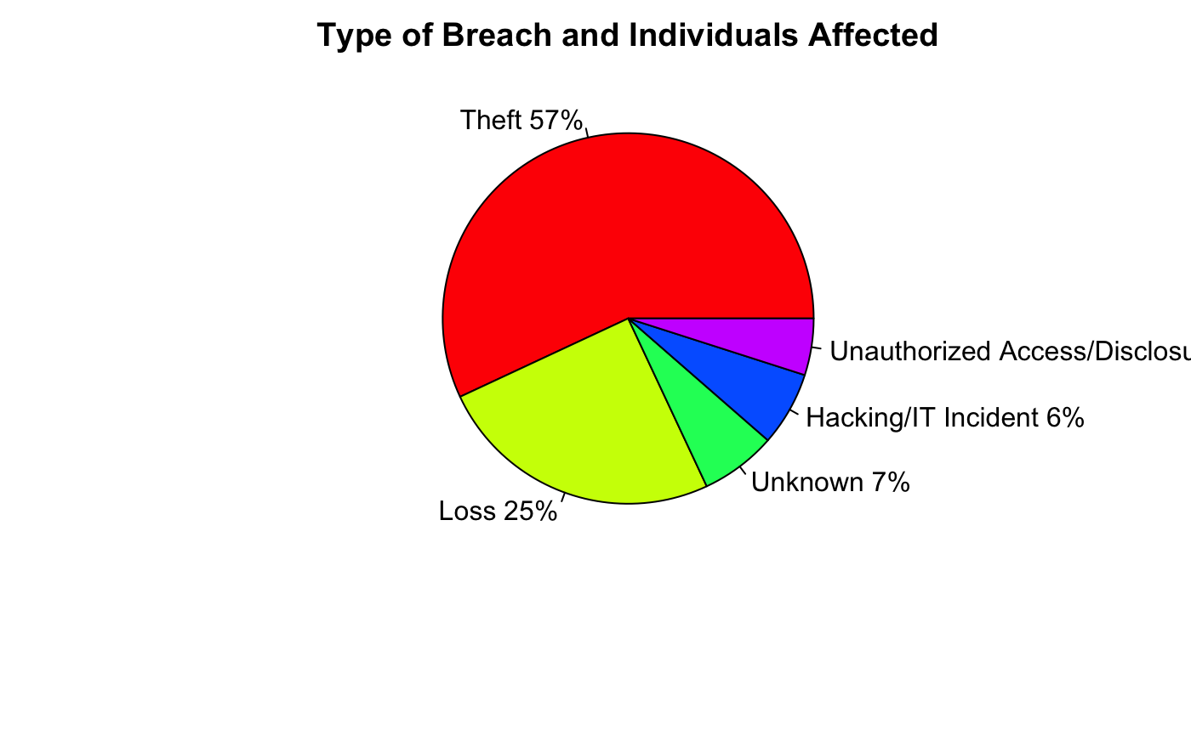
Investigation of Data - Type

Slide 16
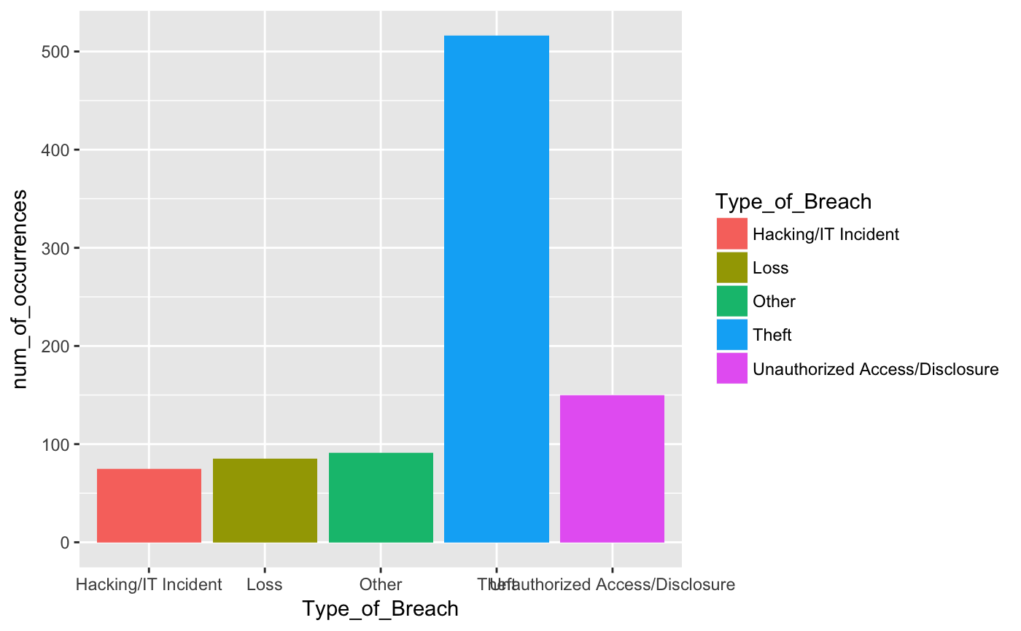
Investigation of Data - Type

Slide 17
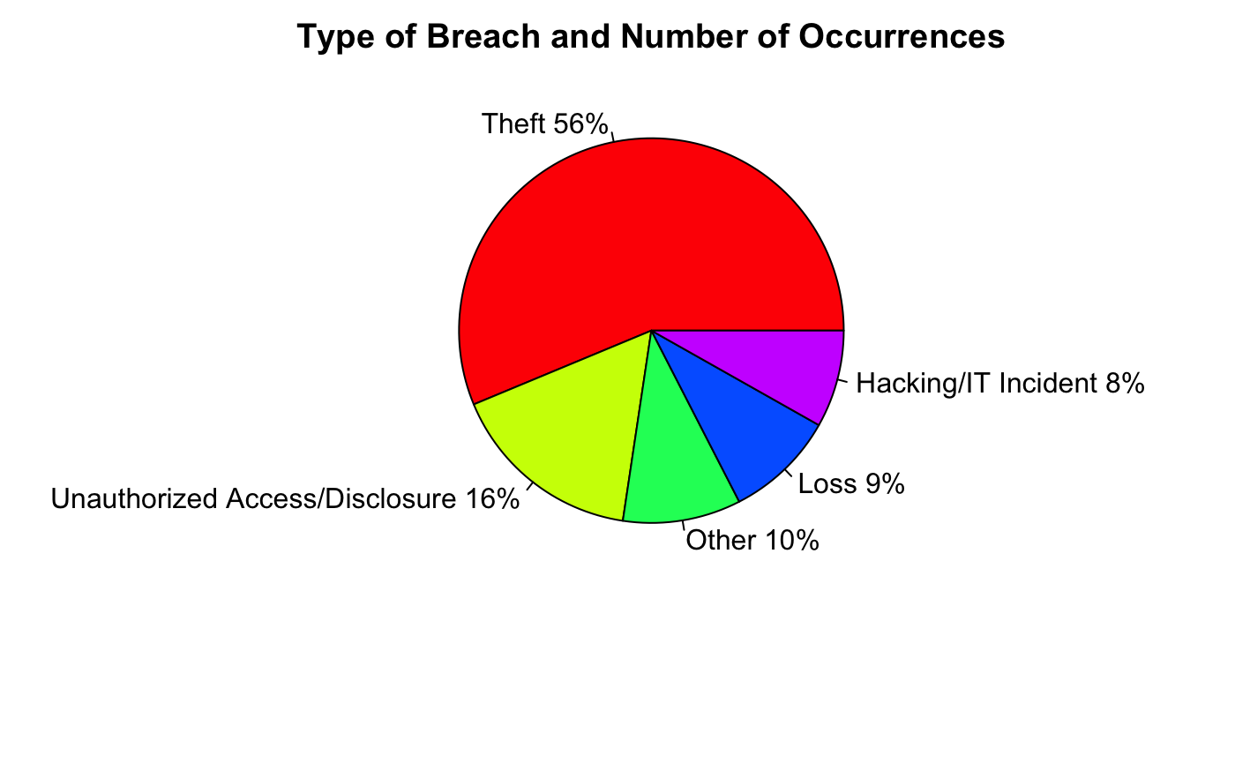
Investigation of Data - Type

Slide 18
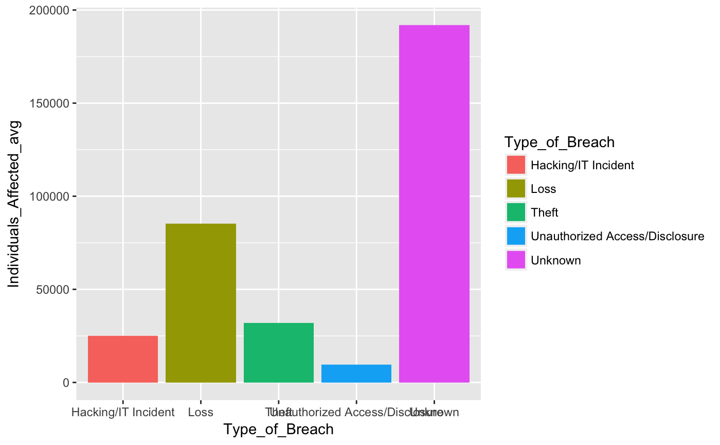
Investigation of Data - Type

Slide 19
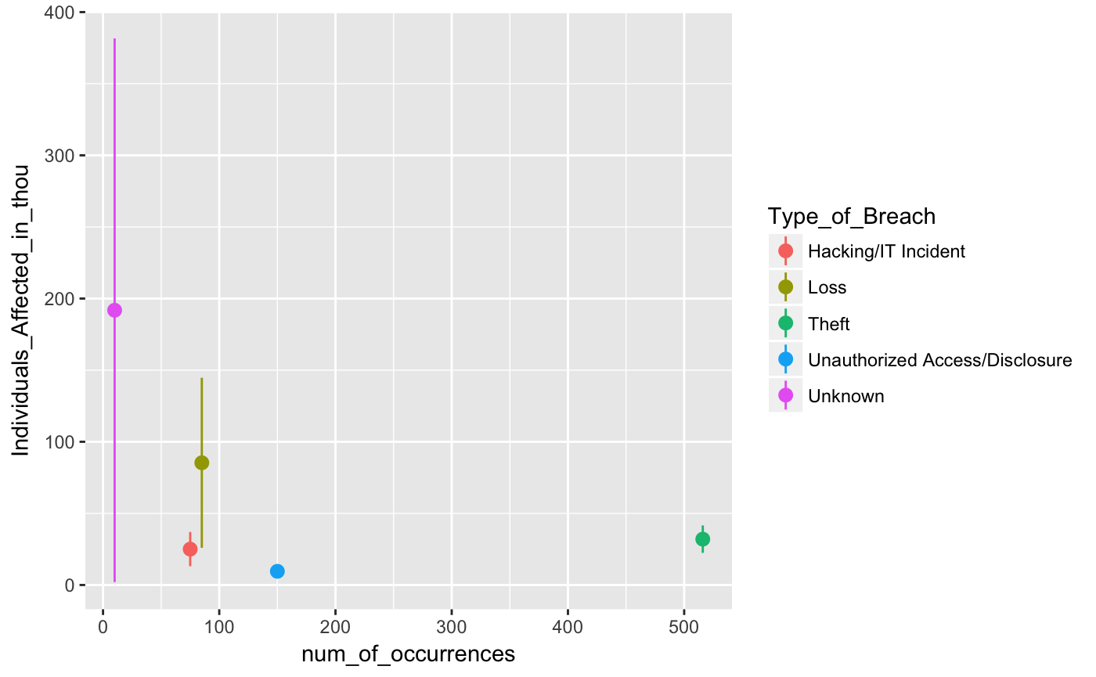
Investigation of Data - Type

Slide 20
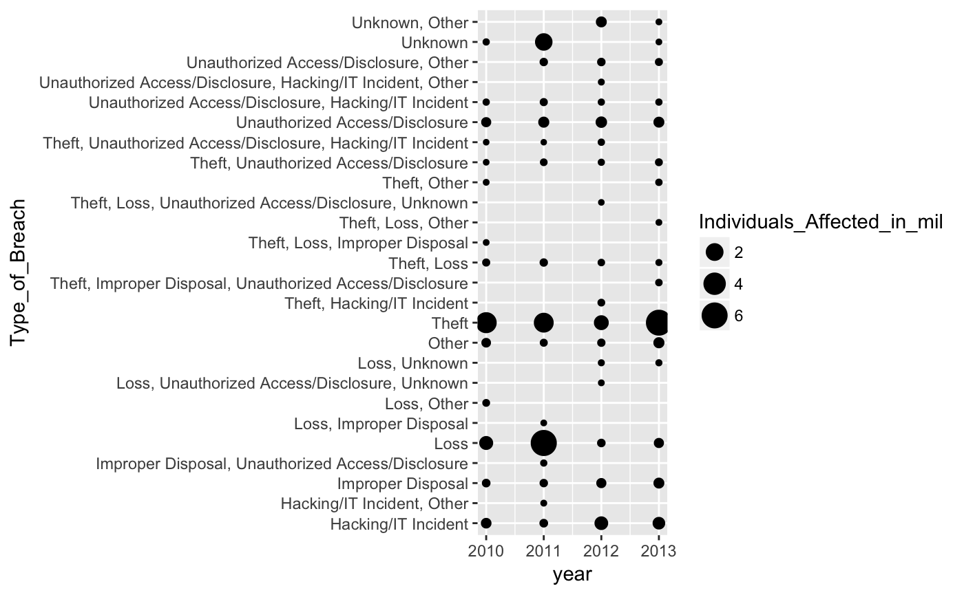
Investigation of Data – Time and Type

Slide 21
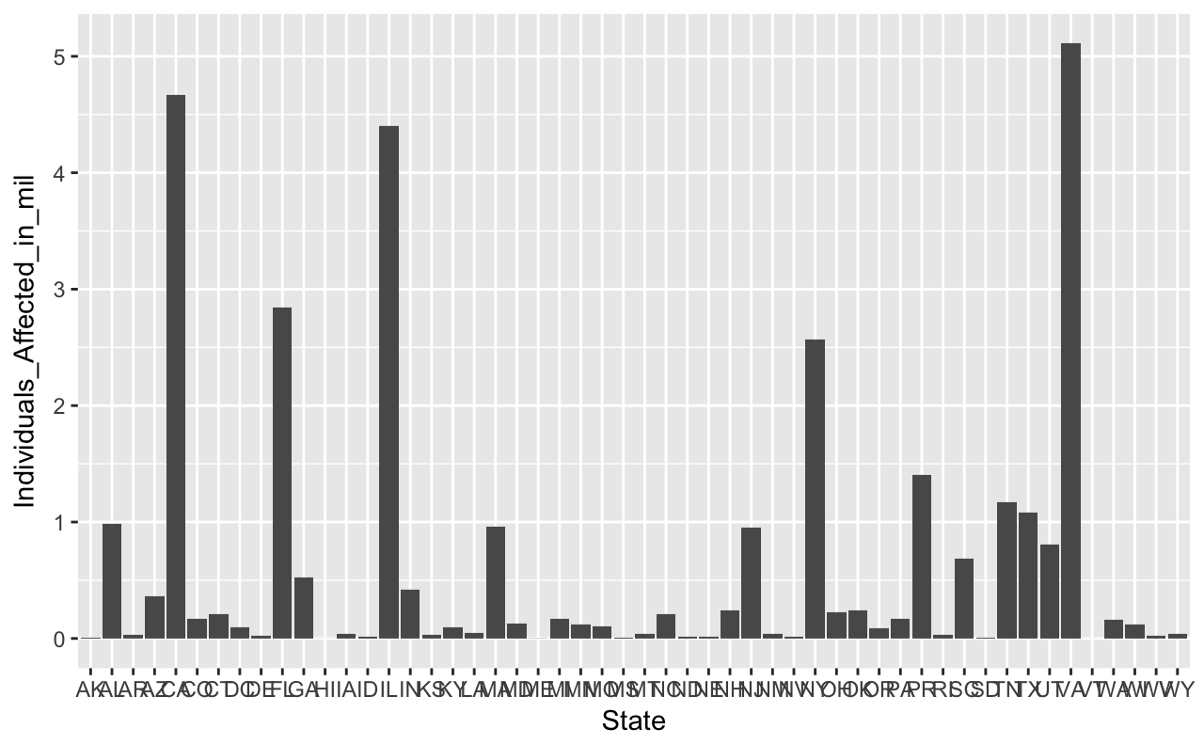
Investigation of Data - State

Slide 22
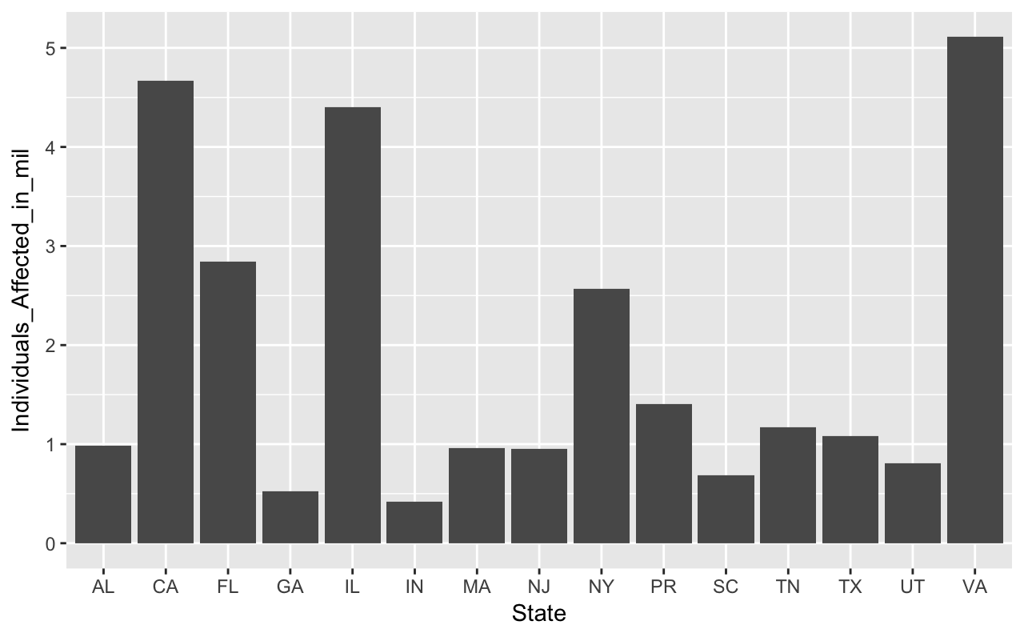
Investigation of Data - State

Slide 23
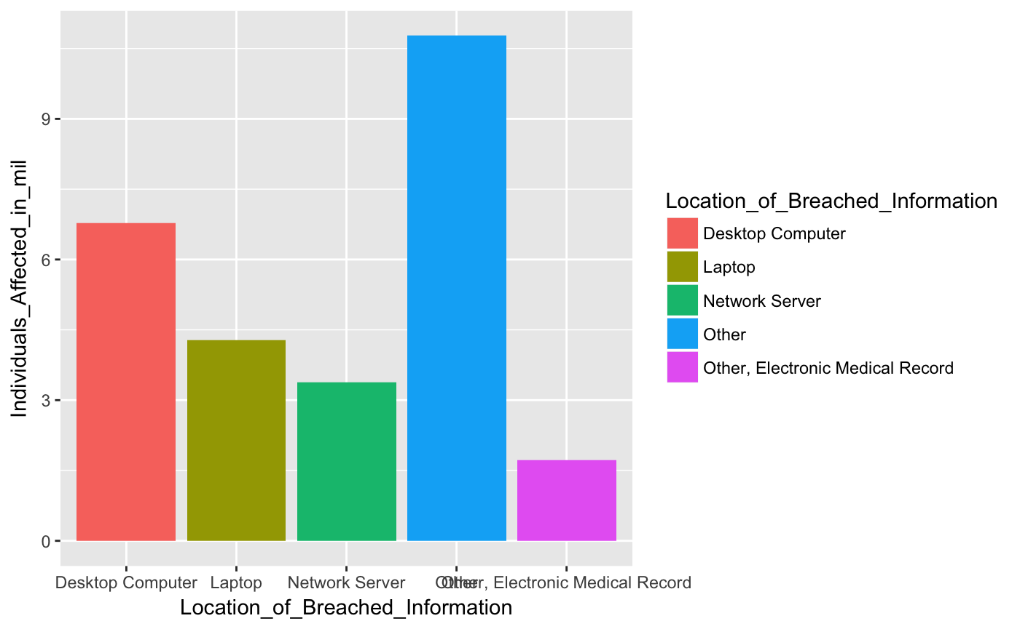
Investigation of Data - Location

Slide 24
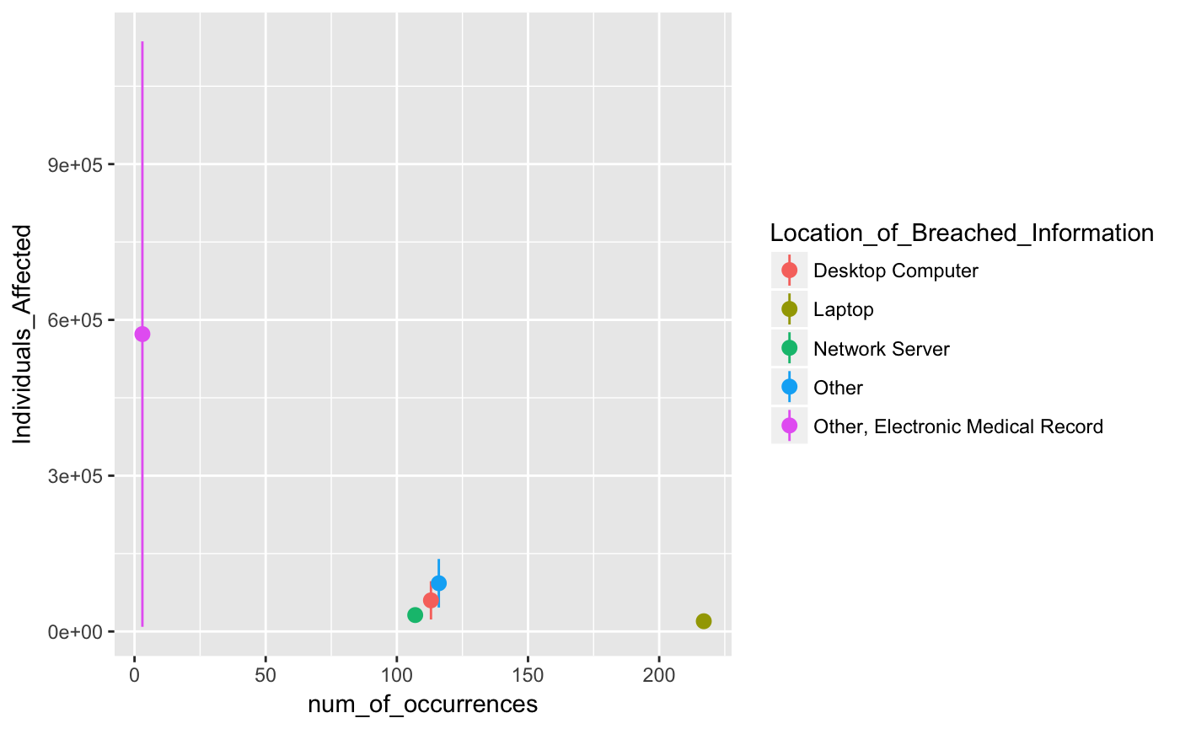
Investigation of Data - Location

Slide 25



Why this matters

Slide 26



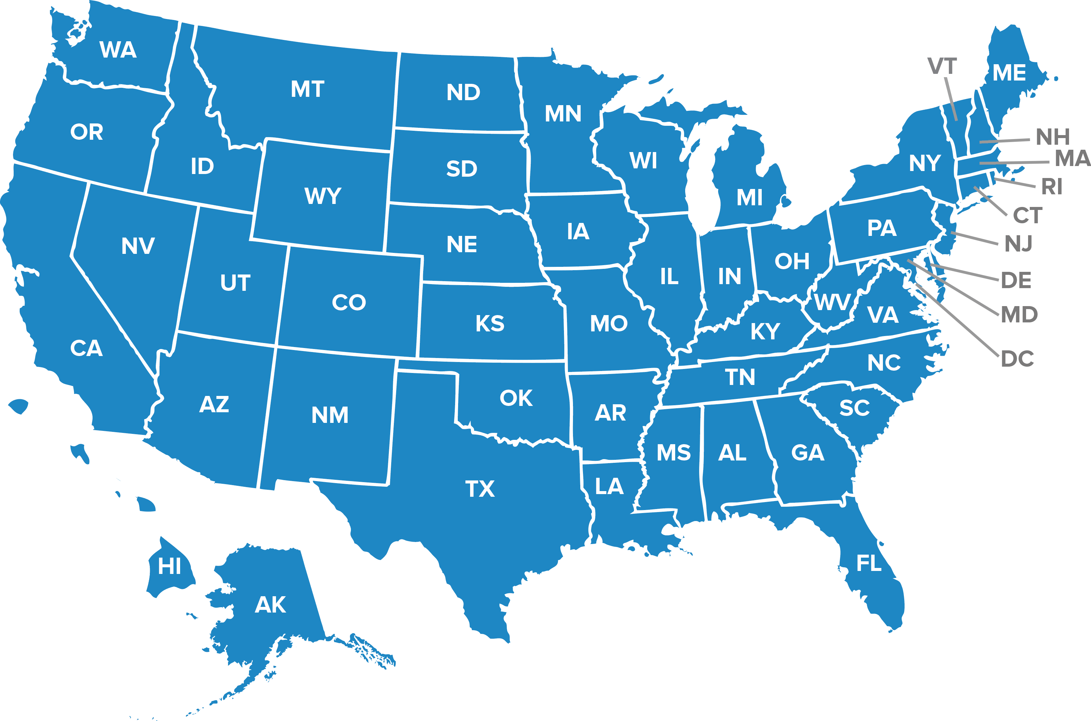




Conclusion
Notes:
HHS Data shows…
This is important for the DoD for the future.
Time
State
Location
Type

