Slide 1
Final Review

Slide 2
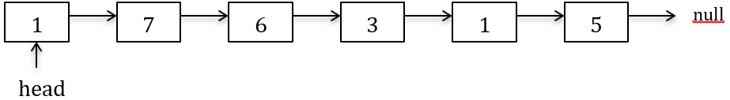
Q1(A)
public class SNode <E>{
public E data;
public SNode<E> next = null;
public SNode() {; }
public double func() {
IntNode cursor;
int num1 = 0;
int num2 = 0;
for (cursor = this; cursor != null; cursor = cursor.link) {
if(cursor.data%2==1)
num1+=cursor.data;
else
num2 +=cursor.data;
}
return ((num1)*1.0/num2);
}
}
Given the above function func(), what is the returned result of running head.func() on the following list

Slide 3
Q1(A)
public class SNode <E>{
public E data;
public SNode<E> next = null;
public SNode() {; }
public double func() {
IntNode cursor;
int num1 = 0;
int num2 = 0;
for (cursor = this; cursor != null; cursor = cursor.link) {
if(cursor.data%2==1)
num1+=cursor.data;
else
num2 +=cursor.data;
}
return ((num1)*1.0/num2);
}
}
Given the above function func(), what is the returned result of running head.func() on the following list
This function calculates the ratio of odd numbers and even numbers. The result is (1+7+3+1+5)/6 = 17/6 = 2.833

Slide 4
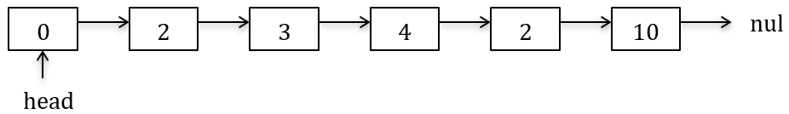
Q1(B)
public SNode f (SNode head, E x){
SNode dummyn = new SNode();
dummyn.next = head;
SNode cursorPrev = dummyn;
SNode cursor = cursorPrev.next;
while(cursor!=null){
if(cursor.data.equals(x))
cursorPrev.next = cursor.next;
else
cursorPrev = cursorPrev.next;
cursor = cursor.next;
}
head = dummyn.next;
return head;
}
Let n be the total number of nodes in the linked list starting from head. What is the worst-case complexity of the above f method in Big-O
Show the result of running f(head,2) on the following list.

Slide 5
Q1(B)
public SNode f (SNode head, E x){
SNode dummyn = new SNode();
dummyn.next = head;
SNode cursorPrev = dummyn;
SNode cursor = cursorPrev.next;
while(cursor!=null){
if(cursor.data.equals(x))
cursorPrev.next = cursor.next;
else
cursorPrev = cursorPrev.next;
cursor = cursor.next;
}
head = dummyn.next;
return head;
}
Let n be the total number of nodes in the linked list starting from head. What is the worst-case complexity of the above f method in Big-O: O(n)
Show the result of running f(head,2) on the following list.
This method removes all the nodes with value x. The result should be.
0->3->4->10->null

Slide 6
Q2
public class LinkStack<E> {
public SNode<E> top;
public LinkStack() {top = null;}
public void push(E e) {//Insert data to the stack
}
public E pop() {
if(top==null) throw new EmptyStackException();
E answer = top.data;
top = top.next;
return answer;
}
}
public class SNode <E>{
public E data;
public SNode<E> next = null;
public SNode() {; }
….
}
Utilizing the SNode class given above, implement an O(1) push method for the class LinkStack, this method needs to match the given pop() method.

Slide 7
Q2
public class LinkStack<E> {
public SNode<E> top;
public LinkStack() {top = null;}
public void push(E e) {//Insert data to the stack
SNode<E> newtop = new SNode<E>();
newtop.data = e;
newtop.next = top;
top = newtop;
}
public E pop() {
if(top==null) throw new EmptyStackException();
E answer = top.data;
top = top.next;
return answer;
}
}
public class SNode <E>{
public E data;
public SNode<E> next = null;
public SNode() {; }
….
}
Utilizing the SNode class given above, implement an O(1) push method for the class LinkStack, this method needs to match the given pop() method.

Slide 8
Q3
What will the queue qu look like after running the following several lines of code? You need to clearly denote (1) which nodes that the front and the rear of qu point to, and (2) how the nodes in the queue link to each other.
LinkedQueue<Integer> qu = new LinkedQueue<Integer>();
qu.f1();
qu.f2(1);
qu.f2(2);
qu.f1();
qu.f2(3);
Given the class LinkedQueue.
public class LinkedQueue<E> {
public SNode<E> rear = null; //the rear of a queue
public SNode<E> front = null; //the front of a queue
public LinkedQueue(){; }
public E f1() {
if(front==null){ return null;}
else{
E answer = front.data;
front = front.next;
if(front==null) rear = null;
return answer;
}
}
public void f2(E e) {
SNode<E> newNode = new SNode<E>();
newNode.data = e;
if(rear==null) {
front = rear = newNode;
}else{
rear.next = newNode;
rear = newNode;
}
}
}

Slide 9
Q3
What will the queue qu look like after running the following several lines of code? You need to clearly denote (1) which nodes that the front and the rear of qu point to, and (2) how the nodes in the queue link to each other.
LinkedQueue<Integer> qu = new LinkedQueue<Integer>();
qu.f1();
qu.f2(1);
qu.f2(2);
qu.f1();
qu.f2(3);
Given the class LinkedQueue.
public class LinkedQueue<E> {
public SNode<E> rear = null; //the rear of a queue
public SNode<E> front = null; //the front of a queue
public LinkedQueue(){; }
public E f1() {
if(front==null){ return null;}
else{
E answer = front.data;
front = front.next;
if(front==null) rear = null;
return answer;
}
}
public void f2(E e) {
SNode<E> newNode = new SNode<E>();
newNode.data = e;
if(rear==null) {
front = rear = newNode;
}else{
rear.next = newNode;
rear = newNode;
}
}
}
Answer:
front=2, rear=3: from front to rear: 2 3

Slide 10
Q4A
Given the classes BSTNode and BST as follows. Assume duplication values are not allowed in the tree.
class BSTNode{
public int data; //the element value for this node
public BST left; //the left child of this node
public BST right; //the right child of this node
public int height=1; //height of the tree rooted at this node
public BSTNode () {data = 0; left = new BST(); right = new BST(); }
public BSTNode (int initData) {data = initData; left = new BST();right = new BST();}
}
public class BST {
public BSTNode root; //instance variable to denote the root of the AVL tree
public BST() {root = null;}
public boolean isEmpty() {return (root==null);}
//Function to find the node that contains e; if e does not exist in the tree, return null
public BSTNode searchNonRecursion (int e){
BST cursor = this;
while ((cursor!=null)&&(cursor.root!=null)){
if(e==cursor.root.data){
return cursor.root;
}else if(e<cursor.root.data){
cursor = cursor.root.left;
}else{
cursor = cursor.root.right;
}
}
return null;
}
}
A. Given the searchNonRecursion() method, its worst case running time complexity in Big-O is O(log n). Is this statement correct (yes/no)?

Slide 11
Q4A
Given the classes BSTNode and BST as follows. Assume duplication values are not allowed in the tree.
class BSTNode{
public int data; //the element value for this node
public BST left; //the left child of this node
public BST right; //the right child of this node
public int height=1; //height of the tree rooted at this node
public BSTNode () {data = 0; left = new BST(); right = new BST(); }
public BSTNode (int initData) {data = initData; left = new BST();right = new BST();}
}
public class BST {
public BSTNode root; //instance variable to denote the root of the AVL tree
public BST() {root = null;}
public boolean isEmpty() {return (root==null);}
//Function to find the node that contains e; if e does not exist in the tree, return null
public BSTNode searchNonRecursion (int e){
BST cursor = this;
while ((cursor!=null)&&(cursor.root!=null)){
if(e==cursor.root.data){
return cursor.root;
}else if(e<cursor.root.data){
cursor = cursor.root.left;
}else{
cursor = cursor.root.right;
}
}
return null;
}
}
A. Given the searchNonRecursion() method, its worst case running time complexity in Big-O is O(log n). Is this statement correct (yes/no)? No
If the binary search tree is not balanced. The performance can be O(n).

Slide 12
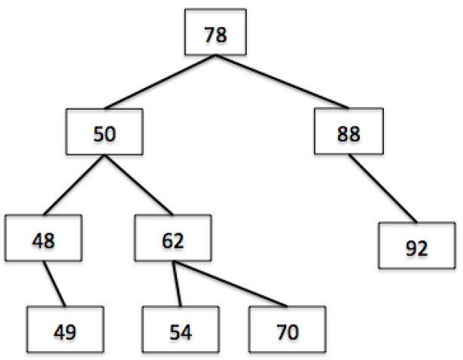
Q4B
Given the following BST tree t1, which is rooted at node with value 78.
Given the following function in BST class,
private int func(){
int result=0;
if(right.isEmpty()){
result = root.data;
root = left.root;
}else{
result = right.func();
}
return result;
}
What will t1 look like and what is the returned value after you call t1.left.func()?

Slide 13
Q4B
Given the following BST tree t1, which is rooted at node with value 78.
Given the following function in BST class,
private int func(){
int result=0;
if(right.isEmpty()){
result = root.data;
root = left.root;
}else{
result = right.func();
}
return result;
}
What will t1 look like and what is the returned value after you call t1.left.func()?
This function conducts removeMax()
The leaf node of t1 with value 70 should be gone.
The returned value is 70.

Slide 14
Q5
Given the below bnarySearch function
// Search e from array A[idxs,…., idxe]
// If e exists in A[idxs,…., idxe], return its index in A; otherwise, return -1
public int binarySearch (int[]A, int idxs, int idxe, int e){
if(idxe<idxs) return (-1);
int idx_middle = (idxe+idxs)/2;
if(A[idx_middle]==e) return idx_middle;
else if(e<A[idx_middle]) return binarySearch(A, idxs, idx_middle,e);
else return binarySearch(A, idx_middle,idxe,e);
}
Given an array A with content {1, 3, 6, 9, 10, 13}.
Draw the recursion trace of binarySearch(A, 0, 5, 10).

Slide 15
Q5
binarySearch(A, 0, 5, 10) return 4;
calls binarySearch(A, 0, 5, 10) return 4;
calls binarySearch(A, 2, 5, 10) return 4;
calls binarySearch(A, 3, 5, 10) return 4;
Given the below binarySearch function
// Search e from array A[idxs,…., idxe]
// If e exists in A[idxs,…., idxe], return its index in A; otherwise, return -1
public int binarySearch (int[]A, int idxs, int idxe, int e){
if(idxe<idxs) return (-1);
int idx_middle = (idxe+idxs)/2;
if(A[idx_middle]==e) return idx_middle;
else if(e<A[idx_middle]) return binarySearch(A, idxs, idx_middle,e);
else return binarySearch(A, idx_middle,idxe,e);
}
Given an array A with content {1, 3, 6, 9, 10, 13}.
Draw the recursion trace of binarySearch(A, 0, 5, 10).

Slide 16
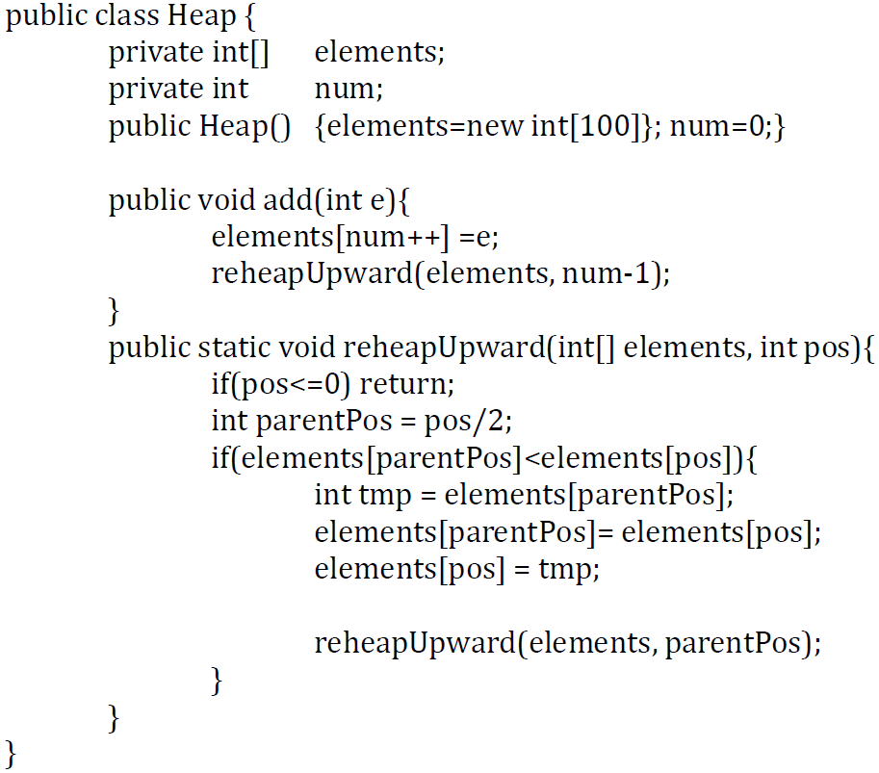
Q6
Given the following Heap class which utilizes an array to hold the elements. This heap needs to be a max heap.
Is there any bug in the provided reheapUpward method? If no, explain. If yes, fix the bug.

Slide 17
Q6
Given the following Heap class which utilizes an array to hold the elements. This heap needs to be a max heap.
Yes. Change
int parentPos = pos/2;
to
int parentPos = (pos-1)/2;

Slide 18
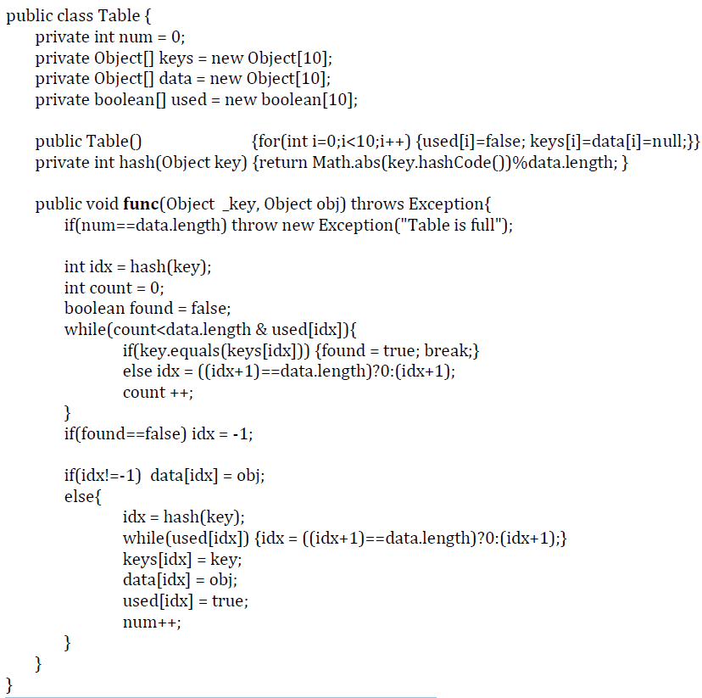
Q7
Given the following Table class.
Assume that your run the following several lines of code:
Table tb = new Table();
tb.f(1, "o1");
tb.f(10, "o10");
tb.f(11, "o11");
tb.f(5, "o5");
tb.f(20, "o20");
What will be the content of keys, data, and used?

Slide 19
Q7
Given the following Table class.
Assume that your run the following several lines of code:
Table tb = new Table();
tb.f(1, "o1");
tb.f(10, "o10");
tb.f(11, "o11");
tb.f(5, "o5");
tb.f(20, "o20");
What will be the content of keys, data, and used?
Keys[0-9]: 10, 1, 11, 20, null, 5, null, null, null, null, null
Data[0-9]: o10, o1, o11, o20, null, o5, null, null, null, null, null
Used[0-9]: T, T, T, T, F, T, F, F, F, F, F

