Slide 1
“I quit!”
Why working for you isn’t working for me
A look at the short term and long term employee attributes that drive turnover
Lok H Ngan, Andrew Narbutis, Justin Pate
Notes:
(Speaker: Andrew) Main messages for slide:
We analyzed a set of employee data to try to understand why employees leave
More importantly, we were trying to understand whether we can provide recommendations to try to address and even reduce turnover

Slide 2
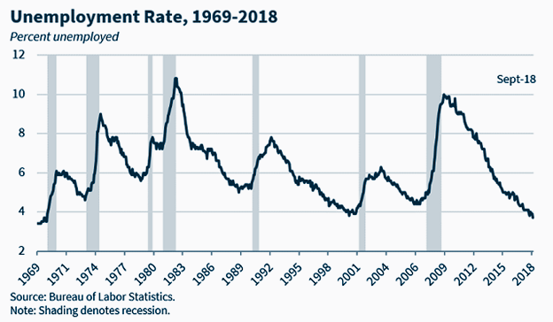
3.6 %
April 2019 Unemployment Rate
Notes:
(Speaker: Andrew) Main messages for slide:
Unemployment is at a 50 year low.
Finding talent is one of the top challenges for leaders.
Competition for talent is fierce.
Script:
Today we have the lowest unemployment rate the U.S. has had in 50 years.
This number keeps corporate leaders up at night. Inability to fill the demand for workers is one of the top challenges cited by leaders (get quote and source)
Competition for talent is now called the “war for talent”. Companies leaders say they are “fighting” for talent.
And in this fiercely competitive environment, leaders realize it is important to retain the talent they already have.

Slide 3
3,400,000
Employees who said “I quit!” in March, 2019
Notes:
(Speaker: Andrew) Main messages for slide:
A lot of people quit every month!
That’s equivalent to 2.3% of all employees saying “I quit”
This number does not count people that are fired or laid off - these truly are the people that say “I quit”
Therefore - in most cases, companies cannot just say “good riddance” and live without someone doing that employee’s job
Script:
Add
Think about this number. This is one month….

Slide 4
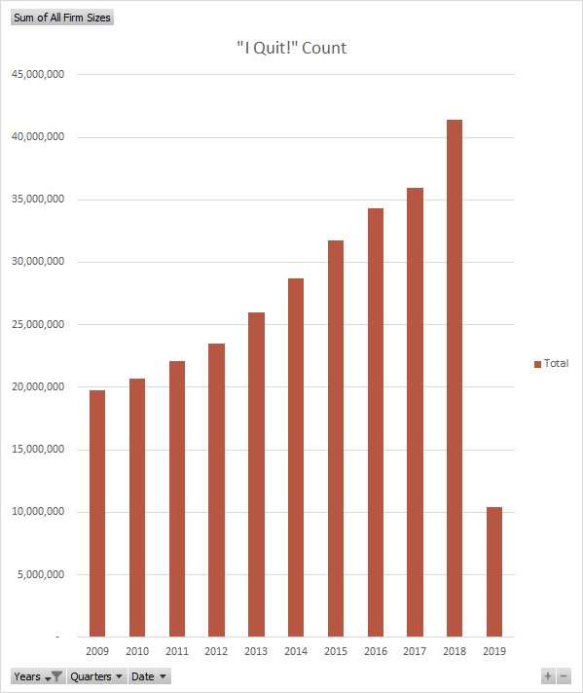
42,000,000
Employees who said “I quit!” in the last year (ended March, 2019)
Source: Bureau of Labor Statistics
Notes:
(Speaker: Andrew) Main messages for slide:
Ever since we have been in recovery from the 2009 recession, more and more people have quit their jobs every year.
The first quarter of 2019 data is indicating that 2019 will meet or exceed the 2018 volumes.
Remember, this does not count people who were fired or laid off, so most of these created a vacancy that needed to be filled.
Script:
Employees quit their job for many reasons. Some are personal (follow spouses or partners across the country, stay home with children, change careers, and even go back to school), but many are within control of the company.
Think about the reason you left your last job. Why did you quit? More money? Advancement? Engagement? Crappy boss?
We hope some in depth analysis will help us understand why.

Slide 5
Employees = Appreciating Assets
*
Employees produce more and add more value to the organization over time
*Most of them, anyway
Notes:
(Speaker: Andrew) Main messages for slide:
Most corporate assets depreciate.
Employees actually appreciate in value.
Therefore, we need to save and protect those assets that are more valuable
Script:
Think about the word in which you work.
The chair you sit on, the computer you use, the phone you make calls with. Almost everything around you is considered a company asset that starts to lose value the moment you get it and start using it. You don’t look at a 5 year old computer and say “this thing works better than ever”.
But employees are different. As early as a day after they start, employees are more valuable than the day they arrived.
Employees learn. They innovate and find new ways to complete work. They remember and can apply what they have seen and done to new situations. They get faster and more accurate. Anyone ever seen an “amazing employees” video on YouTube?
Companies want to keep employees because they become more valuable over time.

Slide 6
Employee Turnover is expensive!
Costs include:
Termination processing
PTO/vacation payouts
Hiring costs
Onboarding
Training
Work coverage
Ramp time to peak productivity
Higher business error rates
Lost institutional knowledge
Team and employee engagement
Estimates range from $1000’s to 1.5–2.0x the employee’s annual salary
Notes:
(Speaker: Andrew) Main messages for slide:
There is a lot of debate over how much employee turnover costs a company.
No one size fits all answer
Consider these costs when an employee leaves.
No company is immune from this. Even fast food companies like McDonalds pay the price for turnover
Script:
There is a lot of debate on how to determine the cost of turnover About the only constant is that everyone agrees it is hard to do.
As you look at this list, think about the costs associated with these activities.
For our dataset, the total estimated cost associated with the turnover of the 237 employees is $5.4 million.
Why is this important?
When companies decide they want to tack the issue of turnover, they invest in solutions ($)
But the risk of that is that they spend a lot of money to fix those things they believe are the cause without ever really addressing the real causes.
I’m going to turn it over to Justin to talk about our dataset and what we found as we looked for the answer to what is driving turnover.

Slide 7
Questions? We have data!
What we know about 1470 Employees
Age | Job Role | Performance Rating
Business Travel Frequency | Job Satisfaction | Relationship Satisfaction
Daily Rate | Marital Status | Standard Hours
Department | Monthly Income | Stock Option Level
Distance from Home | Monthly Rate | Total Working Years
Education | Annual Income | Training Times Last Year
Field of Education | Annual Rate | Work Life Balance Rating
Environment Satisfaction | Number of Companies Worked For | Years at Company
Gender | Over 18 | Years in Current Role
Hourly Rate | Work Overtime? | Years since Last Promotion
Job Involvement | Percent of Last Salary Hike | Years with Current Manager
Job Level
Notes:
(Speaker: Justin) Main messages for slide:
Our dataset included information about 1470 employees
We started with 35 pieces of information about every employee, in addition to whether the employee had quit or was still active.
This is the type of data the business leaders look at every day.
.
Script:
“Real” HR data is very sensitive and just about impossible to get. We’re going to look at a dataset that was created by IBM’s data scientists as part of their work with Watson Analytics.
As you look at this data for 1470 employees, you can quickly start to form hypotheses:
Do people who stay in the same position turnover faster (stagnant/bored)?
Do younger employees leave faster than older employees?
If I promote more, will turnover go down?
Do long commutes drive turnover?
Age factors on attrition?
Am I making my employees travel too much?
Do I offer enough training?
Do stock options make people stay?

Slide 8
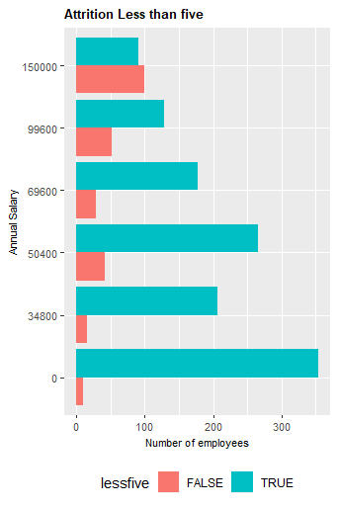
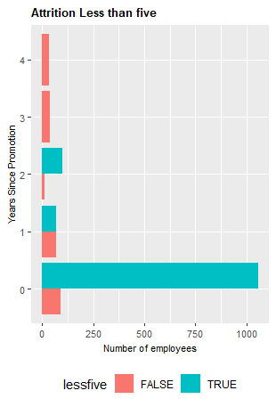
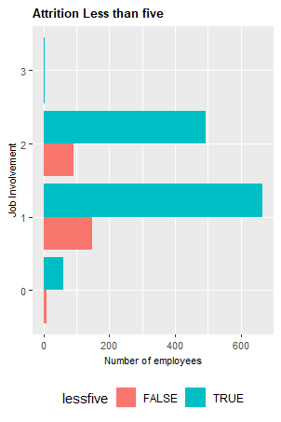
Below are examples of attributes of Employees who left before 5 years
The above graph shows employees who quit before five years based annual salary. It is very clear that the lower the salary, the more likely the person will leave.
The above graph shows employees who quit before five years based on years since the last promotion
The above graph shows employees who quit before five years based Job Involvement
Notes:
(Speaker: Justin) Main messages for slide:
This is Where some Employers Stop
Leaders look at data they can understand and causes of turnover that they believe are drivers.
Leaders often make assumptions that are not driven by data.
While sometimes those leaders can be right, without in depth analysis it is hard to know whether they really did identify the causes or if they are seeing the whole picture.
Turnover is a complex issue and looking for one main driver will often cause a leader to overlook other drivers.
A lot of money is spent by businesses trying to address the wrong problems.
Script:
Faced with the questions we just raised, let’s talk about how most leaders approach this problem.
A leader concerned about turnover will ask someone to create reports that show them salary ranges or years between promotions to see somehow tied to turnover. A more enlightened leader may ask to compare employee engagement to turnover rates because every business publication has been talking about how important employee engagement is to reducing turnover.
So, they will get reports with pretty graphs that look like this.
Looking at graphs like these, a leader concerned with turnover might say things like “If I pay more, they will not quit; I should increase everyone’s pay” or “If I promote more, turnover will go down” or even “I should spend money on engagement programs that boost job involvement to to lower my turnover”
Think about these solutions - they all cost money. But are these the right places to invest?
While some patterns are clear and any of these graphs makes for an impressive visual to sell an idea, this sort of analysis has other challenges.
For example, looking at this last graph:
How is job satisfaction and job involvement measured?
Does the company use an employee survey?
How reliable is the data collected from an employee? Remember what we said about employees being honest about something that might be unpleasant.
Does this mean that the insights and decisions are wrong? Not necessarily. Could the analysis be better? Definitely.
So what is the potential pitfall of limited analysis? In the case of turnover, the real reasons employees leave may not always surface. The problems are not addressed. People keep leaving. Even worse, the company may use that incorrect information to spend a lot of money on something that really does not help lower turnover.
Companies that stop their analysis at this level are fighting the war for talent with the wrong tools.

Slide 9
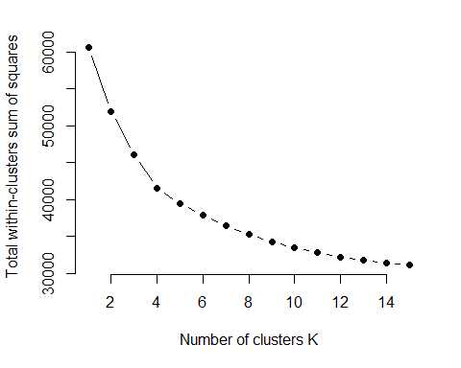
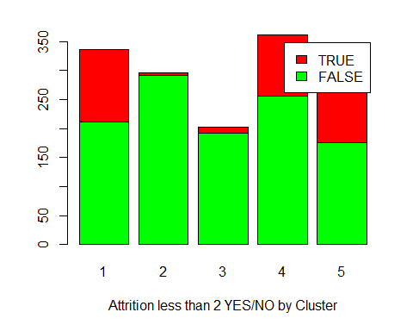
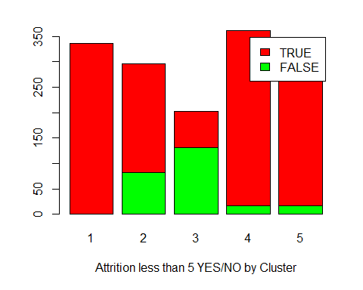
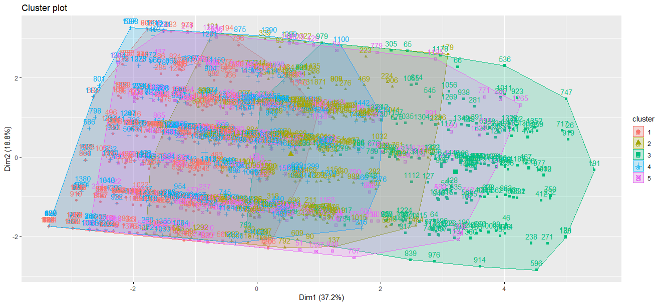
Diving Deeper - Highlights
With the goal of employers to identify a logical way to classify and predict which employees will stay and for how long, grouping the employees by logical clustering can be useful.
When the cluster is applied back to the data set, we are visualizing employees with similar attributes and looking at their attrition percentages. Clusters 1 and three were the largest returns for attrition less than 2 and clusters 2 and 3 were the largest for attrition less than 5
Given the data by grouping, a manager could then choose to deep dive and figure out the common factor in the clusters that have the higher attrition rates.
Notes:
(Speaker: Justin) Main messages for slide:
With the full set of data, we performed some clustering to see if there were any patterns in how these variable could be grouped.
We also found that some variables that we might have thought were important actually were not real drivers of turnover.
Script:
ADD
On the next couple slides, Lok is going to walk through the results of the models that we created to let you know what we found.

Slide 10
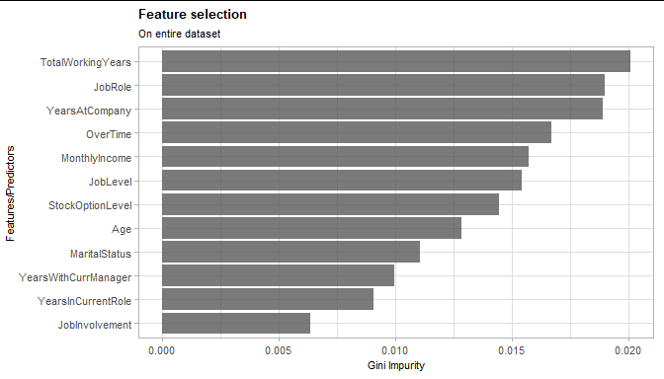
Results: Top Turnover Drivers
85%
Notes:
(Speaker: Lok) Main messages for slide:
Script:
As Justin has mentioned just a moment ago, we have a lot of data. However, we do not have a lot of information on what is actually driving turnover.
In order to get to the information that corporate executives would want to know, we have to take a deeper dive into this data and figure out what exactly are driving turnover.
When we looked at the entire dataset, we found that some of the key drivers in turnover include tenure, such as total working year, year with the same company, year worked under the same manager, as well as year in the current role. We also found that other factors such as the job role itself, salary and personal information like age and marital status, also play a role in driving turnover.
And with about 10 or so of the top drivers, we were able to create a predictive model that determine if someone will stay with the company or leave with an 85% accuracy rate.

Slide 11
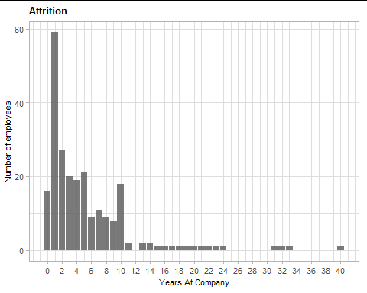
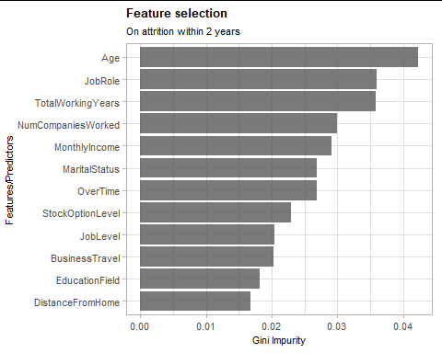
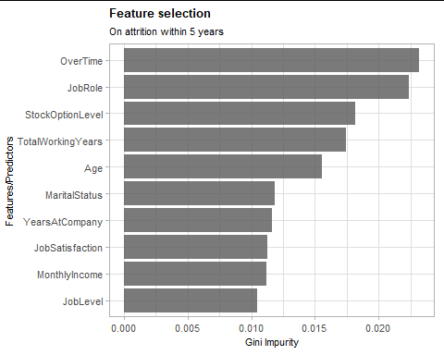
Results: Top Turnover Drivers by Tenure
Early Attrition (< 2 yrs)
Attrition < 5 yrs
List top drivers
List top drivers
78%
83%
Notes:
(Speaker: Lok) Main messages for slide:
While we began by looking to see what drove turnover for the whole population, we decided to segment our population into groups of employees who had worked for the company less than 2 years and less than 5 years.
Turnover in less than two years is a high cost for companies because companies invest more in developing and training new employees early in their careers.
In addition, almost 60% of the turnover in our dataset occurs before an employee has worked for 5 years
Add any other high point on the messaging
Script:
However, we then took even a closer look at this data, and we identify that almost 60% of turnover occurs before an employee has worked for 5 years. This can be seen visually in the graph on the right. Corporate executives understand that there are cost associated with this turnover, and one of the highest cost is associated with turnover for employees who leave within 2 years. We found that it is very important for us to understand what drive this early attrition, for both employees who leave within 2 years, as well as those who leave within 5 years.
As it turns out, a lot of the drivers remained the same between general attrition and early attrition. However, their relative importance changed.
Age became a very important factor for attrition within 2 years. Perhaps it is related to new graduates who just got their first job and later learned that it is not what they are looking for.
And for attrition within 5 years, we learned that overtime became a very important factor. Perhaps those employees have started a family and can no longer afford to work overtime.
Analyzing these subsections of the employee population, we were able to get up to 78% accuracy in predicting employees who leave within 2 years, and an 83% accuracy in predicting employees who leave within 5 years.

Slide 12
Recommendations
Focus On
Age related needs
Overtime
Job Roles
Notes:
Script:
Age was a very important factor for early attrition (2Y or less). But an employer cannot discriminate during the hiring process due to an applicant’s age, so leadership at this company needs to consider investing in programs that are geared toward retaining younger talent.
Overtime was an important factor for attrition at 5Y or less. People are leaving the company because they are unwilling to work overtime. Leadership needs to investigate further to understand what is driving overtime and take steps to remedy the situation.
Job role remained the second most important factor for both general and early attrition. The company should invest in a listening program that will help them understand what it is about their roles that makes employees want to leave. Initiatives such as a rotational program should be considered, allowing more employees to cross-train and try different roles within the company. This would require investment to cross-train and there would be a cost for lower productivity while a resource rotates into an unfamiliar job. However, if it lowers turnover and creates more versatile employees as an outcome, it is likely worth the investment.
Changes in companies can take a long time to implement and to show results. This is not a one and done process. The true value of applying sophisticated data analysis techniques is to constantly revisit the models, the analysis, and seek to improve with every review.

Slide 13
Thank you!
Questions?

