Slide 1

Human resources slide 1
WORK FORCE PREDICTION ANALYSIS
IN AEROSPACE MANUFACTURING
IST 718 FINAL PROJECT
Rebecca M Boyer
Rachel K Shoop
Sulav Rupakheti
Justin Pate
PROBLEM STATEMENT
In large manufacturing environments, the need to predict performance trends and
quality rework is imperative to
maintain a schedule that
meets the needs of the
final assembly line of the
customer.
This need is abundantly present
in aerospace.
A predictable work force leads
to high-quality, on-time delivery.
JP

Slide 2
Human resources slide 2
WE WILL S.O.A.R. WITH TIME-BASED
PREDICTION OF WORK FORCE VARIATION
SPECIFY
Manufacturing environment with unpredictable work force variation leads to missed delivery schedule
OBSERVE
Time-based analysis of work force hours and product quality events allow us to predict variations
ANALYZE
A time-based prediction model will be developed to allow the manufacturing supervisors to adjust man-power constraints
RECOMMEND
A solution can be made for increasing or decreasing man-power in response to poor quality or decreased working hours
S
O
A
R
pecify
bserve
nalyze
ecommend
JP

Slide 3


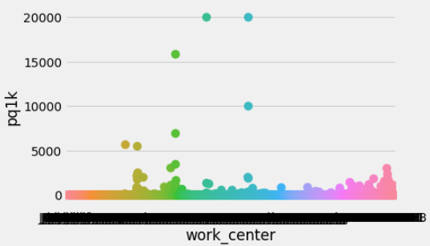

Human resources slide 8
SPECIFY
The problem is an unpredictable work force creates an unpredictable delivery schedule.
Our customers and our military need these products on time.
Missed deliveries cost millions of dollars per year due to expedited freight and line delays at the end item customer.
The components we produce are critical to the final product and line delays increase cost.
Actual data shows unpredictable work completion and quality costs.
Can we predict these variations?
JP

Slide 4
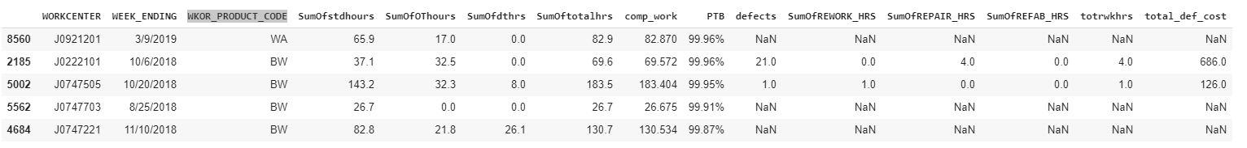
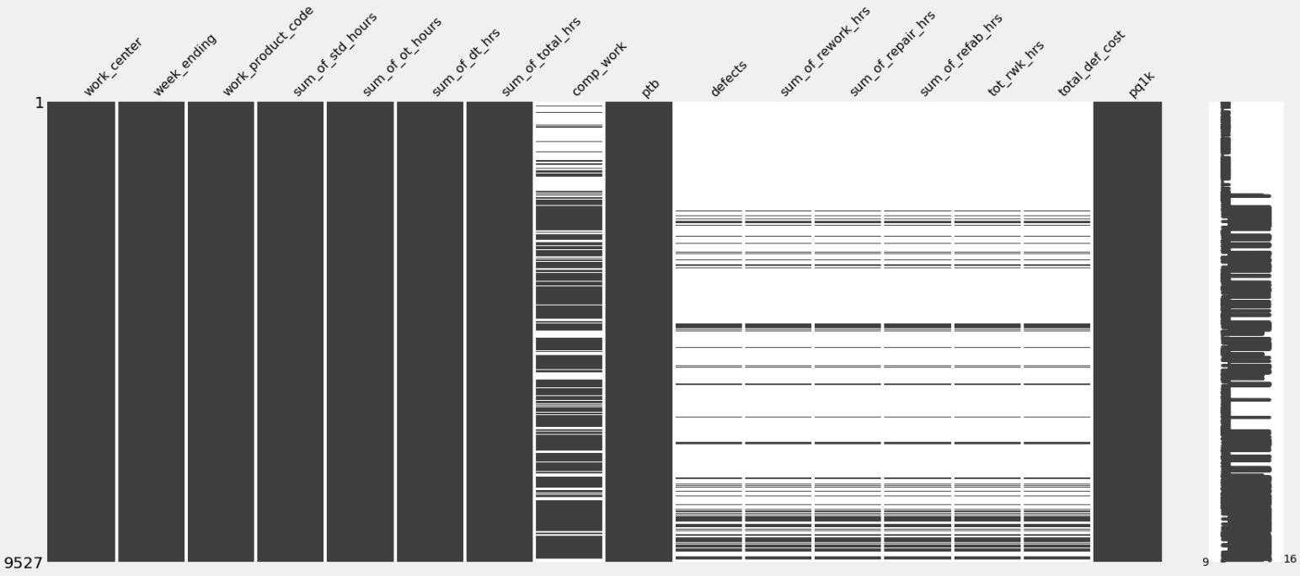
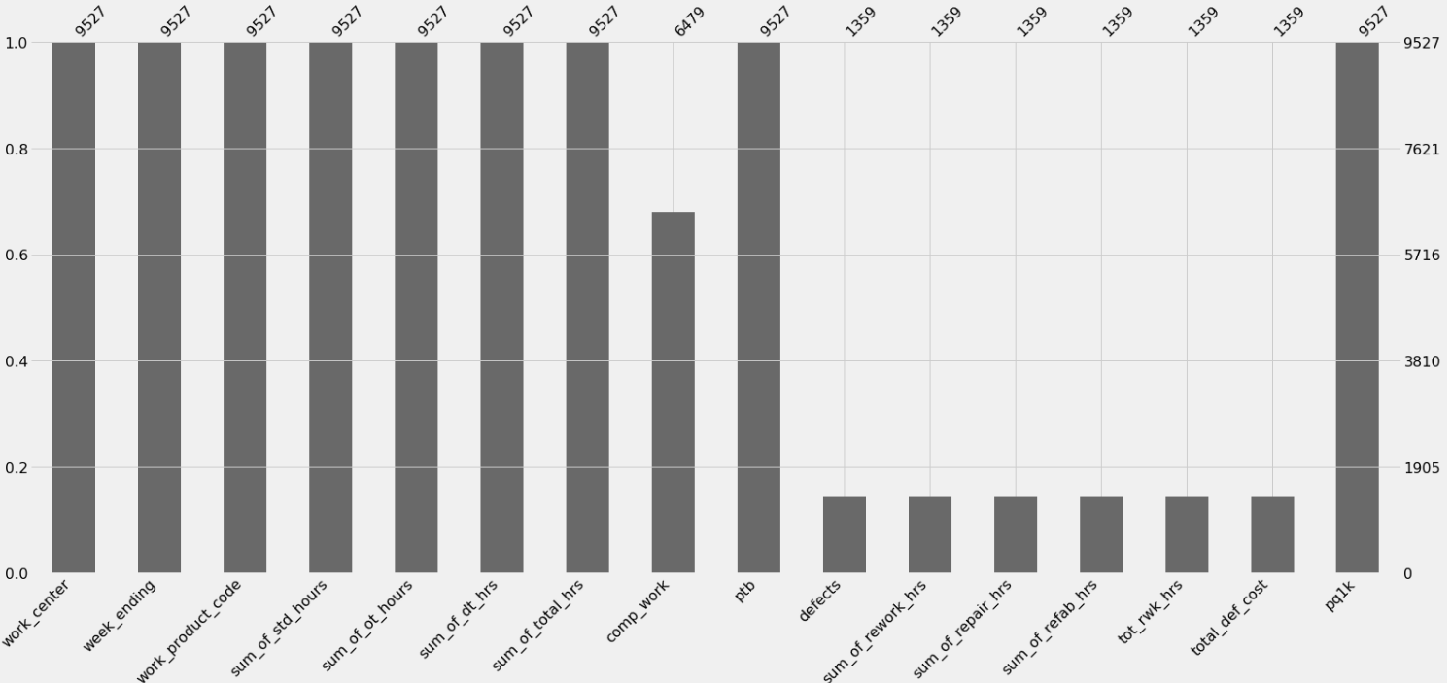
Human resources slide 6
OBSERVE
WHAT IS THE DATA AND HOW DO WE MAKE IT USABLE?
Data sample (below) representing actual man hours and performance measures from a local Texas aerospace manufacturing company.
A performance to budget calculation and defects normalized by completed work were added to the dataset.
FULL DATASET COMPLETENESS
COMPLETENESS BY COUNTS
Completeness of the data visualized using the Missingno package for Python. Missing data will influence the ability of the model to produce accurate predictions
RS
Notes:
*Clean up the data
*Added variables
*Changed Data types
PTB=Performance to Budget
PQ1K=Defects per every 1000 completed hours

Slide 5

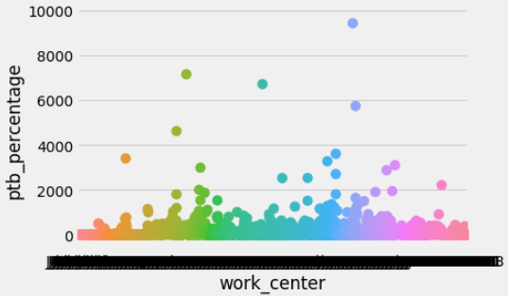
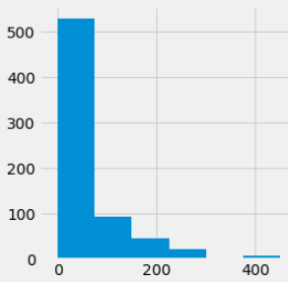
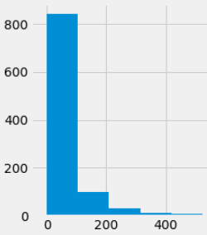
Human resources slide 3
OBSERVE
OTHER
OBSERVATIONS:
One observation is there are some work centers that have a very high defect per 1000 value.
Our goal is
Total hours has a positive relationship to completed work
100%
Another observation is the performance to budget variation also has a large variation.
ON-TIME DELIVERY
Defects are positively related to
total hours
Completed Work Distribution below
Sample of the sum of total hours by date
On-Time delivery is dependent on good performance to budget percentages and low defect counts
Defects are positively related to completed hours increase.
RB

Slide 6

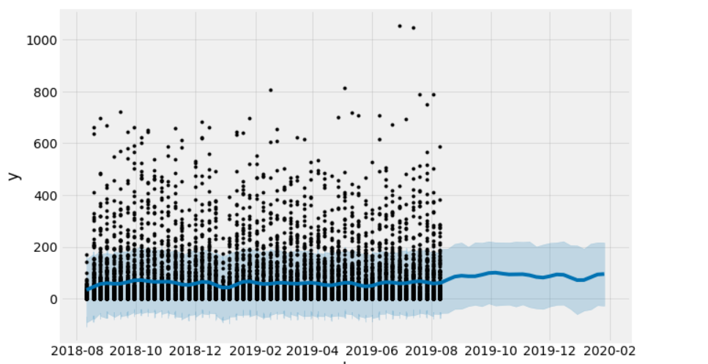
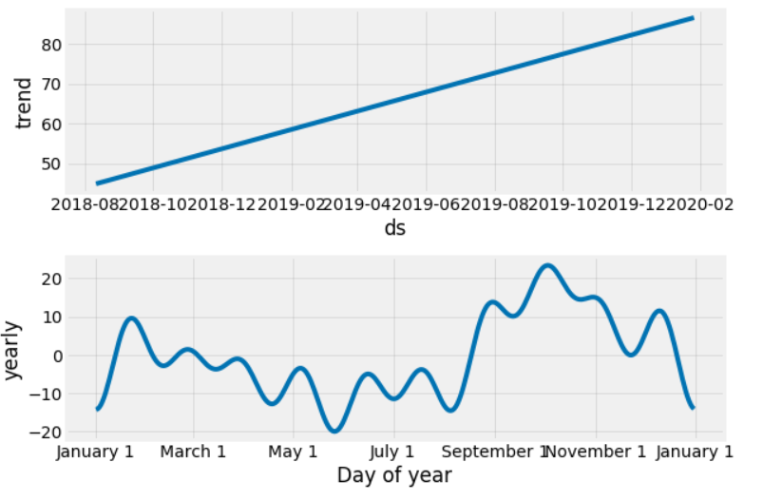
Human resources slide 8
ANALYSIS HOURS WORKED
Over all increase of hours worked in both the actual data and forecast
Increase in hours worked in the last three months of the year
Decrease in hours worked immediately prior to New Year’s Day
Actual hours worked decrease in the summer between May and July
Using Prophet Time Prediction Model
Hours Worked
Date
Trend over years
Trend over months
RB

Slide 7
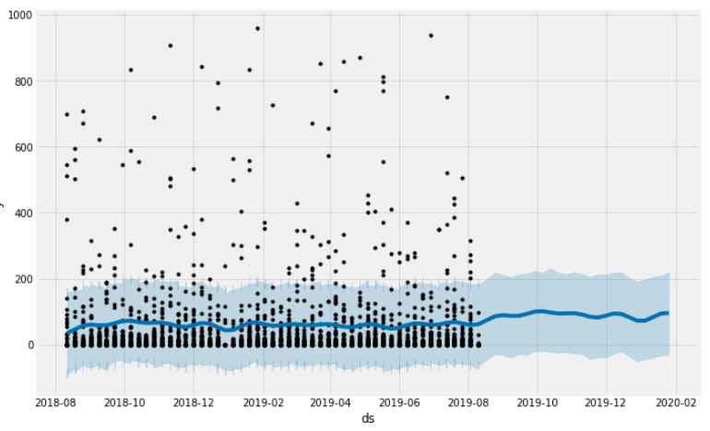
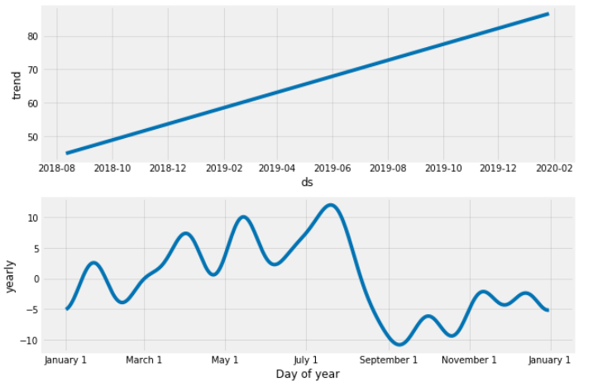
Human resources slide 8
ANALYSIS DEFECTS PER 1000
Over all decrease in defects is predicted in September 2019
An increase is predicted for the months leading up to New Year’s in January
Can we predict hours worked and defects per 1000 hours using the data?
Below is the time series prediction model for Hours worked.
Trend over years
Trend over months
SR
Notes:
Pq1k variable—Defects per 1000 hours of completed work

Slide 8
The forecasted model points to the perfect storm
The hours worked is predicted to decline in September
The defects per 1k is predicted to increase in September
SR
Notes:
Transition slide to hype up the recommendation

Slide 9

Human resources slide 8
RECOMMENDATION
Increase man-power
To counter the effect defects will have and to supplement the estimated decline.
Manage vacation schedules
Request some employees to schedule vacations earlier so that they can be coordinated to account for the anticipated drop in production quality
Apply above steps to other forecasted periods where working hours are low and defects are high
Or where negative trends are predicted to negatively impact production
Survey
Survey the employees to try to understand relationship of employee schedules to seasonal variation
Hours worked
Defects/1000
SR

Slide 10
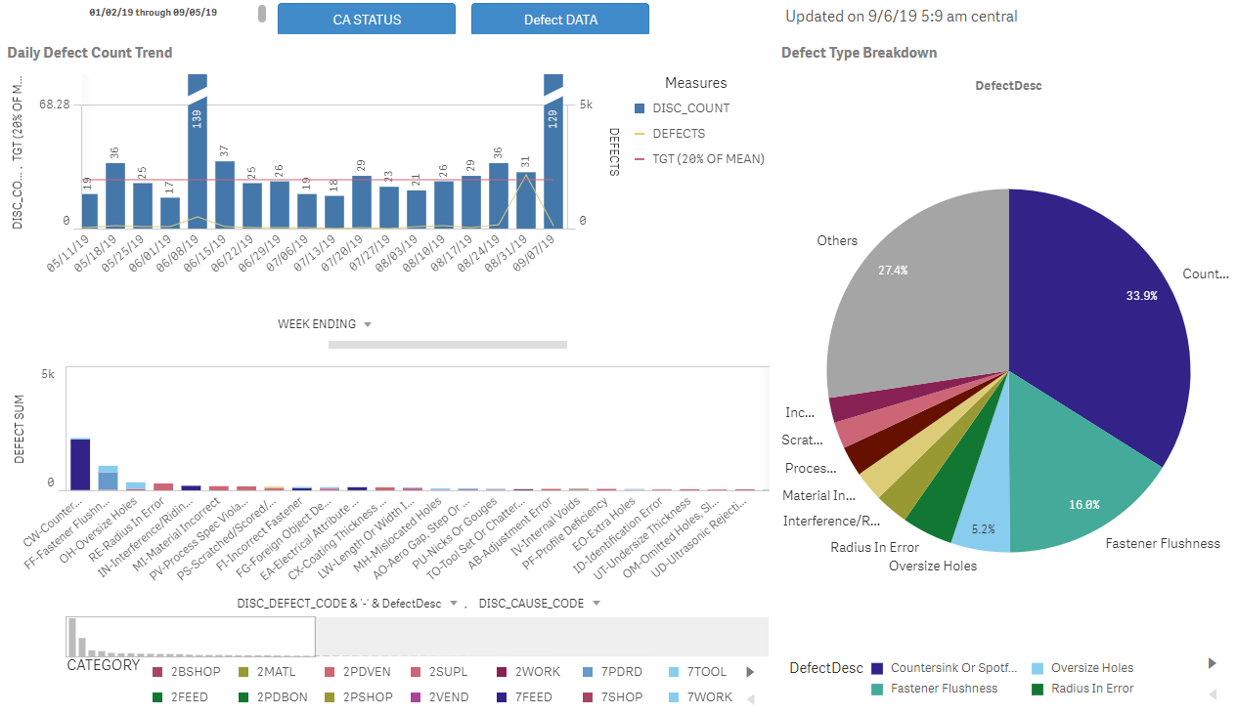
Human resources slide 10
APPENDIX—QLIK REPORTING
JP

Slide 11
Human resources slide 10
QUESTIONS?

