Slide 1
Coursera Capstone Project
Identifying areas with smaller access to Covid hospitals based on population density in the city of London

Slide 2
Contents
Background
Business Problem
Results
Conclusion

Slide 3
Background
In every part of the world, there seems to be a crisis of healthcare facilities during this pandemic. Therefore, the need of the hour is to develop new facilities such as emergency units, critical care units as quickly as possible.

Slide 4
Business Problem
The problem I seek to solve by means of this analysis is: based on the population density, where should we build new emergency Covid care units in the city of London.

Slide 5
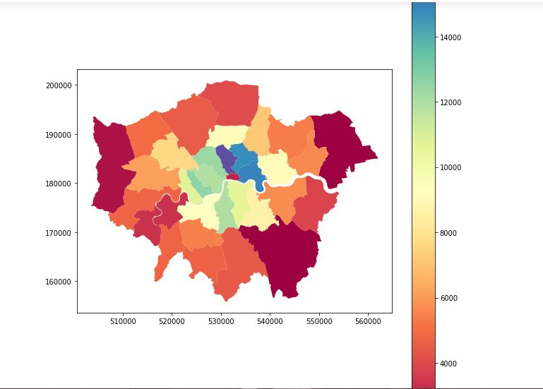
Results
Figure 1: Population density map of borough of London city.

Slide 6
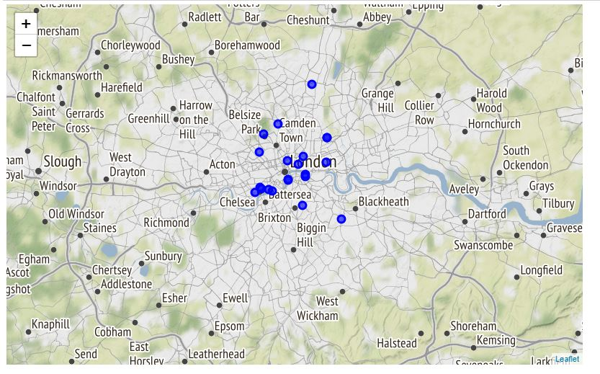
Results
Figure 2: Location of hospitals in London city.

Slide 7
Conclusion
The conclusion of the analysis is: more people live in the outer parts of the London city. However, they have least access to hospitals in these tough times. Therefore, it is required that more Covid centers should be built around these parts.

