Slide 1
🛡️
ENTERPRISE SECURITY INTELLIGENCE — DELIVERED THROUGH YOUR BROWSER
DAST Security Platform
DAST AI
AI-powered DAST platform with browser dashboard. Launch scans, triage findings, and download board-ready reports — with and without CLI based. Powered by local AI (Ollama / Claude / GPT). Fully on-premise.
FRAMEWORK
Accenture Security · 2026
Web UI
REST API
Multi-LLM
On-Premise
OWASP Top 10

Slide 2
BUSINESS CASE
The Challenge & Our Solution
02 / 15
CURRENT PAIN POINTS
DAST AI FRAMEWORK DELIVERS
Alert Fatigue
AI Noise Filter
60–70% of analyst time wasted on false positives. Critical findings buried in noise.
40–60% false positive reduction via hybrid AI + rule engine. Analyst time focused on real risk.
Inconsistent Scoring
LLM Risk Scoring
Raw scanner output has no business context or AI calibration. Teams act on wrong priorities.
Every finding re-scored with OWASP context and exploit likelihood. Accurate, risk-ordered output.
Tool Sprawl
Unified Pipeline
ZAP, Nmap, recon outputs are siloed. No unified risk picture or cross-tool correlation.
ZAP + Nmap + AI merged into one normalised finding set with full cross-tool correlation.
No Web Access
Browser Dashboard
Security tools locked to CLI. No team collaboration, scheduling, or shared visibility.
Full scan-to-report in the browser. RBAC for the whole team. No CLI knowledge required.
DAST AI Framework · Accenture Security · 2026

Slide 3
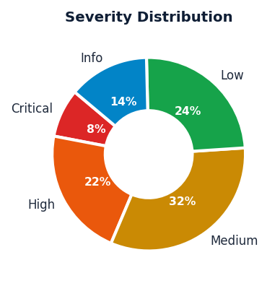
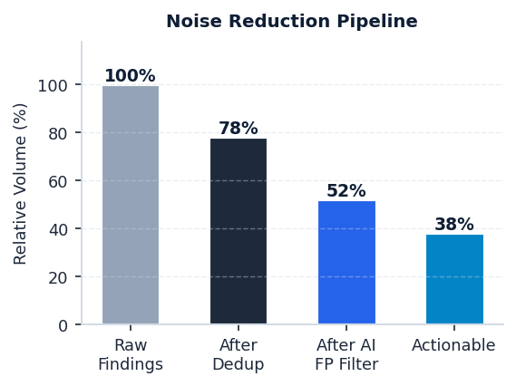
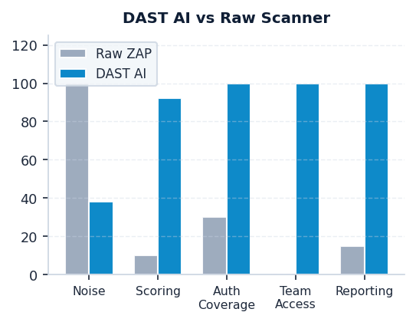
BUSINESS IMPACT
Key Capabilities & Impact Metrics
03 / 15
40–60%
92%+
7 Formats
False Positive Reduction
AI Severity Accuracy
One-Click Report Download
3 LLM
RBAC
Zero CLI
Claude · GPT · Ollama Providers
Team-Ready Multi-User Access
Browser-First Operation
DAST AI Framework · Accenture Security · 2026

Slide 4
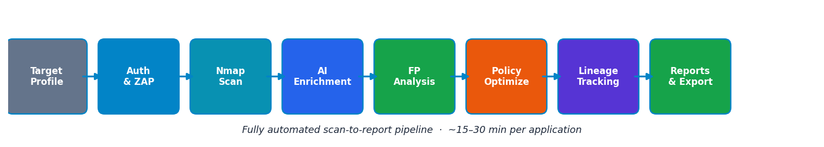
AI ARCHITECTURE
7-Pillar AI Architecture & Scan Pipeline
09 / 15
P1
P2
P3
P4
P5
P6
P7
Auth & Session
FP Reduction
AI Priority
Policy Optimize
Trend Analysis
AI Documentation
AI Validation
HAR · Form · TOTP Watchdog re-auth
AI + Rule hybrid 40–60% noise cut
OWASP scoring Exploit ranking
ZAP policy tuning A/B scan compare
Lineage tracking Regression detect
Exec summary OWASP mapping
Accuracy scoring 92%+ agreement
All 7 pillars run automatically when you click Start Scan in the web UI — no command line needed.
DAST AI Framework · Accenture Security · 2026

Slide 5
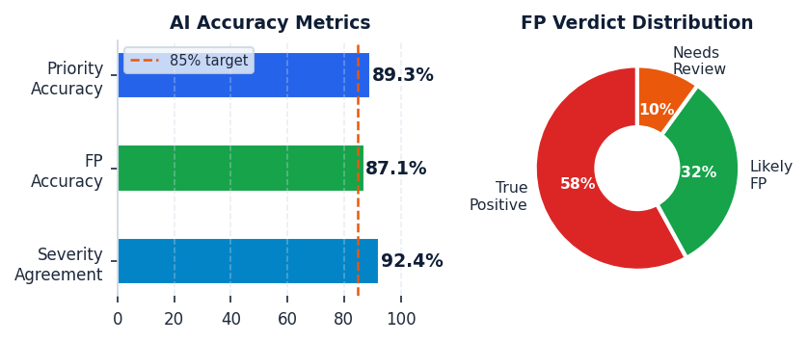
AI DEEP DIVE
AI Engine & False Positive Intelligence
10 / 15
AI Enrichment Engine
FP Analysis Engine — Hybrid AI + Rule
Model
Ollama qwen2.5 — local LLM, zero data exfiltration
Phase 1 — AI Verdict (always runs)
Every finding → LLM prompt → verdict: True Positive · Likely FP · Needs Manual Review + Confidence % + Reason text
Batch Size
8 findings per prompt — parallel async batches for speed
Phase 2 — Rule Tiebreaker (low-confidence only)
Prompt Cache
SHA-256 keyed — instant replay on re-runs (DB-backed)
Mass-fire ≥10 URLs → auto FP Occurrence count ≥10 → auto FP Nmap port closed → auto FP
Enrichment
Severity re-score · OWASP mapping · Exploit scenario Remediation steps · Risk narrative · Priority score
AI Accuracy vs Manual Reviews (PILLAR 7)
Auth Analysis
Parses auth.log — session health score · failure patterns 401/403 sequences · expiry detection
Accuracy
92%+ severity agreement vs original scanner (PILLAR 7)
DAST AI Framework · Accenture Security · 2026

Slide 6
LIVE EVIDENCE
Live Scan Results — Real Vulnerability Intelligence
11 / 15
Real scan · Appname_Testasp · Target: http://testasp.vulnweb.com/ · Auth: HAR — SUCCESS · Date: 2026-04-26
1
3
14
20
2
20
Critical
High
Medium
Low
Info
FP Dismissed
TOP FINDINGS
OWASP Mapping
SEV
#
Vulnerability Name
OWASP Category
FP Status
A01
Broken Access Control
3
HIGH
1
Path Traversal
A03 Injection
—
A02
Cryptographic Failures
1
MED
2
CSP Header Not Set
A05 Sec Misconfiguration
—
MED
3
Missing Anti-clickjacking Header
A01 Broken Access Control
Likely FP
A03
Injection
1
MED
4
CSP Header Not Set (Non-Auth)
A05 Sec Misconfiguration
—
A05
Security Misconfiguration
6
MED
5
Absence of Anti-CSRF Tokens
A01 Broken Access Control
—
A07
Auth & Session Failures
6
MED
6
HTTP Only Site
N/A
—
AI False Positive Analysis
LOW
7
Cookie without SameSite Attribute
A07 Auth Failures
—
Total Findings Analysed
34
LOW
8
Server Leaks Version (Server header)
A07 Auth Failures
—
True Positives
9
LOW
9
X-Content-Type-Options Header Missing
A02 Crypto Failures
True Positive
LOW
10
Cookie No HttpOnly Flag
A07 Auth Failures
—
Likely False Positives
20
Needs Manual Review
5
Noise Reduction
58.8%
DAST AI Framework · Accenture Security · 2026

Slide 7
TECHNICAL ARCHITECTURE
System Architecture & Setup
12 / 15
TIER 1 — ORCHESTRATION
SETUP REQUIREMENTS
Orchestrator
Profiles
Config
Auth Handler
Python 3.12+
main.py
profiles/ myapp.json
config.txt
Strategy selection
python -m venv .venv pip install -r requirements.txt
TIER 2 — AUTH & SESSION
Docker Desktop
HAR Replay
Form Auth
TOTP / MFA
Watchdog
ZAP + Nmap run as Docker containers
Browser session replay
POST login + verify
OTP code generation
Re-auth on session expiry
Ollama + Model
TIER 3 — SCAN ENGINES
ollama serve & ollama pull qwen2.5
ZAP Docker
Spider
Active Scan
Nmap Docker
ZAP API Key
ghcr.io/zaproxy Port 8080
URL crawl asset filter
Policy-based attack rules
Network port & svc scan
Set in config.txt — default port 8080
TIER 4 — AI PIPELINE
Profile JSON
Ollama LLM
AI Enrichment
FP Analysis
Validation
cp profiles/example.json profiles/myapp.json
qwen2.5 / Claude / GPT models
Batch + Cache SHA-256 keyed
Hybrid AI+Rule 58.8% noise cut
Accuracy check 92%+ agreement
HAR Session
Record via browser DevTools, save to auth_sessions/
TIER 5 — REPORTING
Excel 12-tab
Word .docx
HTML
SARIF
JSON/CSV
Web UI
Dashboard·Findings OWASP·FP·Trend
Narrative report 13 sections
Chart.js dash Severity filter
CI/CD native GitHub/Azure
SIEM ingest Splunk·QRadar
bash web/start.sh --port 8090
DAST AI Framework · Accenture Security · 2026

Slide 8
DEPLOYMENT
Deployment Architecture & Operational Model
13 / 15
One command to start. Cloud-accessible in 60 seconds via Cloudflare Tunnel.
DEPLOYMENT STACK
ACCESS CONTROL
start.sh — One-Command Startup
MANAGER
SCANNER
VIEWER
source zapenv/bin/activate → pip install → uvicorn on port 8090
Full admin · User management · All scan & config
Launch · cancel · rerun · View findings & reports
Read-only · View scans, findings · Download reports
Docker Compose — Container Deployment
Image: dast-ai-web · Docker socket sharing · Volumes: reports/ · profiles/
OPERATIONAL HEALTH
Health Check
nginx — Reverse Proxy
/api/system/health · ZAP · Nmap · Ollama status
SPA fallback routing · /api/ proxied · WebSocket upgrade · gzip
Persistent State
SQLite dast_web.db volume-mounted · reports/ bind-mounted
Cloudflare Tunnel — External Access
Log Access
Zero-config TLS certificate · Public HTTPS URL · No port-forwarding
/ws/scans/{id}/logs WebSocket · rotating file logs
Session Auth
X-Username + localStorage · Login modal on 401
DAST AI Framework · Accenture Security · 2026

Slide 9
TEAM OPERATIONS
Team Access, Scheduling & Report Delivery
08 / 15
ROLE-BASED ACCESS CONTROL
SCHEDULED AUTOMATION
MANAGER
Daily
Weekly
Monthly
Full admin rights User management All scan & config actions Report access
Overnight scan — results ready each morning
End-of-sprint scan — trend delta vs prior week
Board report scan — full 7-pillar AI pipeline
REPORT FORMATS — ONE-CLICK DOWNLOAD
SCANNER
XLSX
DOCX
Launch, cancel, rerun View findings & reports Manage scan profiles Auth record mgmt
12-tab Excel Dashboard · Findings · OWASP · Trend
13-section Word Narrative report for stakeholders
HTML
SARIF
VIEWER
Chart.js dashboard Interactive severity filter
CI/CD native GitHub · Azure DevOps · SIEM
Read-only access View scans & findings Download reports No launch or config
JSON
CSV
Full structured data Splunk · QRadar ingest
Flat export Spreadsheet & BI tools
DAST AI Framework · Accenture Security · 2026

Slide 10
NEXT STEPS
Ready to Run — Your First Scan in Three Steps
15 / 15
The web UI is live at http://localhost:8090 — no CLI needed to get started.
01
02
03
Start the Web UI
Create a Target Profile
Click Start Scan
bash web/start.sh --port 8090 Open http://localhost:8090 in your browser. Sign in with your role (Manager / Scanner / Viewer).
Go to Option Profiles in the sidebar. Set the target URL, authentication strategy (HAR / Form / TOTP / API Key), and scan scope.
Select your profile and click + New Scan. Watch the 7-pillar pipeline run live in the browser — AI enrichment, FP analysis, reports.
RECOMMENDED ESCALATION PATH
01
Pilot 3 Apps
02
Jira Integration
03
LLM Fine-tuning
04
Policy A/B Report
Deploy against 3 internal apps over 2 weeks; baseline metrics captured.
Auto-ticket High/Critical findings into existing engineering workflow.
Train on historical scan data to push severity agreement above 95%.
Run policy optimisation; present A/B comparison to security leadership.
DAST AI Framework · Accenture Security · 2026

Slide 11
WEB PLATFORM
Web vs CLI — Why Browser-First Wins
05 / 15
The same 7-pillar AI engine — without needing to touch a terminal.
CAPABILITY
WEB UI
CLI ONLY
Launch a scan
Click Start Scan in the browser
python main.py --profile ...
Team collaboration
RBAC: Manager · Scanner · Viewer
Single terminal user
Watch live progress
WebSocket log stream in browser
Watch terminal scroll
Schedule recurring scans
Calendar UI — daily / weekly / monthly
Manual cron job
Download reports
One-click — XLSX, DOCX, HTML, SARIF
Navigate filesystem
Switch AI model
Settings page — Claude / GPT / Ollama
Edit config.txt, restart
Manage auth profiles
Form UI — HAR, OAuth, TOTP, API Key
Edit JSON files
View finding trends
OWASP heatmap, regression chart
Read raw JSON output
Retest a single finding
Smart Retest button per finding
Re-run full pipeline
DAST AI Framework · Accenture Security · 2026

Slide 12
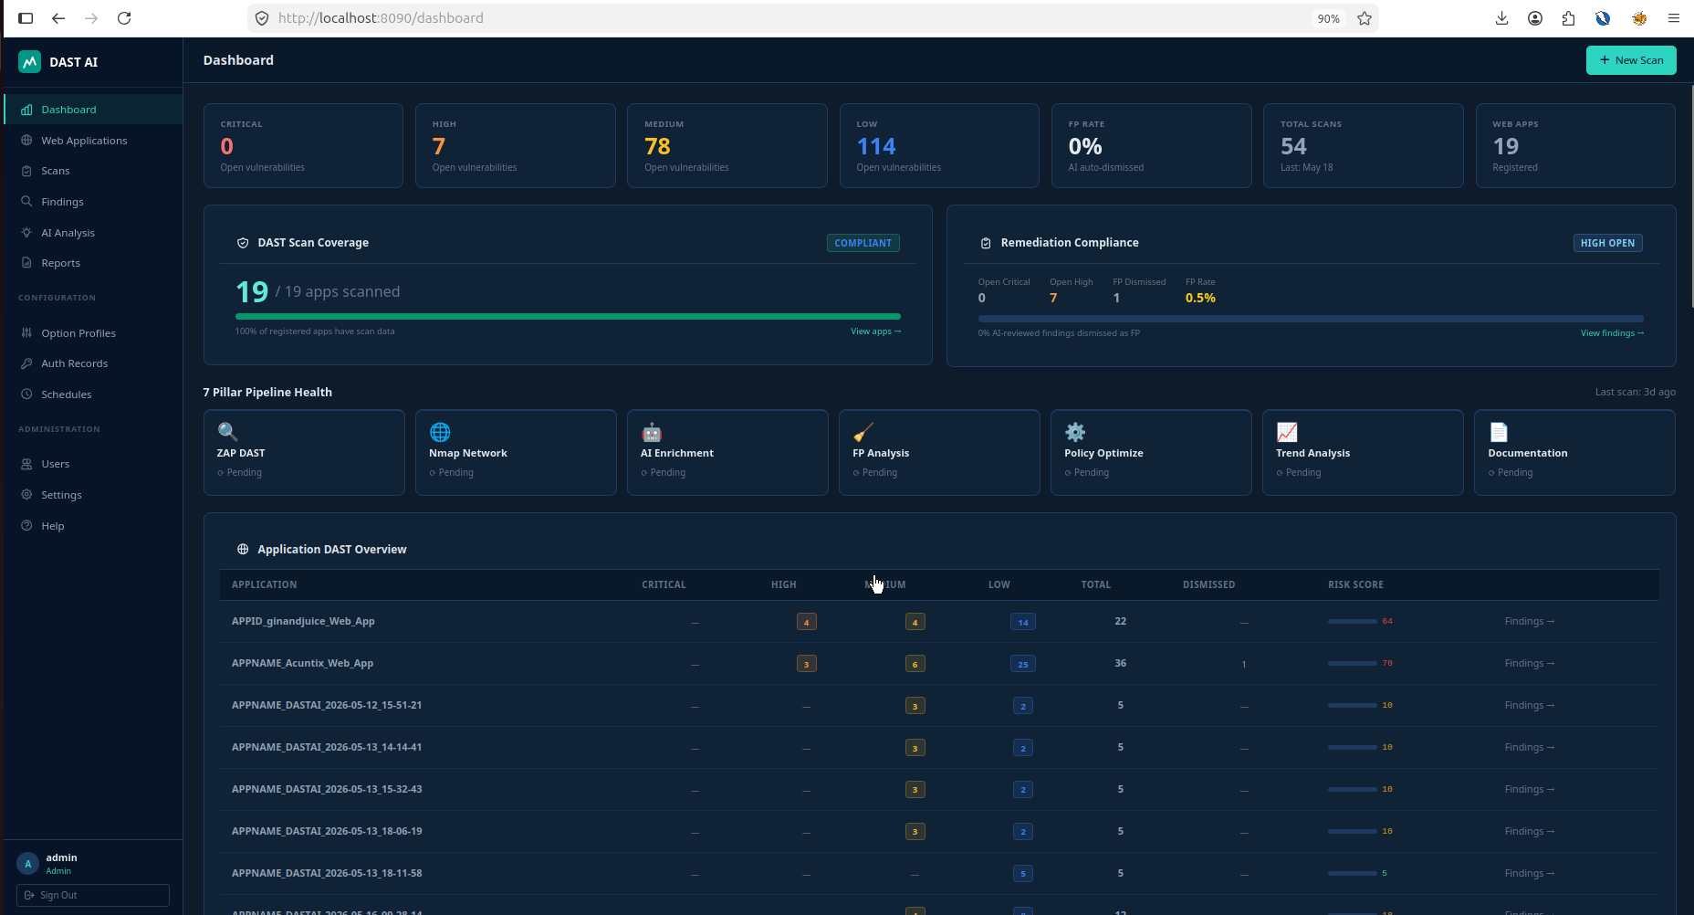
WEB PLATFORM
The Web Dashboard — Scan-to-Report in Your Browser
04 / 15
WHAT YOU SEE IN ONE SCREEN
Launch or schedule any scan from one browser screen
7-Pillar Pipeline Health — per-pillar status at a glance
Severity KPI tiles — Critical, High, Medium, Low, FP Rate
Per-app scan coverage with compliance status indicator
One-click report download: XLSX · DOCX · HTML · SARIF
Role-based access — Manager · Scanner · Viewer
DAST AI Framework · Accenture Security · 2026

Slide 13
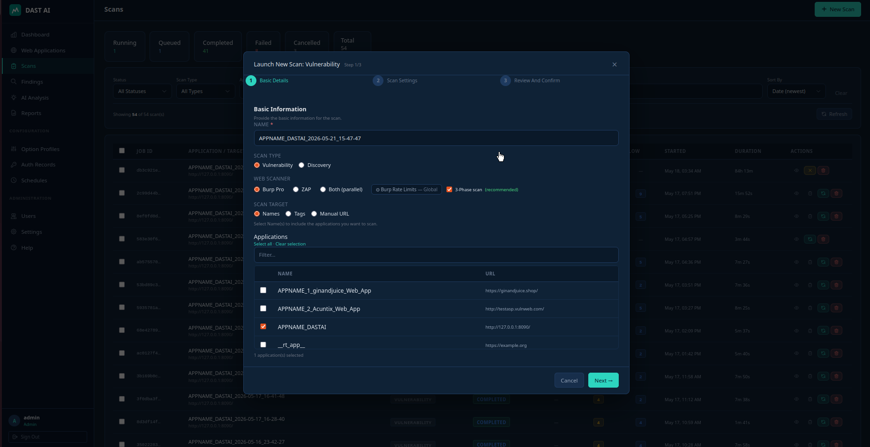
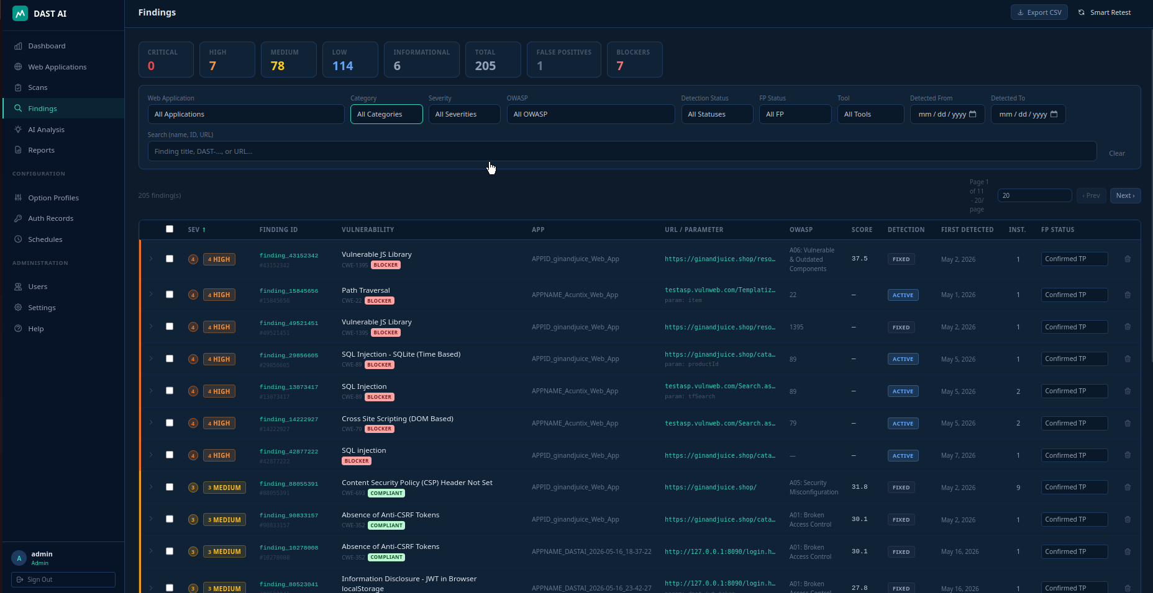
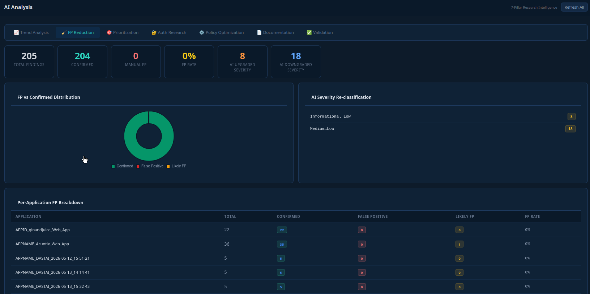
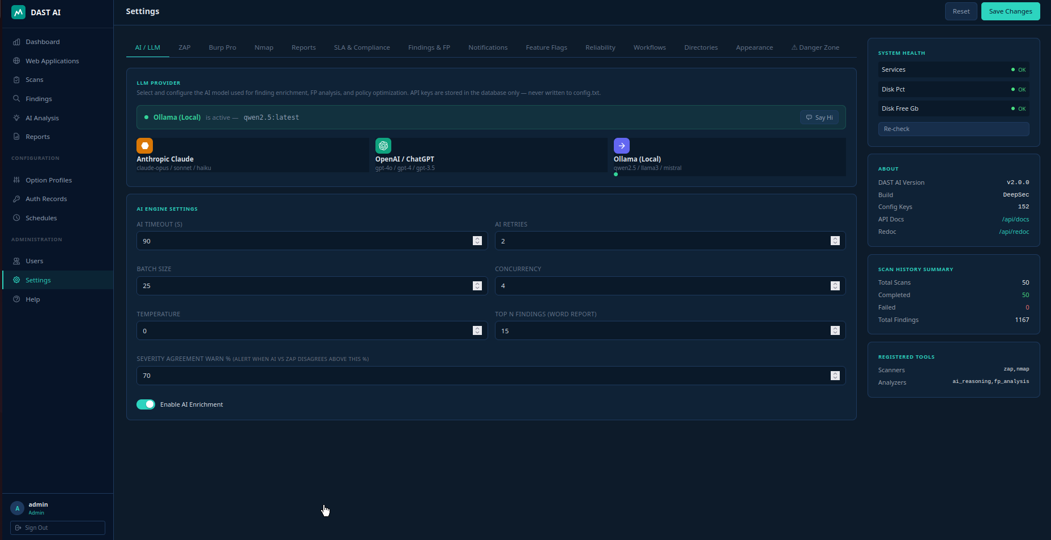
WEB PLATFORM
Dashboard Walkthrough — Key Pages
06 / 15
Scan Management
Findings & Triage
Launch, cancel, and rerun scans — with full status history and duration tracking
Filter by severity, OWASP category, or FP status — Smart Retest any finding instantly
AI Analysis & FP Intelligence
Multi-LLM & Configuration
7-pillar AI engine results — FP rate, severity re-classification, per-app breakdown
Switch between Claude, OpenAI, and Ollama without restarting — hot-swap in the UI

Slide 14
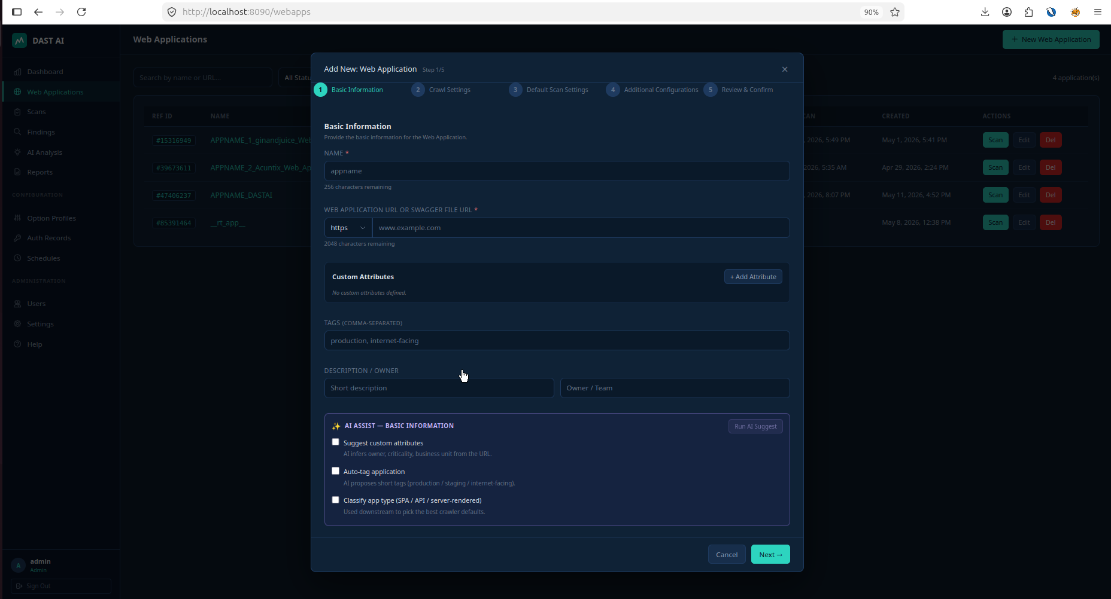
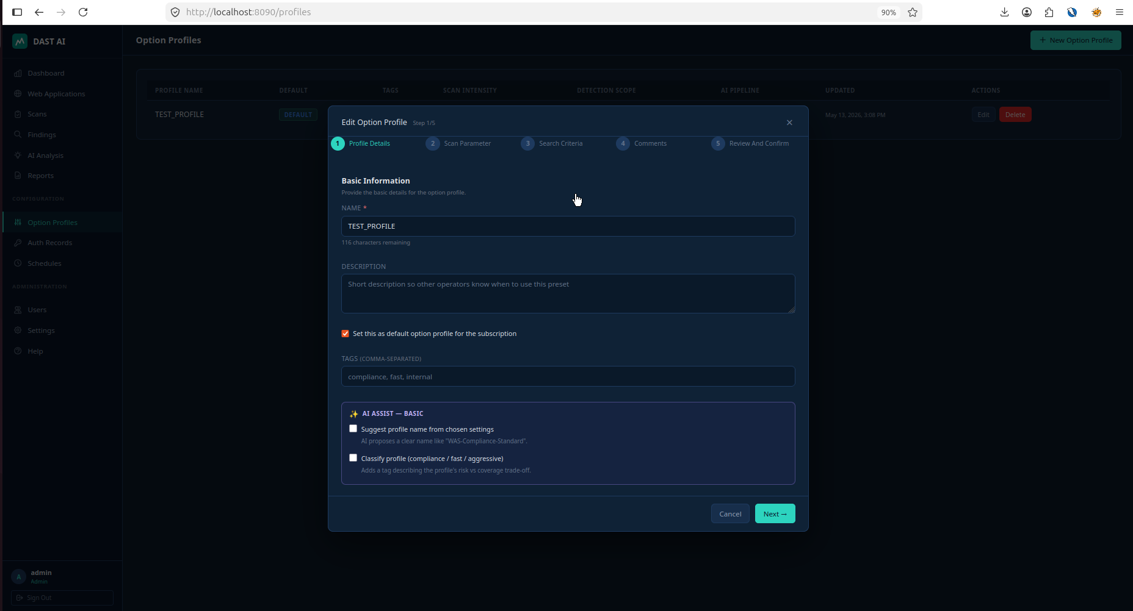
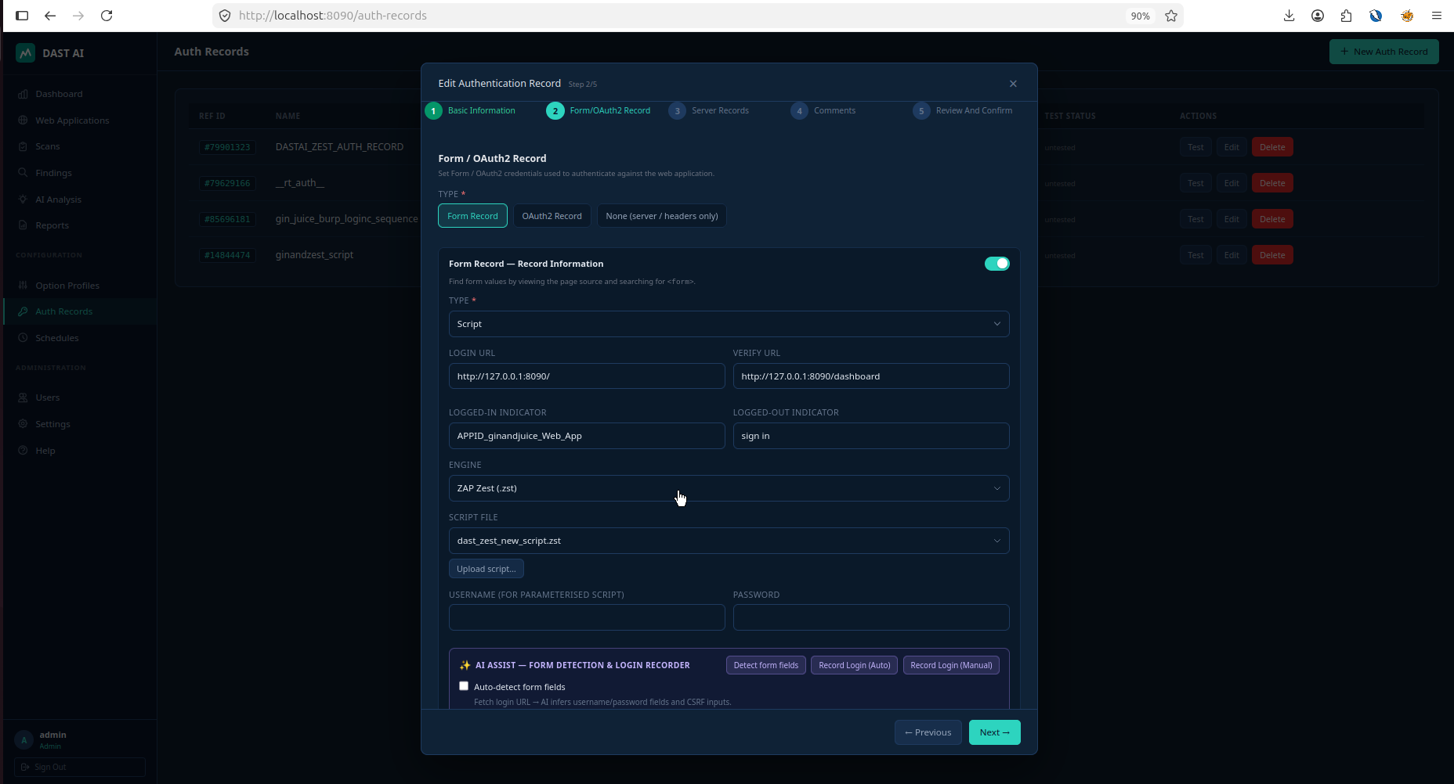
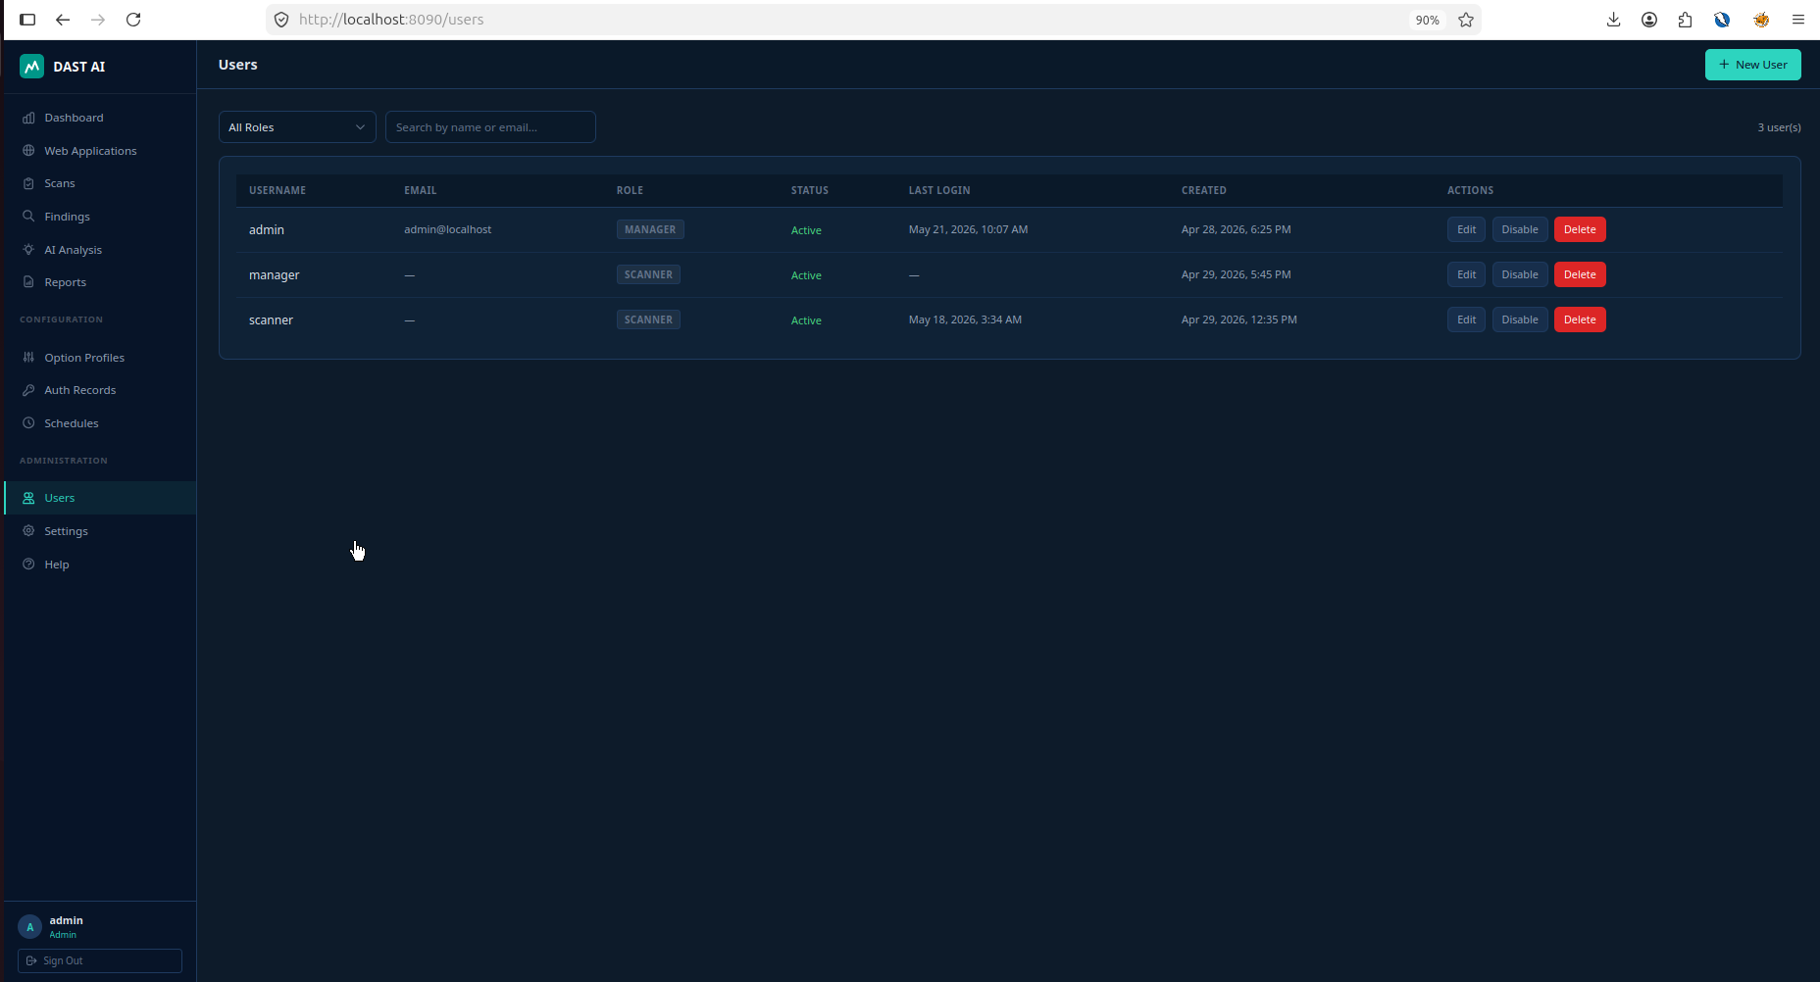
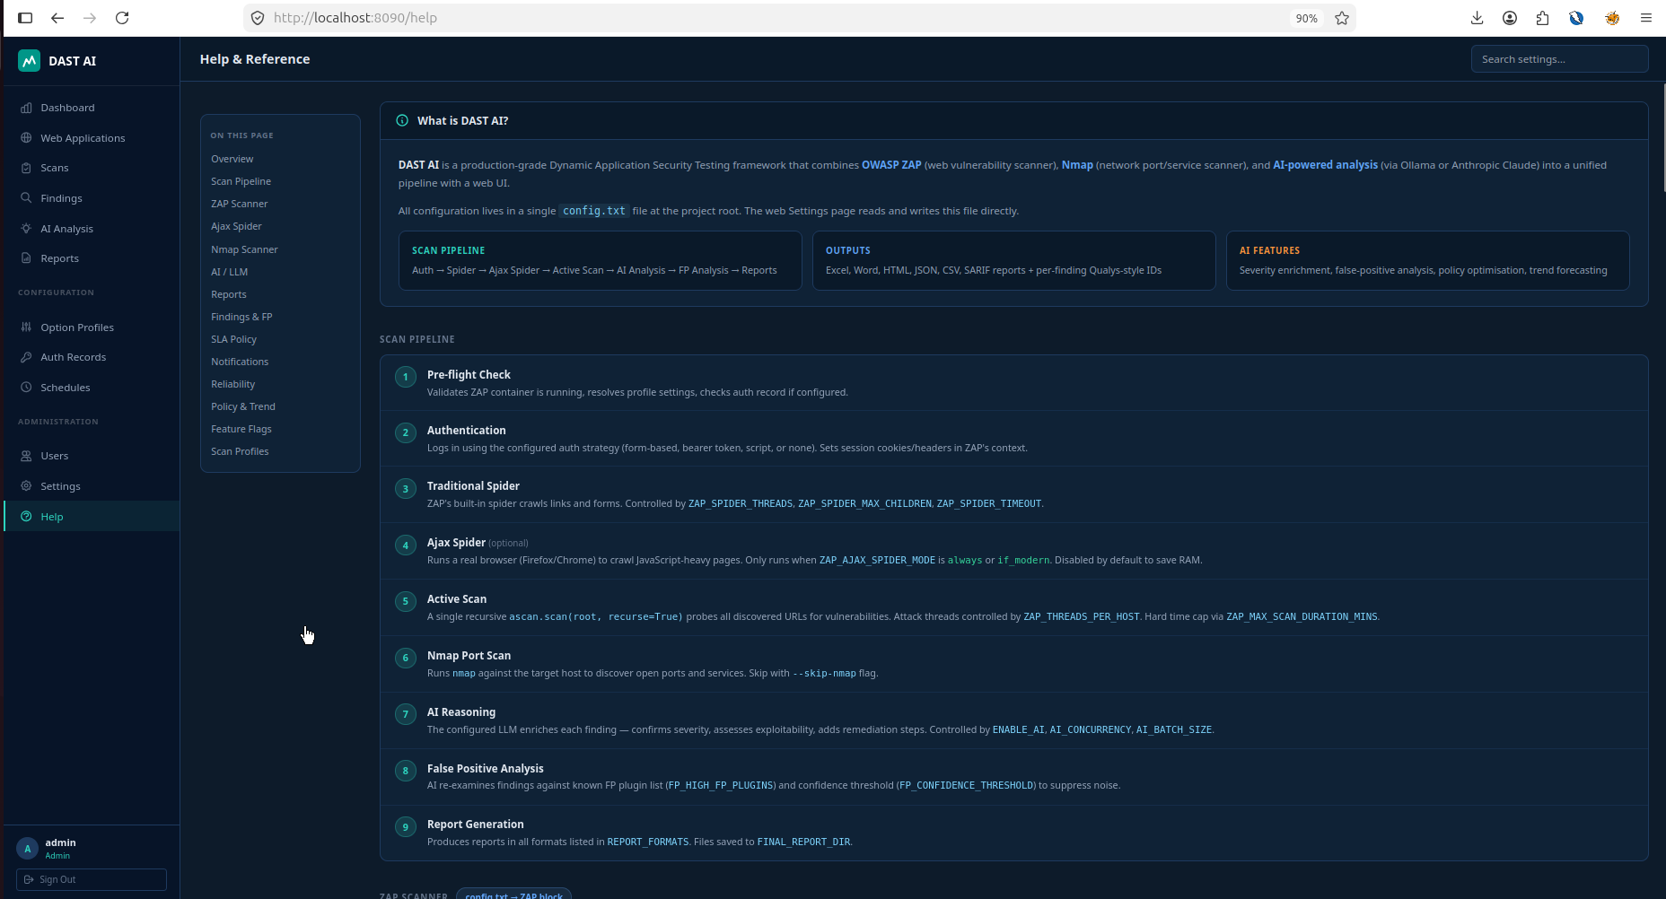
WEB PLATFORM
Dashboard Walkthrough — Key Pages
06 / 15
Web Asset:
Option Profile
Werb Asset manage, Auth Record selection, Scan Option Selection.
Testing Scope Defination. Rate Litmiting, Scam Coverage
Auth Record:
User management and Help Page
Authentication Record Management
Manage User and Help page

Slide 15
STRATEGIC PLAN
Roadmap — Phase Plan
14 / 15
Phase 1 COMPLETE
Phase 2 IN PROGRESS
Phase 3 PLANNED
NOW
Q3 2026
Q4 2026
ZAP + Nmap scanning
CI/CD pipeline integration
Cloud-native Docker deployment
AI FP reduction (hybrid engine)
Multi-target parallel scans
SOC real-time dashboard
7-Pillar AI enrichment pipeline
JIRA · ServiceNow auto-ticketing
Custom LLM fine-tuning on history
Excel · Word · SARIF · HTML reports
CVSS v4 scoring support
Compliance mapping (PCI · ISO 27001)
HAR · Form · TOTP authentication
Slack · Teams alert webhooks
Executive risk score trending
Browser dashboard (RBAC, WebSocket)
Scheduled scan automation UI
Multi-tenant workspace support
DAST AI Framework · Accenture Security · 2026

Slide 16
Thank You
DAST AI Framework · Accenture Security · 2026

