Slide 1
Correlation between different clusters of neighborhoods and their traffic accidents in Medellín
By: Juan D. PINEDA-JARAMILLO, Ph.D.
Email: jdpineda@unal.edu.co

Slide 2
Abstract
The traffic accidents is one of the leading cause of death around the world, especially in low- and mid-income countries. In the case of Medellín (Colombia), the traffic accidents have grown in the last years. For this reason, it is important to develop optimal strategies to reduce those accidents. In that scenario, we present an analysis of the trends in the traffic accidents in Medellín and their correlation with different classes of neighborhoods/zones in the city.
To achieve this, we used the foursquare API to understand the composition of the different neighborhoods in the city based on venues, then we performed a K-means clustering model to define five different clusters of neighborhoods/zones.
After performed a correlation between the clusters of neighborhoods/zones in the city with their respective classes of accidents, we obtained that crashes are the most common traffic accident in all clusters, while places with restaurants, bars, soccer fields and concert halls have more run overs than fallen occupants, and places with food trucks, gyms, bars and stores have more fallen occupants and other classes of traffic accidents than run overs.
These insights could be used for the Public Administration to conduct strategies, based on different classes of neighborhoods, to reduce these traffic accidents.

Slide 3
Introduction
One of the world’s leading causes of death and injuries is urban traffic accidents. According to the World Health Organization (WHO), traffic accidents was the leading cause of death for children and young adults aged 5-29 years, and the eight leading cause of death for all age groups surpassing HIV/AIDS, tuberculosis and diarrheal diseases in 2018 [1]. In addition, more than a million people die each year on the world’s roads, and 90% of those deaths occur in low- and middle-income countries that represent 82% of the world’s population [1], [2].
For this reason, the United Nations declared 2011-2020 as a decade of action for road safety [3], with the aim of reducing the number of deaths of traffic accidents around the world through national and citywide plans, considering five key strategies [4]:
Road safety management
Safer roads and mobility
Safer vehicles
Safer road users
Post-crash response

Slide 4
Introduction
These key strategies are focused on security and prevention, related to strategies in the medium and long term, where the commitment of nations is a key success factor to achieve the goal of the decade, through the design of management plans including investment, transfer and creation of knowledge to face the current problem and to implement sustainable actions in the future.
Colombia is a middle-income country with 13.8 deaths in traffic accidents per 100 000 inhabitants in 2018, where the rate for high-income countries is around 9. Besides, traffic accidents were the second largest cause of violent death in Colombia for the same year, with 26.7% of the total number of deaths [5].
In Medellín, which is one of the largest cities in Colombia, with more than 2.5 million inhabitants (and almost 3.8 million inhabitants in its Metropolitan Area), there has been an increasing trend in the number of traffic accidents. According to 2014 statistics by the Municipality of Medellín [6], from 2008 to 2014, the number of accidents grew a 20.14%. One of the main causes of this problem is the growing number of vehicles, from 2008 to 2014, this figure increased from 767 548 to 1 234 946 (i.e., by 60.9%).

Slide 5
Introduction
Looking for optimal strategies with the aim of reducing the traffic accidents in Medellín, it is necessary to analyze different characteristics in the traffic accidents in the city. Hence, in this project we want to analyze the trends in the traffic accidents in Medellín, and figure it out if there is a correlation between these traffic accidents and different classes of neighborhoods (neighborhoods with leisure services, or neighborhoods full of parks and plazas, for example).
To perform a clustering task of different neighborhoods in Medellín, we will use the foursquare API to understand how it is composed the different neighborhoods in Medellín, then we will use a K-means clustering model to define the clusters.
The main contribution of this project is to perform a detailed analysis of the traffic accidents in Medellín and its correlation with different classes of neighborhoods in Medellín, and to get some useful insights for the Public Administration to conduct strategies, based on different classes of neighborhoods, to reduce these traffic accidents.

Slide 6
Methodology - Data acquisition and cleaning
The geographical information of Medellín, and information related to traffic accidents in the city, can be found in public administrations website. Specifically, we used two main sources to achieve our objectives:
We gathered the traffic accidents information from 2014 to 2019 from the national government website [7], this information contains details of the generalities related to the location of all traffic accidents occurred in Medellín from January 2014 to June 2019. From this dataset we used specifically information related to the following attributes:
Accident ID
Address and location of the accident (with coordinates)
Type of accident
On the other hand, we gathered information of the geographical information related to all neighborhoods and zones of Medellín from the municipality government website [8], this information contains the following attributes, among others:
neighborhood
area of the neighborhood
geometry of the neighborhood (a set of coordinates which surround the area of the neighborhood)
There were a lot of missing values from the data, especially from the traffic accidents data, for this reason, we performed a data cleaning consisted in filling empty values, deleting rows with much lack of information, treating outliers, and normalizing data to the same format.

Slide 7
Methodology – Foursquare API
Foursquare is a technology company based in New York City that have built a massive dataset of location data around the world. They crowd-sourced their data and had people use their app to build their dataset and add venues and complete any missing information they had in their dataset.
At the year 2018, its location data was the most comprehensive on the internet and quite accurate that it powers location data for many popular services like Apple Maps, Uber, Snapchat, Twitter and many others, and is currently being used by over 100 000 developers, and this number is growing with time [9].
The Foursquare Places API provides location based experiences with diverse information about venues, users, photos, and check-ins. The API supports real time access to places, snap-to-place that assigns users to specific locations, and geo-tag. Additionally, foursquare allows developers to build audience segments for analysis and measurements [10].
Several authors have used foursquare social media geographic information to perform exploratory and spatial analyses of different aspects, like tourist attraction [11], estimation of building block use [12], temporal activity patterns of different venues [13], and to identify opportunity places for urban regeneration through location based social networks [14].

Slide 8
Methodology – Clustering venues in Medellín using K-means algorithm
K-Means Clustering is an unsupervised Machine Learning technique used in transportation and other industries and is useful for simplifying large datasets by clustering features with similar values into a smaller number of homogeneous categories [15].
K-Means Clustering is used to divide the data into similar groups with similar features, with the aim of maximizing the heterogeneity between clusters (groups) and the similarities between in-cluster samples [16], [17].
Thus, we will use Foursquare API to explore and analyze different neighborhoods and zones in Medellín using the explore function to get the most common venue categories in each neighborhood/zone, and then use this feature to group the neighborhoods/zones into clusters using the k-means clustering algorithm to complete this task.
Finally, we will use the Folium library in Python to visualize the neighborhoods in Medellín and their emerging clusters.

Slide 9
Methodology – Traffic accidents in Medellín
Once we have the neighborhoods/zones of Medellín and their emerging clusters, we will group the number of traffic accidents in every neighborhood/zone to analyze the most common classes of traffic accidents in each cluster.
After pairing the clusters of neighborhoods with their respective number and classes of accidents, we will obtain important insight about the classes of accidents depending on different kinds of neighborhoods/zones.

Slide 10
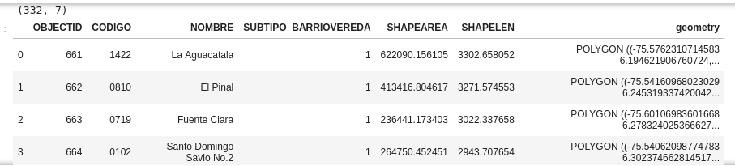
Results and Discussion - Venues in Medellín
Barrio_Vereda.geojson is a geographical information file related to all neighborhoods and zones of Medellín. We built a dataframe in Python with this file using the geopandas library. This file consists in a dataframe of 332 rows and 7 columns, as Table 1 presents. We used specifically the information regarded to neighborhood and the geometry (pair of coordinates that delimitate the region of the neighborhood/zone).
Table 1. Dataframe created using Barrio_Vereda.geojson.

Slide 11
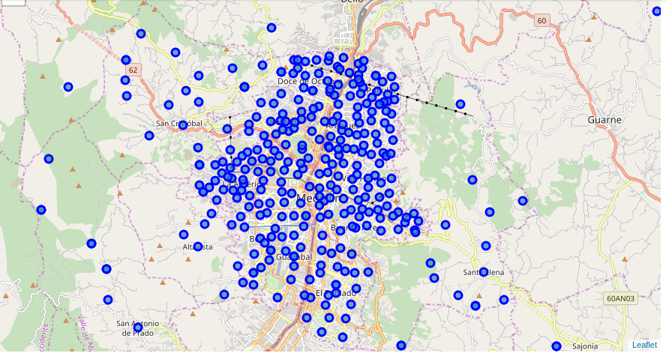
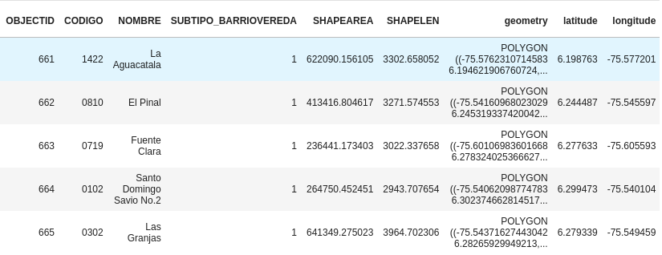
Results and Discussion - Venues in Medellín
To get the coordinates of each neighborhood, we used the Nominatim library which permits to achieve with great accuracy the longitude and latitude of each neighborhood/zone (Table 2). However, for specific points, a data wrangling was necessary to get these coordinates. After that, we created the map of the neighborhoods/zones of Medellín using the Folium library (Figure 1).
Table 2. Neighborhoods with their respective longitude and latitude.
Figure 1. Map of Medellín created using the Folium library with their Neighborhoods/Zones

Slide 12
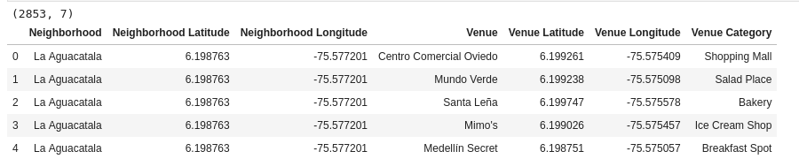
Results and Discussion - Venues in Medellín
After defining the location of each neighborhood/zone of Medellín, we explored the Foursquare API to get information related to all the venues of the city of Medellín, achieving a total of 2853 venues with their respective category and location, as we can see in the Table 3 for the first 5 registered venues. There is a total of 237 venues categories.
Table 3. Venues of Medellín and their respective location, category, and neighborhood/zone.

Slide 13
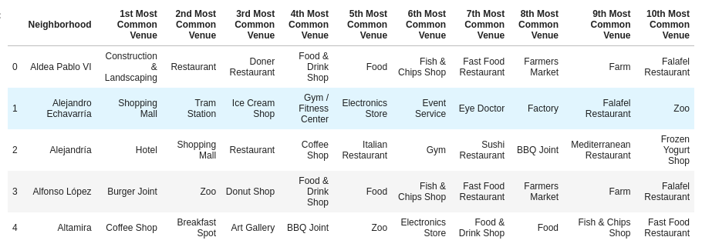
Results and Discussion - Analyzing each Neighborhood
After performing different operations of the data, we obtained the 10 most common venues for each neighborhood /zone, as we can see in Table 4.
Table 4. Ten most common venues for each neighborhood/zone.

Slide 14
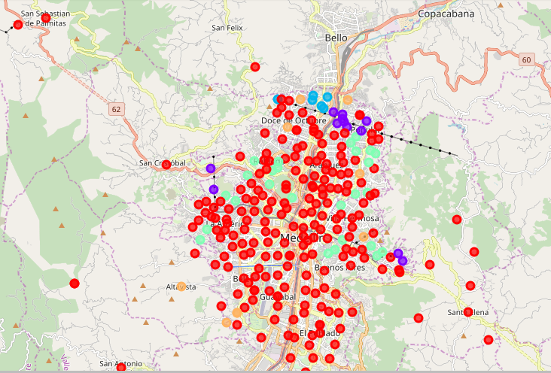
Results and Discussion - Clustering neighborhoods/zones using their respective common venues
Later, using the K-Means clustering, and after applying the Elbow method for choosing the number of K, we decide to divide our dataset in 5 clusters, as we can see in Figure 2 by different colors.
The 5 clusters found were the following:
Cluster 0 is the one with neighborhoods full of restaurants, coffee shops and other leisure services.
Cluster 1 is the one with neighborhoods surrounded by cable car and metro stations. These neighborhoods have restaurants as well.
Cluster 2 is the one with neighborhoods which have food trucks and bars. Also, these neighborhoods have other leisure places like gyms and stores.
We can define Cluster 3 as places with parks and plazas.
Cluster 4 is the one with neighborhoods offering other kind of services, as zoos, soccer fields and concert halls.
Figure 2. Map of Medellín showing different clusters of neighborhoods/zones by different colors

Slide 15
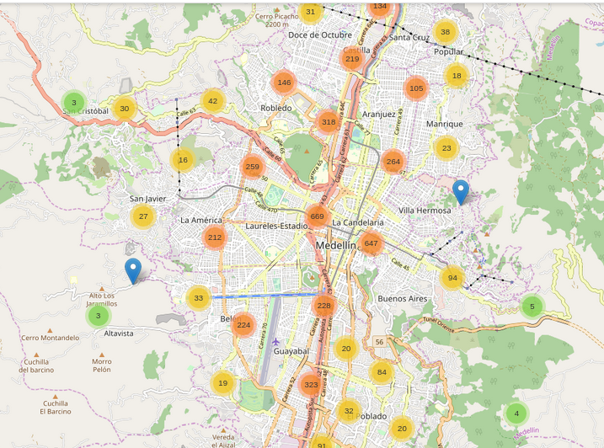
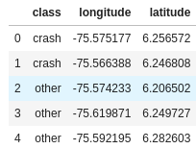
Results and Discussion - Analyzing traffic accidents
Accidentalidad_georreferenciada_2014-2019.csv is a dataset which contains details of the generalities related to the location of more than 226 000 traffic accidents occurred in Medellín from January 2014 to June 2019. Below we present in the Table 5 the first rows of the features we used for the analysis and in the Figure 3 the location of 2% of random traffic accidents from the dataset (we just present 2% of the dataset due to limitations in memory ram, but the analysis was carried out using 100% of the dataset).
Figure 3. Location of 2% random traffic accidents in Medellín in the period of 2014-2019.
Table 5. Features used for the analysis of traffic accidents (first five rows)

Slide 16
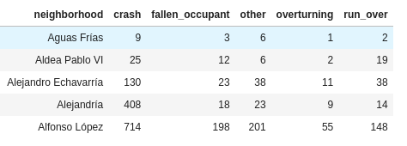
Results and Discussion - Analyzing traffic accidents
Later, we used the coordinates of each traffic accident to assign them to each neighborhood/zone of Medellín using column “geometry” from Table 2, then awe grouped how many traffic accidents were inside each neighborhood/zone of each class, as we show in Table 6 for the first 5 neighborhoods.
Table 6. Number of traffic accidents by class for each neighborhood/zone in Medellín

Slide 17
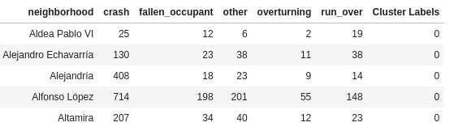
Results and Discussion - Correlation between traffic accidents and venues in Medellín
After having the different clusters of neighborhoods/zones with their respective venues categories, and their respective number of accidents by class, we merged both datasets to obtain the Table 7.
Table 7. Merged dataframe showing the number of traffic accidents by class, and the cluster label for each neighborhood/zone in Medellín

Slide 18
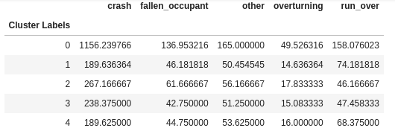
Results and Discussion - Correlation between traffic accidents and venues in Medellín
Later, we calculated the mean number of traffic accidents by class by cluster labels as we show in Table 8.
Table 8. Mean number of traffic accidents by class by cluster labels

Slide 19
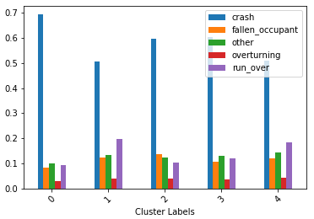
Results and Discussion - Correlation between traffic accidents and venues in Medellín
Finally, we analyzed the percentage of each class of traffic accident per each cluster of neighborhoods/zones in Medellín, obtaining the Figure 4.
Crashes are the most common traffic accidents in every cluster
Clusters 1 and 4 have more run_overs than fallen_occupants and other kind of traffic accidents (neighborhoods with restaurants, bars, soccer fields and concert halls).
Cluster 2 has more fallen_occupants and other kind of traffic accidents than run_overs (places with food trucks, gyms, bars and stores).
Overturning is the least frequent traffic accident in all neighborhoods
Figure 4. Percentage of each class of traffic accident per each cluster of neighborhoods/zones in Medellín.

Slide 20
Conclusions
From the correlation between the different clusters analyzed and their respective classes of accidents, it is important to note that crashes is the most common traffic accident by far in each cluster.
On the other hand, two important insights were noted. First, the places with restaurants, bars, soccer fields and concert halls have more run overs than fallen occupants, and places with food trucks, gyms, bars and stores have more fallen occupants and other classes of traffic accidents than run overs.
It is important to mention that run overs and fallen occupants generally have a major severity than crashes, and these traffic accidents are common in places with leisure services. For this reason, it is necessary that Public Administration to conduct strategies, based on different classes of neighborhoods, to reduce these traffic accidents and their severity.
As future works, it is possible to analyze if it exists some implications in the infrastructure elements and the severity of traffic accidents, for working in improvements in these elements to reduce the severity of traffic accidents.

Slide 21
References
[1] World Health Organization, "Global Status Report on Road Safety," 2018.
[2] F. Wegman, "The future of road safety: A worldwide perspective," IATSS Research, vol. 40, no. 2, pp. 66-71, 2017.
[3] United Nations, "Resolution 64/255. Improving Global Road Saftey," NY, 2010.
[4] United Nations, "Global Plan for the Decade of Action for Road Safety 2011-2020," NY, 2011.
[5] Instituto Nacional de Medicina Legal y Ciencias Forenses, "Forensis 2018 - Datos para la Vida," Bogotá, 2018.
[6] Alcaldía de Medellín, "Informe anual de accidentalidad 2014," Medellín, 2014.
[7] Ministerio TIC - Colombia, "www.datos.gov.co," [Online]. Available: https://www.datos.gov.co/browse?Informaci%C3%B3n-de-la-Entidad_Departamento=Antioquia&Informaci%C3%B3n-de-la-Entidad_Municipio=Medell%C3%ADn&q=transporte&sortBy=relevance. [Accessed 12 February 2020].
[8] Alcaldía de Medellín, "Alcaldía de Medellín OpenData," [Online]. Available: https://geomedellin-m-medellin.opendata.arcgis.com/datasets/c844f0fd764f41b2a808d8747457de8a_4. [Accessed 12 February 2020].
[9] IBM, "IBM Coursera," [Online]. [Accessed 12 Febrary 2020].
[10] BaluNaik - FindNearMe, "github," [Online]. Available: https://github.com/BaluNaik/FindNearMe. [Accessed 12 February 2020].
[11] P. Fernández-Costa, I. da Silva, R. Ribeiro and J. Mercedes, "Strategy for extraction of Foursquare's social media geographic information through data mining," Bulletin of Geodetic Sciences, vol. 25, no. 1, 2019.
[12] S. Spyratos, D. Stathakis, M. Lutz and C. Tsinaraki, "Using Foursquare place data for estimating building block use," Environment and Planning B: Urban Analytics and City Science, vol. 44, no. 4, pp. 693-717, 2017.
[13] K. D'Silva, A. Noulas, M. Musolesi, C. Mascolo and M. Sklar, "Predicting the temporal activity patterns of new venues," EPJ Data Science, vol. 7, no. 13, 2018.
[14] P. Martí, C. García-Mayor and L. Serrano-Estrada, "Identifying opportunity places for urban regeneration through LBSNs," Cities, vol. 90, pp. 191-206, 2019.
[15] J. Pineda-Jaramillo, "A review of Machine Learning (ML) algorithms used for modeling travel mode choice," DYNA, vol. 86, no. 211, pp. 32-41, 2019.
[16] J. Hair Jr, W. Black, B. Babin and R. Anderson, Multivariate Data Analysis, Harlow, UK: Seventh Ed., Pearson, 2014.
[17] C. Fraley and A. Raftery, "How many clusters?. Which Clustering method?. Answers via model-based cluster analysis," The Computer Journal, vol. 41, no. 8, pp. 578-588, 1998.

