Slide 1
Restaurant App
Julia Drahozal, Kate Strombom,
Quinton Wiley, Omar Alzubbi

Slide 2
Goals
Create a streamlined application for ordering food within a restaurant
Allow restaurant owner to track orders and update menu

Slide 3
Sprint Backlog
Create SQL tables – Menu, OrdersToCook, Accounting
Customer pages – ordering, confirmation, bill
Admin pages – kitchen, menu alteration, accounting

Slide 4
Product Backlog
Add multiple restaurants
Make it pretty
Add more functionality to accounting
Popular Items
Sorting by item, table, etc.
Allow customers to delete from order confirmation menu
Allow admin to add and drop tables

Slide 5
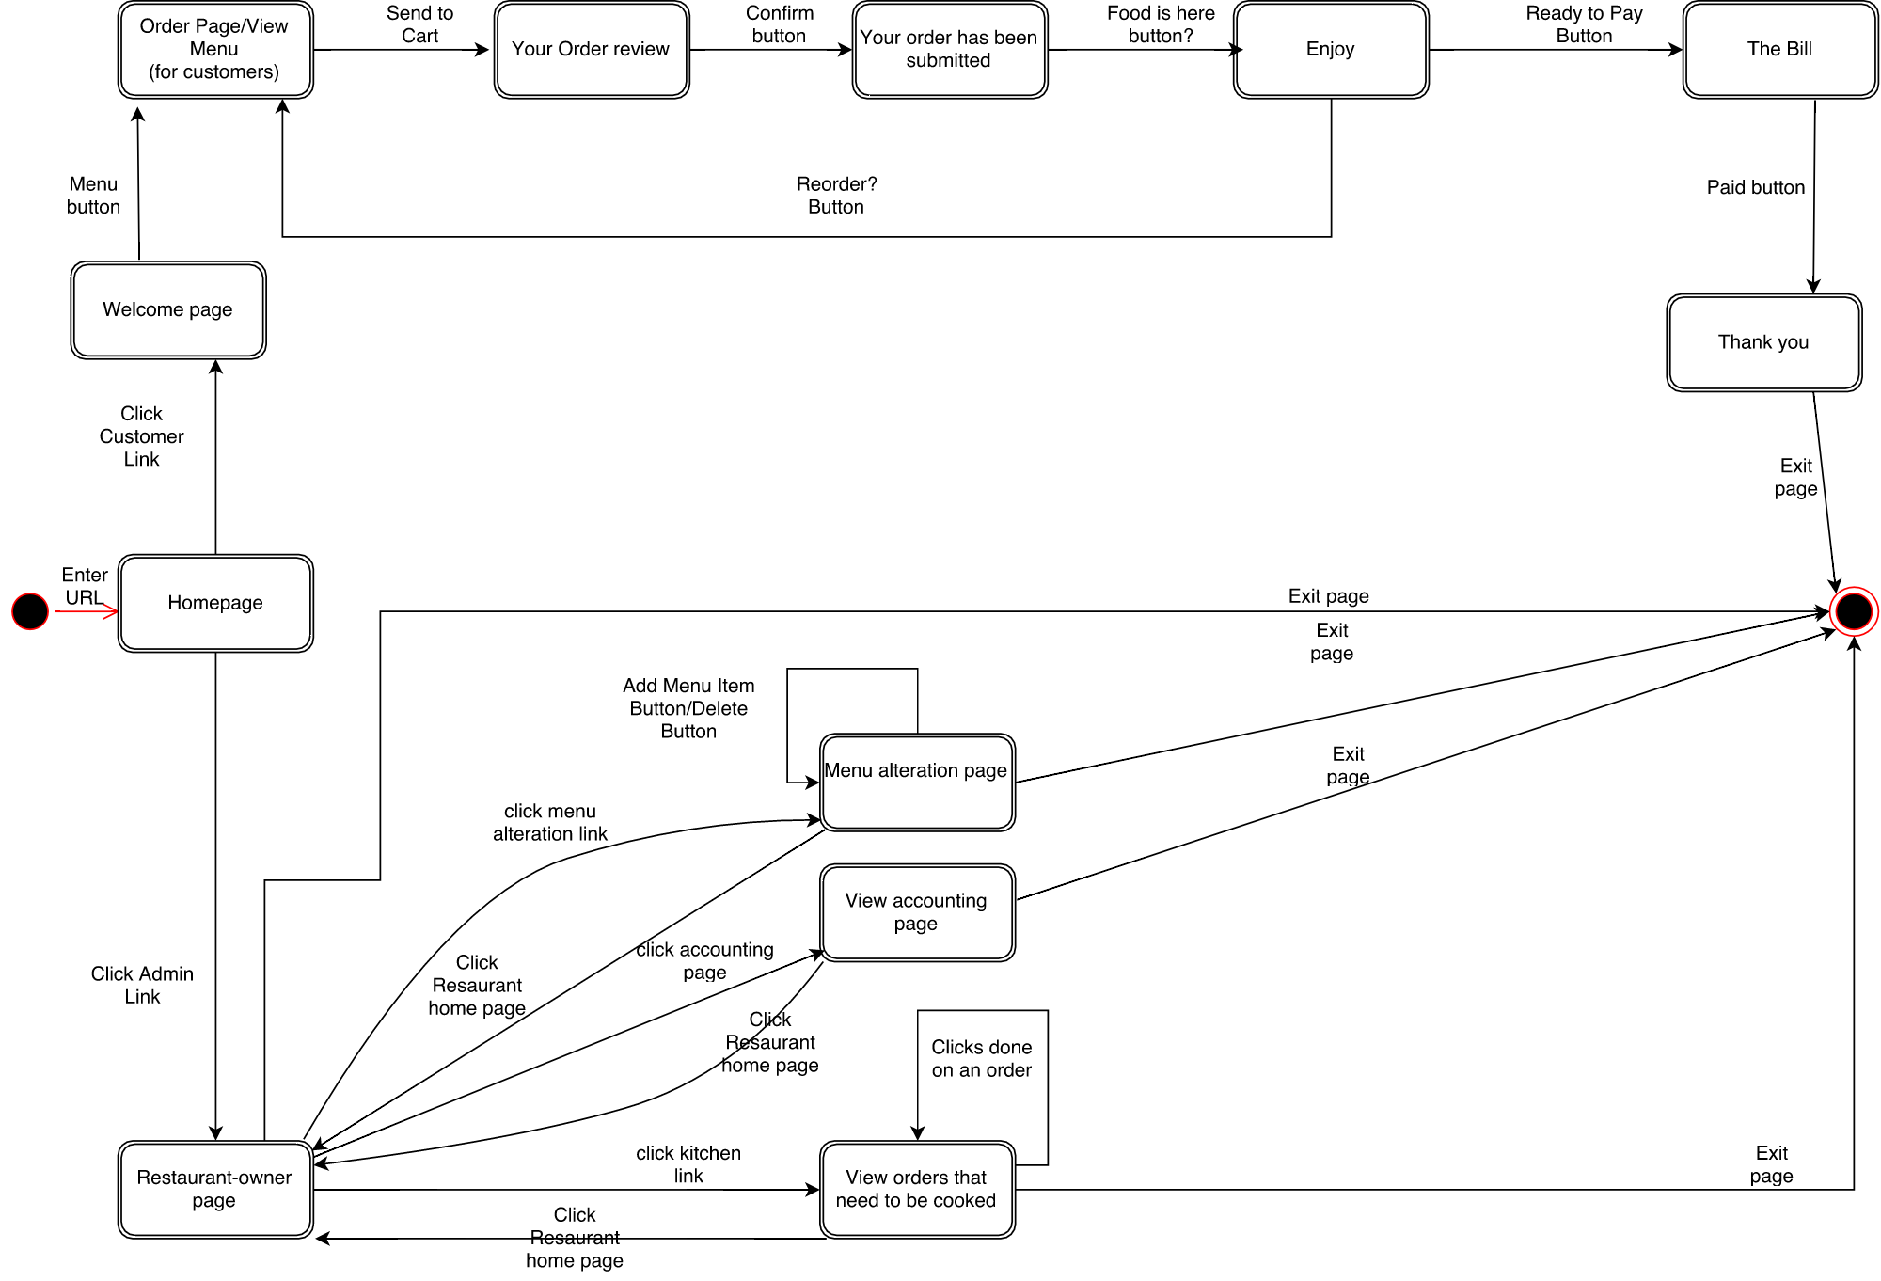
State Diagram

Slide 6
Problems
Issues connecting Qt to SQL
Keeping variable names consistent
Wasted time to replication of work

