Slide 1

Linear Regression
Venelin Valkov
Plovdiv University
2018

Slide 2
Acknowledgements
These slides are heavily based on the excellent course “Deep Learning Zero to All”
by Sung Kim
https://github.com/hunkim

Slide 3
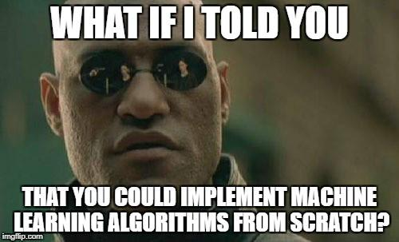

Slide 4

Machine Learning
What would be the grade if I study 4 hours?
4 hours
? points
Prediction
Hours (x) | Points (y)
1 | 2
2 | 4
3 | 6
4 | ?
Training dataset
Test dataset

Slide 5

Machine Learning
What would be the grade if I study 4 hours?
4 hours
? points
Prediction
Hours (x) | Points (y)
1 | 2
2 | 4
3 | 6
4 | ?
Training dataset
Supervised learning
Test dataset

Slide 6

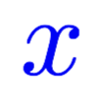
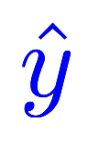
Model design
What would be the best model for the data? Linear?
Hours (x) | Points (y)
1 | 2
2 | 4
3 | 6
4 | ?
Linear
Notes:
\hat{y}=x*w+b

Slide 7

Model design
What would be the best model for the data? Linear?
Hours (x) | Points (y)
1 | 2
2 | 4
3 | 6
4 | ?
Linear

Slide 8
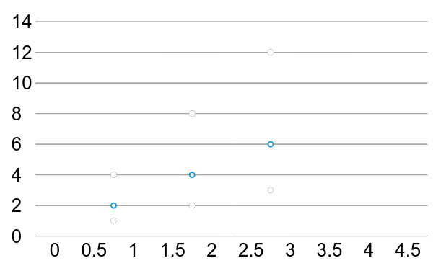
Linear Regression
* The machine starts with a random guess, w=random value
Hours (x) | Points (y)
1 | 2
2 | 4
3 | 6
True line

Slide 9
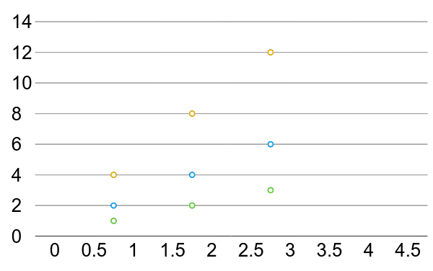
Linear Regression error?
* The machine starts with a random guess, w=random value
Hours (x) | Points (y)
1 | 2
2 | 4
3 | 6

Slide 10
Training Loss (error)
Hours, x | Points, y | Prediction, y^(w=3) | Loss (w=3)
1 | 2 | 3 | 1
2 | 4 | 6 | 4
3 | 6 | 9 | 9
 |  |  | mean=14/3
Notes:
loss = (\hat{y}-y)^2 = (x*w-y)^2

Slide 11
Training Loss (error)
Hours, x | Points, y | Prediction, y^(w=4) | Loss (w=4)
1 | 2 | 4 | 4
2 | 4 | 8 | 16
3 | 6 | 12 | 36
 |  |  | mean=56/3

Slide 12
Training Loss (error)
Hours, x | Points, y | Prediction, y^(w=0) | Loss (w=0)
1 | 2 | 0 | 4
2 | 4 | 0 | 16
3 | 6 | 0 | 36
 |  |  | mean=56/3

Slide 13
Training Loss (error)
Hours, x | Points, y | Prediction, y^(w=1) | Loss (w=1)
1 | 2 | 1 | 1
2 | 4 | 2 | 4
3 | 6 | 3 | 9
 |  |  | mean=14/3

Slide 14
Training Loss (error)
Hours, x | Points, y | Prediction, y^(w=2) | Loss (w=2)
1 | 2 | 2 | 0
2 | 4 | 4 | 0
3 | 6 | 6 | 0
 |  |  | mean=0
Notes:
loss = (\hat{y}-y)^2 = (x*w-y)^2

Slide 15
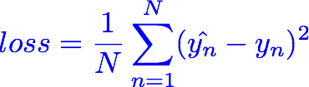
Training Loss (error)
MSE, mean square error
Hours, x | Loss (w=0) | Loss (w=1) | Loss (w=2) | Loss (w=3) | Loss (w=4)
1 | 4 | 1 | 0 | 1 | 4
2 | 16 | 4 | 0 | 4 | 16
3 | 36 | 9 | 0 | 9 | 36
 | MSE=56/3=18.7 | MSE=14/3=4.7 | MSE=0 | MSE=14/3=4.7 | MSE=56/3=18.7
Notes:
loss = (\hat{y}-y)^2 = (x*w-y)^2

Slide 16
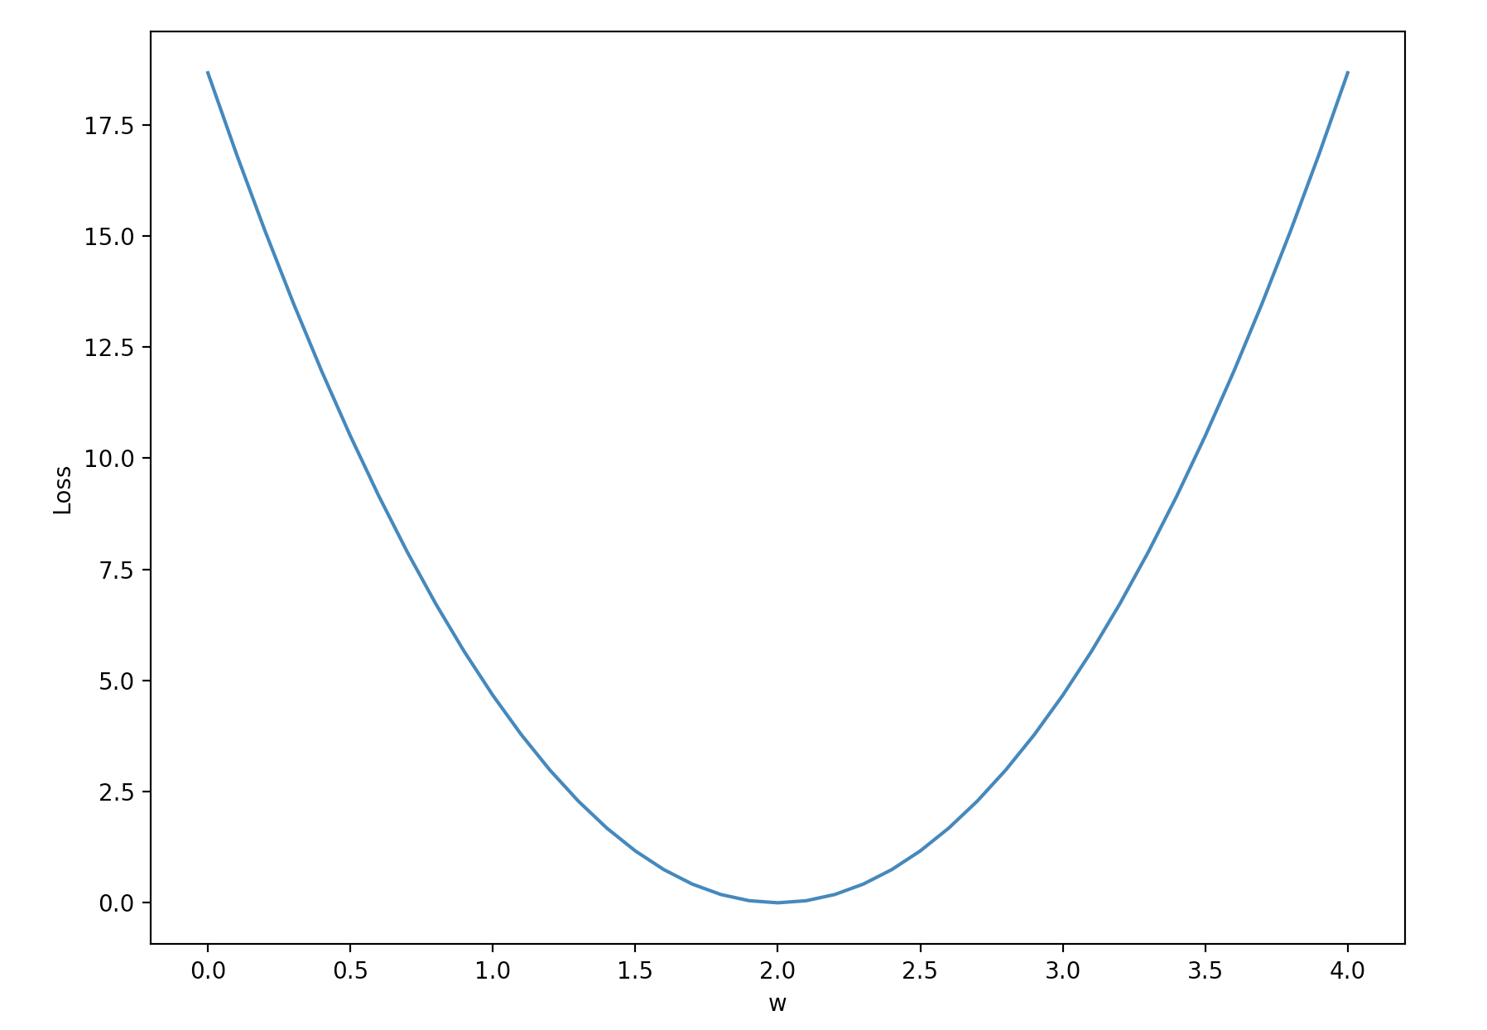
Loss graph
Loss (w=0) | Loss (w=1) | Loss (w=2) | Loss (w=3) | Loss (w=4)
mean=56/3=18.7 | mean=14/3=4.7 | mean=0 | mean=14/3=4.7 | mean=56/3=18.7
Loss
w
Notes:
loss = (\hat{y}-y)^2 = (x*w-y)^2

Slide 17
Loss graph
Loss (w=0) | Loss (w=1) | Loss (w=2) | Loss (w=3) | Loss (w=4)
mean=56/3=18.7 | mean=14/3=4.7 | mean=0 | mean=14/3=4.7 | mean=56/3=18.7
Loss
w

Slide 18


Model & Loss
w = 1.0 # a random guess: random value
# our model for the forward pass
def forward(x):
return x * w
# Loss function
def loss(x, y):
y_pred = forward(x)
return (y_pred - y) * (y_pred - y)

Slide 19

To the notebooks

Slide 20
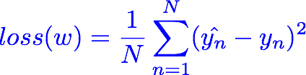
Loss graph
Loss (w=0) | Loss (w=1) | Loss (w=2) | Loss (w=3) | Loss (w=4)
mean=56/3=18.7 | mean=14/3=4.7 | mean=0 | mean=14/3=4.7 | mean=56/3=18.7
Notes:
loss = (\hat{y}-y)^2 = (x*w-y)^2

Slide 21
Linear Regression error?

Slide 22

What is the learning: find w that minimizes the loss
Loss (w=0) | Loss (w=1) | Loss (w=2) | Loss (w=3) | Loss (w=4)
mean=56/3=18.7 | mean=14/3=4.7 | mean=0 | mean=14/3=4.7 | mean=56/3=18.7

Slide 23
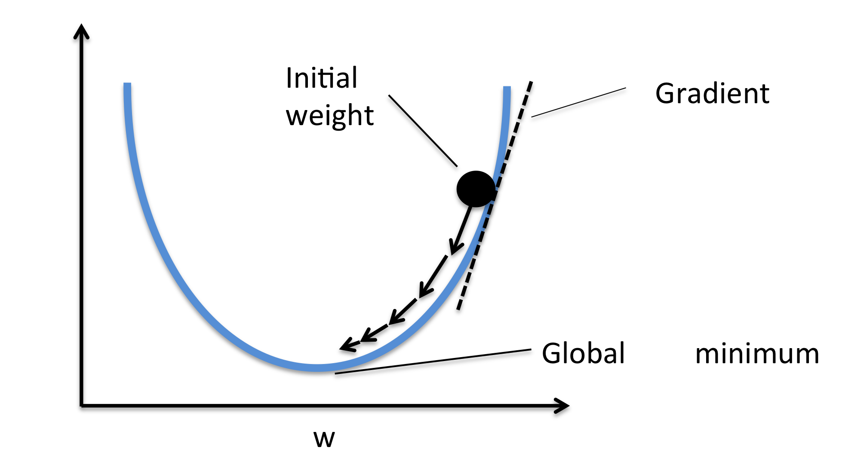

Gradient descent algorithm
loss
loss

Slide 24


Gradient descent algorithm
loss
loss

Slide 25
Derivative

Slide 26

Derivative

Slide 27
Derivative

Slide 28
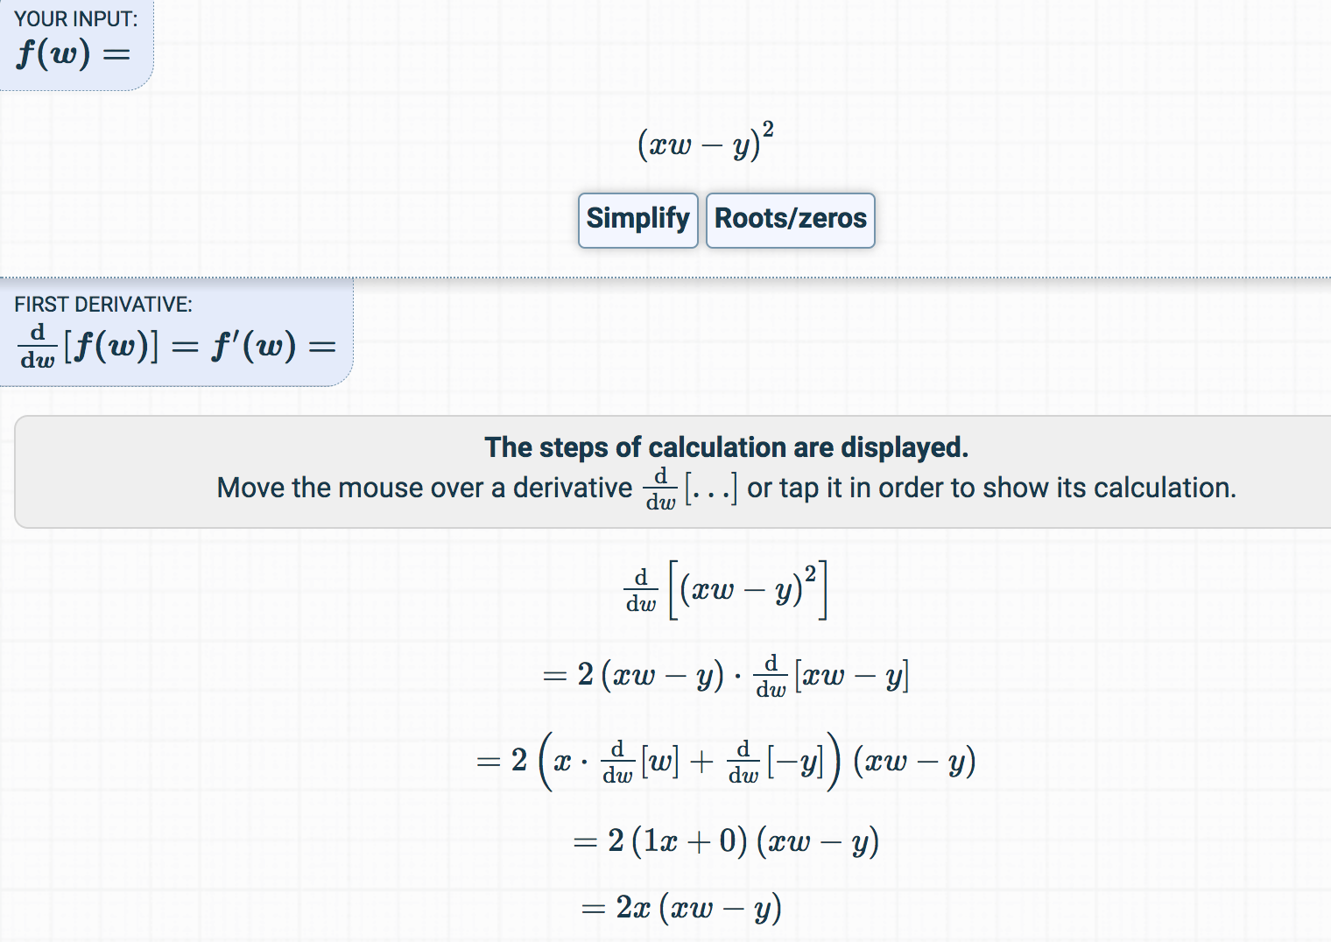
Derivative
https://www.derivative-calculator.net/

Slide 29

To the notebooks
loss
loss

