Slide 1

Welcome to PyTorch
Venelin Valkov
Plovdiv University
2018

Slide 2
Acknowledgements
These slides are heavily based on the excellent course “Deep Learning Zero to All”
by Sung Kim
https://github.com/hunkim

Slide 3
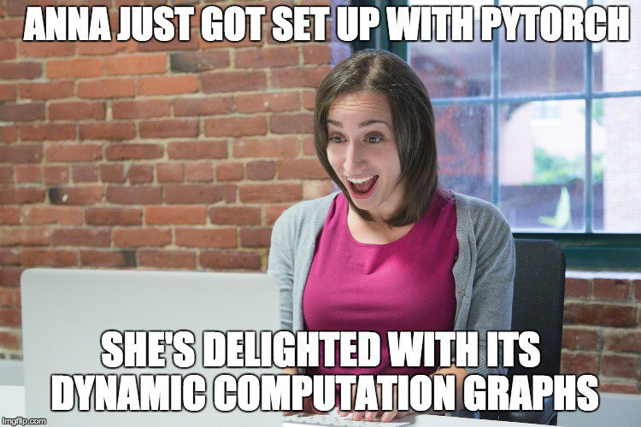

Slide 4
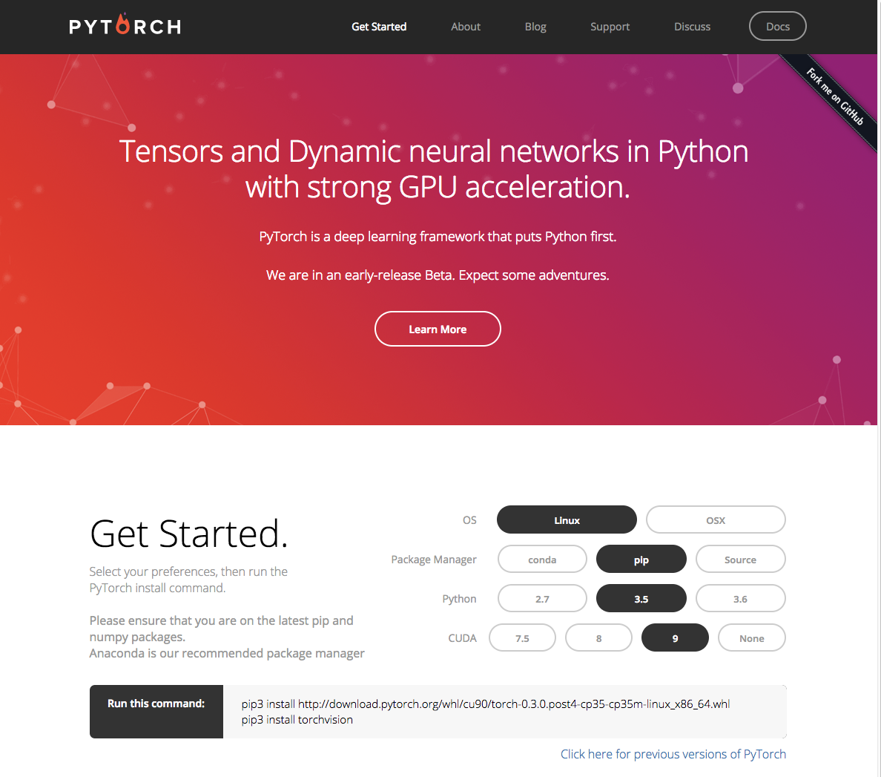
http://pytorch.org/

Slide 5

PyTorch
Deep learning framework created by Facebook Research that puts Python first
Tensor Computation (like numpy) with strong GPU acceleration
http://pytorch.org/

Slide 6
PyTorch
http://pytorch.org/

Slide 7
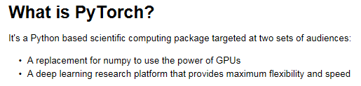
Hello PyTorch!

Slide 8
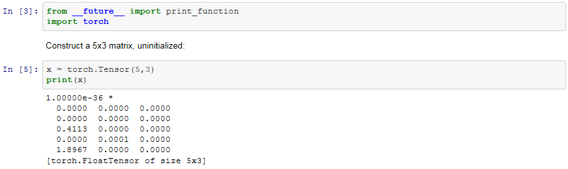
Tensors
Tensors are similar to NumPy ndarrays, with the addition being that Tensors can also be used on a GPU to accelerate computing.

Slide 9
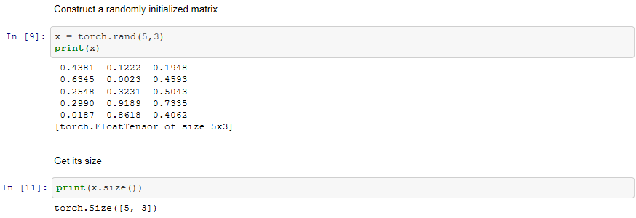
Tensors
Note: torch Size is in fact a tuple, so it supports the same operations.

Slide 10
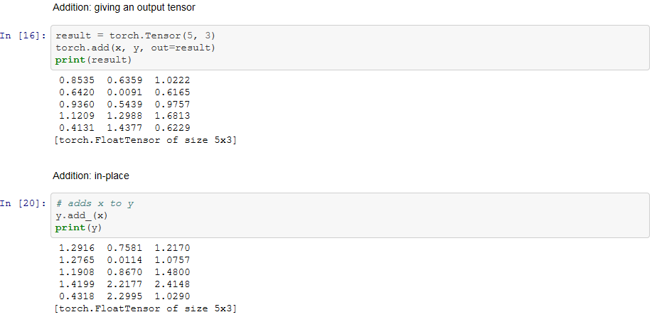
Operations
Note: Any operation that mutates a tensor in-place is post-fixed with an _.
For example, x.copy(y), x.t_(), will change x.

Slide 11
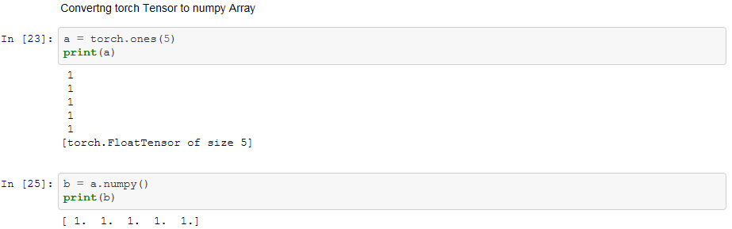
Numpy Bridge
Converting a torch Tensor to a numpy array and vice versa is a breeze.
The torch Tensor and numpy array will share their underlying memory locations, and changing one will change the other.

Slide 12
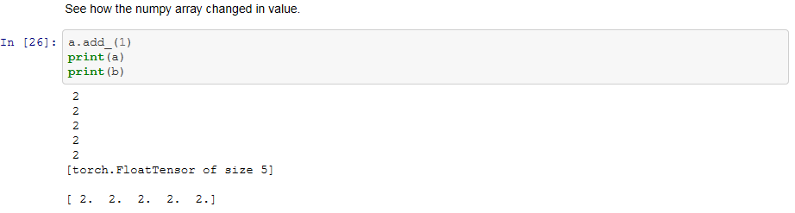
Numpy Bridge

Slide 13
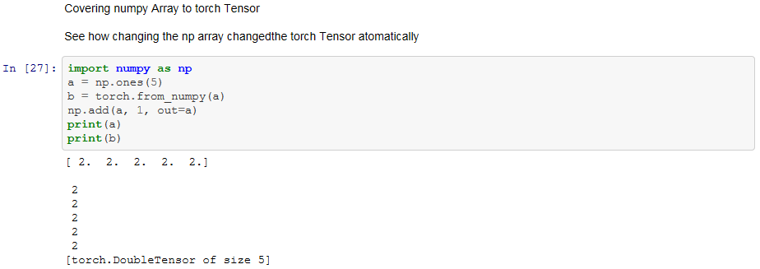
Numpy Bridge
All the Tensors on the CPU except a CharTensor support converting to Numpy and back.

Slide 14
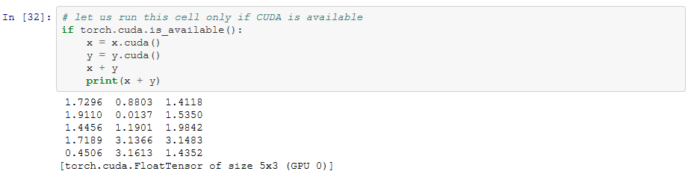
CUDA Tensors
Tensors can be moved onto GPU using the .cuda() method..
References: http://pytorch.org/tutorials/beginner/blitz/tensor_tutorial.html#tensors

Slide 15


