Slide 1


Aura Curativa
¿Me reembolsan?
Your plan's out-of-network refund, explained and filed for you. Built for patients in Puerto Rico.
Raquel Maldonado Navarro
Idea, healthcare insight, plan research
James Dreben
Engineering, deployment
Aurora Borealis
Cat · provides healing effects
Caribbean AI Summit Healthcare Hackathon · October 2026
Aurora Borealis, Chief Healing Officer
Notes:
Introduce the project and the team. Raquel: idea, healthcare insight, and plan research. James: engineering and deployment. Aurora Borealis: our cat, who provides healing effects.

Slide 2
Patients pay cash, then guess the refund
THE PROBLEM
Who needs help
Patients in Puerto Rico who see a provider outside their plan's network: acupuncture, therapy, massage, specialists with long waitlists.
Why it matters
The rules hide in long policy documents. Many patients pay the full cost or skip care. Others file a claim that is returned or denied.
0 of 5
Triple-S 2027 individual plans reimburse a routine out-of-network visit
~$17
Triple-S's published average back for a specialist visit, whatever you paid
90 days
to file with First Medical, which does reimburse out of network
Sources: 2027 policies for 5 Triple-S and 4 First Medical individual plans. Triple-S out-of-network estimates published under Ley 134-2020.
Notes:
Who: patients in Puerto Rico who pay an out-of-network provider. Why: the reimbursement rules are spread across long policy documents, insurers pay their own rate minus copay, and the claim needs a form, a letter, and the provider's signature.

Slide 3
A straight answer, then a claim ready to file
PROPOSED SOLUTION
1
2
3
4
5
6
Pick your plan
Pick your service
Get an answer
Generate the claim
Send to provider
File it
Insurer, then the exact 2027 plan
Acupuncture, specialist, glasses, therapy, more
Reimbursable? About how much back? Cheaper options
Cover sheet, filled form, policy letter
Print, or a prefilled email from your account
Mail or email to the insurer by the deadline
Before you pay, not after a denial. Spanish-first. No account, no sign-up, nothing stored.
Notes:
We chose the patient workflow. The patient answers two questions, gets a straight answer with the policy rule behind it, and leaves with a packet: a cover sheet with next steps and the deadline, the insurer's own form filled in, and a letter that cites the policy clause. If the visit has not happened yet, the app warns when the plan needs preauthorization.

Slide 4
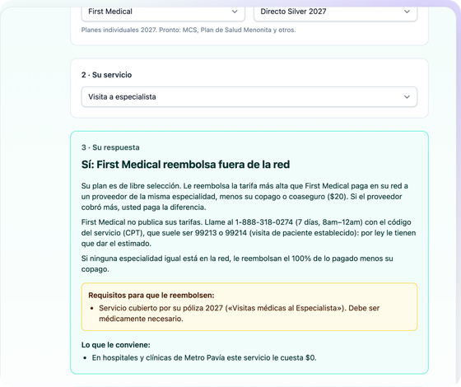
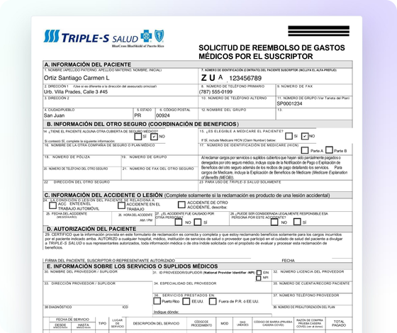
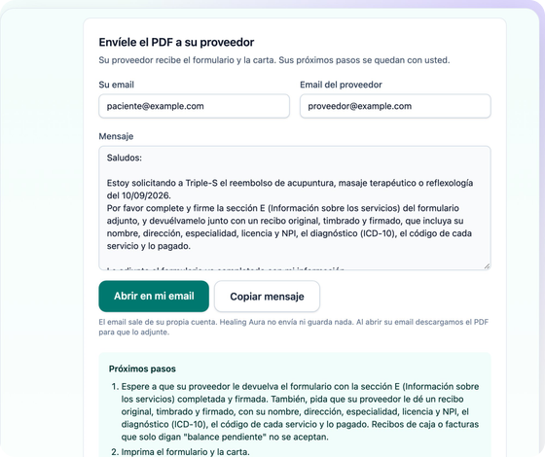
From a question to a filled claim
DEMO
1. A straight answer
2. The insurer's own form
3. Send it to the provider
First Medical Silver, specialist visit: yes, with the rule and a $0 option
Filled field by field. The provider's section stays blank
Prefilled email plus the next steps to file
Live: 18-212-154-202.sslip.io
Notes:
Live demo on 18-212-154-202.sslip.io. Pick First Medical, Directo Silver 2027, specialist visit. Show the answer and the cheaper option. Click ¡Empecemos!, fill the visit details, and show the generated packet: cover sheet, filled form, policy letter. Finish on the prefilled email to the provider. If the network fails, use the backup video.

Slide 5
How it works, and what remains simulated
TECHNOLOGY
1
Policy research
2027 policies, 9 plans, read with AI agents
Real
Simulated or limited
Rules from 5 Triple-S and 4 First Medical 2027 plans
Triple-S's official form, filled by its real field names
First Medical's scanned form, placed by coordinates
Claim data never leaves the device
Vitest and Playwright tests, desktop and phone
Demo patient and provider data is synthetic
Dollar amounts are published averages, not a coverage decision
First Medical: formula and copay, no dollar figure
Patient still mails or emails the claim
Two insurers, individual plans only
2
Rules in code
Network type, rate basis, copays, deadlines, exclusions
3
In the browser
SvelteKit static site. No backend, no database
4
PDF packet
pdf-lib fills the insurer's form and writes the letter
Notes:
Research first: we turned each plan's reimbursement rules into TypeScript. Everything runs in the browser. pdf-lib fills Triple-S's form by field name and First Medical's flat scan by coordinates. A small EC2 instance with Caddy serves the static files. Simulated: demo data is synthetic, estimates are averages, and First Medical does not publish its fee schedule.

Slide 6
Rollout plan and future features
NEXT STEPS
PHASE 1
PHASE 2
PHASE 3
Pilot
More insurers
Provider flow
→
→
Patient groups and integrative clinics in Puerto Rico. Check the rules with each insurer.
MCS, Plan de Salud Menonita, and the rest of the Puerto Rico market.
Provider prints the filled form with the receipt, or gives the patient a QR code.
Future features
Prescription forms
English UI toggle
Deadline reminders
Try it: 18-212-154-202.sslip.io
github.com/jdreben/healing-aura
Notes:
Rollout: pilot with patient groups and clinics, then add the missing insurers, then the provider-facing flow. Future features: prescription forms, an English toggle, and deadline reminders. Close with the live link and thank the judges.

