Slide 1


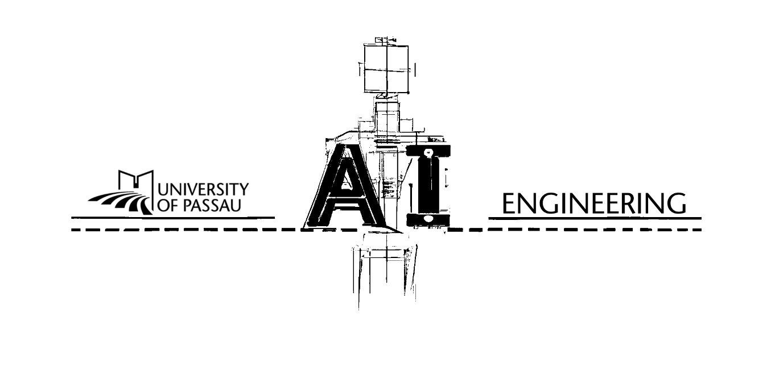
Understanding or Memorizing? A Case Study of German Definite Articles in Language Models
Jonathan Drechsel
University of Passau
Passau, Germany
jonathan.drechsel@uni-passau.de
Erisa Bytyqi
University of Passau
Passau, Germany
bytyqi01@ads.uni-passau.de
Steffen Herbold
University of Passau
Passau, Germany
steffen.herbold@uni-passau.de
Notes:
Good morning, everyone, I’m Jonathan Drechsel from the University of Passau, and this is joint work with Erisa Bytyqi and Steffen Herbold.
This talk asks whether language models predict German articles by understanding grammatical structure or by memorizing surface patterns.

Slide 2
Singular German Articles Depend on Case and Gender
DET
NOUN
VERB
DET
NOUN
PREP
DET
NOUN
Der
The
Der
The
Algorithmus
algorithm
analysiert
analyzes
die
the
die
the
Struktur
structure
von
of
der
the
Datei
file
der
the
Subject
“Algorithmus”
Direct Object
“Struktur”
Preposition “von”
“Datei”
CASE
nominative
GENDER
masculine
CASE
accusative
GENDER
female
CASE
dative
GENDER
female
der
die
der
 | Nominative | Accusative | Dative | Genitive
Masculine
Female
Neutral
6 Articles
der
den
dem
des
Highly syncretic
die
die
der
der
The same surface form occurs in multiple gender-case cells
das
das
dem
des
University of Passau
Notes:
Before answering this question, we first need a little bit of German grammar. Lets consider this example sentence and CLICK lets focus on the articles.
In English, all of them would simply be the.
But in German, we see two different article forms: der and die.
For singular definite German articles, two grammatical properties are combined to determine the correct article form: [CLICK] gender and case.
For the 1st noun, this gender-case combination gives us CLICK der.
For the 2nd noun CLICK, the combination is different, and the article is die.
Then, we see CLICK der again – but this times from a different gender-case combination than the first der.
CLICK More generally, in the German singular definite article paradigm, there are three genders, four cases and CLICK six different article Forms.
The important point is CLICK syncretism: the same surface article is used in different gender-case combinations.
Gender is a property of the noun, and case roughly describes its role in the sentence, like subject or object.

Slide 3
Correct Predictions Do Not Reveal The Mechanism
Der
The
Algorithmus
algorithm
analysiert
analyzes
Struktur
structure
von
of
der
the
Datei
file
[MASK]
Rule-Encoding
Language Model
Memorization
… die Struktur von…
… die Struktur von…
Direct Object
“Struktur”
die
0.93
… die Struktur von…
… analysiert die Struktur …
… analysiert die Struktur …
der
0.04
… analysiert die Struktur …
… analysieren die Strukturen …
… analysieren die Strukturen …
… analysieren die Strukturen …
… die Struktur ist …
0.02
… untersucht die Struktur …
CASE
accusative
GENDER
female
das
… untersucht die Struktur …
… analysiert von der Struktur …
… zeigt die Struktur der Datei …
… zeigt die Struktur der Datei …
… zeigt die Struktur der Datei …
… die Struktur ist …
High-confidence prediction
… die Struktur ist …
But Why
die
die
abstract grammatical features
surface pattern recall
Jonathan Drechsel
University of Passau
DOI: 10.48550/arXiv.2601.09313
Notes:
So suppose a CLICK language model needs to predict a masked German article. This is a task language models are CLICK very good at and they often predict the right article with high confidence. But the key question is: CLICK Why? What mechanism produced that prediction???
CLICK Does the language model internally rely on gender and case information, roughly following the gender-case table we just saw?
CLICK Or does it rely more on memorized surface patterns, such as frequent article-noun and article-context associations?
To study this mechanism, CLICK we move from predictions to CLICK gradients.

Slide 4


Factual vs. Counterfactual Article Targets
Der
The
Algorithmus
algorithm
analysiert
analyzes
Struktur
structure
von
of
der
the
Datei
file
[MASK]
Factual
die
das
Counterfactual
$∇_{f}$LM
$∇_{c}$LM
$∇_{.}$LM denotes the MLM gradient derived using the respective target token
Jonathan Drechsel
University of Passau
DOI: 10.48550/arXiv.2601.09313
Notes:
…we move from predictions to CLICK gradients over a masked article target.
If the target is the grammatically licensed article, we call it the CLICK factual gradient.
If the target is CLICK another selected article, we call it the CLICK counterfactual gradient.
CLICK
Intuitively, CLICK the counterfactual gradient asks: which weights would need to change, and in which direction, to prefer this counterfactual article?

Slide 5
From Article Pairs to Gender-Case Transitions
Der
The
Algorithmus
algorithm
analysiert
analyzes
Struktur
structure
von
of
der
the
Datei
file
[MASK]
Die
The
Analyse
analysis
erklärt
explains
Verhalten
behavior
beim
during
Training
training
[MASK]
Gender-Case Transition:
Surface Realization:
(NEUT, ACC)
(FEM, ACC)
das
die
The same article pair can correspond to different gender-case transitions.
 | NOM | ACC | DAT | GEN
MASC
FEM
NEUT
der
den
dem
des
die
die
der
der
das
das
dem
des
Jonathan Drechsel
University of Passau
DOI: 10.48550/arXiv.2601.09313
This lets us ask whether learned features follow grammatical cells or shared surface articles.
Notes:
What matters now is which sentences we group together for analysis.
We do this by the underlying gender-case cells, not by the article strings.
So this is not simply das versus die, but a transition between Neutral Accusative and Feminine Accusative.

Slide 6
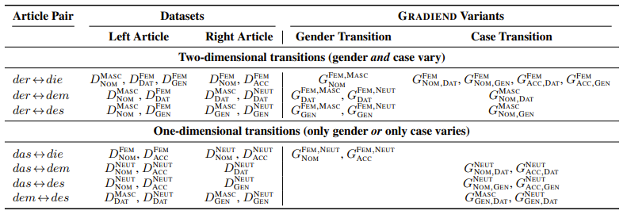
Which Gender-Case Transitions Do We Study?
(MASC, NOM)
(FEM, NOM)
(MASC, NOM)
(MASC, DAT)
(NEUT, NOM)
(NEUT, DAT)
(FEM, DAT)
(FEM, NOM)
(FEM, DAT)
(MASC, DAT)
(NEUT, ACC)
(NEUT, DAT)
19 Gender-Case Transitions
(FEM, GEN)
(FEM, NOM)
(FEM, DAT)
(NEUT, DAT)
(NEUT, NOM)
(NEUT, GEN)
(FEM, DAT)
(FEM, ACC)
(NEUT, ACC)
(NEUT, GEN)
(FEM, GEN)
(FEM, ACC)
(MASC, NOM)
(MASC, GEN)
(NEUT, NOM)
(FEM, NOM)
(FEM, GEN)
(MASC, GEN)
(MASC, DAT)
(MASC, GEN)
(NEUT, ACC)
(FEM, ACC)
(FEM, GEN)
(NEUT, GEN)
(NEUT, DAT)
(NEUT, GEN)
 | NOM | ACC | DAT | GEN
MASC
FEM
NEUT
only one dimension changes per transition: gender or case
19 gender- case cell transitions
dem
des
der
dem
des
der
den
den
die
die
die
die
der
der
der
der
das
das
des
das
das
dem
des
dem
Jonathan Drechsel
University of Passau
DOI: 10.48550/arXiv.2601.09313
Notes:
In total, we consider all gender–case cell transitions where exactly one grammatical dimension changes, either gender OR case.
This gives us CLICK 19 gender–case transitions.

Slide 7
Research Question and Hypotheses
Do model mechanisms follow gender–case structure or surface article forms?
Rule-Encoding
Memorization
(NEUT, ACC)
(FEM, ACC)
das
die
den
(MASC, NOM)
(MASC, DAT)
der
dem
(NEUT, NOM)
(NEUT, GEN)
das
des
follows gender-case cells
follows article forms
Jonathan Drechsel
University of Passau
DOI: 10.48550/arXiv.2601.09313
Notes:
This brings us to our research question: do model mechanisms follow the underlying gender–case structure, or the surface article forms?
A rule-encoding mechanism should follow gender–case cells.
A memorization-like mechanism should instead follow article forms.

Slide 8
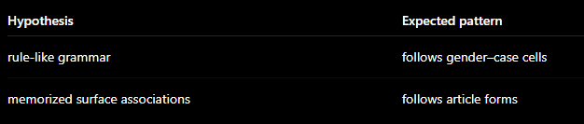
Experimental Setup
German Wikipedia article contexts
spaCy-filtered gender-case datasets
19K – 61K samples per cell
Transitions
19 gender-case cell pairs
one grammatical dimension changes
Data
spaCy
gender-case tagging
filtered
article contexts
masked gender-case datasets
German
Wikipedia
19K-61K samples per cell
Der
Algorithmus
analysiert
[MASK]
Struktur
von
der
Datei
Analyses
Encoding
Intervention
Weight overlap
Vis: image per analysis (simple: embed three result slides)
Models
Encoder-only
Decoder-only
Monolingual
GBERT
GermanBERT
ModernGBERT
GermanGPT-2
Multilingual
EuroBERT
LLaMA
Jonathan Drechsel
University of Passau
DOI: 10.48550/arXiv.2601.09313
Notes:
Our experimental data consists of real-world German Wikipedia sentences. We identify articles with spacy and group the masked examples by gender-case cell.
We evaluate six language models across German-only/multilingual and encoder-only/decoder-only settings.

Slide 9



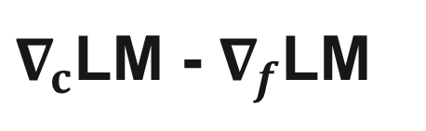
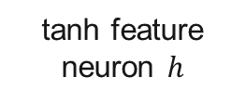
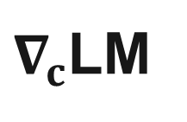
GRADIEND: Targeted Feature Learning from Gradients
GRADIEND is a recent interpretabiltiy method [1] learning a single feature neuron of a targeted gender-case pair, e.g.,
→ one GRADIEND per base LM and transition
(NEUT, ACC)
(FEM, ACC)
Input
GRADIEND
Output
Counterfactual gradient
over all LM parameters
Encoder
Decoder
Difference of Factual and Counterfactual gradient
tanh feature neuron $h$
$∇_{c}$LM
$∇_{c}$LM - $∇_{f}$LM
$$−1$$
$$0$$
$$+1$$
neutral
Takeaway: GRADIEND gives us three objects for analysis – feature activations, decoder-based interventions, and affected weights.
[1] Jonathan Drechsel, Steffen Herbold, GRADIEND: Feature Learning within Neural Networks Exemplified through Biases, ICLR 2026.
Jonathan Drechsel
University of Passau
DOI: 10.48550/arXiv.2601.09313
GRADIEND compresses counterfactual gradients into one interpretable feature getting decoded into feature model update.
Takeaway: GRADIEND compresses counterfactual gradients into one meaningful feature and decodes it into an LM update that shifts model behavior.
Notes:
For each base model and each transition, we train one GRADIEND model. GRADIEND is a recent interpretability method that learns a targeted feature for that selected transition.
CLICK The method operates on model gradients, using the counterfactual gradients introduced before as input.
CLICK Internally, GRADIEND is an encoder–decoder network with a single bottleneck neuron. Unlike sparse autoencoders, which discover many activation-level features, GRADIEND learns a single weight-level feature, controlled by our chosen factual-counterfactual data pairs.
Through a tanh activation, this feature separates the two selected gender-case cells along a -1 and +1 scale.
CLICK The decoder reconstructs the difference between counterfactual and factual gradients, which gives a weight update direction for the language model.
CLICK We then use GRADIEND to answer our research question from three angles: encoded feature values, decoder-based model intervention, and affected weight overlap.

Slide 10


Result 1: Learned Features Are Not Purely Grammatical
$$h$$
How does GRADIEND encode different gradients?
targeted gender-case pair vs. pairs with same articles
GBERT
(MASC, NOM)
(FEM, NOM)
die
der
$$h$$
der
die
(MASC, NOM)
(FEM, NOM)
(FEM, DAT)
(FEM, NOM)
(MASC, NOM)
(FEM, NOM)
Neutral
gradients in sentences without clear gender or case cues
(FEM, NOM)
(MASC, NOM)
(FEM, NOM)
(MASC, NOM)
(FEM, NOM)
(MASC, NOM)
Takeaway: GRADIEND learns a meaningful feature, but its encoding also reflects shared article forms beyond the targeted gender–case transition.
Jonathan Drechsel
University of Passau
DOI: 10.48550/arXiv.2601.09313
Notes:
The first analysis asks how GRADIEND encodes different inputs in the feature neuron.
CLICK Here is one representative example, but the same pattern is consistent across models and transitions. The encoded-value distribution shows a clear separation of the two feature classes.
CLICK At the same time, neutral gradients from sentences without clear gender or case cues, stay close to zero. This means that the learnt feature is meaningful.
But CLICK, other gender-case transitions with the same surface articles are encoded similarly to the targeted one, even though they correspond to different grammatical transitions.
CLICK This suggests that the feature is not purely grammatical. It also reflects memorization-like surface article patterns of the underlying language model.

Slide 11
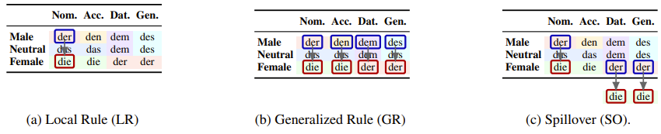
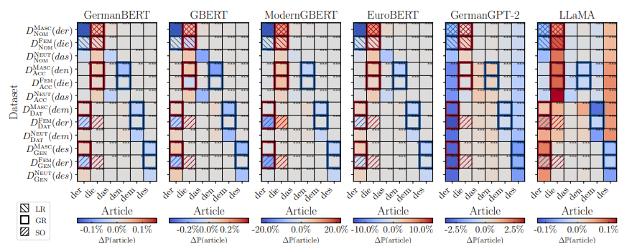
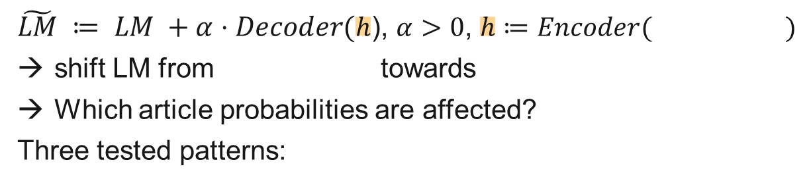







Result 2: Interventions Show Mixed Patterns
$$h$$
We apply an update to the base model and analyze probability shifts on articles.
GBERT
(MASC, NOM)
(FEM, NOM)
$$Encoder$$
$$Decoder$$
Probability Shift: $LM$ vs. $\tilde{LM}$
$\tilde{LM} ≔ LM +α⋅Decoder(h$), $α>0$, $h≔Encoder( )$
shift LM from towards
Which article probabilities are affected?
Three tested patterns:
(FEM, NOM)
(MASC, NOM)
(MASC, NOM)
(FEM, NOM)
(FEM, DAT)
(FEM, GEN)
Local Rule
(FEM, NOM)
Local Rule
Generalized Rule
Generalized Rule
Spillover
Spillover
(FEM, ACC)
 | NOM | ACC | DAT | GEN
MASC
FEM
NEUT
(NEUT, NOM)
$$−20\%$$
$$0\%$$
$$+20\%$$
$$Δ\text{ℙ}(article)$$
dem
des
(NEUT, ACC)
der
dem
des
der
den
der
den
(MASC, ACC)
die
die
die
die
die
die
die
die
die
die
der
der
der
der
der
der
(MASC, DAT)
das
(NEUT, DAT)
das
das
des
das
dem
des
dem
(MASC, GEN)
Takeaway: Probability shifts show a mixed pattern: some rule-like generalization, but also surface-article spillover.
(NEUT, GEN)
der
die
das
den
dem
des
Jonathan Drechsel
University of Passau
DOI: 10.48550/arXiv.2601.09313
Takeaway: Probability shifts show a mixed pattern: some rule-like generalization, but also surface-article spillover.
Notes:
The second analysis is causal. Now that we know that the learned feature is meaningful, CLICK we can add the decoded gradient direction for one selected feature value to the model weights, similar to a single training step. CLICK Intuitively, this shifts the model toward the selected feature class. CLICK We then measure article probability shifts which are shown in CLICK this heatmap. Rows are gender-case datasets, columns are articles. Red means increase in the modified model, blue means decrease.
CLICK To explain these observed shifts, we compare the heatmap against three expected patterns.
CLICK A local rule would mainly affect the targeted gender-case cells. We see this, but it explains only part of the heatmap.
CLICK A generalized rule would apply the same grammatical relation across related cells. This explains more shifts, but still not all.
CLICK A spillover pattern would move probabilities to cells sharing surface article forms, and we see some evidence for this as well.
CLICK Overall, the causal intervention shows a mixed pattern: some rule-like generalization, but also surface article spillover.

Slide 12
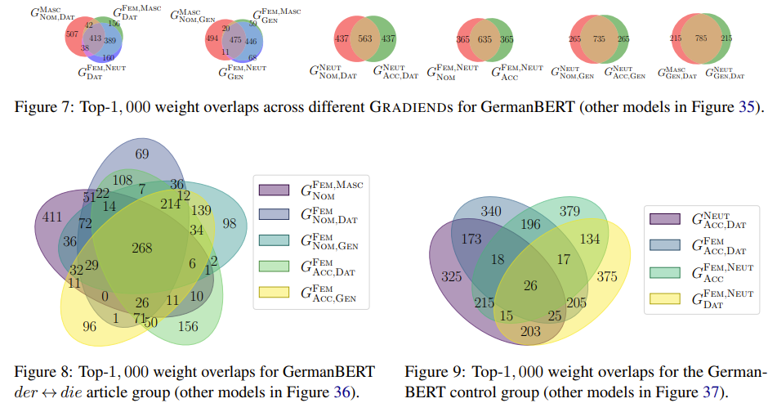
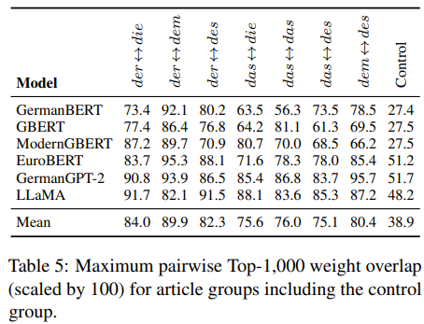
Result 3: Shared Article Forms Affect Similar Weights
(MASC, NOM)
(FEM, DAT)
(NEUT, DAT)
(FEM, DAT)
(FEM, GEN)
(FEM, NOM)
$$h$$
(FEM, ACC)
(FEM, GEN)
(FEM, NOM)
For each GRADIEND, we compare the top-1,000 affected LM weights across transitions.
GBERT
(NEUT, NOM)
(FEM, DAT)
(FEM, ACC)
Max. pairwise top-1,000 overlap proportion
(NEUT, ACC)
Shared surface articles: high overlap
(MASC, ACC)
GermanBERT
GBERT
(FEM, DAT)
(FEM, NOM)
ModernGBERT
EuroBERT
(MASC, DAT)
(MASC, NOM)
(FEM, NOM)
221
148
GermanGPT-2
LLaMA
(NEUT, DAT)
der
die
149
499
197
(MASC, GEN)
CONTROL
der
dem
60
(NEUT, GEN)
245
(FEM, GEN)
(FEM, ACC)
Disjoint/control transitions: low overlap
dem
des
der
des
(NEUT, ACC)
(NEUT, DAT)
(FEM, DAT)
(FEM, ACC)
578
158
577
80
184
185
das
des
das
die
CONTROL
551
(NEUT, ACC)
(FEM, ACC)
das
dem
Takeaway: Transitions sharing surface articles affect more similar weights than control transitions.
:
Jonathan Drechsel
University of Passau
DOI: 10.48550/arXiv.2601.09313
Takeaway: Transitions sharing surface articles affect more similar weights than control transitions.
Notes:
The third analysis asks whether these patterns are also visible at the level of model weights.
For each GRADIEND feature, we take the top 1000 affected weights, and then compare how much these sets overlap across transitions.
CLICK For transitions that share the same surface article forms, the affected weights overlap substantially, suggesting that these transitions rely on substantial overlapping parts of the model.
CLICK As a control, we compare transitions without such shared surface article structure. Here, the overlap is much smaller.
CLICK As for the other analyses, this pattern generalizes across models and article groups.
CLICK The weight overlap for shared article groups is consistently higher than for the control group, where we see a substantial drop.

Slide 13

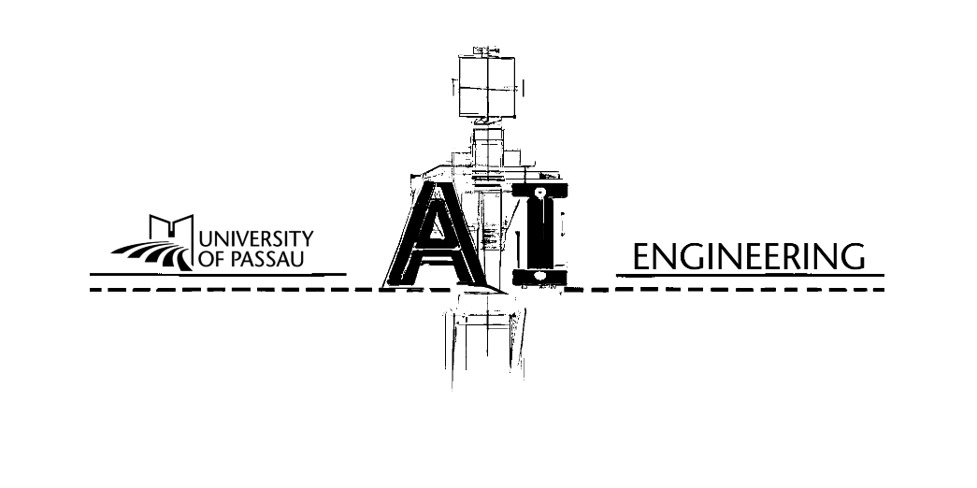

Surface-form memorization plays a role
Understanding or Memorizing ?
A Case Study of German Definite Articles in Language Models
Not purely rule-based
Understanding
Memorizing
WARNING
THE LANGUAGE MODEL YOU ARE USING MAY HAVE MEMORIZED THE GRAMMAR INSTEAD OF LEARNING THE RULES!
LINGUISTIC RESEARCH RELYING ON HOW LANGUAGE MODELS ENCODE GRAMMAR MAY BE MISLEADING.
Conclusion: German article encoding is not purely rule-based.
Feature Activations
Interventions
Affected Weights
Meaningful, but not
purely grammatical
rule-like generalization
and spillover
Higher overlap for shared article forms
Jonathan Drechsel
University of Passau
Passau, Germany
jonathan.drechsel@uni-passau.de
Erisa Bytyqi
University of Passau
Passau, Germany
bytyqi01@ads.uni-passau.de
Steffen Herbold
University of Passau
Passau, Germany
steffen.herbold@uni-passau.de
Notes:
So, back to our question from the beginning, understanding or memorizing?
Across all three analyses, we see consistent evidence against a purely rule-based encoding of German articles.
The learned feature is meaningful, but not purely grammatical. Interventions show spillover patterns, and affected weights overlap more strongly for shared article forms.
[CLICK]
The key message is: language models may predict the right grammatical form, but not necessarily for the right grammatical reason, so probably based on memorized surface patterns rather than the underlying grammatical rule.
For linguistic research, this matters because what looks like grammatical encoding may, at least, partly reflect surface-form memorization.
Thanks for your attention, I am happy to take questions.

