Slide 1
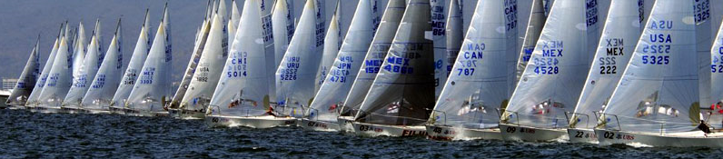
Topics for
Class #4
Crew Safety
Weather Safety
Crew Overboard Recovery
Navigation Lights
Charts/ Lake Lanier Map
REVIEW

Slide 2
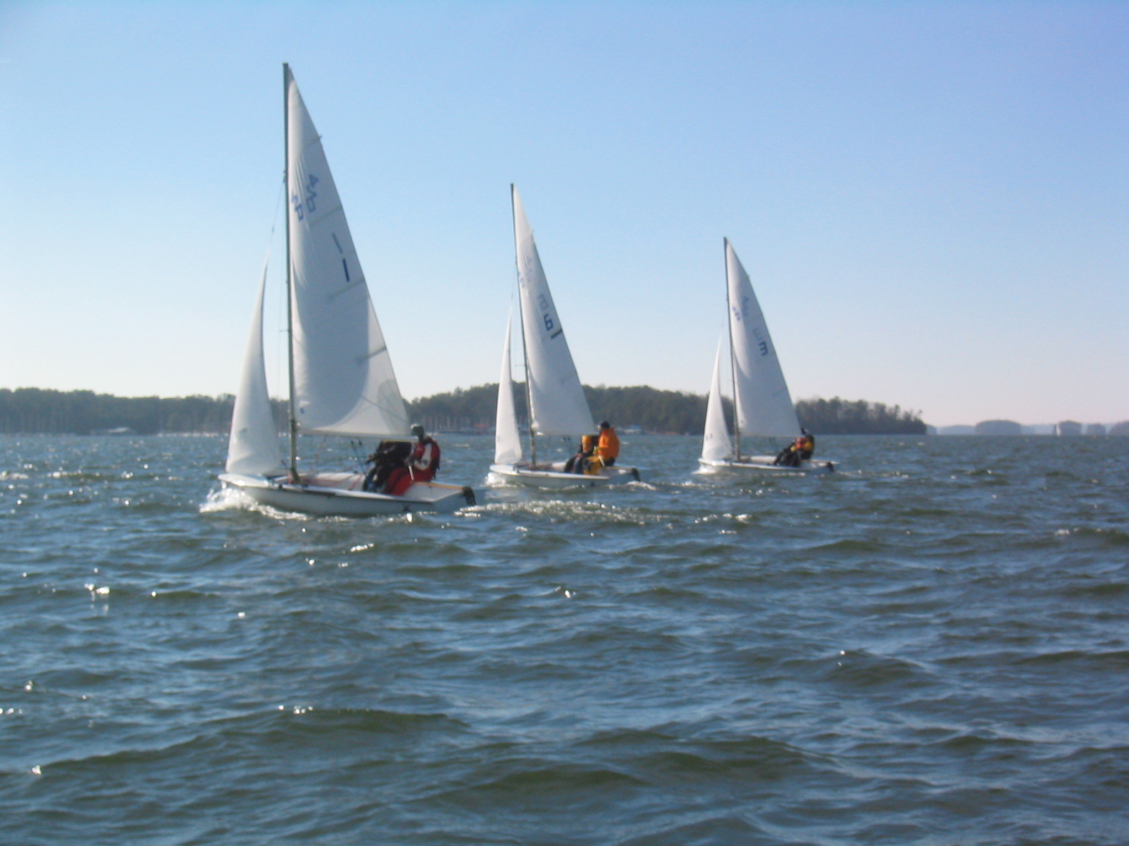
Class Schedule
Meetings: Mondays 8-9:30PM Student Center Room 343
June 1st: Introduction, Terminology, Gear, Steering & Sail Trim
Knots: Figure Eight, Bowline, & Coiling
June 8th: Points of Sail, Tacking & Jibing, Spinnaker, & Racing Intro
Knots: Square Knots & Cleats
June 15th: Maneuvering, Right of Way, Docking, Anchoring,
& Maintenance
Knots: Barrel Roll & Clove Hitches
June 22nd: Safety, Navigation Lights, Charts & REVIEW
June 29th: “Advanced Sailing” Written Exam (Optional)

Slide 3
Web Resources
http://www.gtsailing.org/keelclassoutline.php

Slide 4
Safety Intro
Crew Safety
“Tragedy Hits Home”

Slide 5
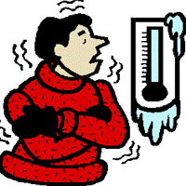
Physical illness: Hypothermia
Crew Safety: First Aid (Page 70)
Can result from cold air, water, or both
Signs and Symptoms:
  Shivering
  Numbness
  Glassy Stare
  Confusion
  Weakness
What do you do?
  Remove ALL wet clothing
  Gradually warm person up

Slide 6
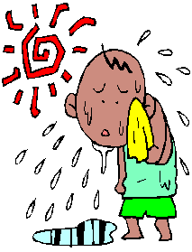
Physical illness: Heat Exhaustion
Crew Safety: First Aid (Page 70)
Can be caused by heat and/or a lack of water intake
Signs and Symptoms:
  Cool, moist, pale skin
  Headache
  Nausea
  Dizziness and weakness
  Exhaustion
  Dilated pupils
What to do?
  Move person to cool location
  Loosen or remove clothing
  Apply moisture to skin
  Drink cool water in moderation

Slide 7
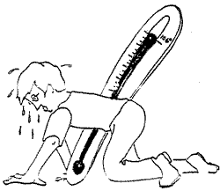
Physical illness: Heat Stroke
Crew Safety: First Aid (Page 70)
Can be Life Threatening!
Signs and Symptoms:
  High body temp
  Dry skin (stopped sweating)
  Constricted pupils
  Rapid, shallow breath
What to do?
  Move person to a cool location
  Contact EMS
  Cool person rapidly by immersion in a cold bath
  Do not give anything to eat or drink

Slide 8
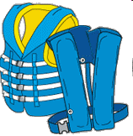
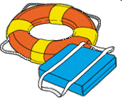
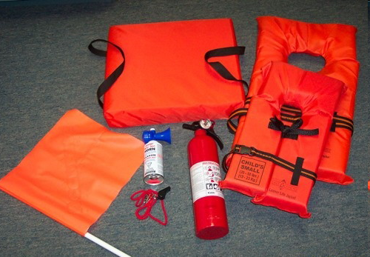
Crew Safety
Required Safety Equipment
(Section I of “Advanced Sailing Exam”)
Department of Natural Resources (DNR) requirements: http://georgiawildlife.dnr.state.ga.us/
 | Type I, II, III, or V PFD per person
 | Type IV PFD in cockpit
 | B-I Fire Extinguisher
 | Sound Producing Device
Other safety equipment required for racing: Anchor, Motor, First Aid Kit
Navigation Lights are required for Boating at Night

Slide 9
Sample Test Questions
Crew Safety:
DNR Required Equipment? Page 78
Where should life preservers be stored?
Radio Distress Signals? Page 79
Fire Extinguishers and how to opperate?
Boating and Alcohol?
  Legal Laws (DNR and US Coast Guard)?
  Affects of alcohol on the sailor?

Slide 10
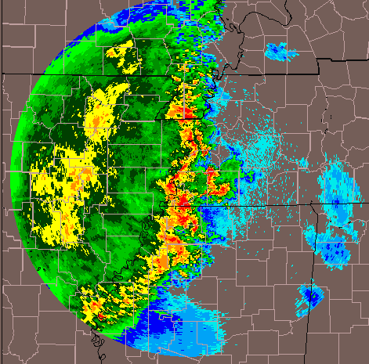

Weather
Weather Safety (pages 62-63)
What does lightning do to a sailboat?
The weather can change very quickly- ALWAYS check the forecast before heading out!
Watch clouds for storms, extreme temperatures and high winds
The wind on the water may be VERY different from weather when rigging
ALWAYS have life jackets on, or easily accessible
Have a back up plan- always have a plan to get everyone off of the water fast- don’t stray too far away on the lake.
Keelboat vs Dinghy Sailing?

Slide 11
Sample Test Questions
Weather Safety (pages 62-63)
Thunderstorm safety?
Reading a weather map?
  Surface pressure (barometric) and weather?
Appearance of the lake?
  Whitecaps
  Wind, Fetch, and Waves
  Beaufort Scale

Slide 12
When in Doubt….

Slide 13
Don’t Go Out!!!

Slide 14
Man Over Board!
Crew Overboard Recovery
Let everyone know: Hail “Man Overboard!”
Throw a flotation device to the person
Assign Crew Responsibilities:
*At least one set of eyes on the person in the water*
4. Lower the head sail (Genoa or Jib)
5. Approach the person slowly with them to windward of the boat with little or no speed
*Remember jibing is dangerous in heavy air*
US Sailing Textbook: Pages 72-73

Slide 15
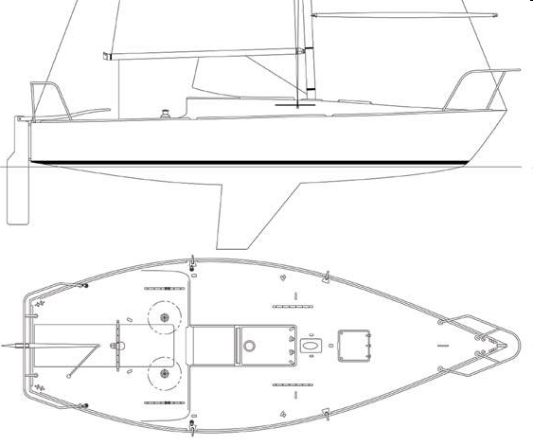
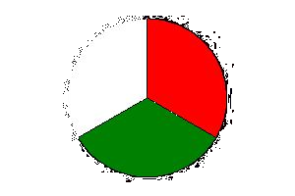
Navigation Lights
Navigation
Port: Red
Stern: White
Starboard: Green
Masthead Light (sailing only)
When to use running lights?
Colors of navigation lights of vessel under sail?
Lights reguired for Sailboat underpower at night?
Lights required while anchored at night? All round white light, visible all directions
“Masthead Light” refers to what?

Slide 16
Lake Lanier Map
Navigation
http://www.gtsailing.org/keel/lake_lanier.tif
Basic Navigation Aids
Textbook: Pages 68-69
Exam Concepts
Lake Lanier Channel Markers?
Key Places (Buford Dam, Brown’s Bridge, Aqualand, LLSC, X Island, Chattahoochee Bay, Flowery Branch Bay)?
Lake Lanier Racing Markers?
Reefs and obstructions?

Slide 17
Review from Clinics
Light Wind vs. Strong Breeze
Skipper and Crew- Working Together
Proper Tiller/Sheeting Form
Spinnaker Sailing
Learn those Knots!!!
Sail Trim, Sail Trim, Sail Trim

Slide 18
Instructional Opportunities
Summer 2009
Clinic #1 (Sunday 6/7) Safety Orientation Rigging Crew Positions Docking Lots of Sailing Practice! De-rigging | Clinic #2 (Saturday 6/20) Docking Tacking/Jibing Sail Trim Right-of-Way Spinnaker sailing
Regatta (Sat-Sun 6/13-14th) “Intro to Racing” LLSC Reggae Regatta Details TBD | Clinic #3 (Sunday 6/28) Overboard Recovery Drill Right-of Way Spinnaker sailing Quick Work-party at the end

Slide 19
On-the-Water Exam
Rigging
Terminology
Safety
Crew Management
Boat Handling (Tacking, Jibing, Points of Sail, Spinnaker)
Man Overboard Drill
Docking
Proper Derigging – “Don’t get lazy at the end!”
Must be conducted in winds over 10kts with a GTSC J/24 Instructor.
More information at www.gtsailing.org/instruction
The practical (on-the-water) exam is difficult and requires practice

Slide 20
What does being GTSC “Skipper Qualified” mean?

Slide 21
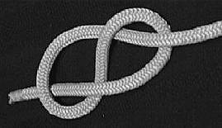
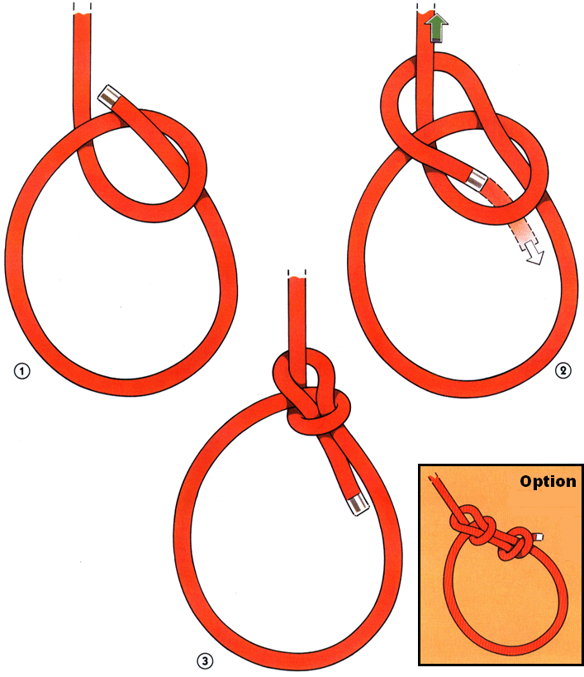
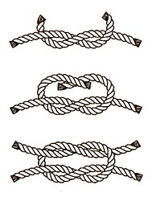
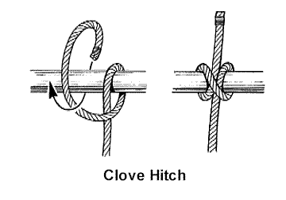
Knots to Review:
Figure Eight Knot
Bowline
Square Knot
Cleating and Coiling
Clove Hitch
Coiling
Cleating

