Slide 1
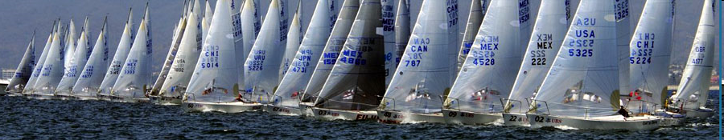
Tonight’s Goals:
Quick Review
Parts of the Boat
Points of Sail
Sail Controls
Spinnaker Video
Racing Intro
Knots

Slide 2
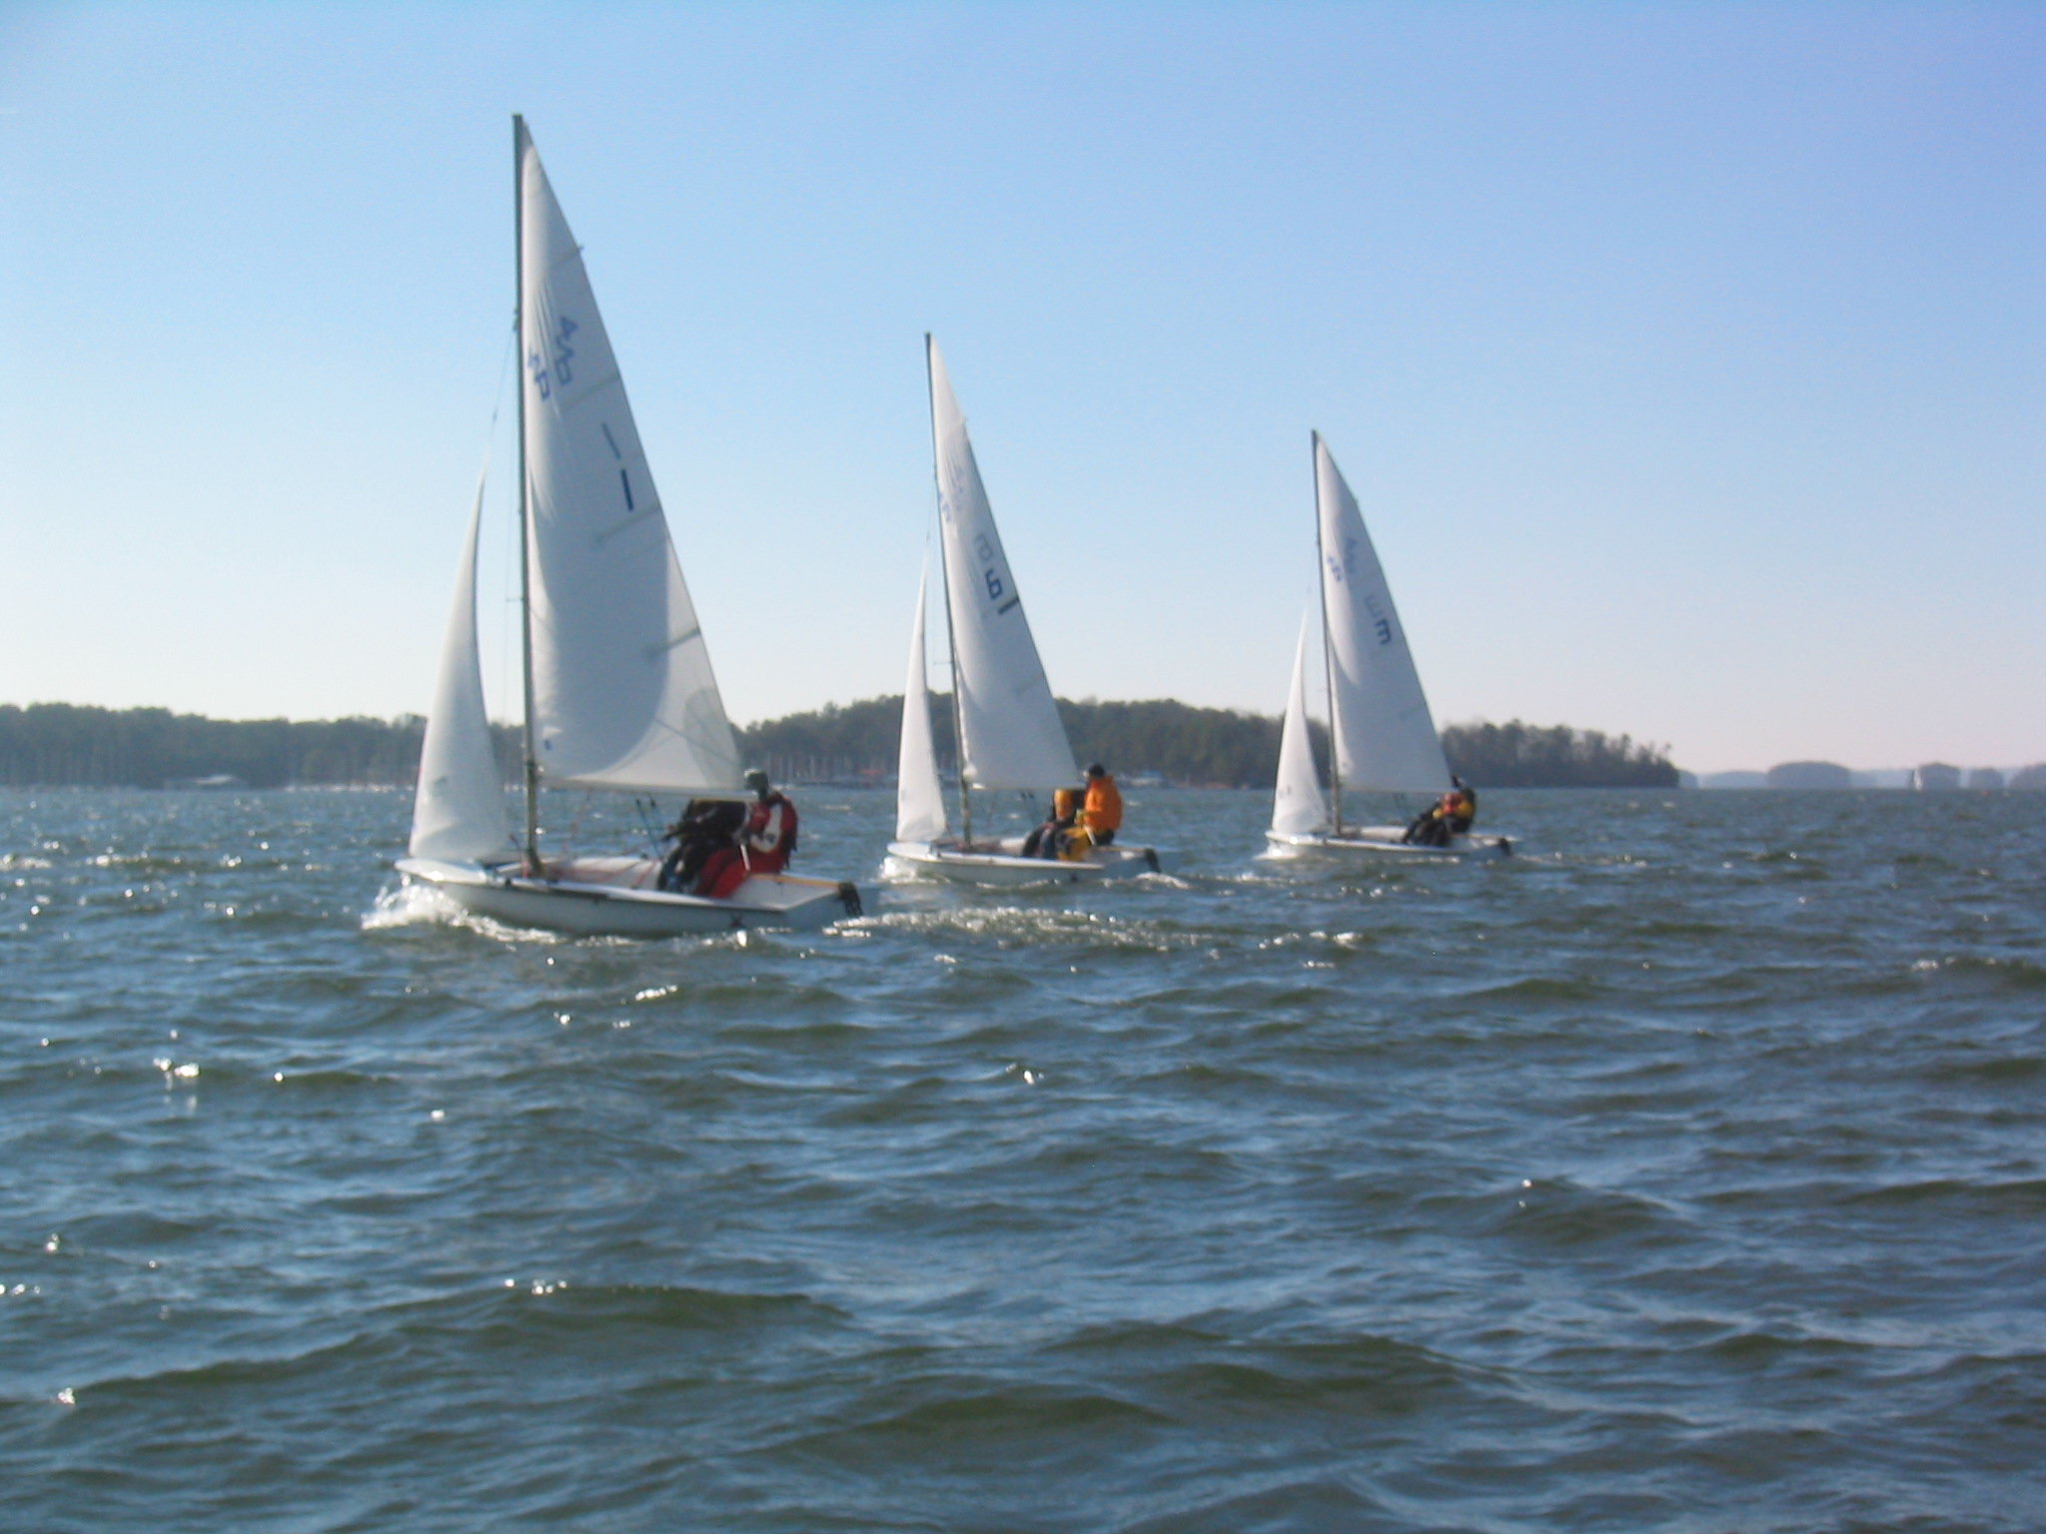
Class Schedule
Meetings: Mondays 8-9:30PM Student Center Room 321
June 1st: Introduction, Terminology, Gear, Steering & Sail Trim
Knots: Figure Eight, Bowline, & Coiling
June 8th: Points of Sail, Tacking & Jibing, Spinnaker, & Racing Intro
Knots: Square Knots & Cleats
June 15th: Maneuvering, Right of Way, Docking, Anchoring,
& Maintenance
Knots: Barrel Roll & Clove Hitches
June 22nd: Safety, Navigation Lights, Charts & REVIEW
June 29th: “Advanced Sailing” Written Exam (Optional)

Slide 3
GT Sailing: Advanced Written Exam (optional)
Purpose
Parts
  Boat Handling
  Sail Trim
  GTSC Maintenance
  Safety
  Weather
  Navigation/Lights and Right of Way (ROW)
Passing Requirements
  A note about the “Beginner Sailing Exam”

Slide 4
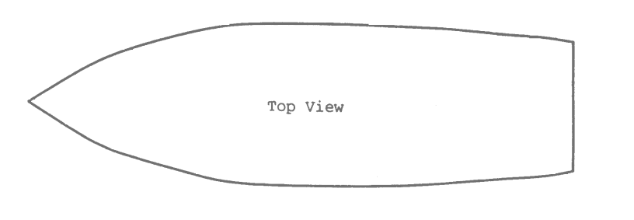
REVIEW- Terminology
Wind
  True Wind
  Apparent Wind
  Puff / Lull
Windward / Leeward
Heeling
Hiking Out
Port / Starboard
Starboard
Port

Slide 5
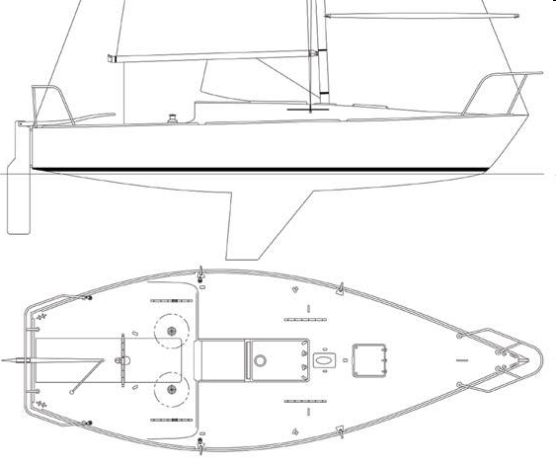
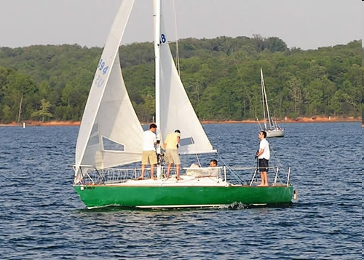
Parts of the Boat
Pages 28-33
Sample Test Questions
Standing Rigging
Hanks
Spinnaker Pole
Foot Bolt Rope
Sail Battens
Shackels
Spinnaker Pole
Winches

Slide 6
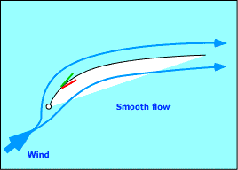
Trimming the Sails
Upwind
  Sails act like a wing
  Sails pull the boat along
Lift

Slide 7
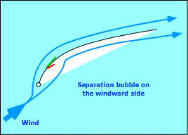
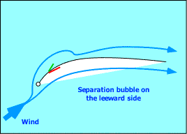
Trimming the Sails
Luffing
  Inside telltale falls
  Sheet In
  Fall Off, Head Down
Too Tight
  Outside telltale falls
  Sheet Out
  Head Up

Slide 8
Trimming the Sails
Downwind
  Sails act like a parachute
  Sails grab the air and are pushed along
  Telltales don’t work
Based on Wind Speed
  Light Air - Fat and powered up
  Heavy Air - Flat and tight, de-powered, reefing

Slide 9
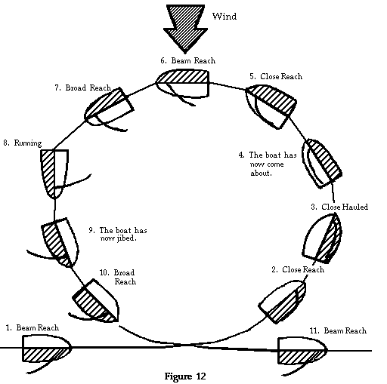
How do the Sails Look?

Slide 10
Sail Controls
Halyards
Main Sheet
Jib Sheet
Jib Blocks
Traveler
Spin Sheet
Spin Guy
Twings
Topping Lift
Foreguy
Boom Vang**
Main Cunningham**
Outhaul**
Leech Lines**
**Purpose: (Main Sail)
Boom Height
Depth of Draft
Fore-aft position of draft
Flutter of Leech
Twist-off top portion
Foot Tension
Luff Tension
Spinnaker Controls
Pages 50-51 (Part 4)
Sample Test Questions

Slide 11
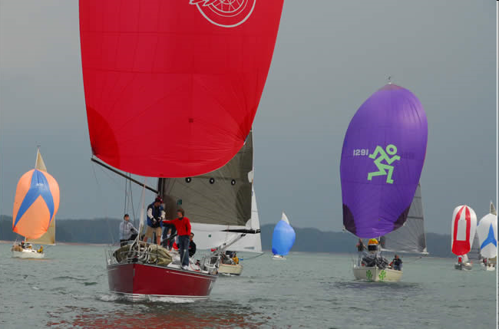
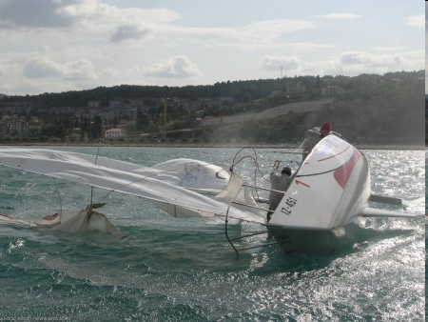
Sailing with Spinnaker

Slide 12
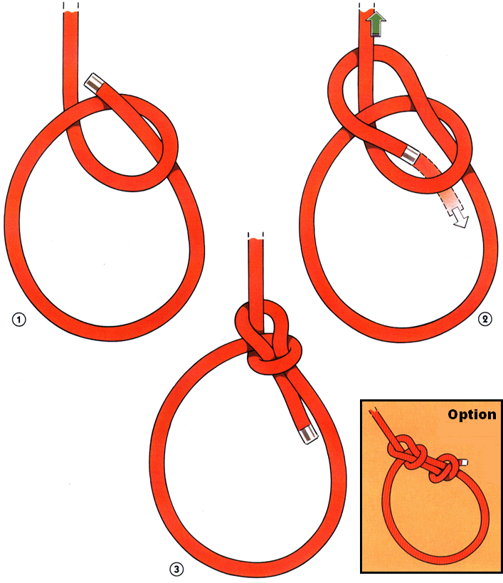
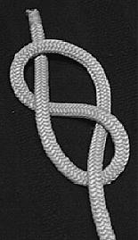
Knots: Review from Last Class:
The Figure-8 The Bowline

Slide 13
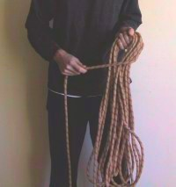
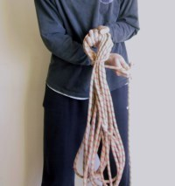
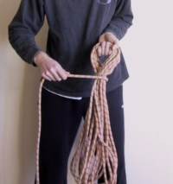
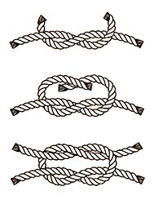
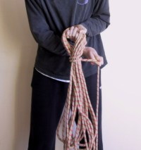
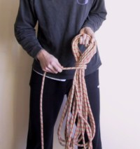
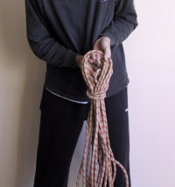
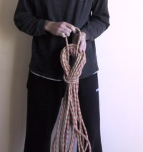
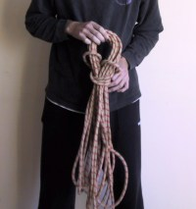
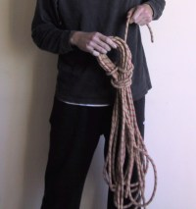
Square Knot
Coiling

Slide 14
Instructional Opportunities
Summer 2009
Clinic #1 (Sunday 6/7) Safety Orientation Rigging Crew Positions Docking Lots of Sailing Practice! De-rigging | Clinic #2 (Saturday 6/20) Docking Tacking/Jibing Sail Trim Right-of-Way Spinnaker sailing
Regatta (Sat-Sun 6/13-14th) “Intro to Racing” LLSC Reggae Regatta Details TBD | Clinic #3 (Saturday 6/27) Overboard Recovery Drill Right-of Way Spinnaker sailing Motoring
Or Sunday???

Slide 15
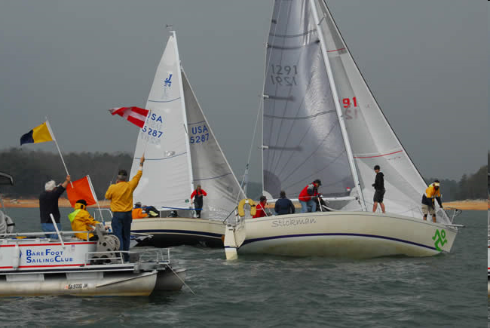

What is a Regatta?

Slide 16
Next Week’s Class:
Maneuvering
Right of Way
Docking
Anchoring
Maintenance
Knots (Cleats and Clove Hitch)
Readings for Next Week: Parts 3 & 4

