Slide 1
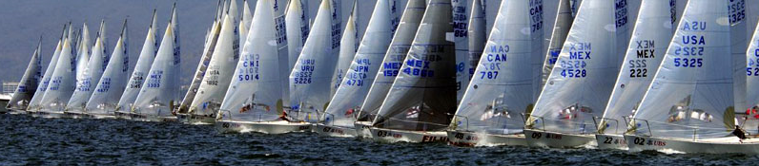
Topics for
Class #3
Maneuvering
Right of Way
Docking
Anchoring
Maintenance
Knots: Barrel Roll & Clove Hitches

Slide 2
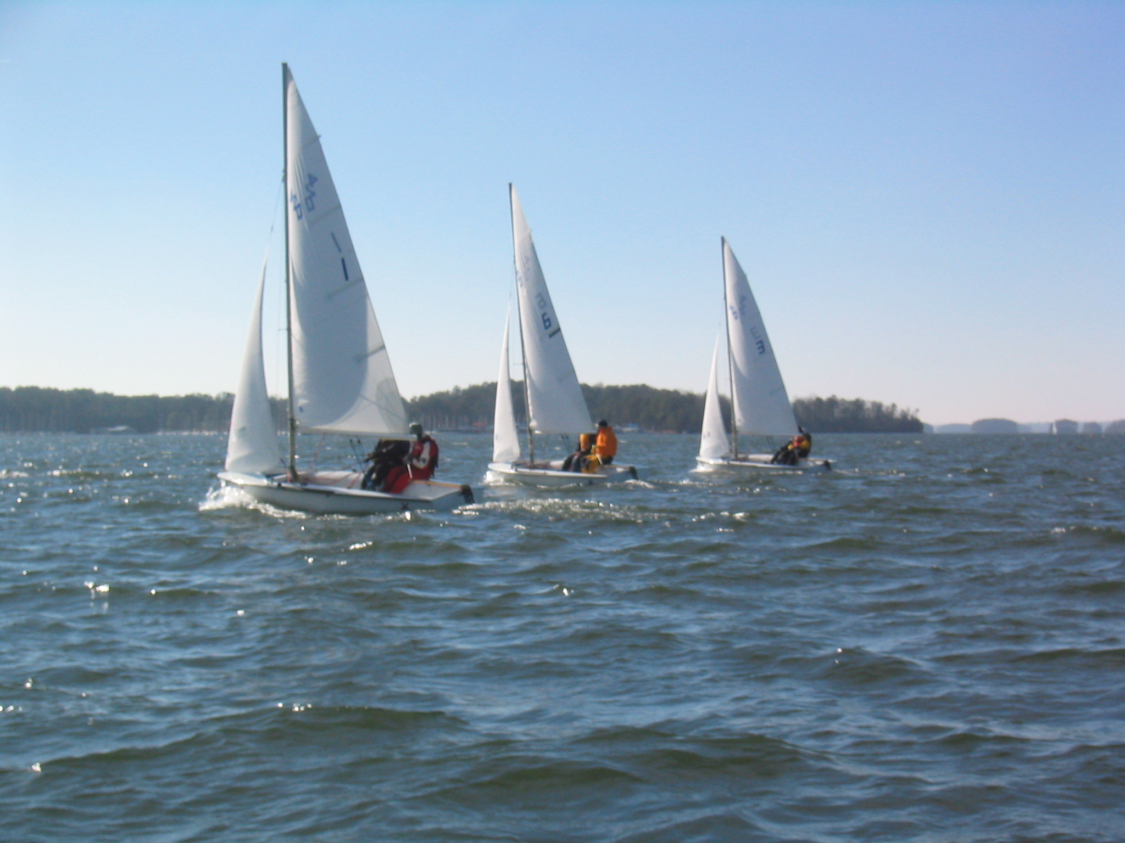
Class Schedule
Meetings: Mondays 8-9:30PM Student Center Room 343
June 1st: Introduction, Terminology, Gear, Steering & Sail Trim
Knots: Figure Eight, Bowline, & Coiling
June 8th: Points of Sail, Tacking & Jibing, Spinnaker, & Racing Intro
Knots: Square Knots & Cleats
June 15th: Maneuvering, Right of Way, Docking, Anchoring,
& Maintenance
Knots: Barrel Roll & Clove Hitches
June 22nd: Safety, Navigation Lights, Charts & REVIEW
June 29th: “Advanced Sailing” Written Exam (Optional)

Slide 3
Web Resources
http://www.gtsailing.org/keelclassoutline.php

Slide 4
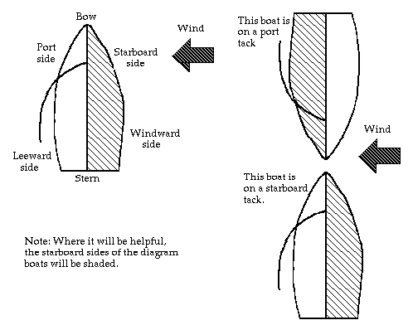
Review of Starboard vs Port
Maneuvering & Sail Trim
Starboard Tack
Port Tack

Slide 5
Skipper Position and Steering
Maneuvering & Sail Trim
Where do you sit?
  Skipper - Windward side of the boat
    Provides better visibility
    Generally balances the boat better
  Crew - Wherever needed to balance the boat
How do you steer?
    When going forward - push the tiller away from the direction you want to turn.
    When going backward - push the tiller the direction you want to go.

Slide 6
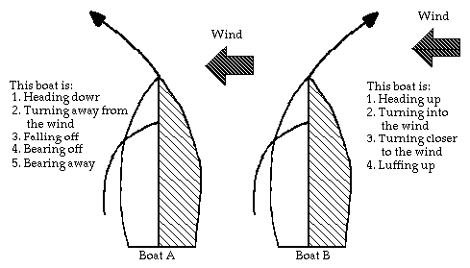
Skipper Position and Steering
Maneuvering & Sail Trim
Important terms in steering

Slide 7
Review of Tacking and Jibing
Maneuvering & Sail Trim
Tacking
  It is how you get straight upwind
  Turning the bow of the boat through the wind
Jibing
  It is how you can get straight downwind
  Turning the stern of the boat through the wind

Slide 8
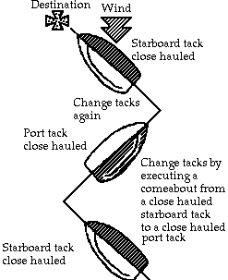
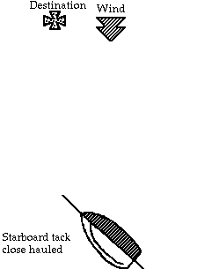
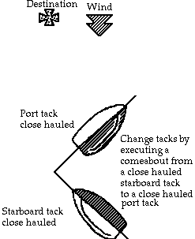
Tacking and Jibing
Maneuvering & Sail Trim
Tacking

Slide 9
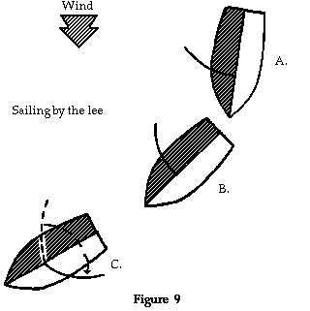
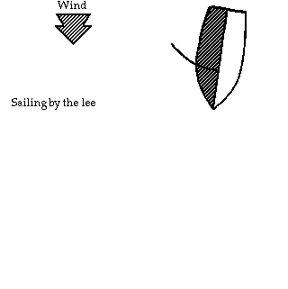
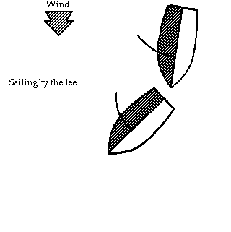
Tacking and Jibing
Maneuvering & Sail Trim
Jibing

Slide 10
More on Jibing
Maneuvering & Sail Trim
Reminder: Why are jibes more dangerous than tacks?
If wind is strong, tack to change directions, don’t jibe!
Beware of dangerous Accidental Jibes
Signs you are about to accidentally jibe:
1. Mainsheet goes slack.
2. Boom starts lifting up.
3. Are able to go wing and wing (jib luffs).
4. Leech of main begins forming an S shape.
Solutions: Head higher up into the wind, AND warn crew.

Slide 11
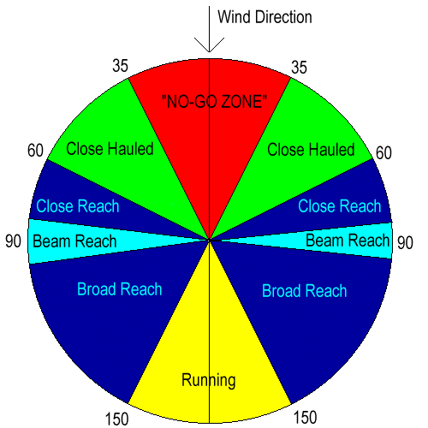
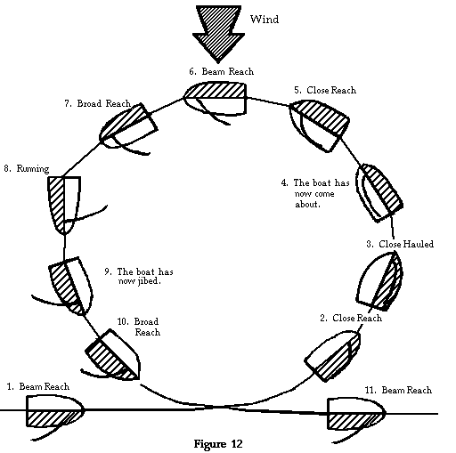
Remember All of This?
Maneuvering & Sail Trim

Slide 12
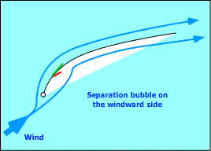
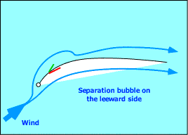
Tell Tale Review:
Maneuvering & Sail Trim
If the sails are luffing or the inner telltale falls:
  Sheet In or Bear off to expose it to more wind.
If the outer telltale falls:
  It is in too tight- ease the sheet out or head up!

Slide 13
Getting out of the No-go-zone
Maneuvering & Sail Trim
Release jib, and push boom & tiller in the direction you want to go.
Patiently wait for the boat to back out of the no-go-zone.
Release boom & straighten tiller.
Trim mainsail back in and begin sailing!

Slide 14
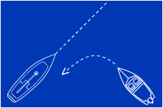
General Right of Way
Right of Way (ROW)
Always Avoid a collision!!!
Swimmers, capsized boats, anchored boats, have right of way over all others.
Sailboats have right of way over boats under power.
Commercial vessels have right of way over pleasure craft,
Give Way to boats much much larger than you (“law of mass tonnage”).

Slide 15
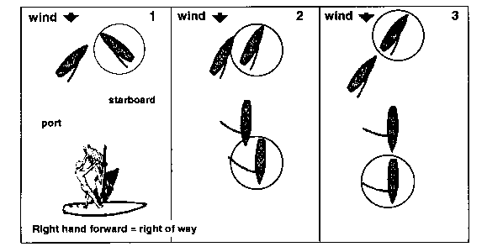
Right of Way between Sailors:
Right of Way (ROW)
Starboard has right of way over port (1).
Leeward has right of way over windward (same tack) (2).
An Overtaken boat has right of way over overtaking boat (3). Racing boats have right of way over cruising boats.

Slide 16
Right of Way examples:
Right of Way (ROW)

Slide 17
Docking
Docking and Anchoring
No-Go Zone Approach (Recommended):
Approach from the leeward side on a close reach. Luff sails and go head-to-wind.

Slide 18
Docking
Docking and Anchoring
Wind
Dock
Plan an “Exit Strategy”
Have Crew Set Fenders along widest part of boat
Better to slow down too early than too late!
If you hit the dock, glance off, don’t “T-bone” it!

Slide 19
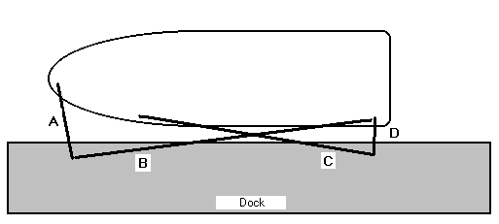
Dock Lines
Docking and Anchoring
Bow Line
Stern Line
Forward Spring Line
Aft Spring Line
High Stretch
Strong (e.g., Nylon)

Slide 20
Docking and Anchoring
Anchoring and/or “Rafting Up”
Textbook: Pages 76-77
Scope- ratio of length of anchor rode to depth of the water
Scope of ~7:1 is adequate for most conditions
Sea Anchor- used to slow and/or steer a boat with lost rudder
Sample Test Questions
Know meters to feet conversion
How to stop vessel from dragging
Using Dock Pilings
Rafting Up- Heaviest boat anchors first, then acts like a dock for next boat.

Slide 21
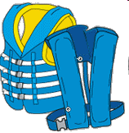
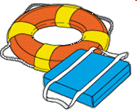
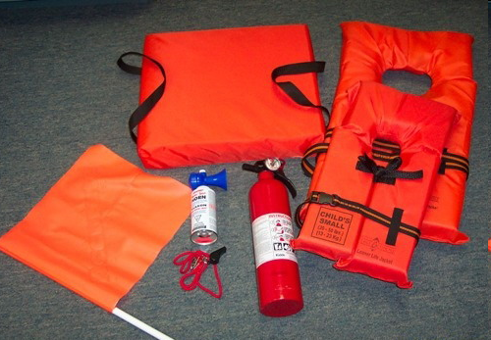
Equipment and Maintenance
Required Safety Equipment
(Section I of “Advanced Sailing Exam”)
Department of Natural Resources (DNR) requirements: http://georgiawildlife.dnr.state.ga.us/
 | Type I, II, III, or V PFD per person
 | Type IV PFD in cockpit
 | B-I Fire Extinguisher
 | Sound Producing Device
Other safety equipment required for racing: Anchor, Motor, First Aid Kit
Navigation Lights are required for Boating at Night

Slide 22
Docking and Anchoring
Routine Sailboat Maintenance
(~15% of “Advanced Sailing Exam”)
Motors:
  4-stroke Outboard Motors, Do Not Mix Oil with Gas
  2-stroke Outboard Motors, 50:1 Gas/Oil Mix
  Nissan 3.5 Horse Power
  No Reverse
General Sailboat Maintenance:
  See Outline
Sample Test Questions

Slide 23
Knots to Review:
Figure Eight Knot
Bowline
Cleating
Coiling
Square Knot
*Can you remember without the diagram?*

Slide 24
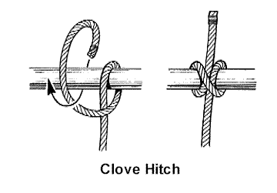
New Knots:
The Barrel Roll & Clove Hitch

Slide 25
Instructional Opportunities
Summer 2009
Clinic #1 (Sunday 6/7) Safety Orientation Rigging Crew Positions Docking Lots of Sailing Practice! De-rigging | Clinic #2 (Saturday 6/20) Docking Tacking/Jibing Sail Trim Right-of-Way Spinnaker sailing
Regatta (Sat-Sun 6/13-14th) “Intro to Racing” LLSC Reggae Regatta Details TBD | Clinic #3 (Sunday 6/28) Overboard Recovery Drill Right-of Way Spinnaker sailing Motoring

Slide 26
Next Week’s Class:
Weather Safety
Crew Overboard Recovery
Navigation Lights
Charts
REVIEW
Readings for Next Week:
Website Notes
Textbook (Parts 5 & 6)

