Slide 1

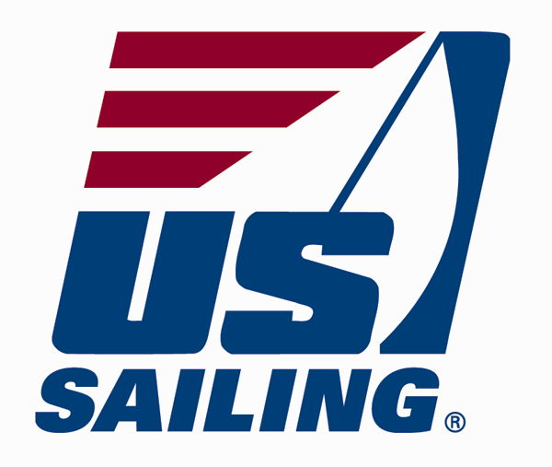

GT Options Class
“Keelboat Sailing”
Brought to you by the GT Sailing Club
www.gtsailing.org
Meetings EVERY Thursday @7:30pm
  CRC Room 251
How Does GT Sailing Work:
  Lake Lanier, Racing, Club Trips
  Dues (included), Qualification, Lake Hosts

Slide 2
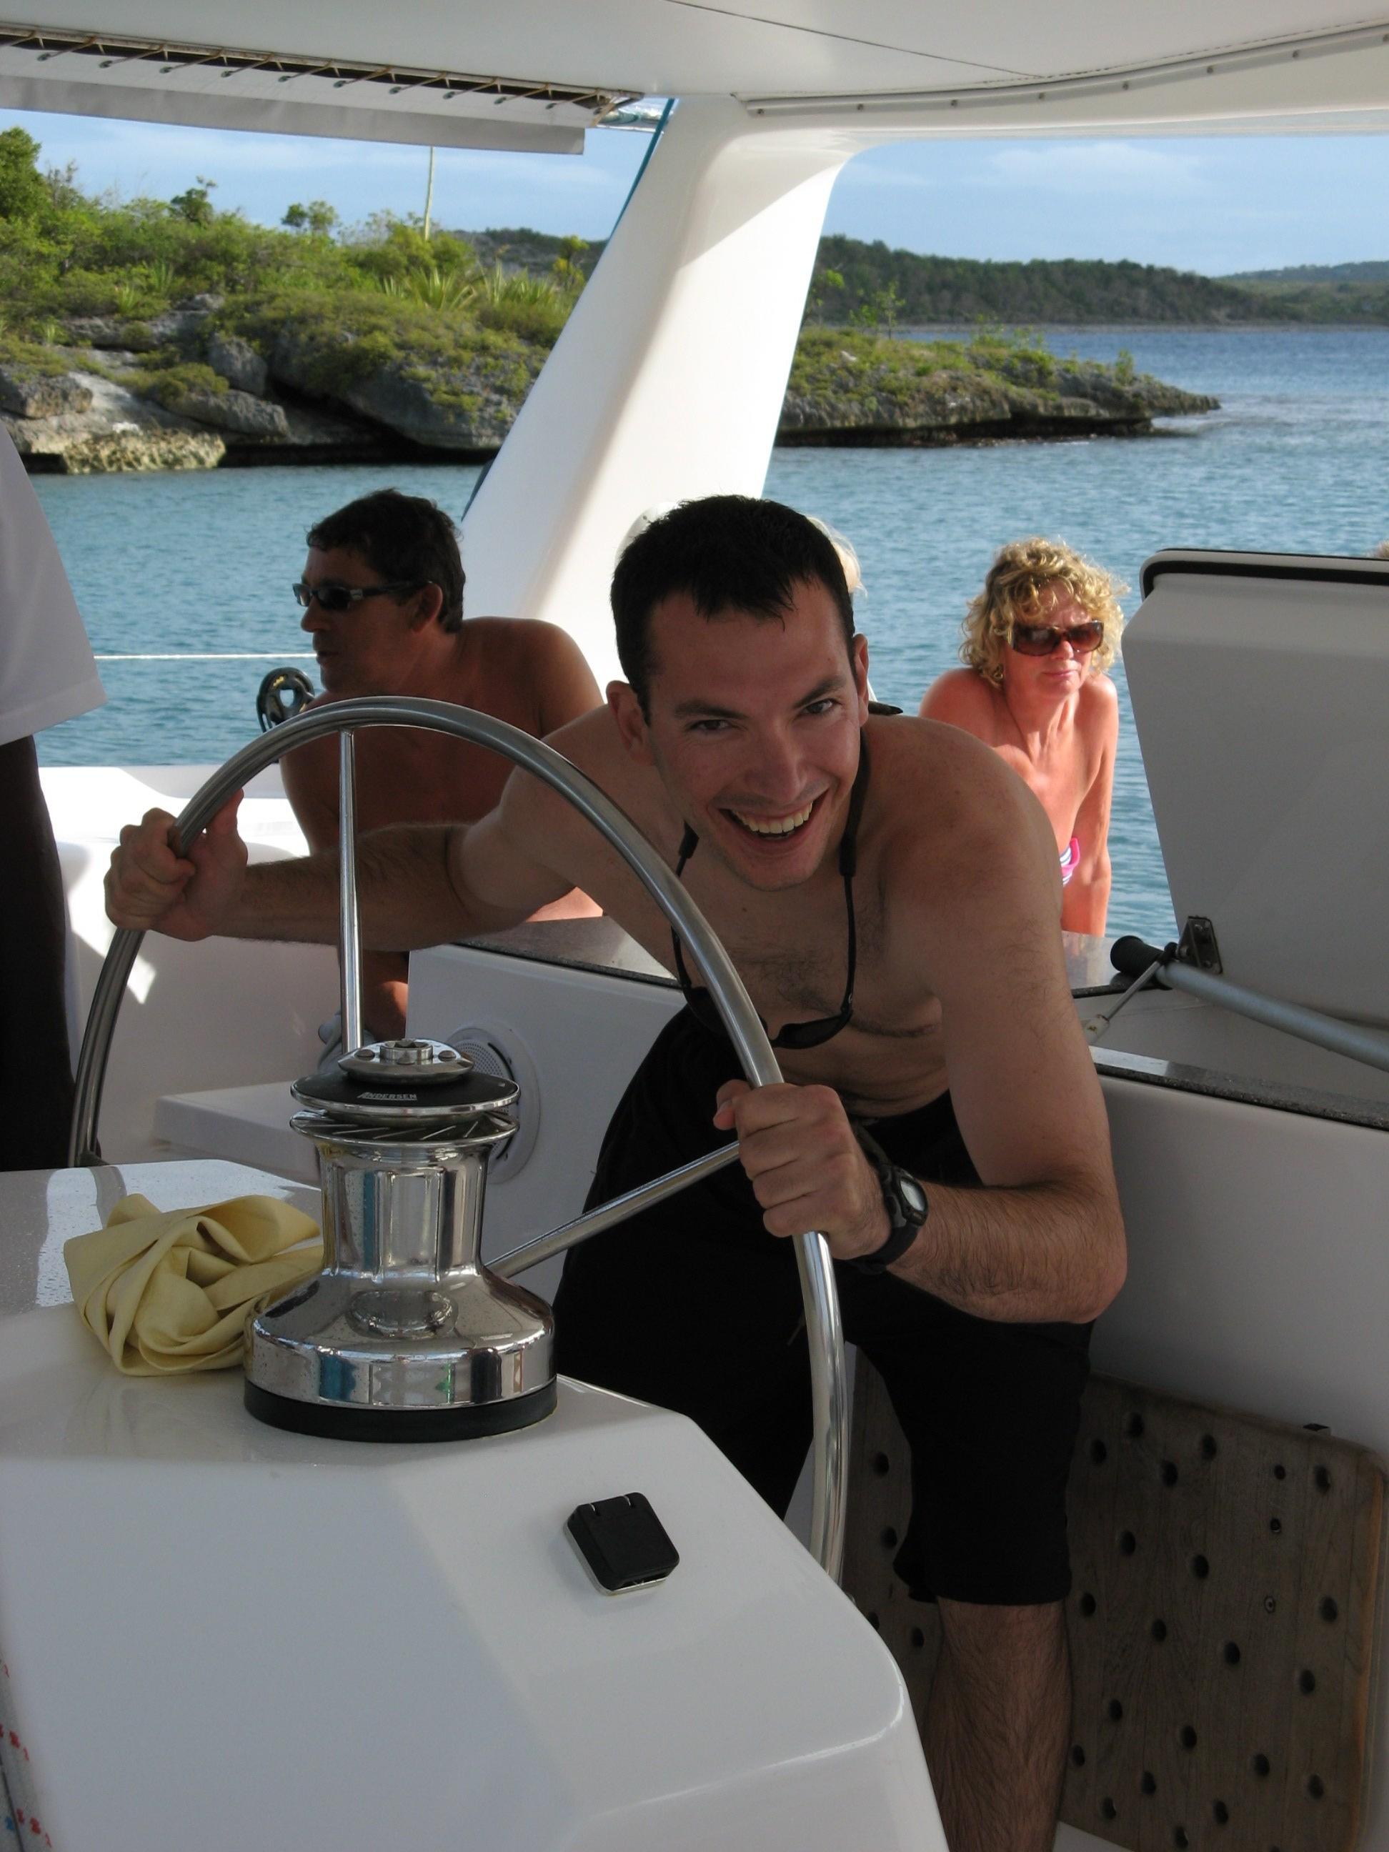
Matthew Widlansky
US Sailing Certified Instructor
Former GT Sailing Team Captain
Qualified to teach on the GT 420s, Lasers, and J/24s
Grew up sailing in South Florida before coming to GT
What has Sailing Done for me?
gtg058g@mail.gatech.edu

Slide 3
Class Goals:
Introduce (or Continue) involvement with GT Sailing
Teach fundamentals of Keelboat Sailing
Provide on-the-water skippering & crewing opportunities
Introduce Keelboat Racing concepts
Prepare you to pass GT’s “Advanced Sailing” written exam
Introduce the components of GT’s on-the-water qualification process

Slide 4
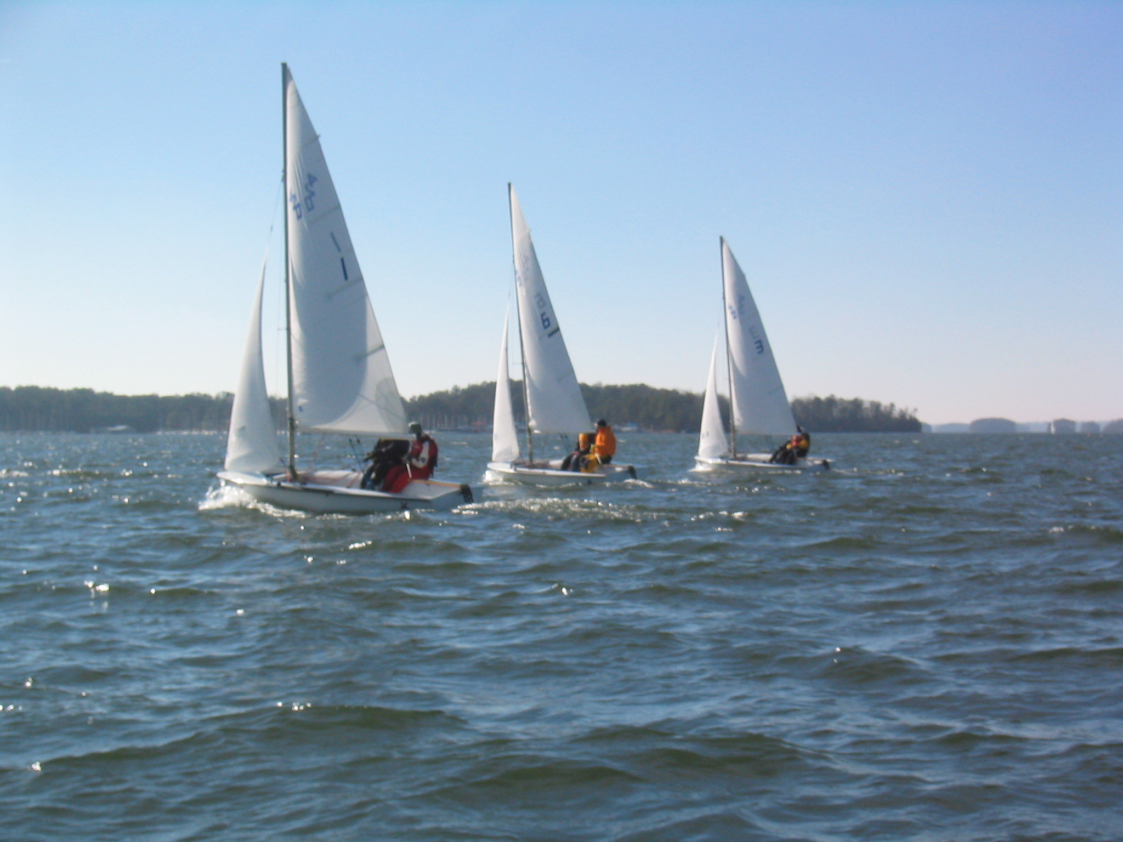
Class Schedule
Meetings: Mondays 8-9:30PM Student Center Room 321
June 1st: Introduction, Terminology, Gear, Steering & Sail Trim
Knots: Figure Eight, Bowline, & Coiling
June 8th: Points of Sail, Tacking & Jibing, Spinnaker, & Racing Intro
Knots: Square Knots & Cleats
June 15th: Rigging, Maneuvering, Right of Way & Docking
Knots: Barrel Roll & Clove Hitches
June 22nd: Safety, Charts & REVIEW
June 29th: “Advanced Sailing” Written Exam (Optional)

Slide 5
Instructional Opportunities
Summer 2009
Clinic #1 (Sunday 6/7) Safety Orientation Rigging Crew Positions Docking Lots of Sailing Practice! De-rigging | Clinic #2 (Saturday 6/20) Docking Tacking/Jibing Sail Trim Right-of-Way Spinnaker sailing
Regatta (Sat-Sun 6/13-14th) “Intro to Racing” LLSC Reggae Regatta Details TBD | Clinic #3 (Saturday 6/27) Overboard Recovery Drill Right-of Way Spinnaker sailing Motoring

Slide 6
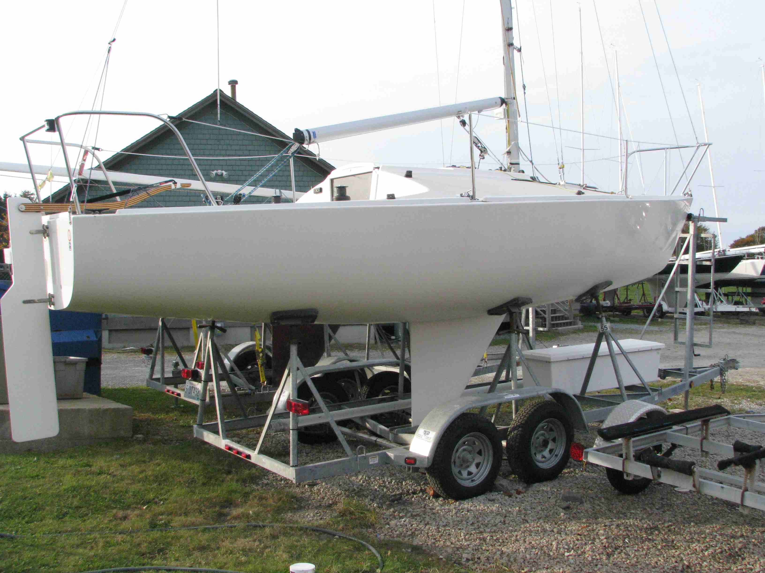
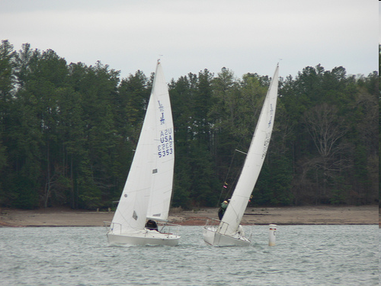
Keelboat – J/24
Crew: 5
Sails: 3
Georgia Tech has: 2
Uses: Wednesday Night Racing (summer), weekend racing, cruising
New for Summer 2009:
“Keelboat Sailing Course”

Slide 7
To Begin:
Some Basic Terminology
True Wind
Apparent Wind
Puff
Lull
Windward
Leeward
Luff (verb)
Heeling
Hiking Out
Port
Starboard

Slide 8
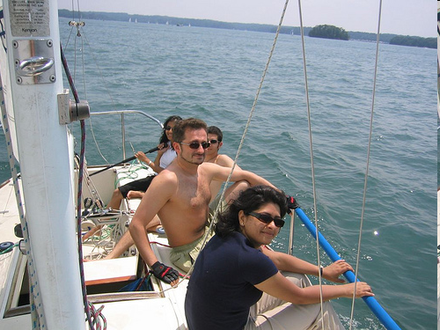
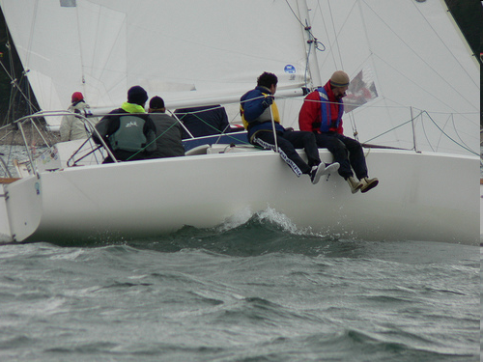
What to Wear: Warm Vs. Windy
Sunscreen, Hat, Bottled Water, Swimsuit, Sunglasses
Spray Jacket&Pants, Gloves, Warm & Quick-Drying Layers
Always: Appropriate Shoes and Change of Clothes!
Comfortable Lifejackets are provided

Slide 9
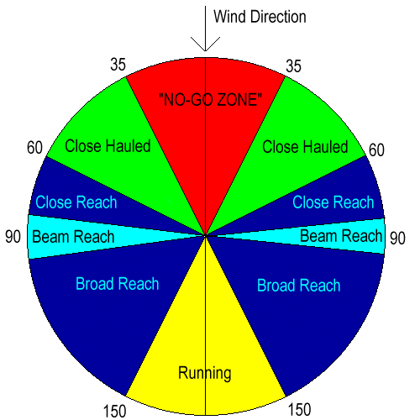
What is the Point of Sail?
Starboard Tack
Port Tack

Slide 10
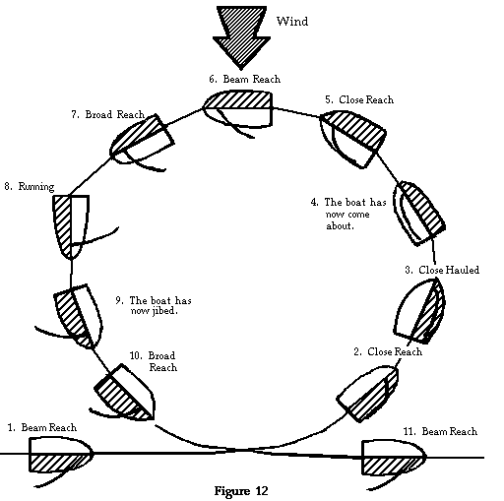
How do the Sails Look?

Slide 11

So What’s It Really Like?

Slide 12
The First of Many Knots

Slide 13
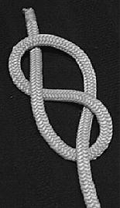
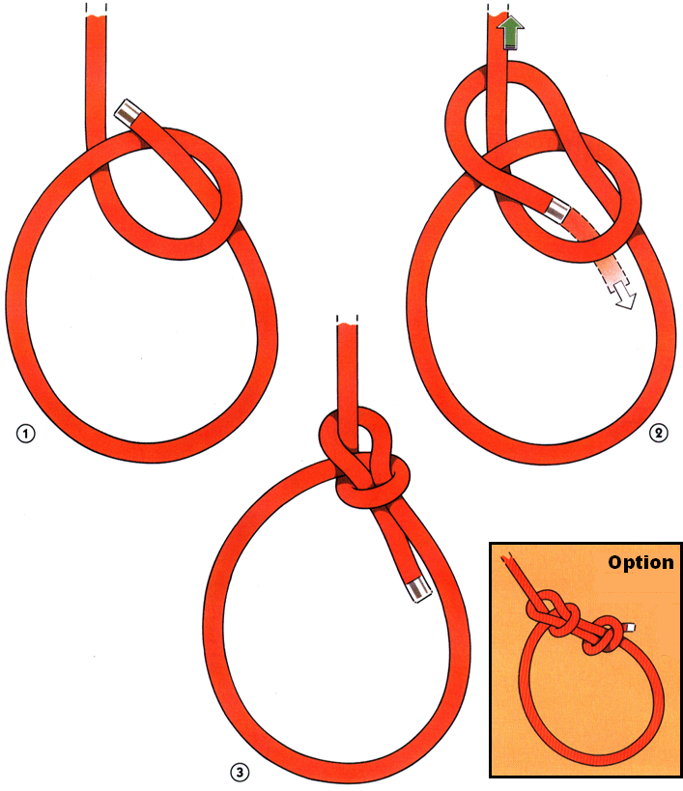
The Figure-8 Knot The Bowline

Slide 14
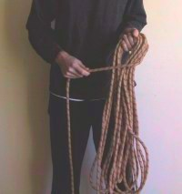
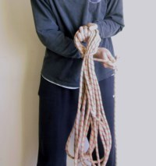
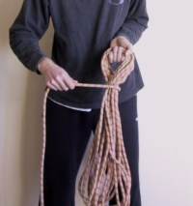
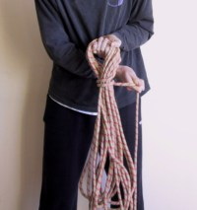
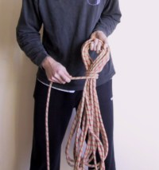
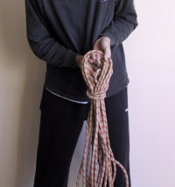
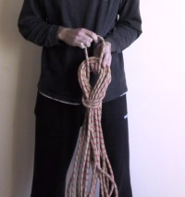
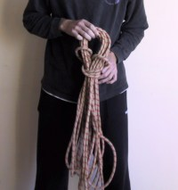
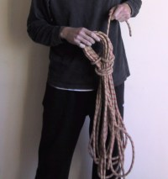
Coiling

Slide 15
How do the Clinics Work?
Sign-up Tonight.
Meet in front of the CRC at 10AM.
Bring the right clothes, water, sunscreen, and lunch.
Expect to be back at Tech around 5:30PM.
We’re Carpooling, so please be nice to your drivers.
New Member BBQ is also this weekend: Saturday

Slide 16
Next Week’s Class:
Parts of the Boat
Points of Sail
Tacking & Jibing
Running Downwind with a Spinnaker
Introduction to Racing
Knots (Square knot and Cleats)
Review the First Clinic
Readings for Next Week: Parts I & II

Slide 17
Remember: GT Sailing Instructors are Volunteers

