Slide 1

Lichen & Xalgorithms
Draft Functional Illustration
17 March 2016
jpotvin@xalgorithms.org
UBL-mapped data
enters Lichen
Lichen receives “found”
rule packages
Notifications of
rule conflicts
or filter fails
e-Commerce
Application
Lichen
UBL Tables
+
Fetch Agent
+
Execution Agent
Xalgorithms
Filter
Rules Agent
For Versioning,
Filtering &
Conflict Testing
Xalgorithms
Federated Registry of Rules
Rule Source
Repository
Transaction
Data
Pull
results data
& references
Not Confidential
Criteria-filtered
rule packages
UBL data used
to search for
rule packages
Versioned
rule packages
Push
results data
& references
Lichen
receives
“found”
rule
packages
Confidential
Lichen
Transformation Records
End-User Controlled
Pre-Selected
Subset of Rules
End-User Controlled
Pull
results data
& references
Lichen UI
UBL-Conformant
Viewer
+
Preferences
End-User Controlled
Role:
End-User
Role:
Rule Owner
Diagram by Joseph Potvin <jpotvin@xalgorithms.org> +1-819-593-5983 © Xalgorithms Foundation, Licensed CC-by v4.0 (V0.3 17 March 2016)

Slide 2
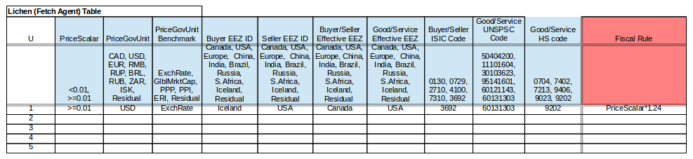
Example of Data Sent by a Lichen Agent to Xalgorithms Registry to Fetch a Rule

Slide 3

Use Case: Specify Payment Attributes
e-Commerce
System
Lichen Component
Specify
Payment Attributes
Display
Goods/Services
For Sale
Display
Payment Instrument
Choices
Display
Goods/Services
Prices
Display
Payment Instrument
Fees
Select
Goods/Services
To Buy
Select Payment
Instrument(s)
Payee
Agent
Payer
Agent
Payee
Agent
Payer
Agent
Generate
Sell/Buy
Part of Invoice
Generate
Payment Part of
Invoice
Agree to Buy
<<system>>
Xalgorithms Registry
<<system>>
Tax
Agent
<<system>>
Xalgorithms Registry
Generate
Payment Terms
Part of Invoice
Activate Payment
17 March 2016. Joseph Potvin
Xalgorithms Foundation http://www.opman.ca

Slide 4
Use Case: Specify Loyalty Attributes
Lichen Component
Specify
Loyalty Attributes
e-Commerce
System
Display
Goods/Services
For Sale
Display
Loyalty Options
Documentation
(static)
Payer
Agent
Display
Goods/Services
Prices
Display
Loyalty Opions
Via Algorithm
(dynamic)
Select
Goods/Services
To Buy
Select Loyalty
Algorithm(s)
Payee
Agent
<<system>>
Xalgorithms Registry
Payee
Agent
Payer
Agent
Generate Digitally
Signed Declarative
Statement(s)
Generate
Sell/Buy
Part of Invoice
Agree to Buy
Display
Goods/Services
Prices
<<system>>
Tax
Agent
<<system>>
Xalgorithms Registry
Generate
Payment Terms
Part of Invoice
Generate
Sell/Buy Part of
Invoice
Activate Payment
17 March 2016. Joseph Potvin
Xalgorithms Foundation http://www.opman.ca

Slide 5
Use Case: Specify Tax Attributes
e-Commerce
System
Lichen Component
Specify
Tax Attributes
Display
Goods/Services
For Sale
Read
Sell/Buy
Metadata
Payer
Agent
Display
Goods/Services
Prices
Read
Payee/Payer
Metadata
Payee
Agent
Select
Goods/Services
To Buy
Select Tax
Algorithm
Payee
Agent
Payer
Agent
<<system>>
Xalgorithms Registry
Generate
Sell/Buy
Part of Invoice
Generate Digitally
Signed Declarative
Statement(s)
Agree to Buy
Generate
Buy/Sell
Part of Invoice
<<system>>
Tax
Agent
<<system>>
Xalgorithms Registry
Generate
Payment Terms
Part of Invoice
Activate Payment
17 March 2016. Joseph Potvin
Xalgorithms Foundation http://www.opman.ca

Slide 6
Use Case: Specify Price Attributes
Lichen Component
Specify
Price Attributes
e-Commerce
System
Display
Goods/Services
For Sale
Display
Price Algorithm
Documentation
(static)
Display
Goods/Services
Prices
Display
Price Data
Via Algorithm
(dynamic)
Select
Goods/Services
To Buy
Select Price
Algorithm(s)
Payee
Agent
<<system>>
Xalgorithms Registry
Payee
Agent
Payer
Agent
Generate Digitally
Signed Declarative
Statement(s)
Generate
Sell/Buy
Part of Invoice
Agree to Buy
Display
Goods/Services
Prices
<<system>>
Tax
Agent
<<system>>
Xalgorithms Registry
Generate
Payment Terms
Part of Invoice
Generate
Sell/Buy Part of
Invoice
Activate Payment
17 March 2016. Joseph Potvin
Xalgorithms Foundation http://www.opman.ca

Slide 7
Use Case: Specify Security Rules
Lichen Component
Validate Against
Security Rules
e-Commerce
System
Display
Goods/Services
For Sale
Display
Security Algorithm
Documentation
(static)
Payer
Agent
Display
Goods/Services
Prices
Generate
Sell/Buy
Part of Invoice
Select
Goods/Services
To Buy
Select Security
Algorithm(s)
Payee
Agent
<<system>>
Xalgorithms Registry
Payee
Agent
Payer
Agent
Generate Digitally
Signed Declarative
Statement(s)
Generate
Sell/Buy
Part of Invoice
Agree to Buy
Activate Payment
<<system>>
Tax
Agent
<<system>>
Xalgorithms Registry
Generate
Payment Terms
Part of Invoice
Validate Payment
Against Invoice
Activate Payment
17 March 2016. Joseph Potvin
Xalgorithms Foundation http://www.opman.ca

