Slide 1

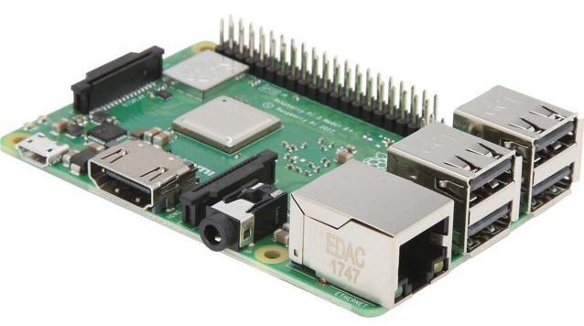
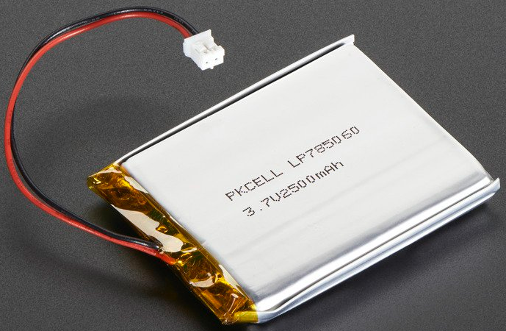
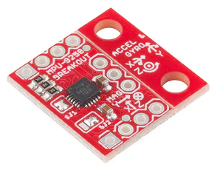
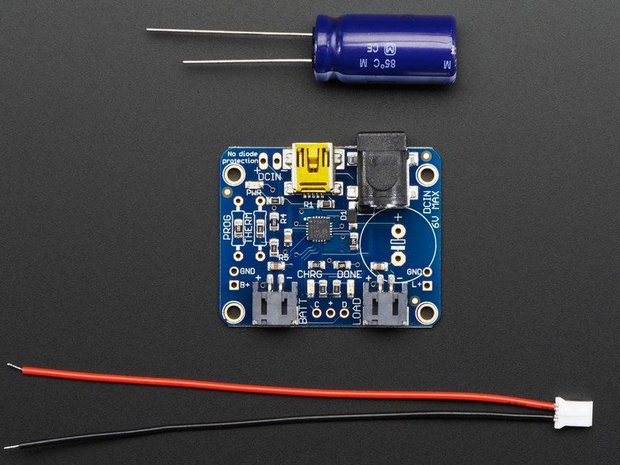
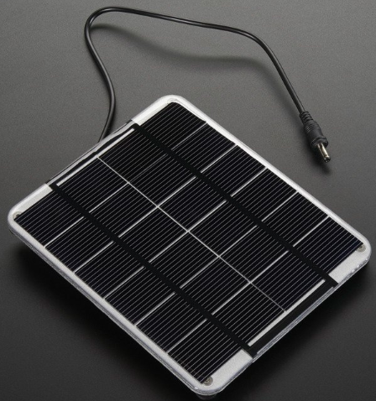
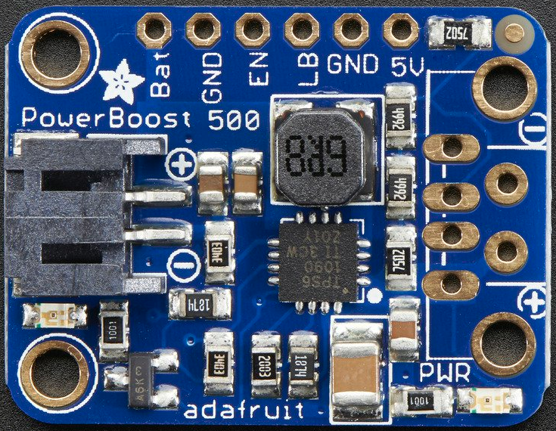
Hardware
Raspberry Pi 3 B+
Lithium Ion Polymer Battery - 3.7v 2500mAh
https://www.adafruit.com/product/328
Description
SparkFun IMU Breakout - MPU-9250 Board
USB / DC / Solar Lithium Ion/Polymer charger - v2
https://www.adafruit.com/product/390
https://www.digikey.com/catalog/en/partgroup/sparkfun-imu-breakout-mpu-9250-board/63263
6V 2W Solar Panel
PowerBoost 500 Basic - 5V USB Boost @ 500mA from 1.8V+
https://www.adafruit.com/product/200
https://www.adafruit.com/product/1903

