Slide 1
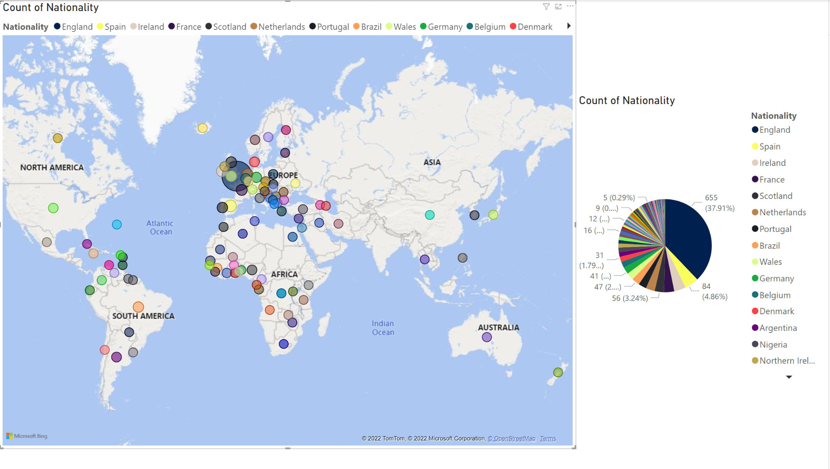

Slide 2
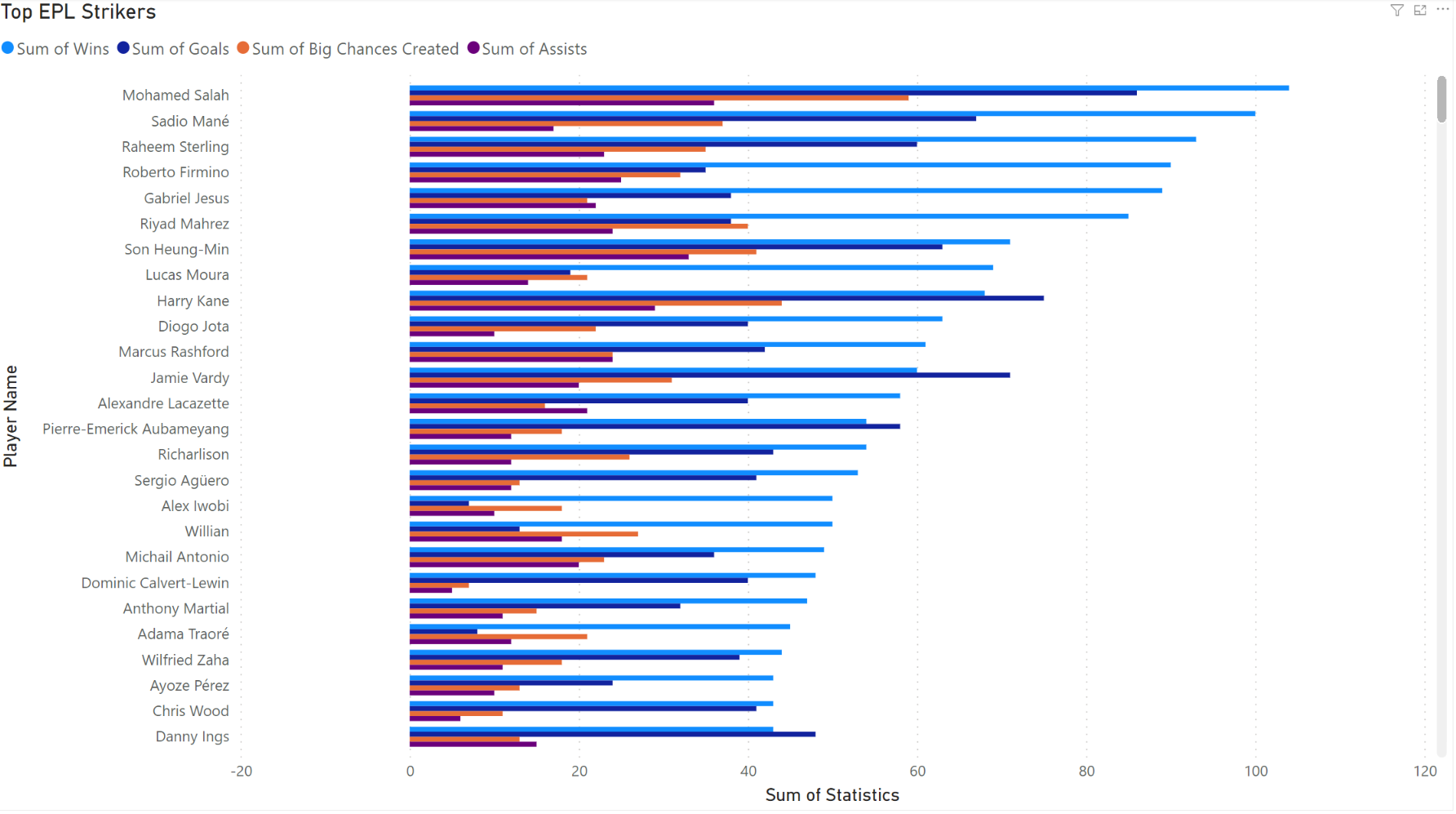
There are rumors that Harry Kane, star striker for the Spurs, may take a trade with Bayern Munich. Spurs also have amazing striker Heung-Min Son. I put together this graph in the theoretical scenario that Kane were to leave the spurs. It seems that with Son, they would still be in a good position. However, if any trade in the EPL becomes available, it may make sense for the Spurs to try and acquire Salah, Vardy or Sterling in place of Kane to keep their spot at the top of the league. I chose Sum for this over Average as players who are recorded in less seasons may have already retired or transferred out of the EPL (i.e. Eden Hazard who would be ranked among the top players if the Average were taken).

Slide 3
