Slide 1

RESTful Web Design
A simple guide

Slide 2
Breaking Down the Acronym
REpresentational State Transfer

Slide 3
What is REST?
A way of designing a web application that keeps the concerns of server resources and the user experience separate.

Slide 4
Key Features
Client-Server separation: the client (user) manages where the user is in the site's map, while the server only cares about providing representations of the resources (like pages and unique data) that the client requests.
Statelessness: The server does not have to worry about whether the client is actively using the interface or not. It only provides resources when (properly) asked for them.
HTTP Requests: The 'proper asking' part. The client forms requests using the HTTP format based on the page they are on and what actions they want to take or what resources they want to see.

Slide 5
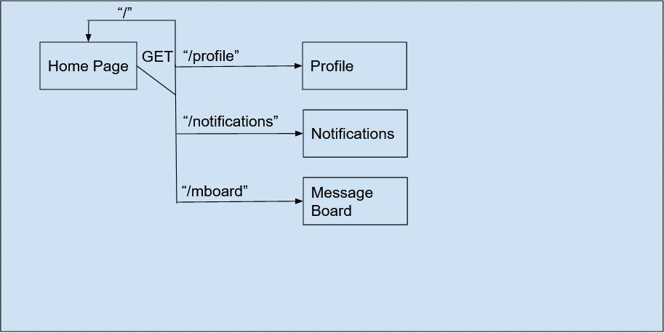
Application State
Think of the application as a series of interconnected positions on an interaction flowchart. The application state is simply the current position of the user in this chart.

Slide 6
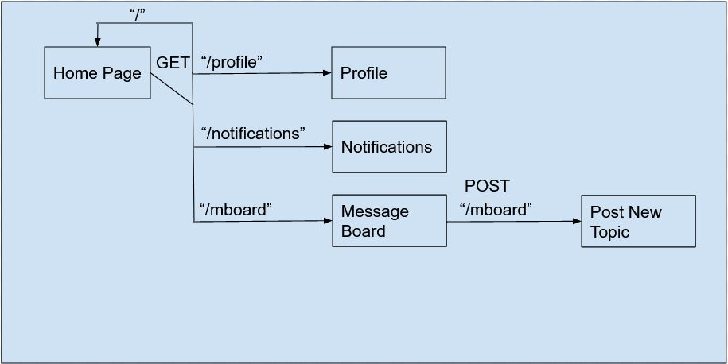
Resource State
The server doesn't care where the user is in the application state. But in this example, if the user is on the Message Board and posts a new topic, they are sending data which changes the state of a resource: the list of topics. This area of concern is the resource state.

Slide 7
HTTP Requests
Hyper Text Transfer Protocol – the standard of web communication.
Packages data in a format called JSON – JavaScript Object Notation.
HTTP requests use keywords, called verbs, to communicate the intent of the packaged JSON data.
The Application State, managed by the client, only uses GET requests to ask the server for resources like pages and unique data (such as the content of a discussion post).
The Resource State, managed by the server responds to other HTTP requests such as GET, HEAD, POST, PUT and DELETE which are used to change the state of resources.

Slide 8
Statelessness
In RESTful architecture, the server does not keep track of what state the client is in. There are no active sessions, only the client forming HTTP requests and the server responding to incoming requests based on business rules.

Slide 9
Why REST?
Highly scalable.
Easy to maintain.
Easy to modify
Independent of client environment.
Utilizes well established HTTP standard.

Slide 10
References
Richardson, L., Amundsen, M., & Ruby, S. (2013). RESTful Web APIs: Services for a Changing World (1st ed.). O’Reilly Media.
What is REST. (n.d.). REST API Tutorial. Retrieved October 19, 2020, from https://restfulapi.net/

Slide 11
Contact Me
Jonathan Roland
https://jdroland31.github.io/

