Slide 1

Open Authentication (OAuth)
Jonathan Roland
Web 420
Assignment 9.2
12/14/2020

Slide 2
What is Authentication?
The practice of confirming user identities
Utilizes values unique to the user including:
Usernames
Passwords
Pins
Keys
One-time use tokens
Biometrics

Slide 3
Authentication vs. Authorization
Authorization is the set of enforced rules that govern what actions a validated user can take.
Authentication must happen first before authorization.
This is because we must know who is being granted a set of privileges for the sake of security.
Authorization often simplifies (in digital systems) to the user’s rights to create, read, update and delete resources.
These resources can include files, object members, user accounts and RESTful resources.
Authorizations can be granted, modified or revoked by a higher authority, usually an admin.

Slide 4
HTTP Basic Authentication
Described by RFC 7235.
Pure HTTP framework that allows a server to challenge a client request and ask for authentication information.
Server sends 401 Unauthorized response header.
Client responds with Authorization request header filled with credentials.
Client will typically prompt user for their password and send with the Authorization header.
Authorization credentials are encoded in base64.
Due to weak encryption, this methodology is only secure over HTTPS.

Slide 5
What is OAuth?
An authentication standard that allows a resource owner to grant resource access to a third party.
The third party is often a sub-account or an application.
Open source protocol.
Secure over HTTP and HTTPS.
Allows the primary user to modify or delete privileges granted to third parties.
Utilizes an independent credentialing authority to allow a primary user to avoid passing credentials directly to a resource server.

Slide 6
How does OAuth Work?
A user wants to allow an application to access certain data that they control.
The data is stored on a third-party server.
The user sets up permissions for the application with a credential service provider.
The application makes a request to the resource server with the user’s data.
The resource server requests credentials from the application.
The application requests an authorization token from the credential server.
Rather than the application having access to or transmitting the true credentials, it provide the resource server with the authorization token.
The resource server validates the authorization token and transmits the requested data.

Slide 7
OAuth Data Flow
To further clarify the data flow of that interaction:
The primary user creates an account with a picture storage service and stores some pictures.
The user wants to allow a social media app to access those pictures so the user can browse and post them to an album on the social media site.
The user authorizes the social media site’s access through the storage service’s UI, verifying with the established username and password.
The picture storage service sends the social media app an authorization token.
Now when the user can browse pictures through the social media app because the picture storage service can securely communicate with it.
Every time the social media site wants to preview the pictures, it makes the request with the authorization token it was granted.

Slide 8
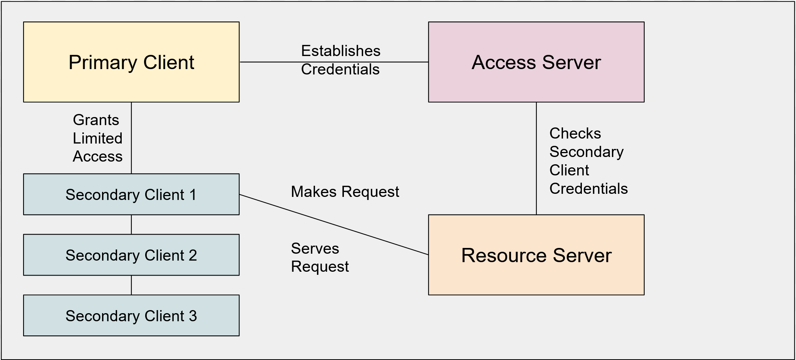
OAuth Illustrated

Slide 9
Why use OAuth?
Transmits securely over HTTP or HTTPS
Allows users to authorize sub-accounts and applications to access resources on their behalf.
Allows users to cancel authorizations for sub-accounts without changing their password or other central authorization data.
Prevents the transmission of the true credentials by sub-accounts.
Allows users to avoid creating credentials with every service.
Allows applications to easily integrate other services in a secure manner.

Slide 10
OAuth 1.0
The client must generate a signature on every API call.
Only works in browsers.
Tokens do not expire.
Does not contain token refresh considerations.
Does not enforce clearly defined roles.
Requires crypto-implementation and crypto-interoperability.

Slide 11
OAuth 2.0
Separate standard from 1.0
Addresses many shortcomings of 1.0
2.0 is the more common standard today.
Security is enforced through TLS/SSL (HTTPS).
Allows token expiration and refresh.
Supports non-browser applications.
Enforces roles.

Slide 12
References
Gamage, S. (2019, March 27). OAuth 2.0 for Dummies - Sominda Gamage. Medium. https://medium.com/@somindagamage/oauth-2-0-for-dummies-8807cff5c3b2
Ramchandani, P. (2018, June 13). What’s the difference between OAuth 1.0 and OAuth 2.0? Packt Hub. https://hub.packtpub.com/what-is-the-difference-between-oauth-1-0-and-2-0/
Components and Props –. (n.d.). React. Retrieved September 24, 2020, from https://reactjs.org/docs/components-and-props.html
Basic Authentication. (n.d.). Swagger. Retrieved December 14, 2020, from https://swagger.io/docs/specification/authentication/basic-authentication/
Authentication vs. Authorization | Okta. (n.d.). Okta, Inc. Retrieved December 12, 2020, from https://www.okta.com/identity-101/authentication-vs-authorization/

Slide 13
Contact Me
https://jdroland31.github.io/​
https://github.com/jdroland31/​
jdroland31@yahoo.com

